Slide 1
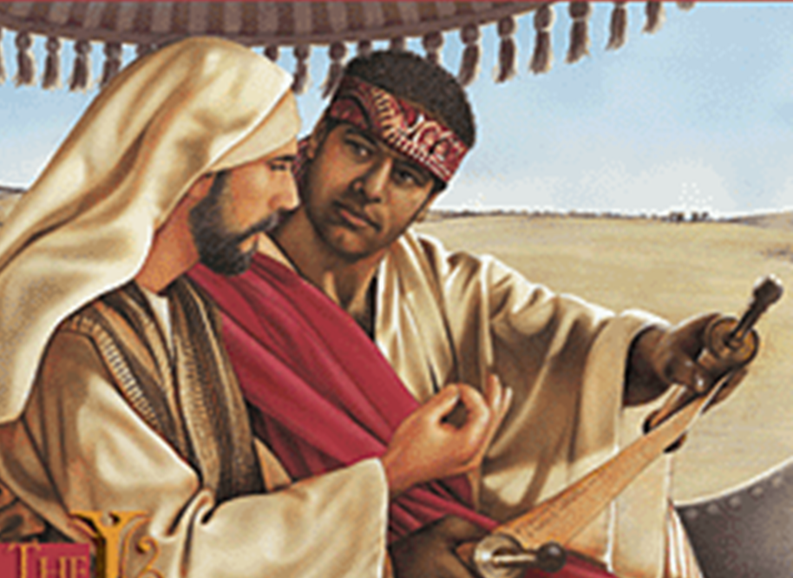
Examples of Conversions In Acts
Conversion of
The Ethiopian
Acts 8:26-40

Slide 2
Conversion of The Ethiopian
Convert; Converted
transitive verb
1 - a : to bring over from one belief, view, or party to another b : to bring about a religious conversion in
2 - a : to alter the physical or chemical nature or properties of especially in manufacturing b (1) : to change from one form or function to another (2) : to alter for more effective utilization

Slide 3
Conversion of The Ethiopian
Convert; Converted
Matthew 18:3-4 (NKJV) ³ and said, "Assuredly, I say to you, unless you are converted and become as little children, you will by no means enter the kingdom of heaven. ⁴ Therefore whoever humbles himself as this little child is the greatest in the kingdom of heaven.

Slide 4
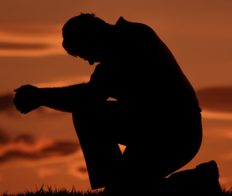
Conversion of The Ethiopian
Convert; Converted
Acts 3:19 (NKJV) ¹⁹ Repent therefore and be converted, that your sins may be blotted out, so that times of refreshing may come from the presence of the Lord,

Slide 5
Conversion of The Ethiopian
Convert; Converted
James 5:19-20 (NKJV) ¹⁹ Brethren, if anyone among you wanders from the truth, and someone turns him back, (convert him KJV) ²⁰ let him know that he who turns (converteth – KJV) a sinner from the error of his way will save a soul from death and cover a multitude of sins.

Slide 6
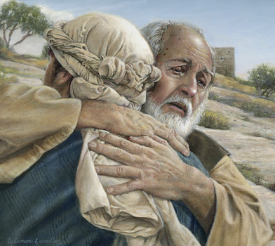
Conversion of The Ethiopian
Convert; Converted
Not merely a change in actions –
A change in knowledge –
A change in conviction -
A change in allegiance –
A change in thinking & will –
A change in commitment – resulting in a change in relationship & identity -
A change in who we are – how we talk – where we go – what we do -
Luke 15:11-24

Slide 7
Conversion of The Ethiopian
Psalm 19:7 (NKJV) ⁷ The law of the LORD is perfect, converting the soul; The testimony of the LORD is sure, making wise the simple;

Slide 8
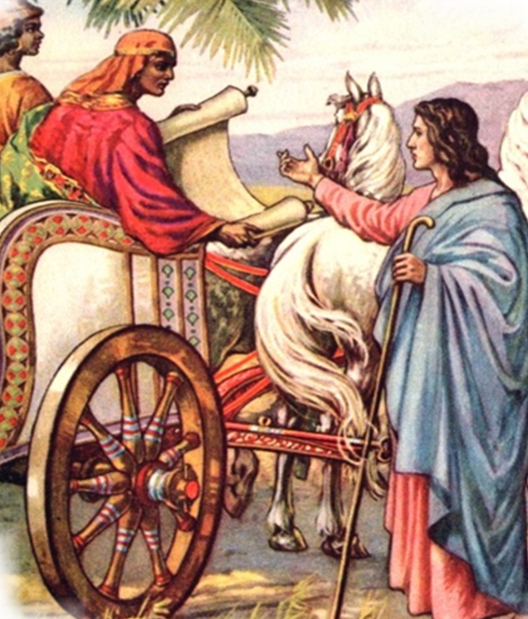
Brief Analysis of Acts 8:26-40
Verses 26-29 – Phillip instructed by an angel and the Holy Spirit -
Verses 30-35 – Phillip preaches Christ to the Ethiopian from the OT scripture – (Is. 53)
Verses 36-39 – The Ethiopian responds to the preaching of Phillip by believing and obeying the gospel.
Notes:
Conversion Of The Ethiopian Eunuch
by David Padfield
In the eighth chapter of the book of Acts we find one of the many cases of conversion in the New Testament. These examples have been recorded for us to demonstrate how men enter the kingdom of God. Like every other case of conversion in Acts, God used the "foolishness of preaching" (1 Corinthians 1:21) to reach the alien sinner. An angel of the Lord sent a preacher named Philip to teach an Ethiopian nobleman (Acts 8:26).
Little is known about the Ethiopian. In all likelihood, he was a black man who had turned to Judaism. We know he was a sincere individual, for he had traveled over 1,000 miles, from Ethiopia to Jerusalem, to worship God (Acts 8:27). It would be hard to believe a man would travel that far across the desert by chariot just for "show." I know folks who claim to love God but won't drive fifteen minutes in a new car to assemble with the saints. His dedication to God is further shown in Acts 8:28, where we find him "reading Isaiah the prophet" as he traveled.
The Ethiopian was a very humble man. When Philip drew near the chariot he asked the Ethiopian if he understood what he was reading. He replied, "How can I, unless someone guides me?" (Acts 8:31). After this, Philip got up into the chariot and "preached Jesus to him" (Acts 8:35). In the course of preaching Jesus, Philip spoke of water baptism. We know this because the Ethiopian said, "See, here is water. What hinders me from being baptized?" (Acts 8:36). Philip responded "If you believe with all your heart you may" (Acts 9:37). The man then confessed, "I believe that Jesus Christ is the Son of God."
His confession was an acknowledgment of the Lordship of Christ. In Romans 10:10 we read, "For with the heart one believes to righteousness, and with the mouth confession is made to salvation." This confession, as noble as it is, will not bring salvation by itself. "Even the demons believe -- and tremble" (James 2:19).
After his confession, "he commanded the chariot to stand still. And both Philip and the eunuch went down into the water, and he baptized him" (Acts 8:38). New Testament baptism was always by immersion in water. It is referred to as a "burial" (Romans 6:1-4). Sprinkling or pouring instead of immersion was introduced by men centuries after the completion of the New Testament. I am certain Philip was not a Baptist preacher, for you will notice that no church voted on the Ethiopian before he was baptized. When a man is saved, the Lord adds him to His church (Acts 2:47).
Furthermore, Bible baptism is "for the remission of sins" (Acts 2:38). We are baptized in order to obtain salvation. Some people have changed the divine order of things by teaching salvation comes at the point of faith, before and without water baptism. This doctrine is out of harmony with the word of God (Mark 16:16; Acts 22:16; 1 Peter 3:21). After his baptism, the Ethiopian "went on his way rejoicing" (Acts 8:39). He had good reason to rejoice, for he was now a child of God, redeemed by the blood of Christ. He was now a "new creation" (2 Cor. 5:17).
If you would like to know more about baptism and the church Jesus built, please contact us. If you do not have a Bible, we will be happy to give you one.

Slide 9
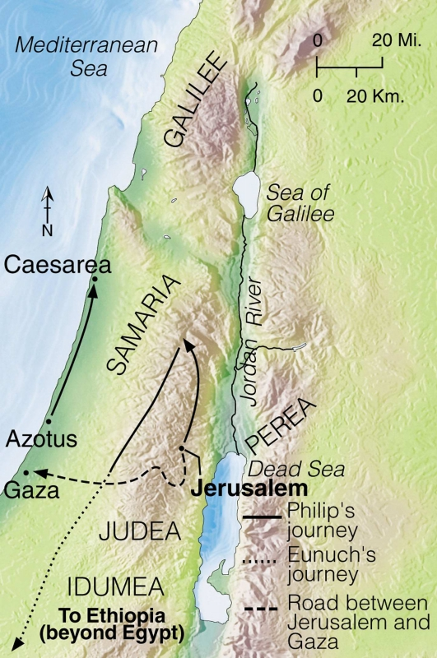
Conversion of The Ethiopian
The Direct Involvement of The Angel & Holy Spirit
Verse 26 – “an angel of the Lord spoke to Philip, arise and go . . .”
Verse 29 – “Then the Spirit said to Philip, ‘Go near and overtake . . .”
No direct operation upon the one being converted – vss 30,31,34-37
The Spirit worked through the message preached – vs 35; 1 Cor. 1:18
Notes:
Acts 8:26 (NKJV) ²⁶ Now an angel of the Lord spoke to Philip, saying, "Arise and go toward the south along the road which goes down from Jerusalem to Gaza." This is desert.
Acts 8:29 (NKJV) ²⁹ Then the Spirit said to Philip, "Go near and overtake this chariot."

Slide 10
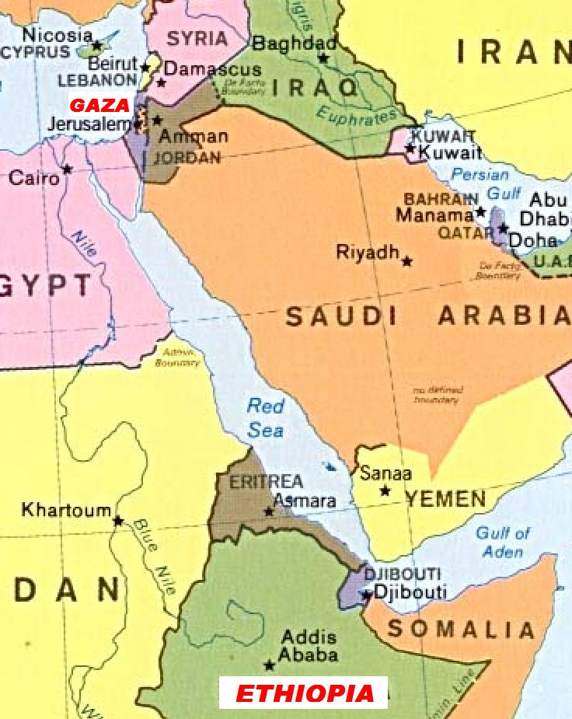
Conversion of The Ethiopian
The Ethiopian Eunuch
An honorable man – vs. 27
A religious man – vs. 27
A truth seeker – vs. 28
A humble man – vs. 30,31,34
A “ready” man – vs. 36
A convicted man – vs. 37
An obedient man – vs. 38
A joyful man – vs. 39
Over 1.000 Miles

Slide 11
Conversion of The Ethiopian
Things That Did NOT Occur
No direct operation! –
Not told to tell experience
Not told to pray –
Not voted on –
Not told to confess being a sinner -
Not told to join a denomination –
Not sprinkled -

Slide 12
Conversion of The Ethiopian
Errors Refuted
Direct operation of the Holy Spirit upon the heart of the sinner? – (30-37; John 16:13; Acts 2;3;8:12,13; 1 Cor. 1:18-23)
Holy Spirit must directly enlighten one in order for them to understand the scriptures? – (31,35; Ps. 119:97-104; Acts 17:11,12; Eph. 5:17; 3:3-5)

Slide 13
Conversion of The Ethiopian
Errors Refuted
Baptism not being a part of the gospel? – (35; Mat. 28:18-20; Mark 16:16; Acts 8:12,13; 1 Cor. 15:29)
Sprinkling for baptism? – (38,39; Rom. 6:3,4; Col. 2:12)
Baptism is to enter a local church, [voting]? – (Acts 2:41,47; Rom. 6:3; Gal. 3:26,27; 1 Cor. 12:13)

Slide 14
Conversion of The Ethiopian
Things That Did Occur
The gospel of Christ was preached –
The Ethiopian believed the gospel –
He changed religions –
He confessed Christ –
He was baptized –
He went on his way rejoicing

Slide 15
Conversions In Acts
Examples
Pentecost – 2:14-41
Samaria – 8:5-13
Eunuch – 8:35-39
Saul – 9,22,26
Cornelius - 10:34-48
Lydia – 16:13-15
Jailor – 16:30-34
Corinthians - 18:8
Ephesians - 19:3-5
Believed
Implied
12
36,37
Implied
43
14
31
8
Implied
Repented
37,38
Implied
Implied
Implied
Implied
Implied
Implied
Implied
Implied
Confessed
Implied
Implied
37
Implied
Implied
Implied
Implied
Implied
Implied
Baptized
38,41
12,13
38
22:16
48
15
33
8
5

Slide 16
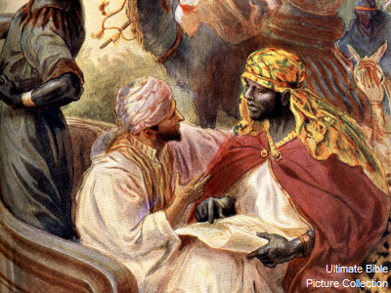
Have You Been Converted?
Do you believe that Jesus is the Christ, the Son of the Living God?
Have you confessed Jesus as the Christ?
Have you repented and been baptized in the name of Jesus Christ for the remission of your sins? (Acts 2:38)
Are you rejoicing in the Lord? (Phili 4:4-8)

Slide 17
Have You Been Converted?
The Gospel has been preached –
How will you respond?

Slide 19
The Conversion of The Ethiopian Eunuch
Acts 8:26-40
Charts by Don McClain
Prepared July 14-16, 2011
Preached July 17, 2011
West 65th Street church of Christ
P.O. Box 190062
Little Rock AR 72219
501-568-1062
Prepared using PPT 2010 –
Email – donmcclain@sbcglobal.net
More PPT & Audio Sermons:
http://w65stchurchofchrist.org/donmaccla/2011SermonPage.html

