Slide 1
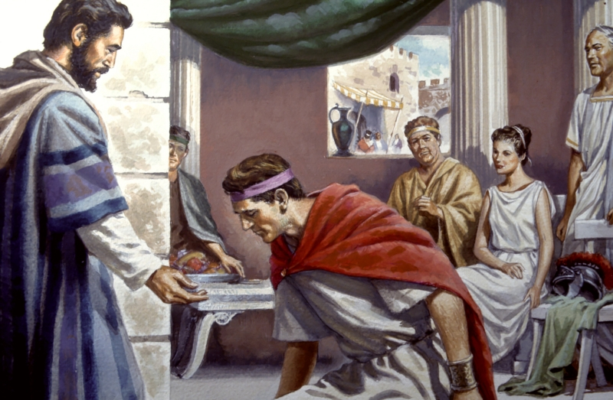
Examples of Conversions In Acts
Conversion of
Cornelius & His Household
Acts 10:1-11:18; 15:6-11

Slide 2
Conversion of Saul From Tarsus
Convert; Converted
transitive verb
1 - a : to bring over from one belief, view, or party to another b : to bring about a religious conversion in
2 - a : to alter the physical or chemical nature or properties of especially in manufacturing b (1) : to change from one form or function to another (2) : to alter for more effective utilization

Slide 3
Conversion of Saul From Tarsus
Convert; Converted
Matthew 18:3-4 (NKJV) ³ and said, "Assuredly, I say to you, unless you are converted and become as little children, you will by no means enter the kingdom of heaven. ⁴ Therefore whoever humbles himself as this little child is the greatest in the kingdom of heaven.

Slide 4
Conversion of Saul From Tarsus
Convert; Converted
Acts 3:19 (NKJV) ¹⁹ Repent therefore and be converted, that your sins may be blotted out, so that times of refreshing may come from the presence of the Lord,

Slide 5
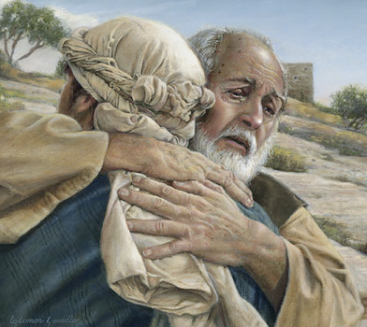
Conversion of Saul From Tarsus
Convert; Converted
Not merely a change in actions –
A change in knowledge –
A change in conviction -
A change in allegiance –
A change in thinking & will –
A change in commitment – resulting in a change in relationship & identity -
A change in who we are – how we talk – where we go – what we do -
Luke 15:11-24

Slide 6
Conversion of Saul From Tarsus
Psalm 19:7 (NKJV) ⁷ The law of the LORD is perfect, converting the soul; The testimony of the LORD is sure, making wise the simple;

Slide 7
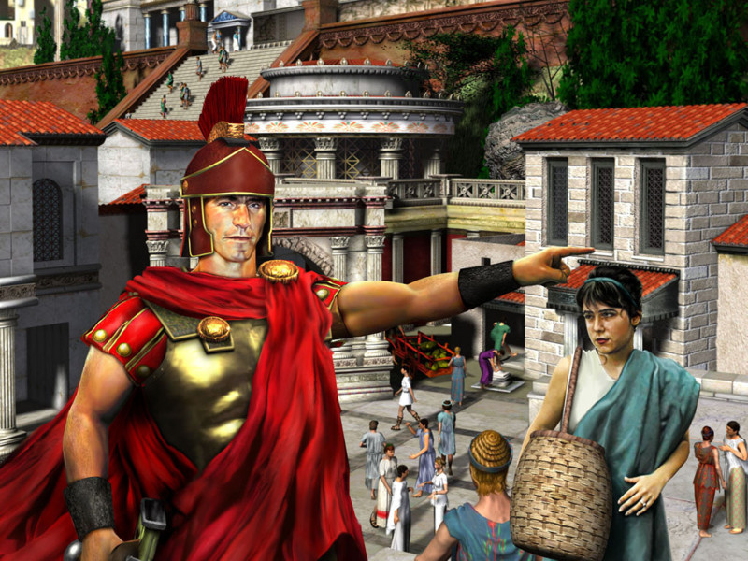
Brief Analysis
Cornelius before his conversion – A honorable, godly. religious, charitable man – vss 1-4,22
The “HOW” of his conversion – Miracles involved & why, the necessity of preaching and compliance – vss 3-48
Cornelius after his conversion – Wanted Peter and company to stay a few days - Most likely wanting to learn more about his new faith – vs. 48

Slide 8
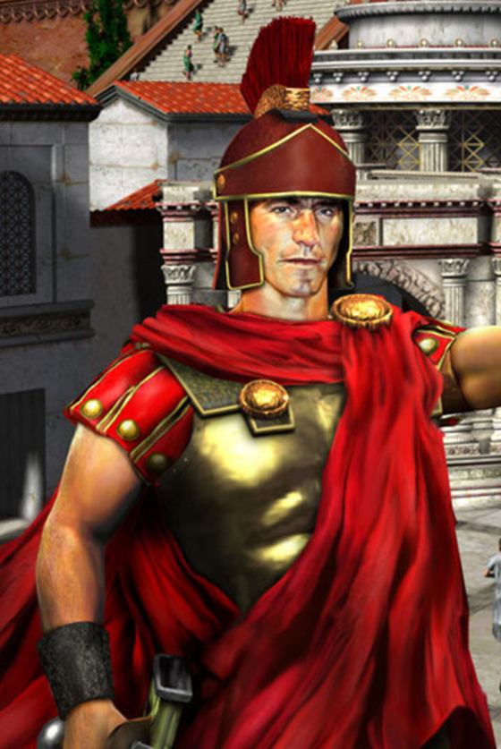
Conversion of Cornelius, (Gentiles)
Cornelius Before His Conversion
‘A centurion’ – over 100 men of the Italian regiment – (v. 1)
‘A devout man’ – very religious, godly, devoted to God - (v. 2).
‘Feared God’ - He and his house - (v. 2; 22; cf Pr 1:7)
‘Gave alms generously’ - a caring, kind man - (v.2)
‘Prayed to God always’ – (v. 2)
‘A just man’ – fair and honest - (v. 22)
‘respected by all the Jewish people’ - even though a foreigner – (vs 22)

Slide 9
Conversion of Cornelius, (Gentiles)
Cornelius Before His Conversion
Regardless of his godly character, moral purity, sincerity, devotion in worship, generosity, conduct & reputation - Cornelius still NEEDED to be saved! – 10:6,22, 32,33; 11:14; cf. Rom. 3:23; 6:23

Slide 10
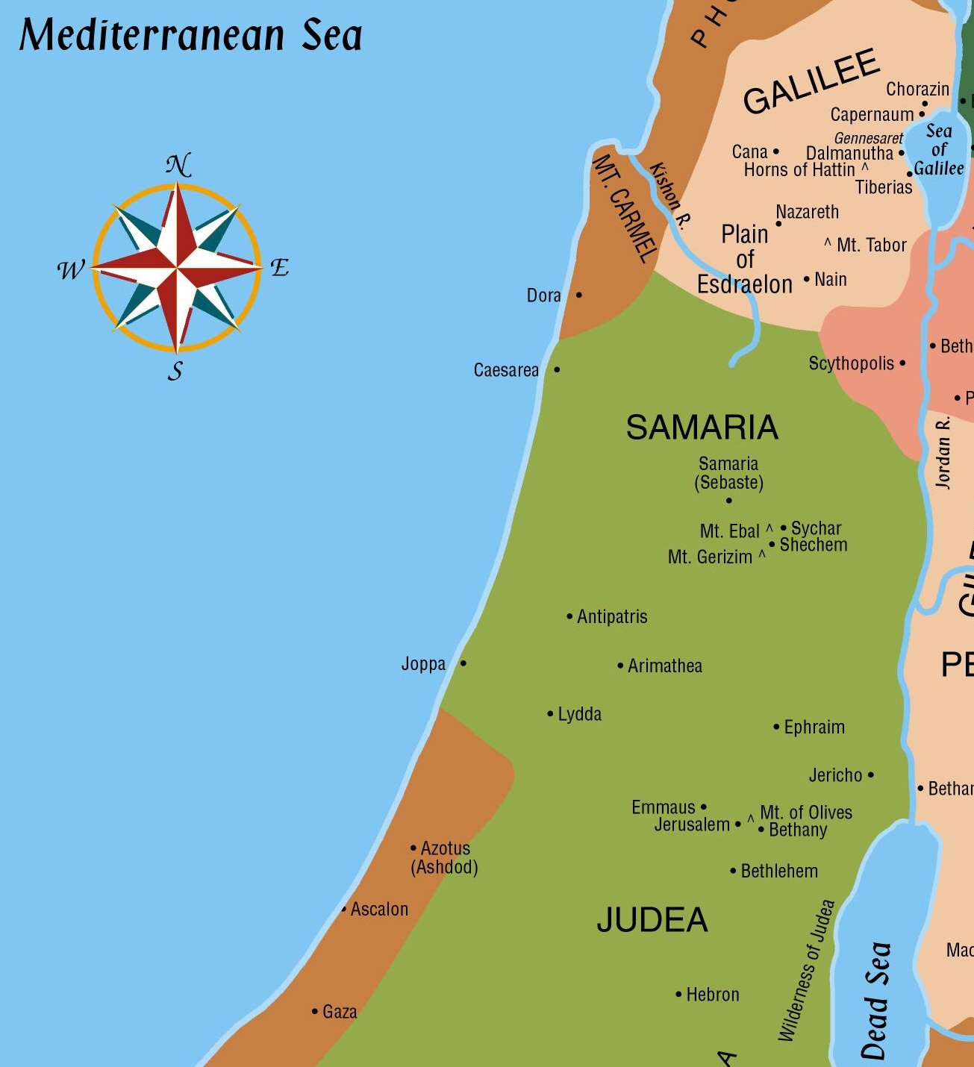
Cornelius’ vision of an angel – (3-8)
“Send men to Joppa”
which Cornelius did – (4-8)
32 miles
Peter’s vision of unclean animals in Joppa – (9-16)

Slide 11
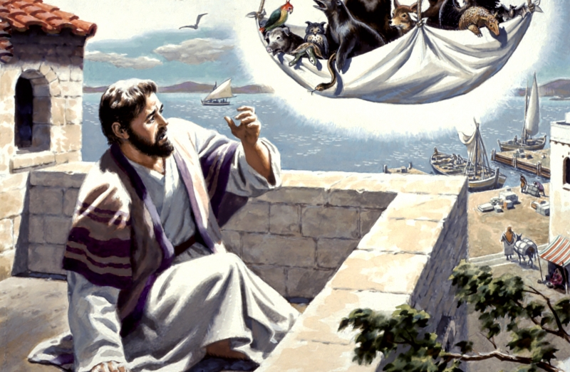
Acts 10:9-16 (NKJV) ⁹ . . . Peter went up on the housetop to pray, about the sixth hour. ¹⁰ Then he became very hungry and wanted to eat; but while they made ready, he fell into a trance ¹¹ and saw heaven opened and an object like a great sheet bound at the four corners, descending to him and let down to the earth.
Peter’s vision of unclean animals in Joppa – (9-16)

Slide 12
Acts 10:9-16 (NKJV) ¹² In it were all kinds of four-footed animals of the earth, wild beasts, creeping things, and birds of the air. ¹³ And a voice came to him, "Rise, Peter; kill and eat." ¹⁴ But Peter said, "Not so, Lord! For I have never eaten anything common or unclean."
Peter’s vision of unclean animals in Joppa – (9-16)

Slide 13
Acts 10:9-16 (NKJV) ¹⁵ And a voice spoke to him again the second time, "What God has cleansed you must not call common." ¹⁶ This was done three times. And the object was taken up into heaven again.
Peter’s vision of unclean animals in Joppa – (9-16)

Slide 14
Cornelius’ vision of an angel – (3-8)
“Send men to Joppa”
which Cornelius did – (4-8)
32 miles
Peter’s vision of unclean animals in Joppa – (9-16)
Peter receives the men from Cornelius and goes with them– (17-23)

Slide 15
Conversion of Cornelius, (Gentiles)
The Miracles (Divine Interaction) Involved
Cornelius’ vision of an angel - 10:3-6 –– did not preach the gospel!
Peter’s vision of unclean animals - 10:9-17,28-35 – prepared the preacher for the task of preaching to the Gentiles
The Holy Spirit falling on the Gentiles and them speaking in tongues - 10:44-46; 11:1-18; 15:7-11 – Not to save them – not for the Gentiles – but for the Jews!
Notes:
Acts 10:33 (NKJV) ³³ So I sent to you immediately, and you have done well to come. Now therefore, we are all present before God, to hear all the things commanded you by God."

Slide 16
Conversion of Cornelius, (Gentiles)
The Miracles (Divine Interaction) Involved
As on the apostles at the beginning (11:15)
The Holy Spirit “fell ON them” (10:44)
The Holy Spirit was “poured out on them” (10:45)
They spoke with tongues (10:46)
Reminding Peter of Jesus’ promise - (11:16)
The gift was the ability to speak in tongues (11:17)
Notes:
When Was Cornelius Saved?
“The Gift of the Holy Spirit” Was “Poured Out On The Gentiles”
Why?

Slide 17
Conversion of Cornelius, (Gentiles)
The Miracles (Divine Interaction) Involved
WHY????
Silenced critics against Peter’s going in to Gentiles (11:1-3)
Astonished the Jewish Christians who were with Peter (10:45,46)
To demonstrate the abolishment of the barrier between Jew & Gentile (10:46; Ep 2:11-13)
To remove ALL doubt that the Gentiles MUST be baptized (saved) (10:47)
Convinced Jews that Gentiles were to be accepted (11:18)
Peter couldn’t withstand God – neither could anyone!! (11:17)
Notes:
When Was Cornelius Saved?
“The Gift of the Holy Spirit” Was “Poured Out On The Gentiles”
Why?

Slide 18
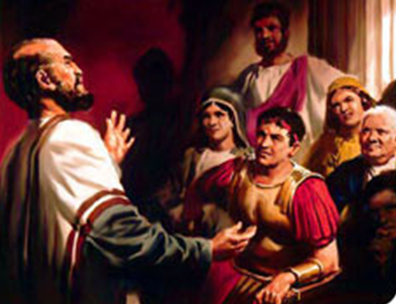
Conversion of Cornelius, (Gentiles)
The Miracles (Divine Interaction) Involved
Holy Spirit Falling On The Gentiles:
Was NOT to SAVE them – and did not save them – (cf Num. 22:28; 23:5,12,26; 1 Sam 19:21-23; John 11:51)
Peter was sent to them to tell them what they MUST do in order to be saved – 11:14
To provide undeniable evidence that the Jewish Christians were to accept Gentiles when they complied with the gospel message.
Notes:
When Was Cornelius Saved?
“The Gift of the Holy Spirit” Was “Poured Out On The Gentiles”
Why?

Slide 19
Conversion of Cornelius, (Gentiles)
The Necessity of Hearing The Gospel
10:6 – “He will tell you what you must do."
10:22 - “to summon you to his house, and to hear words from you."
10:32,33 “When he comes, he will speak to you . . . to hear all the things commanded you by God."
11:14 who will tell you words by which you and all your household will be saved.'
Notes:
Acts 10:33 (NKJV) ³³ So I sent to you immediately, and you have done well to come. Now therefore, we are all present before God, to hear all the things commanded you by God."

Slide 20
Conversion of Cornelius, (Gentiles)
What did Cornelius know?? (10:37)
Feared and worshipped God! (10:2)
The word that God sent to the children of Israel! (10:36,37,42)
That peace through Jesus Christ was preached! (10:36,37,43; [Phillip, Acts 8:40])
That Jesus was preached as being Lord of ALL! (10:36,37,43)
The works of Jesus! (10:38,39,40)
Notes:
Acts 10:33 (NKJV) ³³ So I sent to you immediately, and you have done well to come. Now therefore, we are all present before God, to hear all the things commanded you by God."

Slide 21
Conversion of Cornelius, (Gentiles)
What Did Cornelius NOT know?
God had “granted repentance to life” to the Gentiles as well as the Jews – (11:18)
The words God had commanded Peter to speak to them, i.e. that which they MUST do! – (10:33, [6,22,32,42; 11:14])
That they too must be baptized in the name of Jesus Christ! (10:47,48; 11:17; cf. 2:38)
Notes:
Acts 10:33 (NKJV) ³³ So I sent to you immediately, and you have done well to come. Now therefore, we are all present before God, to hear all the things commanded you by God."

Slide 22
Conversion of Cornelius, (Gentiles)
When Was Cornelius And His House Saved?
After they heard the gospel – their hearts were purified by faith when they obeyed those things commanded them by God - (10:5,22,32,33; 11:14; 15:7-9; 1 Peter 1:22,23; Gal. 3:26,27)
After they repented! – (11:18)
When they were baptized in the name of Jesus Christ! (10:47,48; 11:17; cf. 2:38; 22:16; 1 Pet 3:21)
Notes:
Acts 10:33 (NKJV) ³³ So I sent to you immediately, and you have done well to come. Now therefore, we are all present before God, to hear all the things commanded you by God."

Slide 23
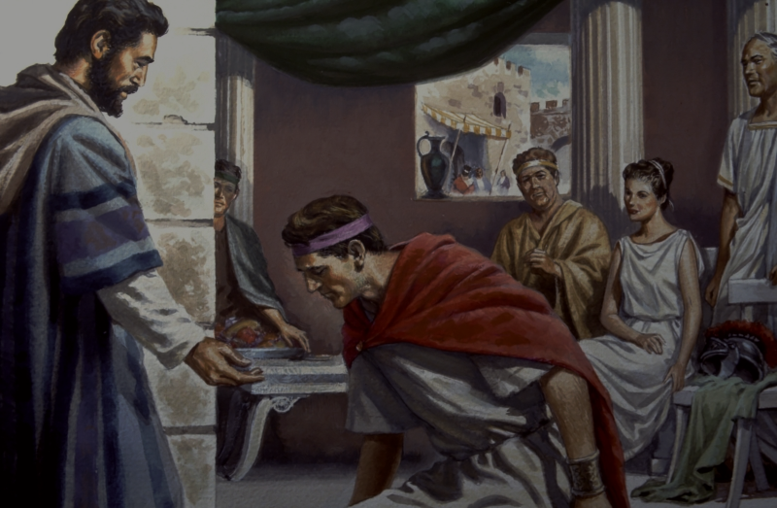
Conversion of Cornelius, (Gentiles)
When Was Cornelius And His House Saved?
Acts 10:42-43 (NKJV)
. . . [43] To Him all the prophets witness that, through His name, whoever believes in Him will receive remission of sins."
Acts 10:47-48 (NKJV)
"Can anyone forbid water, . . . [48] And he commanded them to be baptized in the name of the Lord. . . .
Notes:
Acts 2:38

Slide 24
Conversion of Cornelius, (Gentiles)
Before
Baptized
Pious
Worshipper
After
Pious
Worshipper
Benevolent
Lost
Benevolent
Saved

Slide 25
Conversions In Acts
Examples
Pentecost – 2:14-41
Samaria – 8:5-13
Eunuch – 8:35-39
Saul – 9,22,26
Cornelius - 10:34-48
Lydia – 16:13-15
Jailor – 16:30-34
Corinthians - 18:8
Ephesians - 19:3-5
Believed
Implied
12
36,37
Implied
43
14
31
8
Implied
Repented
37,38
Implied
Implied
Implied
Implied
Implied
Implied
Implied
Implied
Confessed
Implied
Implied
37
Implied
Implied
Implied
Implied
Implied
Implied
Baptized
38,41
12,13
38
9:18
48
15
33
8
5

Slide 26
Conversion of Cornelius, (Gentiles)
Lessons & Applications
Not saved just because religious and sincere.
Not saved by good deeds.
Not saved without hearing the gospel.
Holy Spirit baptism not for us today – (Eph. 4:5).
God is no respecter of persons – (Acts 10:34,35).
All saved the same way.

Slide 27
Conversion of Cornelius, (Gentiles)
Lessons & Applications
Not saved by faith only!
Baptism (immersion in water) is a command that must be obeyed.
Baptism in the name of Jesus is NOT Holy Spirit baptism – Acts 2:38; 8:16; 10:48; 19:5,6
Desire to learn more -

Slide 28
Have You Been Converted?
Do you believe that Jesus is the Christ, the Son of the Living God?
Have you confessed Jesus as the Christ?
Have you by faith, obeyed the truth in repentance and baptism? (1 Pet. 1:22,23)
Are you seeking to grow spiritually? (2 Pet. 1:5-10)

Slide 29
Have You Been Converted?
You have been “granted repentance unto life!”
Have your soul purified by faith today! – Acts 15:9; 1 Pet. 1:22,23; 2 Cor. 6:2

Slide 31
The Conversion of Cornelius
Acts 10:1-11:18; 15:7-11
Charts by Don McClain
Prepared July 26-30, 2011
Preached July 31, 2011
West 65th Street church of Christ
P.O. Box 190062
Little Rock AR 72219
501-568-1062
Prepared using PPT 2010 –
Email – donmcclain@sbcglobal.net
More PPT & Audio Sermons:
http://w65stchurchofchrist.org/donmaccla/2011SermonPage.html

Slide 32
Acts 15:6-11 (NKJV) ⁶ Now the apostles and elders came together to consider this matter. ⁷ And when there had been much dispute, Peter rose up and said to them: "Men and brethren, you know that a good while ago God chose among us, that by my mouth the Gentiles should hear the word of the gospel and believe. ⁸ So God, who knows the heart, acknowledged them by giving them the Holy Spirit, just as He did to us,

Slide 33
Acts 15:6-11 (NKJV) ⁹ and made no distinction between us and them, purifying their hearts by faith. ¹⁰ Now therefore, why do you test God by putting a yoke on the neck of the disciples which neither our fathers nor we were able to bear? ¹¹ But we believe that through the grace of the Lord Jesus Christ we shall be saved in the same manner as they."

