Slide 1
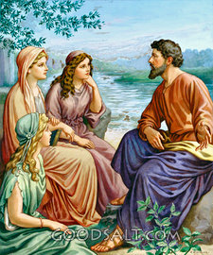
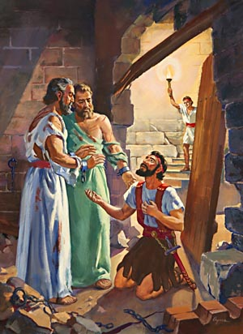
Examples of Conversions In Acts
Conversion of
Lydia & Jailor In Philippi
Acts 16:1-40

Slide 2
Conversion of Saul From Tarsus
Convert; Converted
transitive verb
1 - a : to bring over from one belief, view, or party to another b : to bring about a religious conversion in
2 - a : to alter the physical or chemical nature or properties of especially in manufacturing b (1) : to change from one form or function to another (2) : to alter for more effective utilization

Slide 3
Conversion of Saul From Tarsus
Convert; Converted
Matthew 18:3-4 (NKJV) ³ and said, "Assuredly, I say to you, unless you are converted and become as little children, you will by no means enter the kingdom of heaven. ⁴ Therefore whoever humbles himself as this little child is the greatest in the kingdom of heaven.

Slide 4
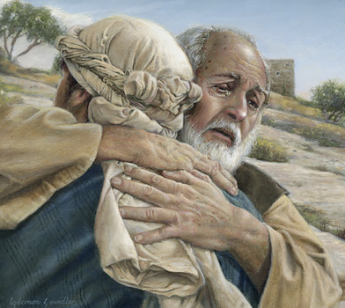
Conversion of Saul From Tarsus
Convert; Converted
Not merely a change in actions –
A change in knowledge –
A change in conviction -
A change in allegiance –
A change in thinking & will –
A change in commitment – resulting in a change in relationship & identity -
A change in who we are – how we talk – where we go – what we do -
Luke 15:11-24

Slide 5
Conversion of Saul From Tarsus
Psalm 19:7 (NKJV) ⁷ The law of the LORD is perfect, converting the soul; The testimony of the LORD is sure, making wise the simple;

Slide 6
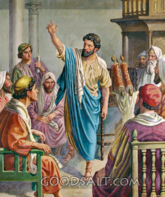
Events From Acts 11-15
Gospel preached in Antioch – Acts 11:19-24
Barnabas finds Saul and the activities of the church in Antioch – called Christians; coming drought and relief – Acts 11:25-30
Activities of Herod, Peter imprisoned – Acts 12:1-24
Paul & Barnabas first missionary journey – Acts 12:25-14:28

Slide 7
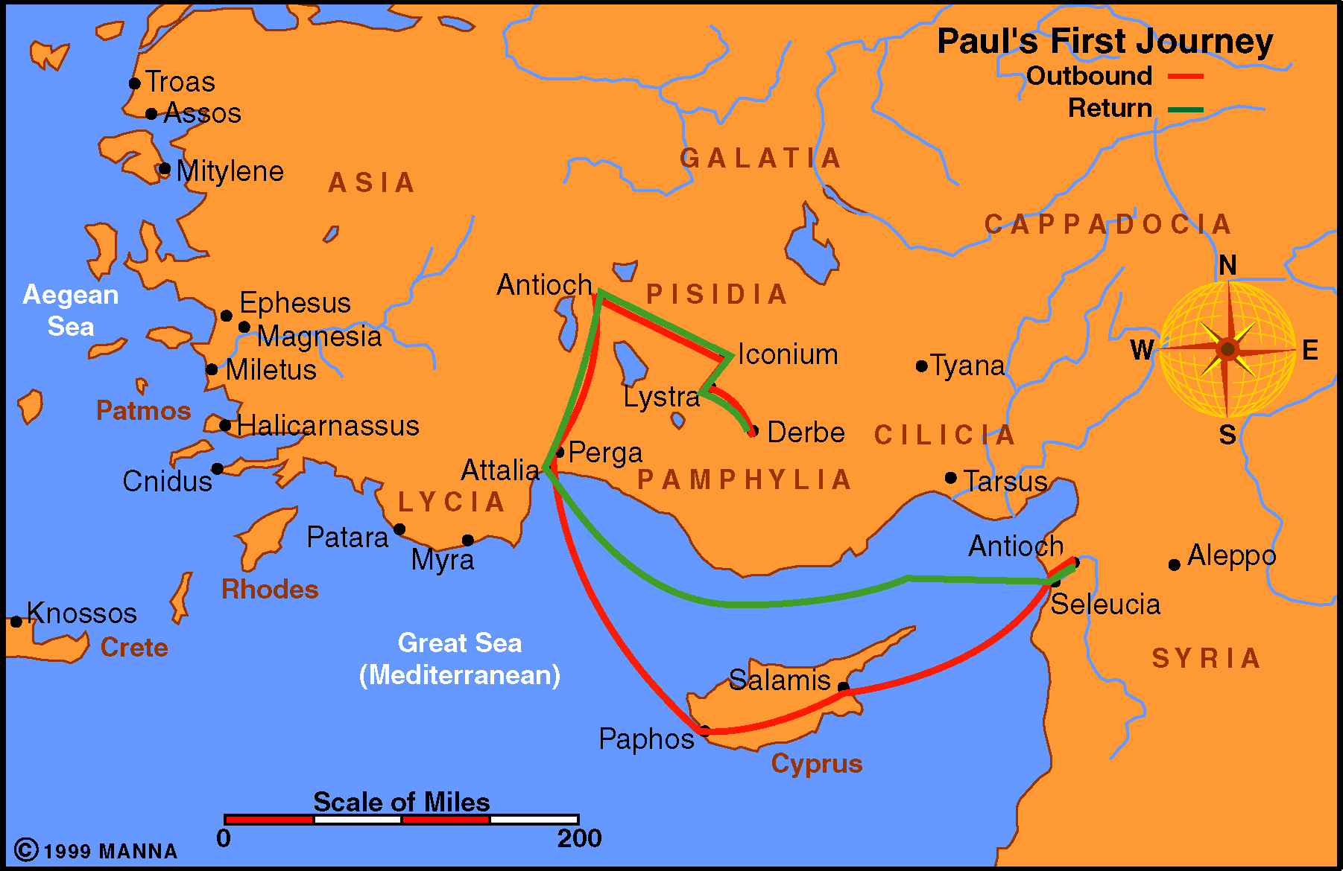
Events From Acts 11-15
14:6-19 – Healing of a lame man – Paul & Barnabas thought to be gods at Lystra
14:1-5 – rejected in Iconium and had to flee
13:13-52 - From Perga to Pisidian Antioch where the Gospel is rejected by the Jews – (13:46)
14:20-28. Many disciples made in Derbe and the return to Antioch of Syria
13:1-3 – Begins in Antioch
13:4-12 - The tour of Cyprus – Elymas the sorcerer blinded

Slide 8
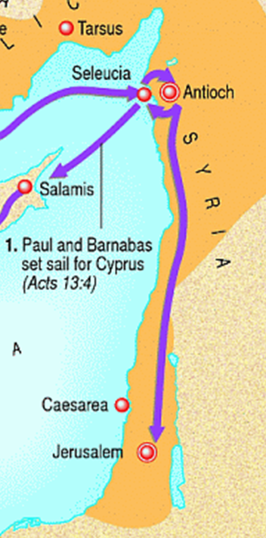
Events From Acts 11-15
Discussion of circumcision in Jerusalem – Acts 15:1-29
Paul and Barnabas return to Antioch – Contention over John Mark – Acts 15:30-40
Paul and Silas embark on second missionary journey – Acts 15:40-18:22

Slide 9
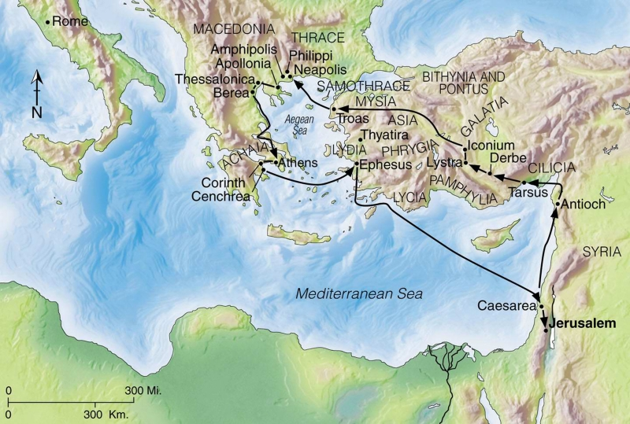
Paul’s Second Missionary Journey - (Acts 15:40-18:22)
Acts 15:40-41 (NKJV) ⁴⁰ but Paul chose Silas and departed, being commended by the brethren to the grace of God. ⁴¹ And he went through Syria and Cilicia, strengthening the churches.

Slide 10
Paul’s Second Missionary Journey - (Acts 15:40-18:22)
Acts 16:1 (NKJV)
Then he came to Derbe and Lystra. And behold, a certain disciple was there, named Timothy, the son of a certain Jewish woman who believed, but his father was Greek.

Slide 11
Paul’s Second Missionary Journey - (Acts 15:40-18:22)
Acts 16:6-10 (NKJV) ⁶ Now when they had gone through Phrygia and the region of Galatia, they were forbidden by the Holy Spirit to preach the word in Asia.

Slide 12
Paul’s Second Missionary Journey - (Acts 15:40-18:22)
Acts 16:6-10 (NKJV) ⁷ After they had come to Mysia, they tried to go into Bithynia, but the Spirit did not permit them. ⁸ So passing by Mysia, they came down to Troas.

Slide 13
Paul’s Second Missionary Journey - (Acts 15:40-18:22)
Acts 16:6-10 (NKJV) ⁹ And a vision appeared to Paul in the night. A man of Macedonia stood and pleaded with him, saying, "Come over to Macedonia and help us."

Slide 14
Paul’s Second Missionary Journey - (Acts 15:40-18:22)
Acts 16:6-10 (NKJV) ¹⁰ Now after he had seen the vision, immediately we sought to go to Macedonia, concluding that the Lord had called us to preach the gospel to them.

Slide 15
Paul’s Second Missionary Journey - (Acts 15:40-18:22)
Acts 16:11-12 (NKJV) ¹¹ Therefore, sailing from Troas, we ran a straight course to Samothrace, and the next day came to Neapolis,

Slide 16
Paul’s Second Missionary Journey - (Acts 15:40-18:22)
Acts 16:11-12 (NKJV) ¹² and from there to Philippi, which is the foremost city of that part of Macedonia, a colony. And we were staying in that city for some days.

Slide 17
Examples of Conversions In Acts
Paul & Silas at Philippi (16:12-40)
Paul and his companions go down to the riverside on the Sabbath – Where women were gathered to pray - (16:13)
Conversion of Lydia (16:14-15).
Evil spirit cast out of a servant girl & Paul and Silas are arrested - (16:16-24).
Conversion of the Jailer (16:25-34).
Asked to Leave the city (16:35-40).

Slide 18
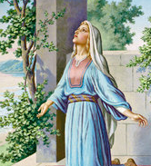
Conversion of Lydia - (Acts 16:11-15)
Who Was Lydia?
Acts 16:14 (NKJV) ¹⁴ Now a certain woman named Lydia heard us.
She was a seller of purple
from the city of Thyatira,
who worshiped God.
The Lord opened her heart to heed the things spoken by Paul.
Notes:
B. Who Was Lydia?
1. Lydia was a merchant of purple from Thyatira.
a. Thyatira was a city of pro-consular Asia (Rev. 1:11), situated on its northern border. It was noted for its excellent purple dyes as indicated by Homer and Strabo (Acts of Apostles; McGarvey, p. 88).
b. Purple was a dye used in the manufacture of fine clothes. It was a rare and precious item.
(1) Lydia's trade in this commodity had been a profitable one making it possible to have her own house (16:15).
(2) She managed a sizeable business and home which included herself, perhaps several of the women who were at the river, and eventually Paul and his three companions. Later, the church will assemble there (16:40).
2. Lydia was a Jewess
a. While not expressly stated, it is reasonably deduced:
(1) Paul and his companions spent several days obviously looking for the Jews of that city (Acts 13:14, 42).
(2) Lydia is identified as a worshipper of God (16:12), she is probably a proselyte (see ISBE).
(3) We find her worshipping according to the customs of the Jews on the Sabbath day along the banks of the river (16:13). Such an observance in a pagan city stands out when most would have regarded it as just another day.
b. This admits Lydia and those of her house to that noble class of God-fearers that Paul encountered throughout the world, whether it was the devout Jews on Pentecost, the Samaritans, Simon, the Eunuch, or the gentiles of Galatia and Cornelius.
c. Her experience and example are noteworthy in that by her devotion she secured the blessing of God.

Slide 19
Conversion of Lydia - (Acts 16:11-15)
Lydia’s Salvation?
‘The Lord opened her heart’
Does NOT specifically state HOW – Many assume what is NOT stated here or ANYWHERE else - (John 6:44,45; 1 Cor. 2:11-15)
The Lord opened her heart just as he opened the hearts of others – Jews on Pentecost, (Act 2:36,37) Samaritans, (Acts 8:4-6) Eunuch, (Acts 8:35,36), Cornelius, (Acts 10:33; 11:14); (cf Rom 1:16; 10:14-17; 1 Cor. 1:18ff)
Notes:
B. Who Was Lydia?
1. Lydia was a merchant of purple from Thyatira.
a. Thyatira was a city of pro-consular Asia (Rev. 1:11), situated on its northern border. It was noted for its excellent purple dyes as indicated by Homer and Strabo (Acts of Apostles; McGarvey, p. 88).
b. Purple was a dye used in the manufacture of fine clothes. It was a rare and precious item.
(1) Lydia's trade in this commodity had been a profitable one making it possible to have her own house (16:15).
(2) She managed a sizeable business and home which included herself, perhaps several of the women who were at the river, and eventually Paul and his three companions. Later, the church will assemble there (16:40).
2. Lydia was a Jewess
a. While not expressly stated, it is reasonably deduced:
(1) Paul and his companions spent several days obviously looking for the Jews of that city (Acts 13:14, 42).
(2) Lydia is identified as a worshipper of God (16:12), she is probably a proselyte (see ISBE).
(3) We find her worshipping according to the customs of the Jews on the Sabbath day along the banks of the river (16:13). Such an observance in a pagan city stands out when most would have regarded it as just another day.
b. This admits Lydia and those of her house to that noble class of God-fearers that Paul encountered throughout the world, whether it was the devout Jews on Pentecost, the Samaritans, Simon, the Eunuch, or the gentiles of Galatia and Cornelius.
c. Her experience and example are noteworthy in that by her devotion she secured the blessing of God.

Slide 20
Conversion of Lydia - (Acts 16:11-15)
Lydia’s Salvation?
‘To Heed The Things Spoken By Paul’
She and her household were baptized – (Acts 16:15)
She would not have known baptism w/o Paul having preached it (cf. Ac 8:35–36).
She understood that saving faith was obedient faith; therefore, she attended unto the things spoken by Paul (16:14,15).
Notes:
B. Who Was Lydia?
1. Lydia was a merchant of purple from Thyatira.
a. Thyatira was a city of pro-consular Asia (Rev. 1:11), situated on its northern border. It was noted for its excellent purple dyes as indicated by Homer and Strabo (Acts of Apostles; McGarvey, p. 88).
b. Purple was a dye used in the manufacture of fine clothes. It was a rare and precious item.
(1) Lydia's trade in this commodity had been a profitable one making it possible to have her own house (16:15).
(2) She managed a sizeable business and home which included herself, perhaps several of the women who were at the river, and eventually Paul and his three companions. Later, the church will assemble there (16:40).
2. Lydia was a Jewess
a. While not expressly stated, it is reasonably deduced:
(1) Paul and his companions spent several days obviously looking for the Jews of that city (Acts 13:14, 42).
(2) Lydia is identified as a worshipper of God (16:12), she is probably a proselyte (see ISBE).
(3) We find her worshipping according to the customs of the Jews on the Sabbath day along the banks of the river (16:13). Such an observance in a pagan city stands out when most would have regarded it as just another day.
b. This admits Lydia and those of her house to that noble class of God-fearers that Paul encountered throughout the world, whether it was the devout Jews on Pentecost, the Samaritans, Simon, the Eunuch, or the gentiles of Galatia and Cornelius.
c. Her experience and example are noteworthy in that by her devotion she secured the blessing of God.

Slide 21
Conversion of Lydia - (Acts 16:11-15)
Lydia’s Salvation?
Note The Process:
The Gospel is preached;
The heart is opened;
Attendance is given to the things spoken;
The obedient is judged faithful.
Notes:
B. Who Was Lydia?
1. Lydia was a merchant of purple from Thyatira.
a. Thyatira was a city of pro-consular Asia (Rev. 1:11), situated on its northern border. It was noted for its excellent purple dyes as indicated by Homer and Strabo (Acts of Apostles; McGarvey, p. 88).
b. Purple was a dye used in the manufacture of fine clothes. It was a rare and precious item.
(1) Lydia's trade in this commodity had been a profitable one making it possible to have her own house (16:15).
(2) She managed a sizeable business and home which included herself, perhaps several of the women who were at the river, and eventually Paul and his three companions. Later, the church will assemble there (16:40).
2. Lydia was a Jewess
a. While not expressly stated, it is reasonably deduced:
(1) Paul and his companions spent several days obviously looking for the Jews of that city (Acts 13:14, 42).
(2) Lydia is identified as a worshipper of God (16:12), she is probably a proselyte (see ISBE).
(3) We find her worshipping according to the customs of the Jews on the Sabbath day along the banks of the river (16:13). Such an observance in a pagan city stands out when most would have regarded it as just another day.
b. This admits Lydia and those of her house to that noble class of God-fearers that Paul encountered throughout the world, whether it was the devout Jews on Pentecost, the Samaritans, Simon, the Eunuch, or the gentiles of Galatia and Cornelius.
c. Her experience and example are noteworthy in that by her devotion she secured the blessing of God.

Slide 22
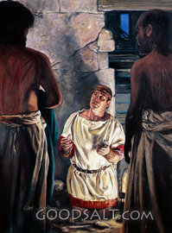
Conversion of Jailor - (Acts 16:23-34)
The Circumstances
Paul & Silas cast demon out of servant girl – (16:16-18)
Paul & Silas imprisoned – (16:19-24)
Paul & Silas set free during earthquake – (16:25,26)
Wakened jailer thought to kill himself – (16:27,28)
Stopped by Paul – (16:28)
Notes:
B. Who Was Lydia?
1. Lydia was a merchant of purple from Thyatira.
a. Thyatira was a city of pro-consular Asia (Rev. 1:11), situated on its northern border. It was noted for its excellent purple dyes as indicated by Homer and Strabo (Acts of Apostles; McGarvey, p. 88).
b. Purple was a dye used in the manufacture of fine clothes. It was a rare and precious item.
(1) Lydia's trade in this commodity had been a profitable one making it possible to have her own house (16:15).
(2) She managed a sizeable business and home which included herself, perhaps several of the women who were at the river, and eventually Paul and his three companions. Later, the church will assemble there (16:40).
2. Lydia was a Jewess
a. While not expressly stated, it is reasonably deduced:
(1) Paul and his companions spent several days obviously looking for the Jews of that city (Acts 13:14, 42).
(2) Lydia is identified as a worshipper of God (16:12), she is probably a proselyte (see ISBE).
(3) We find her worshipping according to the customs of the Jews on the Sabbath day along the banks of the river (16:13). Such an observance in a pagan city stands out when most would have regarded it as just another day.
b. This admits Lydia and those of her house to that noble class of God-fearers that Paul encountered throughout the world, whether it was the devout Jews on Pentecost, the Samaritans, Simon, the Eunuch, or the gentiles of Galatia and Cornelius.
c. Her experience and example are noteworthy in that by her devotion she secured the blessing of God.

Slide 23
Conversion of Jailor - (Acts 16:23-34)
The Most Important Question
A grateful & humbled man prepared to listen – (16:29)
The question - “what must I do to be saved?” – (16:30)
The answer - "Believe on the Lord Jesus Christ, and you will be saved, you and your household." - (16:31)
Understanding the answer – (16:32,33)
Notes:
The Important Inquiry—
The Jailer’s question was most certainly about his eternal well being!
He knew who they were.
He knew what they had done.
He knew in whose name they had done it.
He knew what they had claimed for this name.
He had observed their behavior throughout the day.
Acts 16:31 (NKJV) ³¹ So they said, "Believe on the Lord Jesus Christ, and you will be saved, you and your household."

Slide 24
Conversion of Jailor - (Acts 16:23-34)
The Most Important Question
The Answer Was NOT!
“JUST” believe – faith only -
Ask Jesus to come into your heart –
Confess that you are a sinner
Say the sinners prayer –
Where is a passage where any of these things were EVER told to a non Christian in order for them to be saved?
Notes:
The Important Inquiry—
The Jailer’s question was most certainly about his eternal well being!
He knew who they were.
He knew what they had done.
He knew in whose name they had done it.
He knew what they had claimed for this name.
He had observed their behavior throughout the day.
Acts 16:31 (NKJV) ³¹ So they said, "Believe on the Lord Jesus Christ, and you will be saved, you and your household."

Slide 25
Conversion of Jailor - (Acts 16:23-34)
The Most Important Question
Acts 16:30-33 (NKJV) ³⁰ And he brought them out and said, "Sirs, what must I do to be saved?"
³¹ So they said, "Believe on the Lord Jesus Christ, and you will be saved, you and your household."
³² Then they spoke the word of the Lord to him and to all who were in his house.
³³ And he took them the same hour of the night and washed their stripes. And immediately he and all his family were baptized.
Romans 10:13-17
Notes:
The Important Inquiry—
The Jailer’s question was most certainly about his eternal well being!
He knew who they were.
He knew what they had done.
He knew in whose name they had done it.
He knew what they had claimed for this name.
He had observed their behavior throughout the day.
Acts 16:31 (NKJV) ³¹ So they said, "Believe on the Lord Jesus Christ, and you will be saved, you and your household."

Slide 26
Conversion of Jailor - (Acts 16:23-34)
Different Instructions Due To Where They Were
The Jews believed, they needed to repent and be baptized - (Acts 2:38).
Saul believed and was penitent, he needed to be baptized - (Acts 22:16).
The Jailer didn’t know anything about Jesus, he needed to start at belief - (Acts 16:31).
Notes:
Acts 16:31 (NKJV) ³¹ So they said, "Believe on the Lord Jesus Christ, and you will be saved, you and your household."

Slide 27
Conversion of Jailor - (Acts 16:23-34)
Different Instructions Due To Where They Were
B
Acts 16
They All Did The Same Things!!!
R
Acts 2
Bap
Acts 22:16
S
Mark 16:15,16
Notes:
Acts 16:31 (NKJV) ³¹ So they said, "Believe on the Lord Jesus Christ, and you will be saved, you and your household."

Slide 28
Conversion of Jailor - (Acts 16:23-34)
The Same Hour of The Night
Paul and Silas had been beaten with many stripes – (16:23)
Paul & Silas had been thrown into a dungeon and their feet put in stocks – (16:24)
Well after midnight – (16:25)
It had been a hectic night to say the least, earthquake, saving a man from suicide, teaching the gospel, wounds cleaned – (16:26-32)
Notes:
Acts 16:31 (NKJV) ³¹ So they said, "Believe on the Lord Jesus Christ, and you will be saved, you and your household."

Slide 29
Conversion of Jailor - (Acts 16:23-34)
The Same Hour of The Night
If baptism could have been PUT OFF I would think it would have been put off!!
Notes:
Acts 16:31 (NKJV) ³¹ So they said, "Believe on the Lord Jesus Christ, and you will be saved, you and your household."

Slide 30
Conversion of Jailor - (Acts 16:23-34)
Having Believed In God
Ask about spiritual life –
Told to believe –
Was taught the word of the Lord – (what to believe & DO)
Baptized immediately –
A BELIEVER!!!!!
Notes:
Acts 16:31 (NKJV) ³¹ So they said, "Believe on the Lord Jesus Christ, and you will be saved, you and your household."

Slide 31
Conversions In Acts
Examples
Pentecost – 2:14-41
Samaria – 8:5-13
Eunuch – 8:35-39
Saul – 9,22,26
Cornelius - 10:34-48
Lydia – 16:13-15
Jailor – 16:30-34
Corinthians - 18:8
Ephesians - 19:3-5
Believed
Implied
12
36,37
Implied
43
14
31
8
Implied
Repented
37,38
Implied
Implied
Implied
Implied
Implied
Implied
Implied
Implied
Confessed
Implied
Implied
37
Implied
Implied
Implied
Implied
Implied
Implied
Baptized
38,41
12,13
38
9:18
48
15
33
8
5

Slide 32
Conversion of Lydia & Jailor In Philippi
Lessons & Applications
Not saved just because religious and sincere.
Prayer doesn’t save.
Not saved without hearing the gospel.
Baptism is necessary.
All saved the same way.
There is no greater JOY than salvation!!

Slide 33
Have You Been Converted?
Do you believe that Jesus is the Christ, the Son of the Living God?
Have you confessed Jesus as the Christ?
Have you by faith, obeyed the truth in repentance and baptism? (1 Pet. 1:22,23)
You can leave this morning REJOICING!

Slide 35
Conversion of
Lydia & Jailor In Philippi
Acts 16:1-40
Charts by Don McClain
Prepared August 4-6, 2011
Preached August 7, 2011
West 65th Street church of Christ
P.O. Box 190062
Little Rock AR 72219
501-568-1062
Prepared using PPT 2010 –
Email – donmcclain@sbcglobal.net
More PPT & Audio Sermons:
http://w65stchurchofchrist.org/donmaccla/2011SermonPage.html

Slide 36
Philippians 1:1-11 (NKJV) ¹ Paul and Timothy, bondservants of Jesus Christ, To all the saints in Christ Jesus who are in Philippi, with the bishops and deacons: ² Grace to you and peace from God our Father and the Lord Jesus Christ. ³ I thank my God upon every remembrance of you, ⁴ always in every prayer of mine making request for you all with joy, ⁵ for your fellowship in the gospel from the first day until now,

Slide 37
Philippians 1:1-11 (NKJV)
⁶ being confident of this very thing, that He who has begun a good work in you will complete it until the day of Jesus Christ; ⁷ just as it is right for me to think this of you all, because I have you in my heart, inasmuch as both in my chains and in the defense and confirmation of the gospel, you all are partakers with me of grace. ⁸ For God is my witness, how greatly I long for you all with the affection of Jesus Christ.

Slide 38
Philippians 1:1-11 (NKJV)
⁹ And this I pray, that your love may abound still more and more in knowledge and all discernment, ¹⁰ that you may approve the things that are excellent, that you may be sincere and without offense till the day of Christ, ¹¹ being filled with the fruits of righteousness which are by Jesus Christ, to the glory and praise of God.

Slide 39
