Slide 1
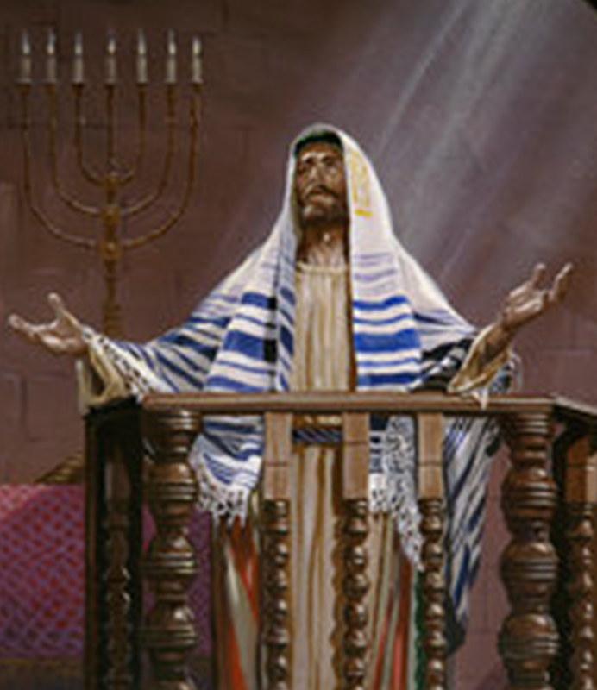
Examples of Conversions In Acts
Receiving The Word of God
Conversions In
Thessalonica, Berea, & Athens Acts 17:1-34

Slide 2
Conversion of Saul From Tarsus
Convert; Converted
transitive verb
1 - a : to bring over from one belief, view, or party to another b : to bring about a religious conversion in
2 - a : to alter the physical or chemical nature or properties of especially in manufacturing b (1) : to change from one form or function to another (2) : to alter for more effective utilization

Slide 3
Conversion of Saul From Tarsus
Convert; Converted
Matthew 18:3-4 (NKJV) ³ and said, "Assuredly, I say to you, unless you are converted and become as little children, you will by no means enter the kingdom of heaven. ⁴ Therefore whoever humbles himself as this little child is the greatest in the kingdom of heaven.

Slide 4
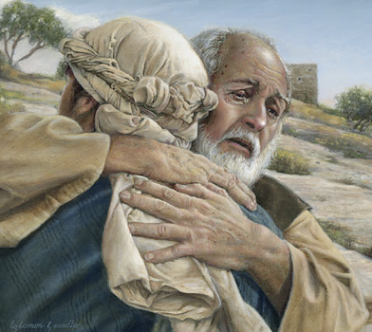
Conversion of Saul From Tarsus
Convert; Converted
Not merely a change in actions –
A change in knowledge –
A change in conviction -
A change in allegiance –
A change in thinking & will –
A change in commitment – resulting in a change in relationship & identity -
A change in who we are – how we talk – where we go – what we do -
Luke 15:11-24

Slide 5
Conversion of Saul From Tarsus
Psalm 19:7 (NKJV) ⁷ The law of the LORD is perfect, converting the soul; The testimony of the LORD is sure, making wise the simple;

Slide 6
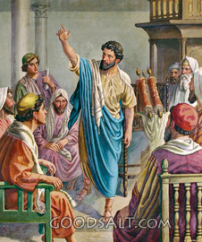
Conversion From 2-16
The Jews on Pentecost – Heard, pricked in hearts, repented and were baptized – Act 2:14-42,47
The Samaritans – Heard Jesus preached, believed and were baptized – Acts 8:4-13
Eunuch – Heard, believed, and was baptized – Acts 8:30-39
Gentiles – Heard, believed, were baptized – Acts 10:1-11:18
Lydia – Heard, believed, heeded – was baptized – Acts 16:11-15
Jailor – Heard, believed, was baptized – Acts 16:25-34

Slide 7
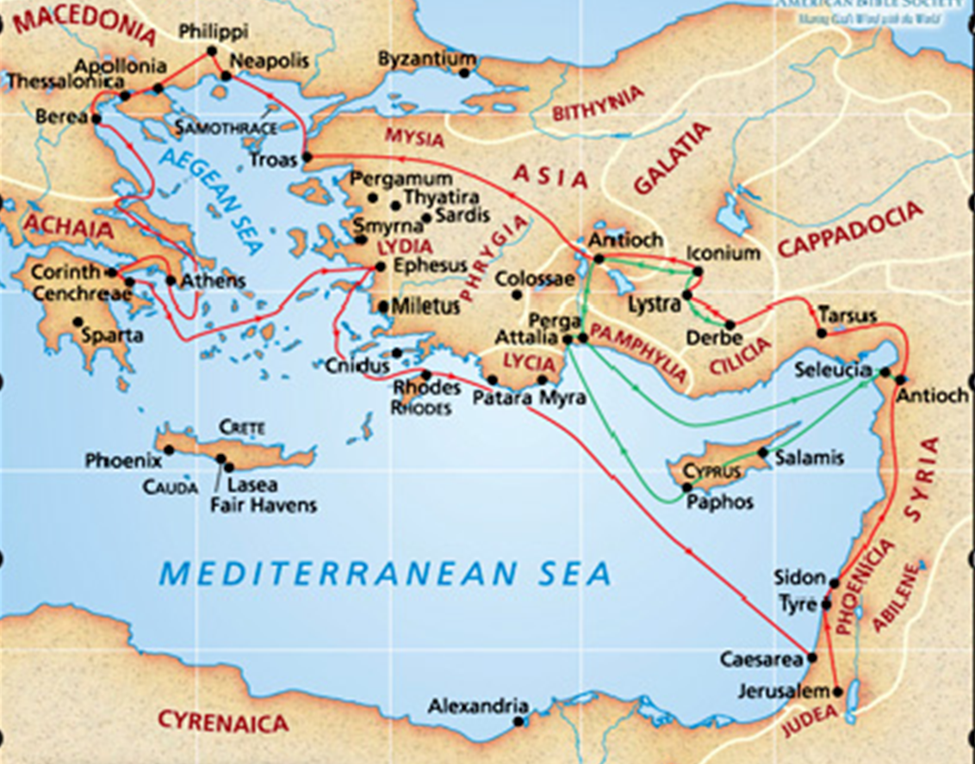
Acts 17:1 (NKJV) ¹ Now when they had passed through Amphipolis and Apollonia, they came to Thessalonica, where there was a synagogue of the Jews.
The journey from Philippi to Thessalonica was about 100 miles with Amphipolis and Apollonia at approximately 30-mile intervals on the Via Egnatia

Slide 8
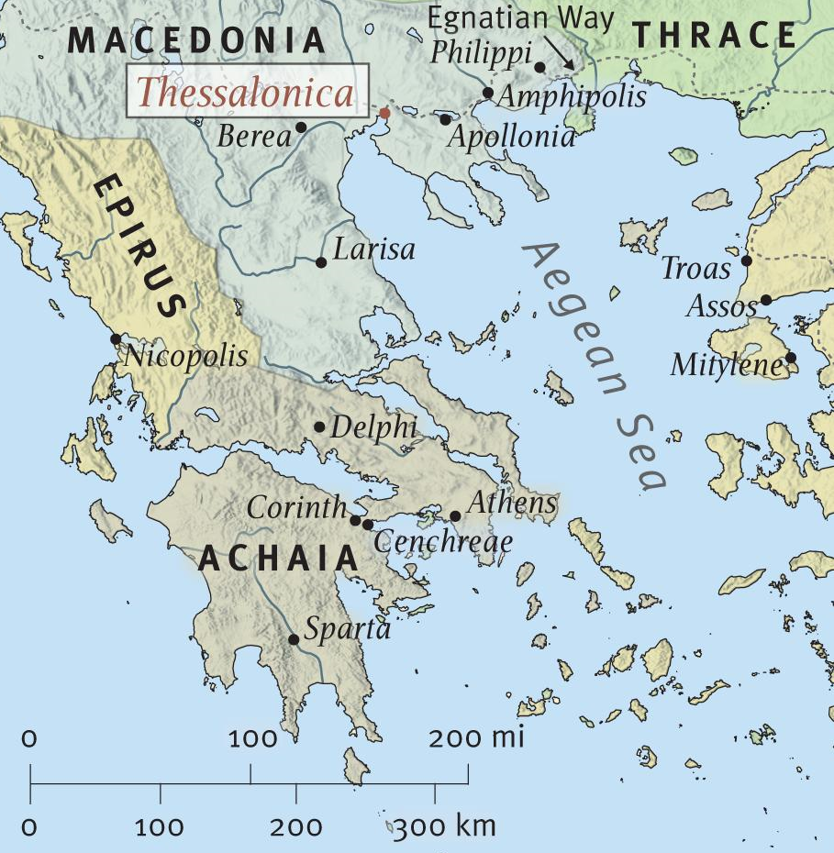
A seaport located at the head of the Themaic Gulf in Macedonia.
The largest city of Macedonia, with a population of ca. 200,000, The city was affectionately called the "mother of all Macedon."
It had been granted the status of a free city.

Slide 9
An immoral city - (1 Thes 1:9).
Large Jewish population with synagogue (Acts 17:1).
1st Thessalonians was written by Paul in 52 A.D. from Corinth and sent by Timothy, who returned with good news of their faith (Acts 18:1,5; 1 Thes. 3:1-8).

Slide 10
Examples of Conversions In Acts
Paul, Silas & Timothy at Thessalonica - (17:1-9)
Paul went into the Synagogue on the Sabbath for three weeks – as was his custom - (17:1,2)
Reasoned with them from the scriptures - (17:2).
Explaining & proving that Jesus is the promised Messiah & that He had to suffer, die & be raised from the dead - (17:3; cf Ps 22; Is 53).
Some were persuaded & joined them - (17:4).
Notes:
Before enter in Thessalonica Paul pass through Amphipolis and Apollonia, he did not stop in there but just pass by knowing that his mission was Thessalonica.
17:1 “through Amphipolis and Apollonia” These two cities were located on the Ignatian Way, a major east-west Roman
road of over 500 miles, which linked the eastern and western parts of the empire and which formed the main street of
Thessalonica.
“Christ had to suffer” The term “had” (dei) is an IMPERFECT ACTIVE INDICATIVE, which denotes necessity.
A suffering Messiah was predicted in the OT (cf. Gen. 3:15; Ps. 22; Isa. 52:13-53:12), but was never clearly seen by the rabbis.
It was forcibly asserted by Apostolic preachers (cf. Acts 3:18; 26:23; I Pet. 1:10-12). This truth was the major stumbling
block to the Jews (cf. I Cor. 1:22-23). See note at 3:18.
“where there was a synagogue” This was Paul’s pattern and sequence for proclamation (cf. v. 2; 3:26; 13:46; Rom. 1:16;
2:9,10; Acts 9:20; 13:5,14; 14:1; 17:2,10,17; 18:4,19; 19:8), probably because he felt the gospel was first for the Jews
because of OT prophecy. Also, many God-fearers also attended, knew, and respected the Old Testament.

Slide 11
Examples of Conversions In Acts
Paul, Silas & Timothy at Thessalonica - (17:1-9)
Unbelieving & envious Jews form a mob of evil men attempting to stop the spread of the gospel – (17:5)
Attacked the house of Jason who had welcomed Paul & his party - (17:5-7).
The power of the gospel to turn the world upside down - (17:6; Ro 1:16).
Accused Paul of teaching against Caesar saying “there is another king – JESUS” - (17:7,8; Lk 23:2; Jn 19:15)

Slide 12
Examples of Conversions In Acts
Paul, Silas & Timothy at Thessalonica - (17:1-9)
Received the word of God as God’s word - (1 Thes 1:6; 2:13)
Chosen by God, in that they heard, believed and obeyed the gospel -(1 Thes 1:4; 2 Thes 2:13-15).
Followed apostles and the Lord - Work of faith and labor of love – Truly repented - (1 Thes 1:3,6,9)
Evangelistic - Helped spread the gospel - (1 Thes 1:7-10)
Imitated the churches in Judea - (1 Thes 2:14)

Slide 13
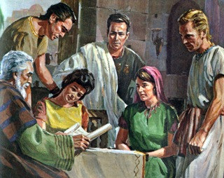
Examples of Conversions In Acts
Paul, Silas & Timothy at Berea - (17:10-15)
Sent away from Thessalonica by night - (17:10)
Went into the synagogue when they arrived at Berea - (17:10).
“These were more noble-minded” – (i.e., noble in character, honest, seeking what is true - 17:11)
They received the word with all readiness - (not gullible, but truth seekers – 17:11; cf. Acts 2:41)
Searched the scriptures daily - (17:11; John 5:39; 2 Tim 3:15-17)

Slide 14
Examples of Conversions In Acts
Paul, Silas & Timothy at Berea - (17:10-15)
Acts 17:11-12 (NKJV) ¹¹ These were more fair-minded than those in Thessalonica, in that they received the word with all readiness, and searched the Scriptures daily to find out whether these things were so.
¹² Therefore many of them believed, and also not a few of the Greeks, prominent women as well as men.

Slide 15
Examples of Conversions In Acts
Paul, Silas & Timothy at Berea - (17:10-15)
They heard the same gospel that those in Jerusalem, Samaria, Caesarea Philippi, Philippi and Thessalonica had heard –
They received the same gospel and believed the same gospel –
Wouldn’t it be reasonable, logical, and certain to conclude that they repented & were baptized just as the others? (Acts 2:41; Acts 8:12,13,37-39; 9:18; 22:16; 10:47,48; 16:15, 33)

Slide 16
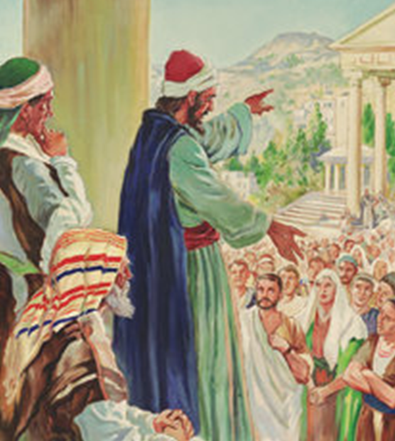
Examples of Conversions In Acts
Paul, Silas & Timothy at Athens - (17:16-34)
The city given over to idols – (Paul’s spirit was provoked - 17:16)
Reasoned with those in the synagogue – (both Jewish & Gentile worshippers – 17:17)
Reasoned daily in the marketplace with those who were there – (17:17)
Encounter with Epicurean and Stoic philosophers – Taken to Areopagus, “Hill of Ares” or “Mars Hill” so they could hear this new doctrine of Jesus and the resurrection –(17:18-21)
Notes:
Epicurean:

Slide 17
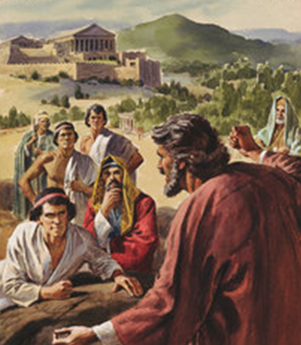
Examples of Conversions In Acts
Paul, Silas & Timothy at Athens - (17:16-34)
Encounter with Epicurean and Stoic philosophers – (17:18-21)
Epicurean: Pleasure, the highest end in loving - (generous, kindly, and patriotic - “eat, drink and be merry”)
Denied the world was created, matter is eternal,
Denied future retribution
Denied the immortality of the soul
Denied the gods exercised any providential control
Notes:
These were the followers of Epicurus, who acknowledged no gods except in name, and absolutely denied that they exercised any government over the world or its inhabitants; and that the chief good consisted in the gratification of the appetites of sense. These points the Epicureans certainly held; but it is not clear that Epicurus himself maintained such doctrines.

Slide 18
Examples of Conversions In Acts
Paul, Silas & Timothy at Athens - (17:16-34)
Encounter with Epicurean and Stoic philosophers – (17:18-21)
Stoic: The world was created by Zeus - All things were governed by the “Fates,” to whom Zeus himself was subject
Self-denial was thought to contribute to the highest end in life
affections were to be suppressed - apathy to pleasure or pain
mastery over all desires and lusts
Denied the immortality of the soul
Notes:
And certain Stoic....Who are these or what is this?
ZENO, the founder of the Stoic sect, was born in the isle of Cyprus, about thirty years before Christ. His disciples were called Stoics

Slide 19
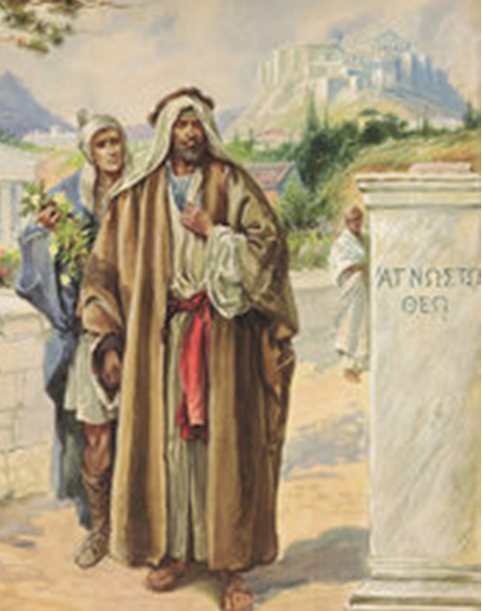
Examples of Conversions In Acts
Paul’s sermon on Mars Hill - (17:22-31)
He perceives the Athenians to be “very religious” – vs. 22
Idols representing all their “gods” lined the city road which Paul referred to as “objects of worship” - vs. 23
Among them was an idol labeled “To The Unknown God” - 23
Notes:
Epicurean:

Slide 20
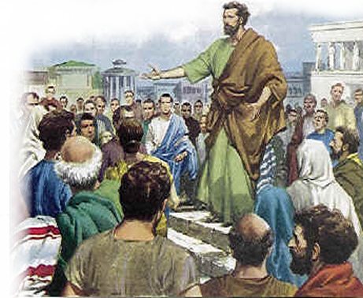
Examples of Conversions In Acts
Paul’s sermon on Mars Hill - (17:22-31)
“Therefore, the One whom you worship without knowing, Him I proclaim to you.”
“Made the world and everything in it…” - 24
“Lord of heaven and earth” – 24
“Does not dwell in temples made with hands” - 24
“Not worshiped with men’s hands…” - 25
“Made from one blood every nation of men…” - 26
“Determined man’s times and the boundaries” - 26
“He is not far from each of us” - 27
“In Him we live and move and have our being.” - 28
“Divine Nature – Spirit, creator, not created” - 29
Notes:
Epicurean:

Slide 21
Examples of Conversions In Acts
Paul’s sermon on Mars Hill - (17:22-31)
“Therefore, the One whom you worship without knowing, Him I proclaim to you.”
Acts 17:30-31 (NKJV) ³⁰ Truly, these times of ignorance God overlooked, but now commands all men everywhere to repent, ³¹ because He has appointed a day on which He will judge the world in righteousness by the Man whom He has ordained. He has given assurance of this to all by raising Him from the dead."
Notes:
Epicurean:

Slide 22
Examples of Conversions In Acts
Paul’s sermon on Mars Hill - (17:22-31)
“Therefore, the One whom you worship without knowing, Him I proclaim to you.”
Some mocked at the idea of the resurrection – 17:32
Some procrastinated – we’ll hear you again . . . 17:32
Some joined Paul and believed - Dionysius, an Areopagus member (i.e., a council member), and a woman named Damaris and others– 17:34
Notes:
Epicurean:

Slide 23
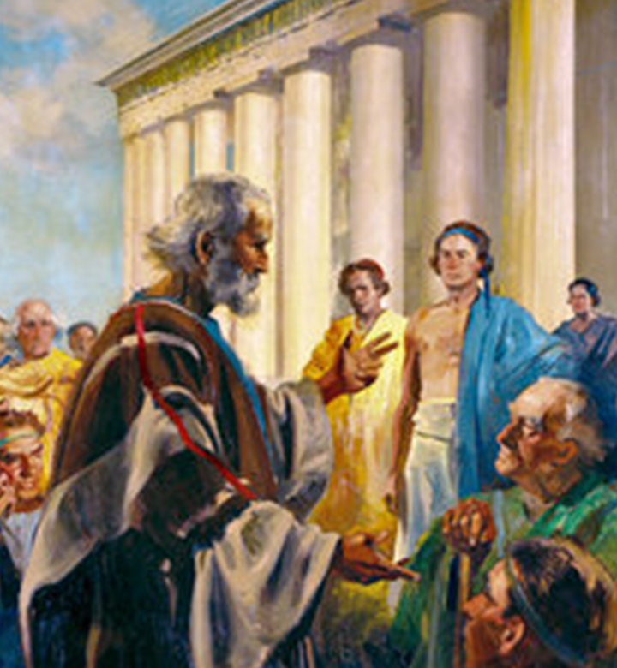
Examples of Conversions In Acts
Conversions In Thessalonica, Berea, & Athens - Acts 17:1-18:18
Some in Thessalonica were persuaded by the evidence – received the word, believed and sanctified by the Holy Spirit – Acts 17:4; 1 Thes 2:13,14; 2 Thes 2:13,14
Many in Berea heard with readiness, searched it out and received the gospel as the truth by obeying it – 17:11,12; Acts 2:41; 1 Pet, 1:22,23
There were some in Athens willing to receive the word of God, repent and join the disciples – 17:34; Acts 2:47;
Notes:
Acts 16:31 (NKJV) ³¹ So they said, "Believe on the Lord Jesus Christ, and you will be saved, you and your household."

Slide 24
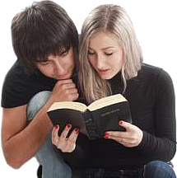
Receive The Word of God
Lessons & Applications
Not saved without hearing the gospel – (start where people are).
We must be truth seekers.
All saved the same way – hearing, believing, repenting, confessing, being baptized.
The gospel is for all!!
We will all stand before the judgment seat of Christ -

Slide 25
Have You Been Converted?
Do you believe that Jesus is the Christ, the Son of the Living God?
Have you confessed Jesus as the Christ?
Have you by faith, obeyed the truth in repentance and baptism? (1 Pet. 1:22,23)
You can leave this morning prepared for the coming judgment!

Slide 27
Receiving The Word of God
Conversions In
Thessalonica, Berea, & Athens Acts 17:1-34
Charts by Don McClain
Prepared August 20, 2011
Preached August 21, 2011
West 65th Street church of Christ
P.O. Box 190062
Little Rock AR 72219
501-568-1062
Prepared using PPT 2010 –
Email – donmcclain@sbcglobal.net
More PPT & Audio Sermons:
http://w65stchurchofchrist.org/donmaccla/2011SermonPage.html

Slide 28
1 Thessalonians 2:13-20 (NKJV) ¹³ For this reason we also thank God without ceasing, because when you received the word of God which you heard from us, you welcomed it not as the word of men, but as it is in truth, the word of God, which also effectively works in you who believe. ¹⁴ For you, brethren, became imitators of the churches of God which are in Judea in Christ Jesus. For you also suffered the same things from your own countrymen, just as they did from the Judeans,

Slide 29
1 Thessalonians 2:13-20 (NKJV) ¹⁵ who killed both the Lord Jesus and their own prophets, and have persecuted us; and they do not please God and are contrary to all men, ¹⁶ forbidding us to speak to the Gentiles that they may be saved, so as always to fill up the measure of their sins; but wrath has come upon them to the uttermost.

Slide 30
1 Thessalonians 2:13-20 (NKJV) ¹⁷ But we, brethren, having been taken away from you for a short time in presence, not in heart, endeavored more eagerly to see your face with great desire. ¹⁸ Therefore we wanted to come to you--even I, Paul, time and again--but Satan hindered us. ¹⁹ For what is our hope, or joy, or crown of rejoicing? Is it not even you in the presence of our Lord Jesus Christ at His coming? ²⁰ For you are our glory and joy.

