Slide 1
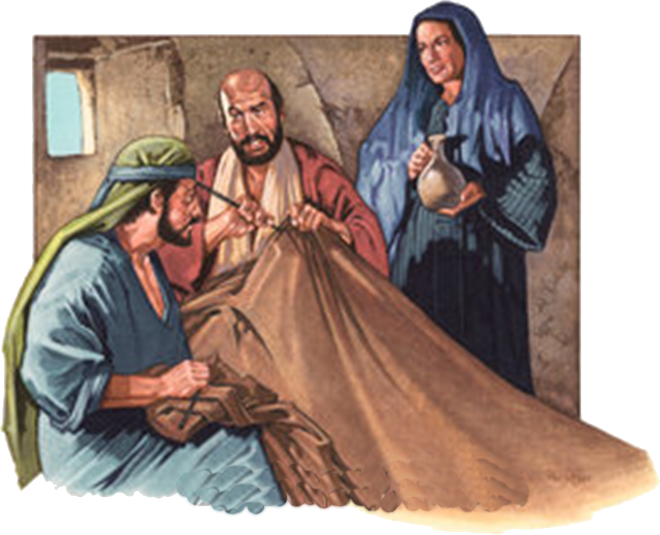
Examples of Conversions In Acts
Conversions In
Corinth . . . Acts 18:1-18

Slide 2
Examples of Conversions In Acts
Conversions In Corinth - Acts 18:1-18
Convert; Converted
transitive verb
1 - a : to bring over from one belief, view, or party to another b : to bring about a religious conversion in
2 - a : to alter the physical or chemical nature or properties of especially in manufacturing b (1) : to change from one form or function to another (2) : to alter for more effective utilization

Slide 3
Examples of Conversions In Acts
Conversions In Corinth - Acts 18:1-18
Convert; Converted
Matthew 18:3-4 (NKJV) ³ and said, "Assuredly, I say to you, unless you are converted and become as little children, you will by no means enter the kingdom of heaven. ⁴ Therefore whoever humbles himself as this little child is the greatest in the kingdom of heaven.

Slide 4
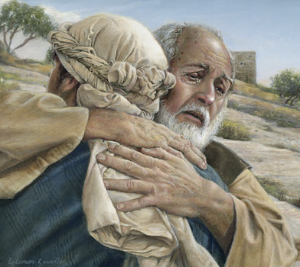
Examples of Conversions In Acts
Conversions In Corinth - Acts 18:1-18
Convert; Converted
Not merely a change in actions –
A change in knowledge –
A change in conviction -
A change in allegiance –
A change in thinking & will –
A change in commitment – resulting in a change in relationship & identity -
A change in who we are – how we talk – where we go – what we do -
Luke 15:11-24

Slide 5
Examples of Conversions In Acts
Conversions In Corinth - Acts 18:1-18
Psalm 19:7 (NKJV) ⁷ The law of the LORD is perfect, converting the soul; The testimony of the LORD is sure, making wise the simple;

Slide 6
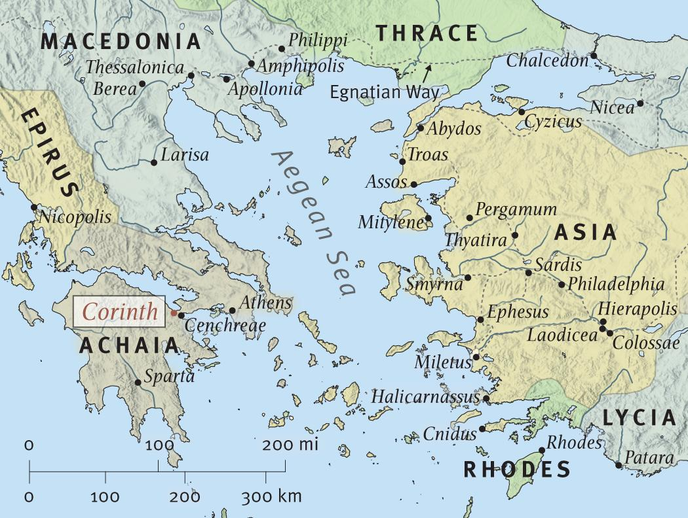
Lydia and a jailor hear the gospel, believes and are baptized –
Acts 16:11-34

Slide 7
Some in Thessalonica were persuaded & received the word of God, but the Jews reject it – Acts 17:1-9

Slide 8
Many in Berea heard with readiness, searched it out and received the gospel as the truth by obeying it – 17:10-14

Slide 9
The soil was more difficult in Athens - but some were willing to receive the word of God, repent and join the disciples – Acts 17:15-34

Slide 10
Acts 18:1 (NKJV) ¹ After these things Paul departed from Athens and went to Corinth.

Slide 11
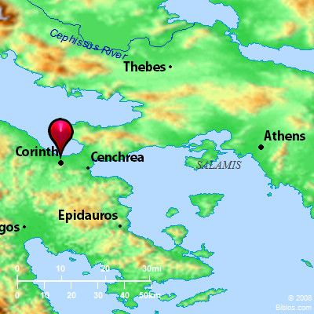
Examples of Conversions In Acts
Conversions In Corinth - Acts 18:1-18
Corinth was located on a narrow isthmus (4 miles wide) between the Agean and Adriatic Seas, about 50 miles west, south west of Athens.
Roman capital of Achaia – largest city in Greece at the time –
Center of trade and commerce -

Slide 12
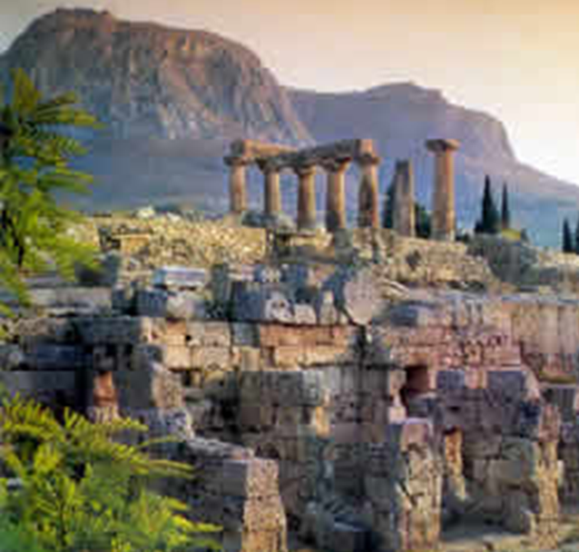
Examples of Conversions In Acts
Conversions In Corinth - Acts 18:1-18
It lay at the foot of Acrocorinth, an acropolis which rises precipitously to 1,886’
Upon which were many shrines to female deities , including the famous and wealthy temple of Aphrodite which was served by a thousand “religious prostitutes”

Slide 13
Examples of Conversions In Acts
Conversions In Corinth - Acts 18:1-18
A center of idolatry: Apollo, Poseidon, Aphrodite and others were worshipped in the many pagan temples.
Corinth had a reputation as a very wicked city; immorality was rampant.
“korinthiazo” – i.e. “to act like a Corinthian,” came to mean, “to commit fornication.”

Slide 14
Examples of Conversions In Acts
Conversions In Corinth - Acts 18:1-18
'"Corinth . . . was the Vanity Fair of the Roman empire... It was into the midst of this mongrel . . . population of Greek adventurers and Romans (middle class), with a tainting infusion of Phoenicians, this mass of Jews, ex-soldiers, philosophers, merchants, sailors, freedmen, slaves, tradespeople, hucksters, and agents of every form of vice"... where "Greeks, Latins, Syrians, Asiatics, Egyptians and Jews bought and sold, labored and revelled, quarreled and hob-nobbed, in its cities and its ports, as nowhere else in Greece."'
(McGuiggan pp. 5-6)

Slide 15
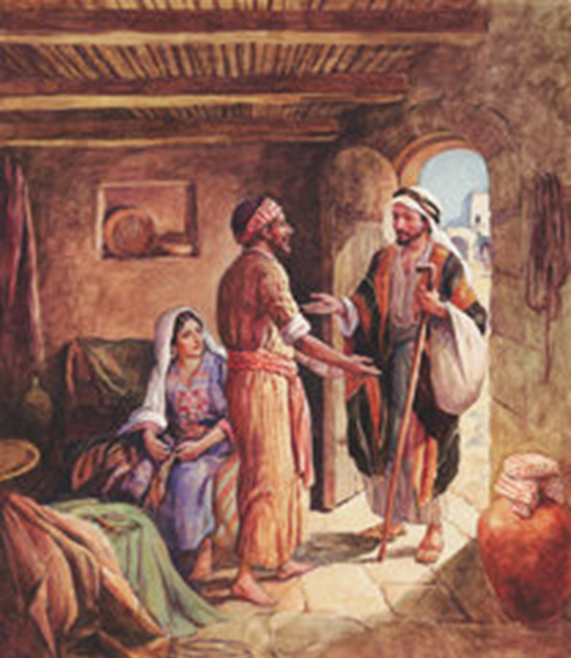
Examples of Conversions In Acts
Conversions In Corinth - Acts 18:1-18
Aquila & Priscilla - Acts 18:1-3
Aquila - a Jew, originally from Pontus, a province in northeast Asia Minor south of the Black Sea.
Aquila and Priscilla – had come from Italy, (Rome) because of an edict in A.D. 49 or 50 from Claudius for all the Jews to leave Rome,
Notes:
Acts 18:1-3 (NKJV) ¹ After these things Paul departed from Athens and went to Corinth. ² And he found a certain Jew named Aquila, born in Pontus, who had recently come from Italy with his wife Priscilla (because Claudius had commanded all the Jews to depart from Rome); and he came to them. ³ So, because he was of the same trade, he stayed with them and worked; for by occupation they were tentmakers.
Suetonius (a.d. 69?-140), a biographer of Roman emperors, referred to the constant riots of the Jews at the instigation of Chrestus.
Whether Aquila and Priscilla were Christians before they met Paul is not known. —

Slide 16
Examples of Conversions In Acts
Conversions In Corinth - Acts 18:1-18
Aquila & Priscilla - Acts 18:1-3
Paul stayed with them because they were tentmakers – (18:3)
Whether Aquila and Priscilla were Christians before they met Paul is not known - but they became Christians at some point – (18:18,26; Rom 16:3; 1 Cor. 16:19; 2 Tim 4:19)
Notes:
Acts 18:1-3 (NKJV) ¹ After these things Paul departed from Athens and went to Corinth. ² And he found a certain Jew named Aquila, born in Pontus, who had recently come from Italy with his wife Priscilla (because Claudius had commanded all the Jews to depart from Rome); and he came to them. ³ So, because he was of the same trade, he stayed with them and worked; for by occupation they were tentmakers.

Slide 17
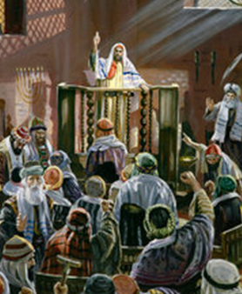
Examples of Conversions In Acts
Conversions In Corinth - Acts 18:1-18
Rejected By The Jews- Acts 18:4-6
Paul, as was his custom, began his work of evangelism in the synagogue - (cf. 9:20; 13:5, 14; 14:1; 17:2, 10, 17; 18:19; 19:8).
When Timothy and Silas arrived from Macedonia Paul was able to devote more time to preaching - (18:5, compare NASV; cf. 2 Cor. 11:8,9)
Acts 18:5 (NASB95) ⁵ But when Silas and Timothy came down from Macedonia, Paul began devoting himself completely to the word, solemnly testifying to the Jews that Jesus was the Christ.
Notes:
Acts 18:1-3 (NKJV) ¹ After these things Paul departed from Athens and went to Corinth. ² And he found a certain Jew named Aquila, born in Pontus, who had recently come from Italy with his wife Priscilla (because Claudius had commanded all the Jews to depart from Rome); and he came to them. ³ So, because he was of the same trade, he stayed with them and worked; for by occupation they were tentmakers.

Slide 18
Examples of Conversions In Acts
Conversions In Corinth - Acts 18:1-18
Rejected By The Jews- Acts 18:4-6
Acts 18:6 (NKJV) ⁶ But when they opposed him and blasphemed, he shook his garments and said to them, "Your blood be upon your own heads; I am clean. From now on I will go to the Gentiles."
Acts 13:45-51; Mat 10:14; Acts 20:26,27; Ez. 33:4-9
Notes:
Acts 18:1-3 (NKJV) ¹ After these things Paul departed from Athens and went to Corinth. ² And he found a certain Jew named Aquila, born in Pontus, who had recently come from Italy with his wife Priscilla (because Claudius had commanded all the Jews to depart from Rome); and he came to them. ³ So, because he was of the same trade, he stayed with them and worked; for by occupation they were tentmakers.

Slide 19
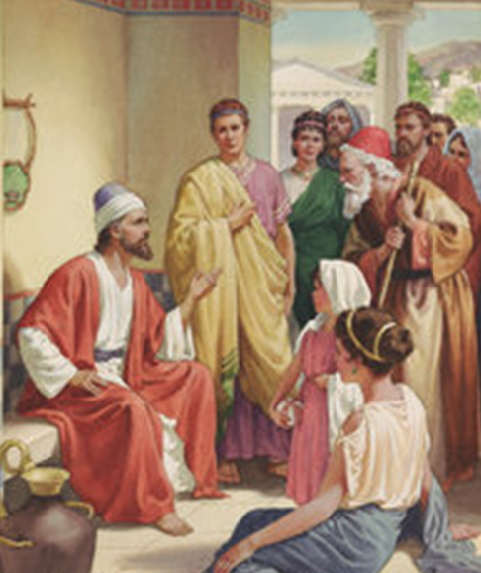
Examples of Conversions In Acts
Conversions In Corinth - Acts 18:1-18
Some Are Converted - Acts 18:7-8
Paul left the Synagogue and began teaching in the house of Titius Justus - (18:7 - probably a Gentile as he is called a worshipper of God – 10:2,22).
Crispus, the ruler of the synagogue, with all his house, along with many other Corinthians heard, believed and were baptized - (18:8)
Notes:
Acts 18:1-3 (NKJV) ¹ After these things Paul departed from Athens and went to Corinth. ² And he found a certain Jew named Aquila, born in Pontus, who had recently come from Italy with his wife Priscilla (because Claudius had commanded all the Jews to depart from Rome); and he came to them. ³ So, because he was of the same trade, he stayed with them and worked; for by occupation they were tentmakers.

Slide 20
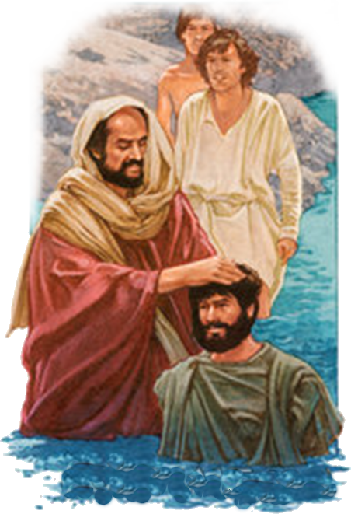
Examples of Conversions In Acts
Conversions In Corinth - Acts 18:1-18
Some Are Converted - Acts 18:7-8
Hearing – (every example in Acts – cf. Romans 10:9-17)
Believed – (John 3:16; 8:24; Heb 11:6)
And were Baptized – (Act 2:38; 8:12,38; 9:18; 22:16; 10:47,48; 16:15,33; Rom 6:3-6; 1 Cor. 1:14-17; 12:13; Gal 3:26,27; etc.)

Slide 21
Examples of Conversions In Acts
Conversions In Corinth - Acts 18:1-18
Some Are Converted - Acts 18:7-8
What About 1 Corinthians 1:17?
1 Corinthians 1:12-17 (NKJV) ¹² Now I say this, that each of you says, "I am of Paul," or "I am of Apollos," or "I am of Cephas," or "I am of Christ." ¹³ Is Christ divided? Was Paul crucified for you? Or were you baptized in the name of Paul? ¹⁴ I thank God that I baptized none of you except Crispus and Gaius, ¹⁵ lest anyone should say that I had baptized in my own name. ¹⁶ Yes, I also baptized the household of Stephanas. Besides, I do not know whether I baptized any other. ¹⁷ For Christ did not send me to baptize, but to preach the gospel, not with wisdom of words, lest the cross of Christ should be made of no effect.

Slide 22
Examples of Conversions In Acts
Conversions In Corinth - Acts 18:1-18
Some Are Converted - Acts 18:7-8
What About 1 Corinthians 1:17?
Paul did not die for them!
Paul did not baptize in his own name
Therefore: They could not be “of Paul”
JESUS DIED FOR THEM
They were baptized in the name of Christ
Therefore: They belonged to Christ!!
Two Things Essential To Be OF Christ
His Death – Baptized In His Name

Slide 23
Examples of Conversions In Acts
Conversions In Corinth - Acts 18:1-18
Some Are Converted - Acts 18:7-8
What About 1 Corinthians 1:17?
Paul did NOT make the cross of Christ of no effect when he baptized Crispus, Gaius and the house of Stephanas – (cf. Rom 6:3-6; Col. 2:12,13)
Every Christian in Corinth had been baptized – 1 Cor. 12:13
Paul did not baptize in his own name – (1 Cor. 1:15)
It’s not important who baptizes you –
but - by whose authority you are baptized!!

Slide 24
Examples of Conversions In Acts
Conversions In Corinth - Acts 18:1-18
Paul Encouraged - Acts 18:9-17
Acts 18:9-10 (NKJV) ⁹ Now the Lord spoke to Paul in the night by a vision, "Do not be afraid, but speak, and do not keep silent; ¹⁰ for I am with you, and no one will attack you to hurt you; for I have many people in this city."
Notes:
Acts 18:1-3 (NKJV) ¹ After these things Paul departed from Athens and went to Corinth. ² And he found a certain Jew named Aquila, born in Pontus, who had recently come from Italy with his wife Priscilla (because Claudius had commanded all the Jews to depart from Rome); and he came to them. ³ So, because he was of the same trade, he stayed with them and worked; for by occupation they were tentmakers.

Slide 25
Examples of Conversions In Acts
Conversions In Corinth - Acts 18:1-18
Paul Encouraged - Acts 18:9-17
Let us not be discouraged by lack of results – or rejection – if we preach the Gospel – plant the seed – God will give the increase - (1 Cor 3:7; Is. 55:11)
What may appear to be hard soil – may be receptive to the gospel – (Jews rejected – the immoral Gentiles accepted – 1 Cor. 6:9-11)
Notes:
Acts 18:1-3 (NKJV) ¹ After these things Paul departed from Athens and went to Corinth. ² And he found a certain Jew named Aquila, born in Pontus, who had recently come from Italy with his wife Priscilla (because Claudius had commanded all the Jews to depart from Rome); and he came to them. ³ So, because he was of the same trade, he stayed with them and worked; for by occupation they were tentmakers.

Slide 26
Examples of Conversions In Acts
Conversions In Corinth - Acts 18:1-18
Paul Encouraged - Acts 18:9-17
Paul continues in Corinth for a year and six months - (18:11; )
The Jews bring accusation against Paul to Gallio (18:12,13)
Gallio wants the Jews to deal with matters of their own law themselves – (18:14,15)
Sosthenes, the chief ruler of the synagogue, beaten before the judgment seat (18:16,17)
Notes:
Acts 18:1-3 (NKJV) ¹ After these things Paul departed from Athens and went to Corinth. ² And he found a certain Jew named Aquila, born in Pontus, who had recently come from Italy with his wife Priscilla (because Claudius had commanded all the Jews to depart from Rome); and he came to them. ³ So, because he was of the same trade, he stayed with them and worked; for by occupation they were tentmakers.

Slide 27
Conversions In Acts
Examples
Pentecost – 2:14-41
Samaria – 8:5-13
Eunuch – 8:35-39
Saul – 9,22,26
Cornelius - 10:34-48
Lydia – 16:13-15
Jailor – 16:30-34
Corinthians - 18:8
Ephesians - 19:3-5
Believed
Implied
12
36,37
Implied
43
14
31
8
Implied
Repented
37,38
Implied
Implied
Implied
Implied
Implied
Implied
Implied
Implied
Confessed
Implied
Implied
37
Implied
Implied
Implied
Implied
Implied
Implied
Baptized
38,41
12,13
38
9:18
48
15
33
8
5

Slide 28
Examples of Conversions In Acts
Conversions In Corinth - Acts 18:1-18
Lessons & Applications
The gospel may be rejected by those we think most likely to accept it – and accepted by those we think most likely to reject it –
To be free from the blood of others – we must do what we can to teach them
We must never tire of doing the Lord’s work –

Slide 29
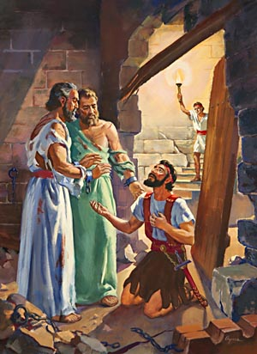
Have You Been Converted?
Have you heard, and do you believe that Jesus is the Christ, the Son of the Living God?
Have you confessed Jesus as the Christ?
Have you by faith, obeyed the truth in repentance and baptism? (1 Pet. 1:22,23)
You can be washed – sanctified and justified today of any & every sin! – 1 Cor. 6:11

Slide 31
Examples of Conversions In Acts
Conversions In Corinth - Acts 18:1-18
Charts by Don McClain
Prepared August 25-27, 2011
Preached August 28, 2011
West 65th Street church of Christ
P.O. Box 190062
Little Rock AR 72219
501-568-1062
Prepared using PPT 2010 –
Email – donmcclain@sbcglobal.net
More PPT & Audio Sermons:
http://w65stchurchofchrist.org/donmaccla/2011SermonPage.html

Slide 32
1 Corinthians 1:12-25 (NKJV) ¹² Now I say this, that each of you says, "I am of Paul," or "I am of Apollos," or "I am of Cephas," or "I am of Christ." ¹³ Is Christ divided? Was Paul crucified for you? Or were you baptized in the name of Paul?
¹⁴ I thank God that I baptized none of you except Crispus and Gaius, ¹⁵ lest anyone should say that I had baptized in my own name.

Slide 33
1 Corinthians 1:12-25 (NKJV) ¹⁶ Yes, I also baptized the household of Stephanas. Besides, I do not know whether I baptized any other. ¹⁷ For Christ did not send me to baptize, but to preach the gospel, not with wisdom of words, lest the cross of Christ should be made of no effect.

Slide 34
1 Corinthians 1:12-25 (NKJV) ¹⁸ For the message of the cross is foolishness to those who are perishing, but to us who are being saved it is the power of God. ¹⁹ For it is written: "I will destroy the wisdom of the wise, And bring to nothing the understanding of the prudent." ²⁰ Where is the wise? Where is the scribe? Where is the disputer of this age?

Slide 35
1 Corinthians 1:12-25 (NKJV) Has not God made foolish the wisdom of this world? ²¹ For since, in the wisdom of God, the world through wisdom did not know God, it pleased God through the foolishness of the message preached to save those who believe. ²² For Jews request a sign, and Greeks seek after wisdom;

Slide 36
1 Corinthians 1:12-25 (NKJV) ²³ but we preach Christ crucified, to the Jews a stumbling block and to the Greeks foolishness, ²⁴ but to those who are called, both Jews and Greeks, Christ the power of God and the wisdom of God. ²⁵ Because the foolishness of God is wiser than men, and the weakness of God is stronger than men.

