Slide 1
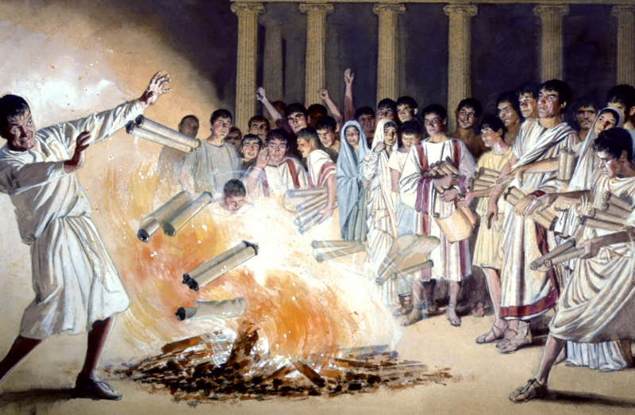
Examples of Conversions In Acts
Conversions In
Ephesus . . . Acts 18:18-19:41

Slide 2
Examples of Conversions In Acts
Conversions In Corinth - Acts 18:1-18
Convert; Converted
To bring over from one belief, view, or party to another -
To change from one form or function to another

Slide 3
Examples of Conversions In Acts
Conversions In Corinth - Acts 18:1-18
Convert; Converted
Matthew 18:3-4 (NKJV) ³ and said, "Assuredly, I say to you, unless you are converted and become as little children, you will by no means enter the kingdom of heaven. ⁴ Therefore whoever humbles himself as this little child is the greatest in the kingdom of heaven.

Slide 4
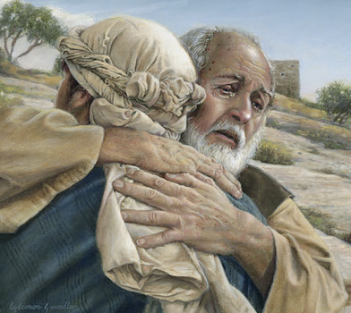
Examples of Conversions In Acts
Conversions In Corinth - Acts 18:1-18
Convert; Converted
Not merely a change in actions –
A change in knowledge –
A change in conviction -
A change in allegiance –
A change in thinking & will –
A change in commitment – resulting in a change in relationship & identity -
A change in who we are – how we talk – where we go – what we do -
Luke 15:11-24

Slide 5
Examples of Conversions In Acts
Conversions In Corinth - Acts 18:1-18
Psalm 19:7 (NKJV) ⁷ The law of the LORD is perfect, converting the soul; The testimony of the LORD is sure, making wise the simple;

Slide 6
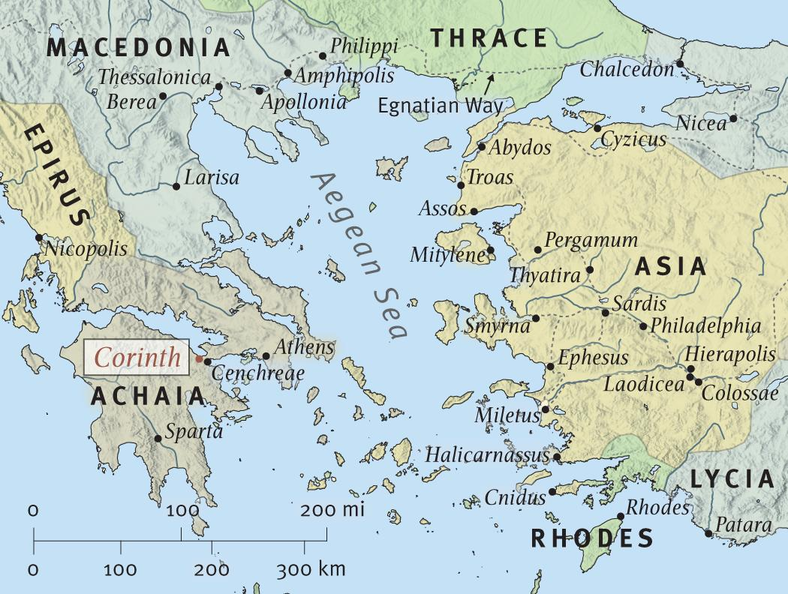
Lydia and a jailor hear the gospel, believes and are baptized –
Acts 16:11-34

Slide 7
Some in Thessalonica were persuaded & received the word of God, but the Jews reject it – Acts 17:1-9

Slide 8
Many in Berea heard with readiness, searched it out and received the gospel as the truth by obeying it – 17:10-14

Slide 9
The soil was more difficult in Athens - but some were willing to receive the word of God, repent and join the disciples – Acts 17:15-34

Slide 10
Acts 18:1 (NKJV) ¹ After these things Paul departed from Athens and went to Corinth.

Slide 11
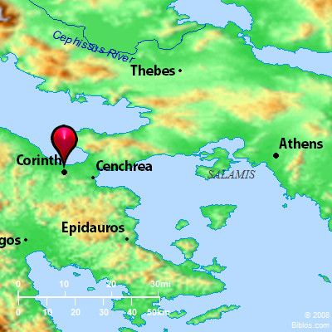
Acts 18:18-19 (NKJV) ¹⁸ So Paul still remained a good while. Then he took leave of the brethren and sailed for Syria, and Priscilla and Aquila were with him. He had his hair cut off at Cenchrea, for he had taken a vow.

Slide 12
Acts 18:18-19 (NKJV) ¹⁹ And he came to Ephesus, and left them there; but he himself entered the synagogue and reasoned with the Jews.

Slide 13
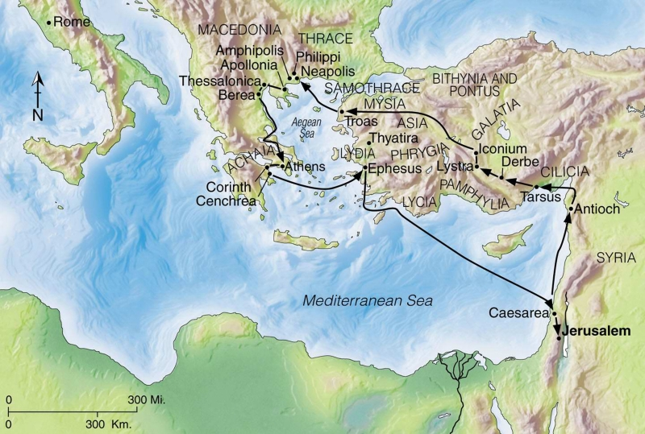
Acts 18:21-22 (NKJV) ²¹ but took leave of them, saying, "I must by all means keep this coming feast in Jerusalem; but I will return again to you, God willing." And he sailed from Ephesus. ²² And when he had landed at Caesarea, and gone up and greeted the church, he went down to Antioch.

Slide 14
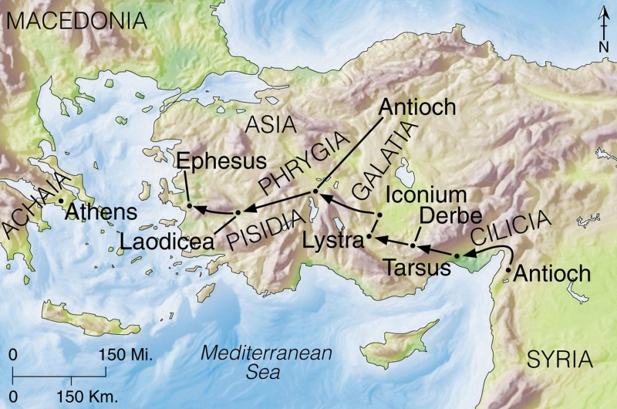
Acts 18:23 (NKJV) ²³ After he had spent some time there, he departed and went over the region of Galatia and Phrygia in order, strengthening all the disciples. . . . ¹ And it happened, while Apollos was at Corinth, that Paul, having passed through the upper regions, came to Ephesus. . . .
Third Preaching Journey (18:23-21:15).
A.D. 54 through 58 – 2,800-3,000 Miles
Notes:
A.D. 54 through 58 Begins Acts 18:23 Ends Acts 21:17 2800-3000 miles
The third missionary journey would prove to be the longest of Paul's trips, lasting from approximately AD 54 through AD 58, and ending with his arrest in Jerusalem. Paul began his third mission tour as he did the second, by re-visiting some previously established churches and strengthening the believers there.
Paul started his third journey after a stay in Antioch of probably a year or two (18:23). This new trip begins with him going through Galatia and Phrygia, where there were now numerous Christians, to strengthen and encourage them before moving on. It is always good to take note of the example that Paul and the others set in continually making efforts to strengthen the saved. They do not simply convert as many persons as possible and then leave them on their own in order to continue racking up more numbers - rather, they have a strong commitment to making sure that they have what they need to remain faithful for a lifetime.

Slide 15
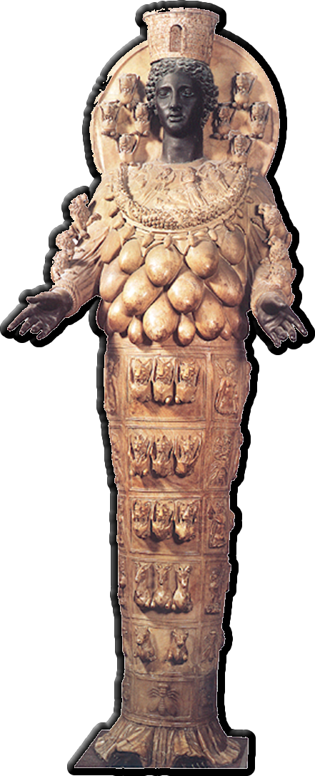
Examples of Conversions In Acts
Background Information of Ephesus
Ephesus was an illustrious city in its day, capital of the Roman province of Asia, in the district called Ionia, an important commercial city.
Magical arts were prevalent in Ephesus as evidenced by the number and value of books burned – (19:19)
The temple erected to the goddess Diana {Artemis) - an entire industry had grown up around it, making and selling idols & “portable shrines.” – (19:23-41)
Notes:
The passage tells of seven sons of a Jewish priest who were apparently exorcists who tried to cast out an evil spirit using Jesus' name in a magical way. The demon-possessed man beat and stripped all seven! The demonic activity this suggests was very likely stimulated by the devotion of many in Ephesus to occult practices. Many who were now Christians had been involved in such evil, and those who had practiced sorcery publicly burned books of magic worth in our day some $2.5 million! In a city where Satan had gained a foothold and the supernatural was a dominating theme, God's Spirit performed miracles that demonstrated Jesus' power over supernatural powers!— Teacher's Commentary

Slide 16
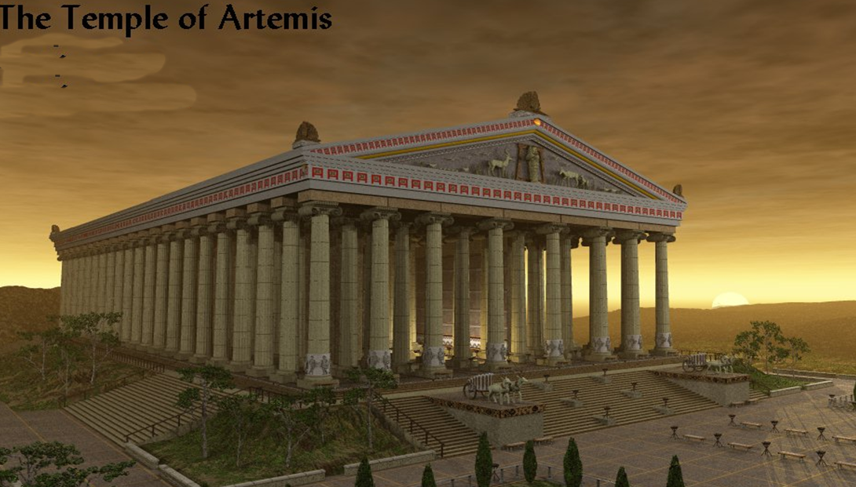
Examples of Conversions In Acts
Temple of Diana (Artemis)
Made of marble
130 x 60 yards
127 massive ionic columns 60 feet tall.
4 times larger than the Parthenon in Athens
Under construction in 333 BC when Alexander the Great arrived.
One of the seven Wonders of the Ancient World,
Notes:
Temple of Diana - Ephesus
A rusty sign and some broken columns stacked on a crude cement base commemorate Ephesus Temple of Diana. During Ephesus' heyday, the Temple of Diana covered 130 x 60 yards. Each of the Temple of Diana's 127 massive ionic columns were 60 feet tall. Deemed one of the seven Wonders of the Ancient World, the Temple of Diana in Ephesus was 4 times larger than the Parthenon in Athens. Ephesus' Temple of Diana actually started as the Temple of Artemis, the Greek goddess. By the 1st century AD, however, Romans ruled Ephesus and substituted their goddess Diana for Artemis. The substitution of Diana appears to have been fine with Ephesus' silversmiths as long as they could continue to peddle miniature copies of the Temple of Diana / Artemis. Their profit margin appears to have been squeezed, however, when Paul came to Ephesus and preached against idolatry:

Slide 17
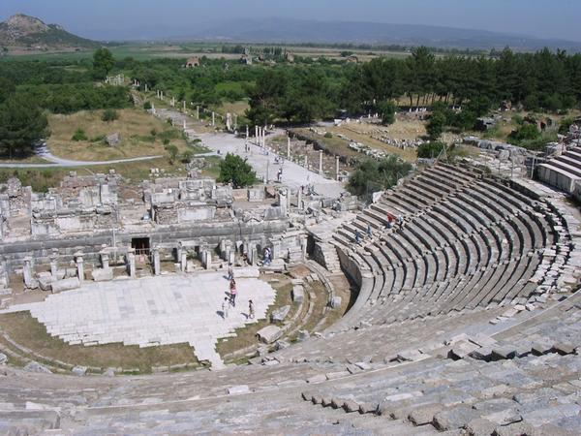
Examples of Conversions In Acts
Significance of Ephesus In NT
Paul’s first visit – Acts 18:19
Aquila and Priscilla corrects Apollos in Ephesus – Act 18:24-28
Paul returns and stays for three years – Acts 20:31
Timothy in Ephesus - 1 Tim. l:3, 20; 2 Tim.1:15-18; 4:12, 14 19;
Book of Ephesians written by Paul from prison in about 61 or 62 AD;
The Lord addresses the church - Revelation 2:1-7
Notes:
Acts 18:18-28 (NKJV) ¹⁸ So Paul still remained a good while. Then he took leave of the brethren and sailed for Syria, and Priscilla and Aquila were with him. He had his hair cut off at Cenchrea, for he had taken a vow. ¹⁹ And he came to Ephesus, and left them there; but he himself entered the synagogue and reasoned with the Jews. ²⁰ When they asked him to stay a longer time with them, he did not consent, ²¹ but took leave of them, saying, "I must by all means keep this coming feast in Jerusalem; but I will return again to you, God willing." And he sailed from Ephesus. ²² And when he had landed at Caesarea, and gone up and greeted the church, he went down to Antioch. ²³ After he had spent some time there, he departed and went over the region of Galatia and Phrygia in order, strengthening all the disciples. ²⁴ Now a certain Jew named Apollos, born at Alexandria, an eloquent man and mighty in the Scriptures, came to Ephesus. ²⁵ This man had been instructed in the way of the Lord; and being fervent in spirit, he spoke and taught accurately the things of the Lord, though he knew only the baptism of John. ²⁶ So he began to speak boldly in the synagogue. When Aquila and Priscilla heard him, they took him aside and explained to him the way of God more accurately. ²⁷ And when he desired to cross to Achaia, the brethren wrote, exhorting the disciples to receive him; and when he arrived, he greatly helped those who had believed through grace; ²⁸ for he vigorously refuted the Jews publicly, showing from the Scriptures that Jesus is the Christ.

Slide 18
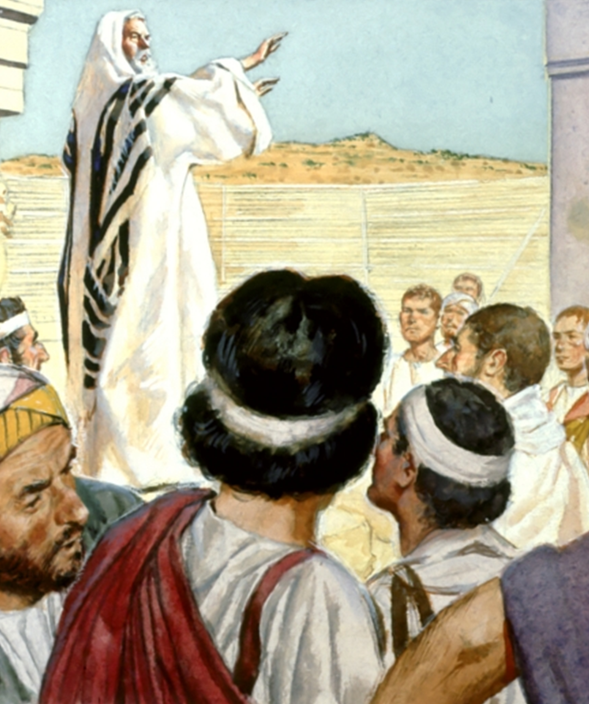
Examples of Conversions In Acts
Conversions In Ephesus - Acts 19
Paul Finds Some Disciples – 1-7
Paul on meeting them asks about the Holy Ghost and questions their baptism – 2
They explain they had been baptized “Unto John’s baptism.” - 3
Paul, after further instructing them, baptizes them “in the name of the Lord Jesus” – 4-7

Slide 19
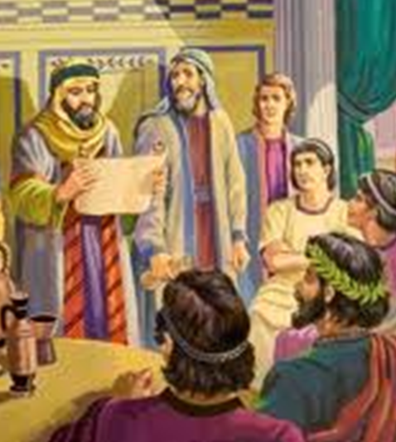
Examples of Conversions In Acts
Conversions In Ephesus - Acts 19
Paul In The Synagogue And In The School Of Tyrannus - 8-10
Paul taught in the synagogue for three months - “disputing and persuading” - 8
Paul’s message: THE KINGDOM OF GOD! – Many Jews hardened their hearts and spoke evil of THE WAY - 9
Paul moved on to the school of Tyrannus, and taught there for 2 years – 9,10

Slide 20
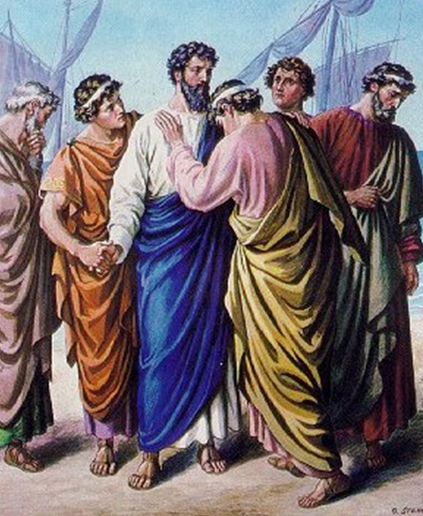
Examples of Conversions In Acts
Conversions In Ephesus - Acts 19
The Miracles Of Paul At Ephesus - 11-16
Healing takes place from cloths - note that Luke calls these “special miracles” – 11,12
Certain “Jews” invoked the name of Jesus in an attempt to cast out demons – 13,14
Jesus and Paul were known by the demons - 15
Jews were overcome and fled naked and wounded – 16

Slide 21
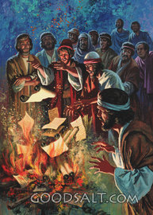
Examples of Conversions In Acts
Conversions In Ephesus - Acts 19
The Results Of Paul’s Work - 17-20
Two reactions: FEAR and the name of Jesus MAGNIFIED! - 17
Many that believed confessed, and told their deeds - 18
Those who practiced “magic arts” Burned their books (app. $2.5 mil) - 19
“So mightily grew the word of God and prevailed” - 20

Slide 22
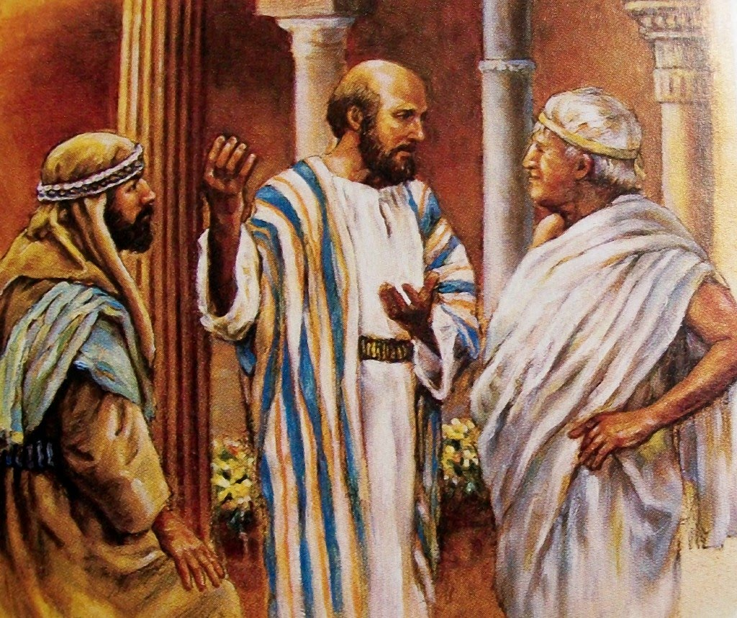
Examples of Conversions In Acts
Conversions In Ephesus - Acts 19
Paul’s Future Plans - 21-22
Paul planned to leave Asia soon and pass again through Macedonia & Achaia on his way to Jerusalem, desiring also to “see Rome.’ – 21
Paul sends Timothy and Erastus, ahead but he himself stayed in Asia for a time – 22

Slide 23
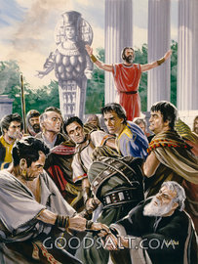
Examples of Conversions In Acts
Conversions In Ephesus - Acts 19
The Riot In Ephesus - 23-41
An instigator by the name of Demetrius rallied the people against the disciples because the gospel threatened their business – 23-28
Two of Paul’s traveling companions are caught – 29-32 - GAIUS - (20:4; 1 Cor. 1:14; Rom. 16:23) and ARISTARCHUS (20:4, 27; Col 4:10; Phil 2:4)

Slide 24
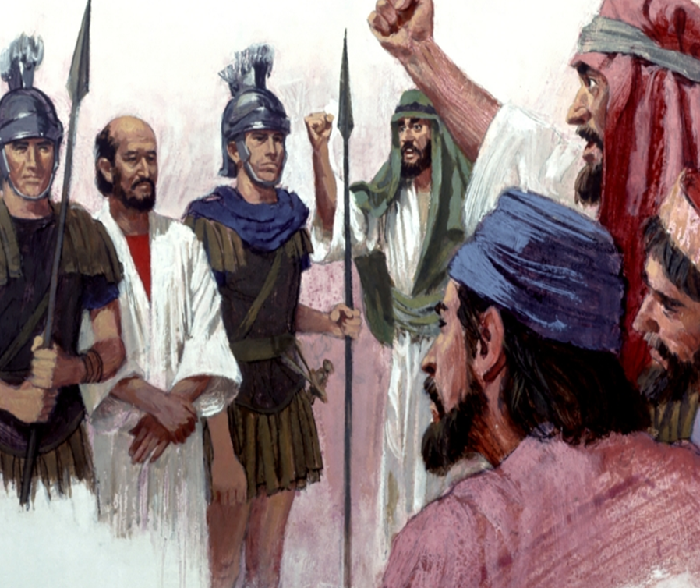
Examples of Conversions In Acts
Conversions In Ephesus - Acts 19
The Riot In Ephesus - 23-41
The Jews put forth one Alexander, but he is “shouted down.” For two hours, the mob rules! – 33-34
The town clerk of Ephesus calms the situation, and dismissed the assembly – 35-41

Slide 25
Examples of Conversions In Acts
Conversions In Ephesus - Acts 19
Twelve Men Baptized Again – 1-7
Paul’s first question and their answer – vs. 2
Paul knew that something was wrong with their conversion since they knew nothing of the Holy Spirit! - Mat 28:18-20
Paul’s second question and their response – vs 3

Slide 26
Examples of Conversions In Acts
Conversions In Ephesus - Acts 19
Twelve Men Baptized Again – 1-7
Paul’s second question and their response – “into what then were you baptized?” . . . “Into John’s baptism.” - vs 3
Notice what his question was and what it was not -
Paul's question implies that it is important what one "knows, understands, & believes” when baptized!

Slide 27
Examples of Conversions In Acts
Conversions In Ephesus - Acts 19
Twelve Men Baptized Again – 1-7
They had been baptized – but their baptism was not effective – vs. 3,4
Temporarily authorized by God - Mt 21:25-27; Luke 7:30
John’s baptism was “unto the remission of sins” – Mark 1:4; Lukek 3:3
John’s baptism was pointing to Christ and His kingdom – Acts 19:4; Mat 3:1-12

Slide 28
Examples of Conversions In Acts
Conversions In Ephesus - Acts 19
Twelve Men Baptized Again – 1-7
They had not been baptized into the Lord Jesus – Rom. 6:3-6; Gal. 3:26,27
They had not been added to the Lord’s church – Acts 2:47; 1 Cor. 12:13
Even though they had been baptized – they were STILL needing their sins washed away and added to the church.

Slide 29
Examples of Conversions In Acts
Conversions In Ephesus - Acts 19
Twelve Men Baptized Again – 1-7
Since the baptism of John was insufficient to save – How can denominational baptism save?
Not for Remission of sins;
Not unto salvation;
Not into Christ;
Often Not immersion;
False doctrine regarding the church, kingdom, salvation, godhead, etc.

Slide 30
Examples of Conversions In Acts
Conversions In Ephesus - Acts 19
Twelve Men Baptized Again – 1-7
They were baptized AGAIN in the name of the Lord Jesus . . .
By His authority – the baptism taught by Jesus and commanded by His apostles – Mat 28:19; Mark 16:16; Acts 2:38; 8:12; 10:47,48
Only one effective baptism – Acts 19:5; Eph. 4:5

Slide 31
Conversions In Acts
Examples
Pentecost – 2:14-41
Samaria – 8:5-13
Eunuch – 8:35-39
Saul – 9,22,26
Cornelius - 10:34-48
Lydia – 16:13-15
Jailor – 16:30-34
Corinthians - 18:8
Ephesians - 19:3-5
Believed
Implied
12
36,37
Implied
43
14
31
8
Implied
Repented
37,38
Implied
Implied
Implied
Implied
Implied
Implied
Implied
Implied
Confessed
Implied
Implied
37
Implied
Implied
Implied
Implied
Implied
Implied
Baptized
38,41
12,13
38
9:18
48
15
33
8
5

Slide 32
Examples of Conversions In Acts
Conversions In Corinth - Acts 18:1-18
Lessons & Applications
Strong faith and honest convictions, when possessed in error, are not enough to be obedient and pleasing to the Lord.
One cannot be taught error pertaining to one’s salvation, (including baptism), believe that error, and then be obedient to the Lord.

Slide 33
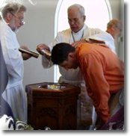
Examples of Conversions In Acts
Conversions In Ephesus - Acts 19
Into What Were You Baptized?
If baptized as an infant or small child? - Mark 16:16; Rom. 10:14-17; Acts 8:37
If “baptized” by sprinkling or pouring? – Rom. 6:3-6; Col. 2:11-13; Acts 8:38,39
If baptized 'because' already saved? – Mk 16:16; Acts 2:38; 22:16; 1 Peter 3:21
If baptized into a denominational church? Acts 2:38,47; 8:35-39; 1 Cor. 12:13 . . .
If baptized to please parents or friends – Rom. 6:3-6, 16-18; Gal. 3:26,27
Notes:
Do You Need To Be Baptized Again?

Slide 34
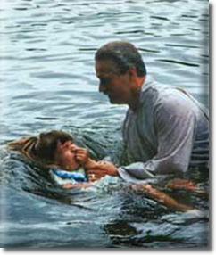
Examples of Conversions In Acts
Conversions In Ephesus - Acts 19
Do You Need To Be Baptized Again?
Maybe you believe that you were baptized unto the remission of sins, but what did you know about the Lord's church – (Acts 8:12; 1 Cor 12:13; Rom 6:3-6; Gal. 3:26,27)
Were the men who Paul met baptized unto the remission of sins?
Were they baptized to obey God?
Were they sincere when they were baptized?
Were they humble enough to submit to the truth when they learned it?
Notes:
Do You Need To Be Baptized Again?

Slide 35
Examples of Conversions In Acts
Conversions In Corinth - Acts 18:1-18
Lessons & Applications
The Lord should be respected with reverence and obeyed!
Repentance is not just a change of mind – but a change of actions.
Although societal change is NOT the main objective of the gospel – It is a powerful force for change in society

Slide 36
Examples of Conversions In Acts
Conversions In Corinth - Acts 18:1-18
Lessons & Applications
Those baptized, but not according to the authority of Jesus Christ, has a need to submit to the Lord's commands and be baptized in the name, (authority) of Jesus Christ.
Those who have been baptized correctly must put away sin from themselves.

Slide 37
Have You Been Converted?
Have you heard, and do you believe that Jesus is the Christ, the Son of the Living God?
Have you confessed Jesus as the Christ?
Have you by faith, obeyed the truth in repentance and baptism? (1 Pet. 1:22,23)
Have you been baptized into the body of Christ? – Rom. 6:3-6; Gal. 3:26,27; 1 Cor 12:13

Slide 39
Examples of Conversions In Acts
Conversions In Ephesus - Acts 19
Charts by Don McClain
Prepared September 1-3, 2011
Preached September 4, 2011
West 65th Street church of Christ
P.O. Box 190062
Little Rock AR 72219
501-568-1062
Prepared using PPT 2010 –
Email – donmcclain@sbcglobal.net
More PPT & Audio Sermons:
http://w65stchurchofchrist.org/donmaccla/2011SermonPage.html

Slide 40
Ephesians 2:1-10 (NKJV) ¹ And you He made alive, who were dead in trespasses and sins, ² in which you once walked according to the course of this world, according to the prince of the power of the air, the spirit who now works in the sons of disobedience, ³ among whom also we all once conducted ourselves in the lusts of our flesh, fulfilling the desires of the flesh and of the mind, and were by nature children of wrath, just as the others. ⁴ But God, who is rich in mercy, because of His great love with which He loved us,

Slide 41
Ephesians 2:1-10 (NKJV) ⁵ even when we were dead in trespasses, made us alive together with Christ (by grace you have been saved), ⁶ and raised us up together, and made us sit together in the heavenly places in Christ Jesus, ⁷ that in the ages to come He might show the exceeding riches of His grace in His kindness toward us in Christ Jesus. ⁸ For by grace you have been saved through faith, and that not of yourselves; it is the gift of God, ⁹ not of works, lest anyone should boast. ¹⁰ For we are His workmanship, created in Christ Jesus for good works, which God prepared beforehand that we should walk in them.

