Slide 1
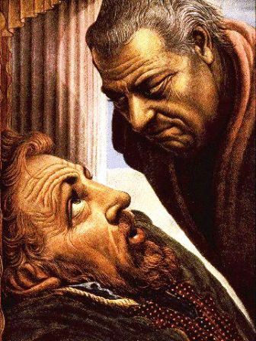
Are You The Man?
2 Samuel 12:7 (NKJV) ⁷ Then Nathan said to David, "You are the man! Thus says the LORD God of Israel: 'I anointed you king over Israel, and I delivered you from the hand of Saul.

Slide 2
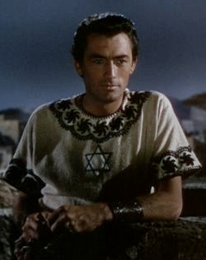
Are You The Man?
David’s Sin
2 Samuel 11
Was Idle – vs. 1
Saw & Beheld – vs. 2
Inquired & Committed Adultery – vs. 3,4
Bathsheba Conceives – vs. 5
Prideful Shame & Cover Up – vs. 5-27
Tries to get Uriah to go in to Bathsheba – vs. 6-13
Murders Uriah – vs. 14-25

Slide 3
Are You The Man?
2 Samuel 12:1-15 (NKJV) ¹ Then the LORD sent Nathan to David. And he came to him, and said to him: "There were two men in one city, one rich and the other poor. ² The rich man had exceedingly many flocks and herds. ³ But the poor man had nothing, except one little ewe lamb which he had bought and nourished; and it grew up together with him and with his children. It ate of his own food and drank from his own cup and lay in his bosom; and it was like a daughter to him..

Slide 4
Are You The Man?
2 Samuel 12:1-15 (NKJV) ⁴ And a traveler came to the rich man, who refused to take from his own flock and from his own herd to prepare one for the wayfaring man who had come to him; but he took the poor man's lamb and prepared it for the man who had come to him." ⁵ So David's anger was greatly aroused against the man, and he said to Nathan, "As the LORD lives, the man who has done this shall surely die! ⁶ And he shall restore fourfold for the lamb, because he did this thing and because he had no pity."

Slide 5
Are You The Man?
2 Samuel 12:1-15 (NKJV) ⁷ Then Nathan said to David, "You are the man! Thus says the LORD God of Israel: 'I anointed you king over Israel, and I delivered you from the hand of Saul. ⁸ I gave you your master's house and your master's wives into your keeping, and gave you the house of Israel and Judah. And if that had been too little, I also would have given you much more!
⁹ Why have you despised the commandment of the LORD, to do evil in His sight?

Slide 6
Are You The Man?
2 Samuel 12:1-15 (NKJV) You have killed Uriah the Hittite with the sword; you have taken his wife to be your wife, and have killed him with the sword of the people of Ammon. ¹⁰ Now therefore, the sword shall never depart from your house, because you have despised Me, and have taken the wife of Uriah the Hittite to be your wife.' ¹¹ Thus says the LORD: 'Behold, I will raise up adversity against you from your own house; and I will take your wives before your eyes and give them to your neighbor, and he shall lie with your wives in the sight of this sun.

Slide 7
Are You The Man?
2 Samuel 12:1-15 (NKJV) ¹² For you did it secretly, but I will do this thing before all Israel, before the sun.' " ¹³ So David said to Nathan, "I have sinned against the LORD." And Nathan said to David, "The LORD also has put away your sin; you shall not die. ¹⁴ However, because by this deed you have given great occasion to the enemies of the LORD to blaspheme, the child also who is born to you shall surely die." ¹⁵ Then Nathan departed to his house. And the LORD struck the child that Uriah's wife bore to David, and it became ill.

Slide 8
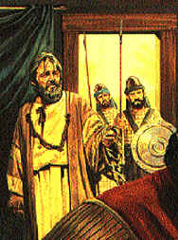
Are You The Man?
Nathan’s Rebuke
2 Samuel 12:1-15
Nathan was sent – vs. 1
Nathan’s Parable – vs. 1-4
David Saw The Guilt In Another That He Would Not See In Himself – vs. 5,6
Nathan Makes The Point Clear – vs. 7-12
David Repents, Confesses & Is Pardoned – vs. 13
David’s Sin Had Temporal Consequences – vs. 14

Slide 9
Are You The Man?
Lessons To Learn
2 Samuel 12:1-15
God’s Word Has Been Revealed – (vs. 1; Heb. 1:1,2; 4:12; 2 Tim 3:16,17; James 1:21-25)
We Should Strive To Present The Gospel In A Way That It CAN Be Understood – (vs. 2-4; Parables! – Eph. 3:3-5; 4:15; Col. 4:6; Prov. 16:21-24)
We Are Often Blinded To Our Own Faults & Sin – (vs. 5,6; Mat. 7:1-6; Rom. 2:1; Gen 3:9-13)

Slide 10
Are You The Man?
Lessons To Learn
2 Samuel 12:1-15
The Need To Be Direct In Making Application – (vs. 7; Acts 2:36; 4:11,12; 5:30,31; 7:51; 24:25)
The Attitude We Ought To Have Towards Our Sin – (Ps. 51:1-12)
God Will Pardon The Penitent – (vs. 13; Ezekiel 18:20-32; Acts 2:38; 22:16; 1 John 1:9)
Consequences Of Sin Often Follow Despite Pardon – (10-12, 14, 16-23; 13:1-14; 15,16; Gal. 6:7-9)

Slide 11
Are You The Man?
Matthew 13:18-23 (NKJV) ¹⁸ "Therefore hear the parable of the sower: ¹⁹ When anyone hears the word of the kingdom
Wayside Soil
Rejects
Does Not Receive
Rocky Soil
Receives
Falls Away
Good Soil
Thorny Soil
Receives
Bears No Fruit
Receives
Bears Fruit
Notes:
Wayside Soil Rocky Soil Thorny Soil Good Soil
Rejects / Does Not Receive Receives But Falls Away Receives / But Choked Receives / Bears Fruit

Slide 12
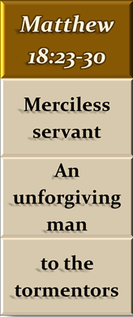
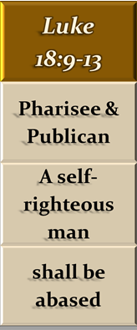
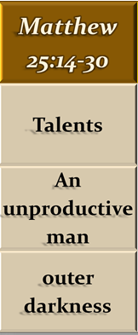
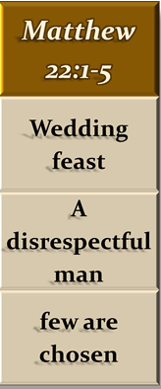
Are You The Man?

Slide 13
Are You The Man?
Luke 7:29-30 (NKJV) ²⁹ And when all the people heard Him, even the tax collectors justified God, having been baptized with the baptism of John. ³⁰ But the Pharisees and lawyers rejected the will of God for themselves, not having been baptized by him.
Acts 2:38-41 (NKJV) ³⁸ Then Peter said to them, "Repent, and let every one of you be baptized in the name of Jesus Christ for the remission of sins; and you shall receive the gift of the Holy Spirit. ^{. . . 41} Then those who gladly received his word were baptized; and that day about three thousand souls were added to them.

Slide 14
Have You Come To See Your Guilt Before God?
Have You Come To See Your Need To Obey God?
Are You The Man?

Slide 16
Are You The Man?
Charts by Don McClain
Prepared January 13-15, 2011
Preached January 16, 2011
West 65th Street church of Christ
P.O. Box 190062
Little Rock AR 72219
501-568-1062
Prepared using PPT 2010 –
Email – donmcclain@sbcglobal.net
More PPT & Audio Sermons:
http://w65stchurchofchrist.org/donmaccla/2010SermonPage.html
Note – Many of the transition effects used in this presentation are lost using PPT 2007 Viewer
To view transitions you can download PPT 2010 viewer:
http://www.microsoft.com/downloads/en/details.aspx?displaylang=en&FamilyID=cb9bf144-1076-4615-9951-294eeb832823

