Slide 1
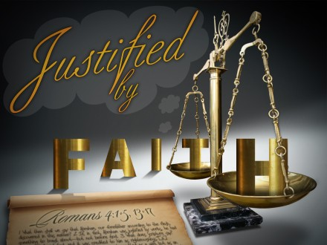

Slide 2
The Doctrine of Justification
Justification: <G1344> δικαιόω, dikaioō—
Vine's Expository Dictionary of Old and New Testament Words
Usage Notes: primarily, "to deem to be right," signifies, in the NT, (a) "to show to be right or righteous;" in the Passive Voice, to be justified, Matt. 11:19; Luke 7:35; Rom. 3:4; 1 Tim. 3:16; (b) "to declare to be righteous, to pronounce righteous," (1) by man, concerning God, Luke 7:29 (see Rom. 3:4, above); concerning himself, Luke 10:29; Luke 16:15; (2) by God concerning men, who are declared to be righteous before Him on certain conditions laid down by Him. . . .

Slide 3
The Doctrine of Justification
Justification: <G1344> δικαιόω, dikaioō—
Vine's Expository Dictionary of Old and New Testament Words
Ideally the complete fulfillment of the law of God would provide a basis of "justification" in His sight, Rom. 2:13. But no such case has occurred in mere human experience, and therefore no one can be "justified" on this ground, Rom. 3:9-20; Gal. 2:16; Gal. 3:10, 11; Gal. 5:4. . . . "justification" being the legal and formal acquittal from guilt by God as Judge, the pronouncement of the sinner as righteous, who believes on the Lord Jesus Christ. . . . "Justification" is primarily and gratuitously by faith, subsequently and evidentially by works.

Slide 4
The Doctrine of Justification
Justification: <G1344> δικαιόω, dikaioō—
“1. to prove or show to be just, or conformable to law, right, justice, propriety, or duty; to defend or maintain; to vindicate as right. 2. to declare free from guilt or blame; to absolve; to clear.” (Webster, p. 993)
“be acquitted, be pronounced and treated as righteous” (Arndt and Gingrich, p. 197)

Slide 5
The Doctrine of Justification
Justification: <G1344> δικαιόω, dikaioō—
Simply put, justification means that one stands right(eously) before God.
Man cannot be right with God without:
God’s means of salvation – (love, grace & mercy)
Man’s living by faith, (obeying God by faith) Rom. 1:16,16; 4:5; 6:16-19; James 2:14-26
Notes:
Acts 13:39 (NKJV) ³⁹ and by Him everyone who believes is justified from all things from which you could not be justified by the law of Moses.
Romans 3:24 (NKJV) ²⁴ being justified freely by His grace through the redemption that is in Christ Jesus,
Romans 3:28 (NKJV) ²⁸ Therefore we conclude that a man is justified by faith apart from the deeds of the law.
Romans 5:1 (NKJV) ¹ Therefore, having been justified by faith, we have peace with God through our Lord Jesus Christ,
Romans 5:9 (NKJV) ⁹ Much more then, having now been justified by His blood, we shall be saved from wrath through Him.
1 Corinthians 6:11 (NKJV) ¹¹ And such were some of you. But you were washed, but you were sanctified, but you were justified in the name of the Lord Jesus and by the Spirit of our God.
Galatians 3:11 (NKJV) ¹¹ But that no one is justified by the law in the sight of God is evident, for "the just shall live by faith."
Titus 3:7 (NKJV) ⁷ that having been justified by His grace we should become heirs according to the hope of eternal life.
James 2:21 (NKJV) ²¹ Was not Abraham our father justified by works when he offered Isaac his son on the altar?
James 2:24 (NKJV) ²⁴ You see then that a man is justified by works, and not by faith only.
James 2:25 (NKJV) ²⁵ Likewise, was not Rahab the harlot also justified by works when she received the messengers and sent them out another way?

Slide 6
The Doctrine of Justification
Man’s Need For Justification
Sin and death entered the world through Adam - Gen 3; Rom 5:12,
Has passed to all men because all have sinned - Rom 3:9,19,23; 5:12; Ezekiel 18:21-32
Sin separates men from God – Isa. 59:1,2
The wages of sin is death - Rom 6:23
God’s wrath is coming - Rom 1:18; Eph 5:6; Col 3:6;
Notes:
Acts 13:39 (NKJV) ³⁹ and by Him everyone who believes is justified from all things from which you could not be justified by the law of Moses.
Romans 3:24 (NKJV) ²⁴ being justified freely by His grace through the redemption that is in Christ Jesus,
Romans 3:28 (NKJV) ²⁸ Therefore we conclude that a man is justified by faith apart from the deeds of the law.
Romans 5:1 (NKJV) ¹ Therefore, having been justified by faith, we have peace with God through our Lord Jesus Christ,
Romans 5:9 (NKJV) ⁹ Much more then, having now been justified by His blood, we shall be saved from wrath through Him.
1 Corinthians 6:11 (NKJV) ¹¹ And such were some of you. But you were washed, but you were sanctified, but you were justified in the name of the Lord Jesus and by the Spirit of our God.
Galatians 3:11 (NKJV) ¹¹ But that no one is justified by the law in the sight of God is evident, for "the just shall live by faith."
Titus 3:7 (NKJV) ⁷ that having been justified by His grace we should become heirs according to the hope of eternal life.
James 2:21 (NKJV) ²¹ Was not Abraham our father justified by works when he offered Isaac his son on the altar?
James 2:24 (NKJV) ²⁴ You see then that a man is justified by works, and not by faith only.
James 2:25 (NKJV) ²⁵ Likewise, was not Rahab the harlot also justified by works when she received the messengers and sent them out another way?

Slide 7
The Doctrine of Justification
Things Ineffectual In Justifying Man
Supposed partiality on the part of God - Rom. 2:5-11
Self-justification - Lk. 10:29; 16:15
The Law of Moses - Acts 13:39; Rom. 3:19-20; 4:4; Gal. 5:4
Works of Merit – Eph 2:8,9; Lk. 18:11-12; Jn. 1:29
Man’s ways or teaching - Rom. 10:1-3; Matt. 15:9; Gal. 1:8-9

Slide 8
The Doctrine of Justification
Things Necessary For Our Justification
Grace - through the redemption that is in Christ – Rom 3:24; Titus 3:7
Jesus’ blood - saved from wrath in Him – Rom 5:9
Our faith –we have peace with God – Rom 5:1;
Our obedience – (which is by faith) - James 2:14-26; Rom 4:12; 6:16-18

Slide 9
The Doctrine of Justification
The
Basis of
Justification
God's Universal Kindness, Love &
Mercy.
The Gracious
Gift of God’s Son & The Gospel
The
Conditions
of
Justification
The
Provision
of
Justification
Faith – Repentance – Confession – Baptism - Faithfulness
Notes:
Keys to Understanding the Issue

Slide 10
The Doctrine of Justification
The Example of Abraham
The term “works” in this context is not equivalent to obedience to the gospel - (Rom. 1:5; 2:7,8; 6:3-6,16-18; 16:25,26)
Romans 4:1-4 (NKJV) ¹ What then shall we say that Abraham our father has found according to the flesh? ² For if Abraham was justified by works, he has something to boast about, but not before God. ³ For what does the Scripture say? "Abraham believed God, and it was accounted to him for righteousness." ⁴ Now to him who works, the wages are not counted as grace but as debt.

Slide 11
The Doctrine of Justification
The Example of Abraham
NOT by fleshly decent
OR Works of the Law – 3:27
Romans 4:1-4 (NKJV) ¹ What then shall we say that Abraham our father has found according to the flesh? ² For if Abraham was justified by works, he has something to boast about, but not before God. ³ For what does the Scripture say? "Abraham believed God, and it was accounted to him for righteousness." ⁴ Now to him who works, the wages are not counted as grace but as debt.
He believed God – Gen 15:6
By grace – Not debt!

Slide 12
The Doctrine of Justification
The Example of Abraham
Romans 4:12 (NKJV)
and the father of circumcision to those who not only are of the circumcision, but who also walk in the steps of the faith which our father Abraham had while still uncircumcised.
Genesis 12:1-4
Hebrews 11:8
Genesis 15:6
Romans 4:1-4,12
Genesis 13:4
Hebrews 11:9
Genesis 22:3,12,16,18
James 2:21-25

Slide 13
The Doctrine of Justification
The Example of David
Does not seek based upon merit – but seeks by faith.
His faith is accounted as justification
Romans 4:5-8 (NKJV) ⁵ But to him who does not work but believes on Him who justifies the ungodly, his faith is accounted for righteousness, ⁶ just as David also describes the blessedness of the man to whom God imputes righteousness apart from works: ⁷ "Blessed are those whose lawless deeds are forgiven, And whose sins are covered; ⁸ Blessed is the man to whom the LORD shall not impute sin."
Justification is gained through forgiveness

Slide 14
The Doctrine of Justification
Justification Not By Faith ALONE!!
Romans 4:6 (NKJV)
just as David also describes the blessedness of the man to whom God imputes righteousness apart from works:
Romans 6:16 (NKJV)
Do you not know that to whom you present yourselves slaves to obey, you are that one's slaves whom you obey, whether of sin leading to death, or of obedience leading to righteousness?
[dikaiosune - δικαιοσύνη]
Notes:
Not Equivalents
The term Works in Romans 4

Slide 15
The Doctrine of Justification
All occur at the same point in time
Justification
Rom 6:16,17
FORGIVENESS
Acts 2:38
Sanctification
Acts 26:18
Regeneration
1 Pet 1:22,23
Notes:
Keys to Understanding the Issue

Slide 16
The Doctrine of Justification
1 Corinthians 6:11 (NKJV) ¹¹ And such were some of you. But you were washed, but you were sanctified, but you were justified in the name of the Lord Jesus and by the Spirit of our God.
All occur at the same point in time
Sanctified
1 Cor. 1:2
Baptism
Acts 18:8
1 Cor. 12:13
Washed
Acts 22:16
1 Pet 1:22,23
Justified
1 Cor 6:11
Rom 6:16,17
Notes:
Keys to Understanding the Issue

Slide 17
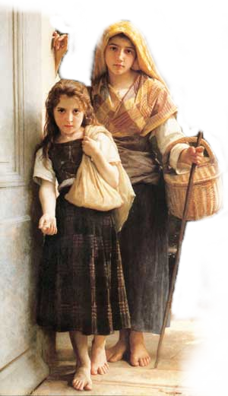
The Doctrine of Justification
Justification Not By Faith ALONE!!
James 2:14-26 (NKJV) ¹⁴ What does it profit, my brethren, if someone says he has faith but does not have works? Can faith save him? ¹⁵ If a brother or sister is naked and destitute of daily food, ¹⁶ and one of you says to them, "Depart in peace, be warmed and filled," but you do not give them the things which are needed for the body, what does it profit?
The Faith That Saves Is A Faith That Obeys!

Slide 18
The Doctrine of Justification
Justification Not By Faith ALONE!!
James 2:14-26 (NKJV) ¹⁷ Thus also faith by itself, if it does not have works, is dead. ¹⁸ But someone will say, "You have faith, and I have works." Show me your faith without your works, and I will show you my faith by my works. ¹⁹ You believe that there is one God. You do well. Even the demons believe--and tremble!
Faith that does not obey is worthless!
Demons Believe But Do Not Obey!

Slide 19
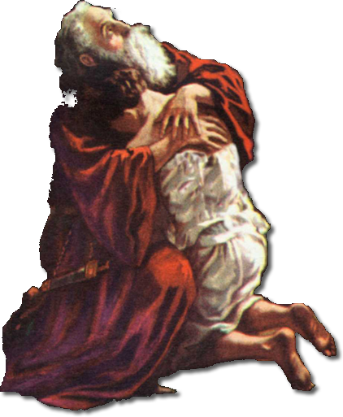
The Doctrine of Justification
Justification Not By Faith ALONE!!
Genesis 22:16-19
Before God!!
James 2:14-26 (NKJV) ²⁰ But do you want to know, O foolish man, that faith without works is dead? ²¹ Was not Abraham our father justified by works when he offered Isaac his son on the altar? ²² Do you see that faith was working together with his works, and by works faith was made perfect?
What kind of faith did Abraham have? Rom 4:12

Slide 20
The Doctrine of Justification
Justification Not By Faith ALONE!!
Genesis 15:6
Before God!!
James 2:14-26 (NKJV) ²³ And the Scripture was fulfilled which says, "Abraham believed God, and it was accounted to him for righteousness." And he was called the friend of God. ²⁴ You see then that a man is justified by works, and not by faith only.
The Faith That Saves Is The Faith That Obeys!

Slide 21
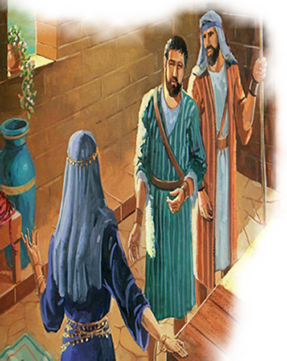
The Doctrine of Justification
Justification Not By Faith ALONE!!
Hebrews 11:31
Rahab justified by faith
James 2:14-26 (NKJV) ²⁵ Likewise, was not Rahab the harlot also justified by works when she received the messengers and sent them out another way? ²⁶ For as the body without the spirit is dead, so faith without works is dead also.

Slide 22
The Doctrine of Justification
Justification Not By Faith ALONE!!
James 2:14 (NKJV)
What does it profit, my brethren, if someone says he has faith but does not have works? Can faith save him?
Faith That Can’t Save
Inactive
Faith That Will Save
Active
Unfruitful
Disobedient
Incomplete
Dead
Fruitful
Obedient
Complete
Alive

Slide 23
The Doctrine of Justification
Justification Not By Faith ALONE!!
“WORKS used in two different senses or else a contradiction!
Romans 4:1-6
Justified
Counted for righteousness
Fulfilled Genesis 15:6
Strong
Not of works
James 2:21-24
Justified
Counted for righteousness
Fulfilled Genesis 15:6
Perfect
By works
Notes:
Comparing Romans 4 & James 2

Slide 24
The Doctrine of Justification
Are You Justified Before God?
If You Have Never Obeyed The Gospel
Hear - (Rom 10:17)
Believe - (Jn 8:24)
Repent - (Acts 2:38)
Confess - (Mt 10:32)
Be Baptized - (Acts 22:16)
If You Have obeyed the gospel but have Sinned:
Confess - (1 Jn. 1:9)
Repent - (Acts 8:22)
Pray For Forgiveness - (Acts 8:22)
We are justified in our initial obedience to Christ and remain justified so long as we continue to walk in the light in fellowship with Jesus – 1 John 1:5-2:2
Notes:
Acts 13:39 (NKJV) ³⁹ and by Him everyone who believes is justified from all things from which you could not be justified by the law of Moses.
Romans 3:24 (NKJV) ²⁴ being justified freely by His grace through the redemption that is in Christ Jesus,
Romans 3:28 (NKJV) ²⁸ Therefore we conclude that a man is justified by faith apart from the deeds of the law.
Romans 5:1 (NKJV) ¹ Therefore, having been justified by faith, we have peace with God through our Lord Jesus Christ,
Romans 5:9 (NKJV) ⁹ Much more then, having now been justified by His blood, we shall be saved from wrath through Him.
1 Corinthians 6:11 (NKJV) ¹¹ And such were some of you. But you were washed, but you were sanctified, but you were justified in the name of the Lord Jesus and by the Spirit of our God.
Galatians 3:11 (NKJV) ¹¹ But that no one is justified by the law in the sight of God is evident, for "the just shall live by faith."
Titus 3:7 (NKJV) ⁷ that having been justified by His grace we should become heirs according to the hope of eternal life.
James 2:21 (NKJV) ²¹ Was not Abraham our father justified by works when he offered Isaac his son on the altar?
James 2:24 (NKJV) ²⁴ You see then that a man is justified by works, and not by faith only.
James 2:25 (NKJV) ²⁵ Likewise, was not Rahab the harlot also justified by works when she received the messengers and sent them out another way?

Slide 26
The Doctrine of Justification
Charts by Don McClain
Prepared December 16,17, 2011
Preached December 18, 2011
West 65th Street church of Christ
P.O. Box 190062
Little Rock AR 72219
501-568-1062
Prepared using PPT 2010
Email – donmcclain@sbcglobal.net
More PPT & Audio Sermons:
http://w65stchurchofchrist.org/donmaccla/2010SermonPage.html
Note – Many of the transition effects used in this presentation may be lost using PPT 2007 Viewer
http://www.microsoft.com/downloads/details.aspx?FamilyID=cb9bf144-1076-4615-9951-294eeb832823&displaylang=en

Slide 27
Romans 3:21-31 (NKJV) ²¹ But now the righteousness of God apart from the law is revealed, being witnessed by the Law and the Prophets, ²² even the righteousness of God, through faith in Jesus Christ, to all and on all who believe. For there is no difference; ²³ for all have sinned and fall short of the glory of God,

Slide 28
Romans 3:21-31 (NKJV) ²⁴ being justified freely by His grace through the redemption that is in Christ Jesus, ²⁵ whom God set forth as a propitiation by His blood, through faith, to demonstrate His righteousness, because in His forbearance God had passed over the sins that were previously committed,

Slide 29
Romans 3:21-31 (NKJV) ²⁶ to demonstrate at the present time His righteousness, that He might be just and the justifier of the one who has faith in Jesus. ²⁷ Where is boasting then? It is excluded. By what law? Of works? No, but by the law of faith. ²⁸ Therefore we conclude that a man is justified by faith apart from the deeds of the law.

Slide 30
Romans 3:21-31 (NKJV) ²⁹ Or is He the God of the Jews only? Is He not also the God of the Gentiles? Yes, of the Gentiles also, ³⁰ since there is one God who will justify the circumcised by faith and the uncircumcised through faith. ³¹ Do we then make void the law through faith? Certainly not! On the contrary, we establish the law.

