Slide 2
Remove the reality of sin, personal guilt and the human conscience & You Remove the Need for a Savior, repentance and redemption

Slide 3
The Danger of a Silenced Conscience:
Romans 1:18-32 (NKJV) ¹⁸ For the wrath of God is revealed from heaven against all ungodliness and unrighteousness of men, who suppress the truth in unrighteousness, ¹⁹ because what may be known of God is manifest in them, for God has shown it to them. ²⁰ For since the creation of the world His invisible attributes are clearly seen,

Slide 4
The Danger of a Silenced Conscience:
Romans 1:18-32 (NKJV) being understood by the things that are made, even His eternal power and Godhead, so that they are without excuse, ²¹ because, although they knew God, they did not glorify Him as God, nor were thankful, but became futile in their thoughts, and their foolish hearts were darkened.

Slide 5
The Danger of a Silenced Conscience:
Romans 1:18-32 (NKJV) ²² Professing to be wise, they became fools, ²³ and changed the glory of the incorruptible God into an image made like corruptible man--and birds and four-footed animals and creeping things. ²⁴ Therefore God also gave them up to uncleanness, in the lusts of their hearts, to dishonor their bodies among themselves,

Slide 6
The Danger of a Silenced Conscience:
Romans 1:18-32 (NKJV) ²⁵ who exchanged the truth of God for the lie, and worshiped and served the creature rather than the Creator, who is blessed forever. Amen. ²⁶ For this reason God gave them up to vile passions. For even their women exchanged the natural use for what is against nature. ²⁷ Likewise also the men,

Slide 7
The Danger of a Silenced Conscience:
Romans 1:18-32 (NKJV) leaving the natural use of the woman, burned in their lust for one another, men with men committing what is shameful, and receiving in themselves the penalty of their error which was due. ²⁸ And even as they did not like to retain God in their knowledge, God gave them over to a debased mind,

Slide 8
The Danger of a Silenced Conscience:
Romans 1:18-32 (NKJV) to do those things which are not fitting; ²⁹ being filled with all unrighteousness, sexual immorality, wickedness, covetousness, maliciousness; full of envy, murder, strife, deceit, evil-mindedness; they are whisperers, ³⁰ backbiters, haters of God, violent, proud, boasters, inventors of evil things, disobedient to parents,

Slide 9
The Danger of a Silenced Conscience:
Romans 1:18-32 (NKJV) ³¹ undiscerning, untrustworthy, unloving, unforgiving, unmerciful; ³² who, knowing the righteous judgment of God, that those who practice such things are deserving of death, not only do the same but also approve of those who practice them.

Slide 10
The Danger of a Silenced Conscience:
Whatever Happened To Sin?
Redefining Sin
U.S. Dept. of Health and Human Services (1989 Report of the Secretary’s Task Force on Youth Suicide). According to this study, because “fundamentalist religion” portrays homosexuality as sinful it created “unresolvable internal conflicts for youth who … will not change their sexual orientation.” The study recognized that youths involved in homosexuality “feel wicked and condemned to hell and attempt suicide in despair of ever obtaining redemption.” The study recommends that churches should begin to “reassess homosexuality in a positive context.”

Slide 11
The Danger of a Silenced Conscience:
Whatever Happened To Sin?
Redefining Sin
Abortion – “The Right To Choose” – instead of murder - shedding the blood of the most innocent!
Adultery - “an open relationship,”
Pornography – “adult entertainment”
Drunkenness – over indulgence in “adult beverages”
Immodesty – “swimming apparel” – etc.

Slide 12
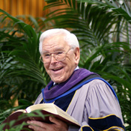
The Danger of a Silenced Conscience:
Whatever Happened To Sin?
“I don’t think anything has been done in the name of Christ and under the banner of Christianity that has proven more destructive of human personality and hence, counterproductive for the evangelism enterprise than the often crude, uncouth and unchristian strategy of attempting to make people aware of their lost and sinful condition” (Time, 3-18-85).
Robert Schuler

Slide 13
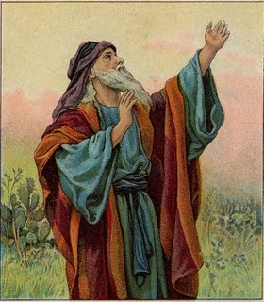
The Danger of a Silenced Conscience:
Whatever Happened To Sin?
Isaiah 5:20 (NKJV) ²⁰ Woe to those who call evil good, and good evil; Who put darkness for light, and light for darkness; Who put bitter for sweet, and sweet for bitter!

Slide 14
The Danger of a Silenced Conscience:
Whatever Happened To Sin?
Denial of Guilt
Dr. Wayne Dyer, wrote that our “guilt zones must be exterminated, spray-cleaned and sterilized forever” (Erroneous Zone, 90-91).
Defy guilt until it goes away?

Slide 15
The Danger of a Silenced Conscience:
Whatever Happened To Sin?
Denial of Guilt
“Do something which you know is bound to result in feelings of guilt….Take a week to be alone if you have always wanted to do so, despite the guilt-engendering protestation from other members of your family. These kinds of behavior will help you to tackle that…guilt.”

Slide 16
The Danger of a Silenced Conscience:
Whatever Happened To Sin?
Denial of Guilt
Renounce the reality of guilt – Sin!
B.F. Skinner (Harvard professor, founder of behaviorist psychology) - Believed guilt to be a myth because man is simply a product of evolution—controlled exclusively by his environment.
B.F. Skinner

Slide 17
The Danger of a Silenced Conscience:
Whatever Happened To Sin?
Denial of Guilt
Words like “sin,” “repentance,” “contrition,” “atonement” and “redemption” have been removed out of public discourse and deemed politically incorrect.

Slide 18
The Danger of a Silenced Conscience:
Whatever Happened To Sin?
Sin As A Disease
In 1973, psychiatrist Karl Menninger published a book with the provocative title, Whatever Became of Sin?
He exposed the sociology and psychology trend to avoid terms like “evil,” “immorality,” and “wrongdoing.” Menninger detailed how the theological notion of sin became relegated to the psychological category of sickness.

Slide 19
The Danger of a Silenced Conscience:
Whatever Happened To Sin?
Sin As A Disease
“Connection between mental health and moral health, i.e. there is no help for those who deny responsibility of their own behavior.”
Dr. Karl Menninger - “Whatever Became of Sin.”

Slide 20
The Danger of a Silenced Conscience:
Whatever Happened To Sin?
Sin As A Disease
Conduct Disorder – “A persistent pattern of conduct in which the basic rights of others and major societal norms and rules are violated.”
Selfishness?

Slide 21
The Danger of a Silenced Conscience:
Whatever Happened To Sin?
Sin As A Disease
Oppositional Defiant Disorder – “A pattern of negativistic, hostile and defiant behavior.”
Rebellion?

Slide 22
The Danger of a Silenced Conscience:
Whatever Happened To Sin?
Sin As A Disease
Histrionic Personality Disorder – “A pervasive pattern of excessive emotionality and attention seeking.”
Self-Centered?

Slide 23
The Danger of a Silenced Conscience:
Whatever Happened To Sin?
Sin As A Disease
Obsessive–compulsive disorder (OCD) – “an anxiety disorder and is characterized by recurrent, unwanted thoughts (obsessions) and/or repetitive behaviors (compulsions).”
Lack Self-Control?

Slide 24
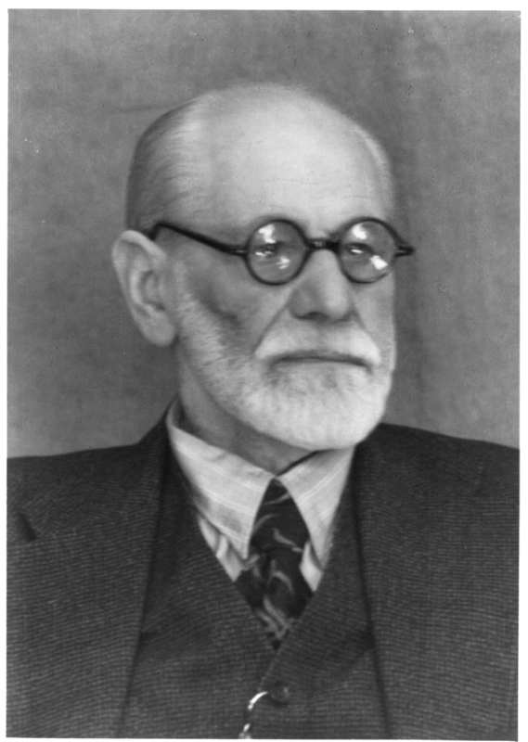
The Danger of a Silenced Conscience:
Whatever Happened To Sin?
Denial of Guilt By Blaming Others
Freud believed that all guilt came from authoritarian sources, i.e. religion, parents, government, etc.
Adam & Eve – Gen. 3:12,13
King Saul – 1 Sam 15:15,20,21
Ahab – 1 Kings 18:17,18
Sigmund Freud

Slide 25
The Danger of a Silenced Conscience:
Whatever Happened To Sin?
To Remove Sin & Guilt Destroys Conscience
"a knowing with" (syn, "with," oida, "to know"), i.e., "a co-knowledge (with oneself), the witness borne to one's conduct by conscience, that faculty by which we apprehend the will of God, as that which is designed to govern our lives;"
(Vines Expository Dictionary)

Slide 26
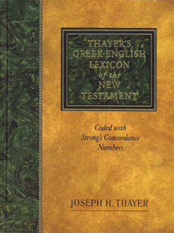
The Danger of a Silenced Conscience:
Whatever Happened To Sin?
To Remove Sin & Guilt Destroys Conscience
“the soul as distinguishing between what is morally good and bad, prompting to do the former and shun the latter, commending the one, condemning the other;
— Thayer's Greek-English Lexicon

Slide 27
The Danger of a Silenced Conscience:
Ephesians 4:17-19 (NKJV) ¹⁷ This I say, therefore, and testify in the Lord, that you should no longer walk as the rest of the Gentiles walk, in the futility of their mind, ¹⁸ having their understanding darkened, being alienated from the life of God, because of the ignorance that is in them, because of the blindness of their heart; ¹⁹ who, being past feeling, have given themselves over to lewdness, to work all uncleanness with greediness.

Slide 28
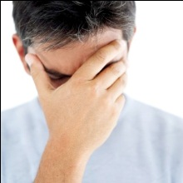
The Danger of a Silenced Conscience:
Whatever Happened To Sin?
The Destruction of Conscience
“Hardened by the deceitfulness of sin” - (Hebrews 3:13)
leads to the “searing of the conscience” - (I Timothy 4:2).
Those who suppress the truth in their conscience will be abandoned by God - (Romans 1:18-20).

Slide 29
The Danger of a Silenced Conscience:
Whatever Happened To Sin?
Destruction of Conscience
Romans 1:21-32
Foolish speculations – (21).
Death of common sense (22)
Corrupt religion – (23)
Uncontrolled desires (24)
Sexual perversion (26-27)
Death of the Conscience (28-32)

Slide 30
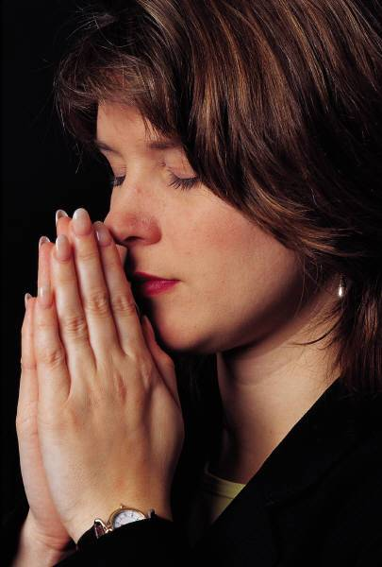
The Danger of a Silenced Conscience:
Clearing Your Conscience
Not by perfection, but by cleansing (Heb 9:14; 10:22).
Not by perfection, but by obedience (I Tim 1:5, 18-19; 2 Tim 1:3; I Peter 3:16, 21).

Slide 31
The Danger of a Silenced Conscience:
Clearing Your Conscience
Confess and forsake known sin (Proverbs 28:13).
Reconcile with those you have wronged (Matt. 5:23, 24).
Make restitution (Numbers 5:6-7).
Do not procrastinate in clearing your wounded conscience (Acts 24:16).
Educate your conscience (Romans 14:22; Acts 23:1).

Slide 32
The Danger of a Silenced Conscience:
Clearing Your Conscience
Crucifying Sin (Rom. 6:7; Col. 3:5).
Sin is not mortified when we:
Merely cover it up (Pro. 28:13).
Merely exchange it for another sin.
Merely repressing it
Sin is put to death when the conscience is cleared by obeying the truth (2 Cor. 7:10; 1 Pet 1:22,23).

Slide 34
The Danger of a Silenced Conscience:
Charts by Don McClain
Prepared - April 13-16, 2011
Preached April 17, 2011
West 65th Street church of Christ
P.O. Box 190062; Little Rock AR 72219
501-568-1062
Prepared using PPT 2010 –
Email – donmcclain@sbcglobal.net
More PPT & Audio Sermons:
http://w65stchurchofchrist.org/donmaccla/2011SermonPage.html

