Slide 1
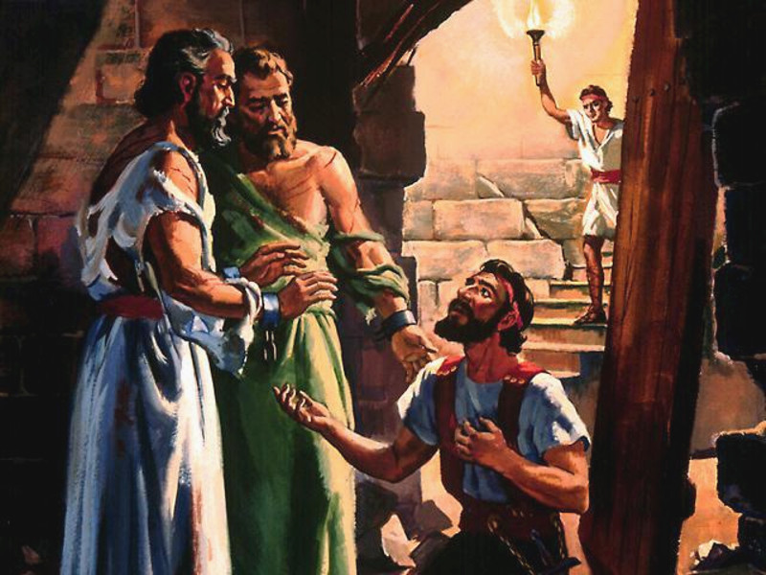
"Sirs, what must I do to be saved?"
Have You Been Converted?
Notes:
Acts 16:30 (NKJV) ³⁰ And he brought them out and said, "Sirs, what must I do to be saved?"
Are You Really Converted?
Raymond E. Harris Muscle Shoals, Alabama
The word "convert" means "to change" or "to turn." There are three things involved in the process of one's turning from sin to God.
1. A Change of Heart. The heart or mind can only be changed by faith. Faith comes by hearing the word of God (Rom. 10:17). Hence, the Bible teaches that people's hearts are purified "by faith" (Acts 15:9). In other words, when one learns from the Bible about the love God has toward us and the sacrifice of Jesus for us we are moved to repentance. "Repentance" and "conversion" are terms that go hand in hand. When one changes his mind about God and Jesus and sin he will have:
2. A Change of Life. A change of heart will lead to a change of life. Repentance is defined as "a change of mind that leads to a change of life." Hence, we see the evolution of conversion. As a result of faith produced by the word of God, man is led to repentance. This reformation in behavior is very visible as the person turns from sin to obedience, from wickedness to righteousness. And when obedience is completed there is:
3. A Change of Relationship. In this world there are two classes of accountable people - the wicked and the righteous - the children of the Devil and the children of God. No one can be translated from the kingdom of darkness to the kingdom of God without a change of heart and a change of life. But one must have remission of sins to make conversion complete. When one's sins are forgiven, he enters a state or relationship with God. Baptism is". . for the remission of sins" (Acts 2:38). Also the Bible says people are baptized "into Christ" (Gal. 3:26-27). Hence, the converted are buried with Christ in baptism and raised to walk in "newness of life" (Rom. 6:3-5).
Faith changes the heart, repentance changes the life, and baptism changes the relationship to God. One's sins are not forgiven merely because we believe that Jesus is the Savior or because we quit committing them. Sins are forgiven by God when we complete our conversion in baptism. Have you been converted? Truly converted? Fully converted, according to the scriptural plan?
Guardian of Truth XXX: 2, p. 43 January 16, 1986

Slide 2
Have You Been Converted?
Convert; Converted
transitive verb
1 - a : to bring over from one belief, view, or party to another b : to bring about a religious conversion in
2 - a : to alter the physical or chemical nature or properties of especially in manufacturing b (1) : to change from one form or function to another (2) : to alter for more effective utilization

Slide 3
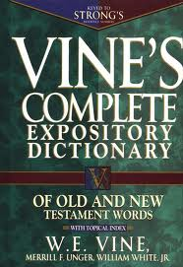
Have You Been Converted?
Convert; Converted
Strong's Number: <G4762> - Original Word: στρέφω, strephō
Part Of Speech: Verb
"to turn," is translated "be converted" in Matt. 18:3, AV. See TURN.
Notes:
Definition of CONVERT
transitive verb
1
a : to bring over from one belief, view, or party to another b : to bring about a religious conversion in
2
a : to alter the physical or chemical nature or properties of especially in manufacturing b (1) : to change from one form or function to another (2) : to alter for more effective utilization (3) : to appropriate without right c : to exchange for an equivalent <convert foreign currency into dollars> <convert a bond>

Slide 4
Have You Been Converted?
Convert; Converted
στρεφω <G4762>:
Passive reflexively, “to turn” oneself: . . . (R.V. they “turned back in their hearts unto Egypt”) i.e. to their condition there, Acts 7:39; absolutely and tropically, “to turn oneself” namely, from one’s course of conduct, i.e. “to change one’s mind” - Matthew 18:3
Greek-English Lexicon of the New Testament – pg. 591
Notes:
Definition of CONVERT
transitive verb
1
a : to bring over from one belief, view, or party to another b : to bring about a religious conversion in
2
a : to alter the physical or chemical nature or properties of especially in manufacturing b (1) : to change from one form or function to another (2) : to alter for more effective utilization (3) : to appropriate without right c : to exchange for an equivalent <convert foreign currency into dollars> <convert a bond>

Slide 5
Have You Been Converted?
Convert; Converted
Matthew 18:3-4 (NKJV) ³ and said, "Assuredly, I say to you, unless you are converted and become as little children, you will by no means enter the kingdom of heaven. ⁴ Therefore whoever humbles himself as this little child is the greatest in the kingdom of heaven.

Slide 6
Have You Been Converted?
Convert; Converted
Strong's Number: <G1994> - ἐπιστρέφω, epistrephō - Part Of Speech: Verb
Usage Notes: "to turn about, turn towards" (epi, "towards" and No. 1), is used transitively, and so rendered "convert" (of causing a person to turn) in Jas. 5:19, 20. Elsewhere, where the AV translates this verb, either in the Middle Voice and intransitive use, or the Passive, the RV adheres to the Middle Voice significance, and translates by "turn again," Matt. 13:15; Mark 4:12; Luke 22:32; Acts 3:19; Acts 28:27.

Slide 7
Have You Been Converted?
Convert; Converted
Acts 3:19 (NKJV) ¹⁹ Repent therefore and be converted, that your sins may be blotted out, so that times of refreshing may come from the presence of the Lord,

Slide 8
Have You Been Converted?
Convert; Converted
James 5:19-20 (NKJV) ¹⁹ Brethren, if anyone among you wanders from the truth, and someone turns him back, (convert him KJV) ²⁰ let him know that he who turns (converteth – KJV) a sinner from the error of his way will save a soul from death and cover a multitude of sins.

Slide 9
Have You Been Converted?
Convert; Converted
Strong's Number: <G1995> - ἐπιστροφή, epistrophē - Part Of Speech: Noun
Usage Notes: akin to A, No. 2, "a turning about, or round, conversion," is found in Acts 15:3. The word implies "a turning from and a turning to;" corresponding to these are repentance and faith; cp. "turned to God from idols" (1 Thess. 1:9). Divine grace is the efficient cause, human agency the responding effect.—

Slide 10
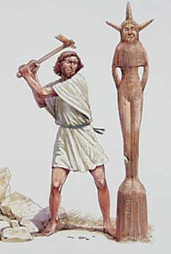
Have You Been Converted?
Convert; Converted
1 Thessalonians 1:9-10 (NKJV) ⁹ For they themselves declare concerning us what manner of entry we had to you, and how you turned to God from idols to serve the living and true God, ¹⁰ and to wait for His Son from heaven, whom He raised from the dead, even Jesus who delivers us from the wrath to come.

Slide 11
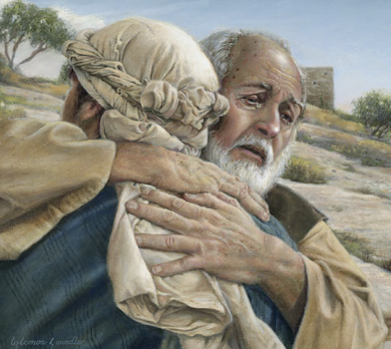
Have You Been Converted?
Convert; Converted
Not merely a change in actions –
A change in knowledge –
A change in conviction -
A change in allegiance –
A change in thinking & will –
A change in commitment – resulting in a change in relationship & identity -
A change in who we are – how we talk – where we go – what we do -
Luke 15:11-24

Slide 12
Have You Been Converted?
The Truth! - John 8:32; 17:17; 1 Peter 1:22; Rom 2:8; 2 Thes 2:10
The REAL Gospel – 1 Cor 15:1-4; Rom 1:16; Mark 16:15,16; Acts 2; Acts 8; Acts 16:30-34; 19:1-5
One Cannot Be Taught Error –Believe Error – Obey Error and Be Converted By and To The Truth!! – Mat 15:14
Notes:
Must Receive Correct Information

Slide 13
Have You Been Converted?
Impossible to please God without FAITH – Hebrews 11:1,6
Faith comes by hearing God’s word – the truth – Romans 10:14-17; Acts 17:11,12; 1 John 1:1-4; John 20:30,31

Slide 14
Have You Been Converted?
Who God Is & What He Has Done For Us – Acts 17:23-31; Jn 3:16; 8:24
Who Jesus Is & What He Has Done For Us – Heb 2:9-18; Phili 2:5-10
Who We Are, What We Have Done, & What We MUST Do – Eccl 12:13; Rom 3:23; Is 59:1,2; Jn 8:24; Heb 11:6; Acts 2:38;

Slide 15
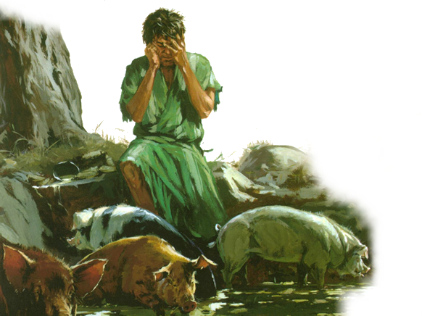
Have You Been Converted?
Something We Must Do - (Luke 13:3,5; Acts 17:30)
Repentance Requires Radical Change – (Eze. 18:20-32)
Something God wants us to do - (Rom 2:3-6; 2 Peter 3:9)
Luke 15:17-20 (NKJV)

Slide 16
Have You Been Converted?
Recognition – (i.e. Acknowledgement of Sin)
Remorse -(Regret & Grieving Over Sin)
Resolve – (i.e. A Change of Mind & Will)
Reformation – (i.e. A Change of Lifestyle)
Restitution – (i.e. Make Amends As Far As Possible)
Luke 15:17-20 (NKJV)

Slide 17
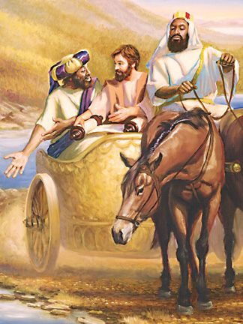
Have You Been Converted?
(c) "to declare openly by way of speaking out freely, such confession being the effect of deep conviction of facts," Matt. 7:23; Matt. 10:32 (twice) and Luke 12:8 . . . “conveys the thought of "confessing" allegiance to Christ as one's Master and Lord, . . .—Vine's Expository Dictionary of Old and New Testament Words

Slide 18
Have You Been Converted?
Matthew 10:32-33 (NKJV)
32 "Therefore whoever confesses Me before men, him I will also confess before My Father who is in heaven. 33 But whoever denies Me before men, him I will also deny before My Father who is in heaven.

Slide 19
Have You Been Converted?
Romans 10:9-10 (NKJV)
9 that if you confess with your mouth the Lord Jesus and believe in your heart that God has raised Him from the dead, you will be saved. 10 For with the heart one believes unto righteousness, and with the mouth confession is made unto salvation.

Slide 20
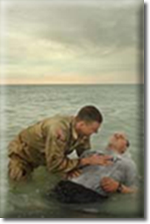
Have You Been Converted?
A Change In Commitment
United with Christ in His death – (Romans 6:3-6)
Submitting to the authority of Christ -(Receiving the remission of sins – Acts 2:38)
Becoming a child of God by faith – (Gal. 3:26,27)
Cleansing the conscience – (1 Peter 3:21)

Slide 21
Conversions In Acts
Examples
Pentecost – 2:14-41
Samaria – 8:5-13
Eunuch – 8:35-39
Saul – 9,22,26
Cornelius - 10:34-48
Lydia – 16:13-15
Jailor – 16:30-34
Corinthians - 18:8
Ephesians - 19:3-5
Believed
Implied
12
36,37
Implied
43
14
31
8
Implied
Repented
37,38
Implied
Implied
Implied
Implied
Implied
Implied
Implied
Implied
Confessed
Implied
Implied
37
Implied
Implied
Implied
Implied
Implied
Implied
Baptized
38,41
12,13
38
22:16
48
15
33
8
5

Slide 22
Have You Been Converted?
Psalm 19:7 (NKJV) ⁷ The law of the LORD is perfect, converting the soul; The testimony of the LORD is sure, making wise the simple;

Slide 23
Have You Been Converted?
Acts 26:16-18 (NKJV) ¹⁶ But rise and stand on your feet; for I have appeared to you for this purpose, to make you a minister and a witness both of the things which you have seen and of the things which I will yet reveal to you. ¹⁷ I will deliver you from the Jewish people, as well as from the Gentiles, to whom I now send you, ¹⁸ to open their eyes, in order to turn them from darkness to light, and from the power of Satan to God, that they may receive forgiveness of sins and an inheritance among those who are sanctified by faith in Me.'
Notes:
Ac 26:17 — Delivering thee from the people, and from the Gentiles, unto whom now I send thee,
Ac 26:18 — To open their eyes, and to turn them from darkness to light, and from the power of Satan unto God, that they may receive forgiveness of sins, and inheritance among them which are sanctified by faith that is in me.
2Ti 4:17 — Notwithstanding the Lord stood with me, and strengthened me; that by me the preaching might be fully known, and that all the Gentiles might hear: and I was delivered out of the mouth of the lion.
Tit 1:3 — But hath in due times manifested his word through preaching, which is committed unto me according to the commandment of God our Saviour;

Slide 24
Have You Been Converted?
Acts 2:38-47 (NKJV) ³⁸ Then Peter said to them, "Repent, and let every one of you be baptized in the name of Jesus Christ for the remission of sins; and you shall receive the gift of the Holy Spirit. . . . ⁴⁷ praising God and having favor with all the people. And the Lord added to the church daily those who were being saved.
Acts 2:38-47 (NKJV) ³⁸ Then Peter said to them, "Repent, and let every one of you be baptized in the name of Jesus Christ for the remission of sins; and you shall receive the gift of the Holy Spirit. . . . ⁴⁷ praising God and having favor with all the people. And the Lord added to the church daily those who were being saved.
Acts 3:19-26 (NKJV) ¹⁹ Repent therefore and be converted, that your sins may be blotted out, so that times of refreshing may come from the presence of the Lord, ²⁶ To you first, God, having raised up His Servant Jesus, sent Him to bless you, in turning away every one of you from your iniquities."

Slide 25
Have You Been Converted?
2 Corinthians 5:17 (NKJV) ¹⁷ Therefore, if anyone is in Christ, he is a new creation; old things have passed away; behold, all things have become new.

Slide 26
Have You Been Converted?
Colossians 3:1-4 (NKJV) ¹ If then you were raised with Christ, seek those things which are above, where Christ is, sitting at the right hand of God. ² Set your mind on things above, not on things on the earth. ³ For you died, and your life is hidden with Christ in God. ⁴ When Christ who is our life appears, then you also will appear with Him in glory.

Slide 27
Have You Been Converted?
Romans 12:1-2 (NKJV) ¹ I beseech you therefore, brethren, by the mercies of God, that you present your bodies a living sacrifice, holy, acceptable to God, which is your reasonable service. ² And do not be conformed to this world, but be transformed by the renewing of your mind, that you may prove what is that good and acceptable and perfect will of God.

Slide 28
Have You Been Converted?
1 Thessalonians 1:5-10 (NKJV) . . . ⁶ And you became followers of us and of the Lord, having received the word in much affliction, with joy of the Holy Spirit, ⁷ so that you became examples to all in Macedonia and Achaia who believe. ⁸ For from you the word of the Lord has sounded forth, not only in Macedonia and Achaia, but also in every place. Your faith toward God has gone out, so that we do not need to say anything. ⁹ For they themselves declare concerning us what manner of entry we had to you, and how you turned to God from idols to serve the living and true God, ¹⁰ and to wait for His Son from heaven, whom He raised from the dead, even Jesus who delivers us from the wrath to come.

Slide 29
Have You Been Converted?
Not merely “have you changed your actions”
But have you been changed in your convictions, allegiance, thinking, will, commitment, and relationship with God through a knowledge of the truth –
True conversion results in a change in who we are – how we talk – where we go – what we do – “proving what is that acceptable and perfect will of God” in our lives -

Slide 31
Have You Been Converted?
Charts by Don McClain
Prepared June 23-25, 2011
Preached June 26, 2011
West 65th Street church of Christ
P.O. Box 190062
Little Rock AR 72219
501-568-1062
Prepared using PPT 2010 –
Email – donmcclain@sbcglobal.net
More PPT & Audio Sermons:
http://w65stchurchofchrist.org/donmaccla/2011SermonPage.html

