Slide 1
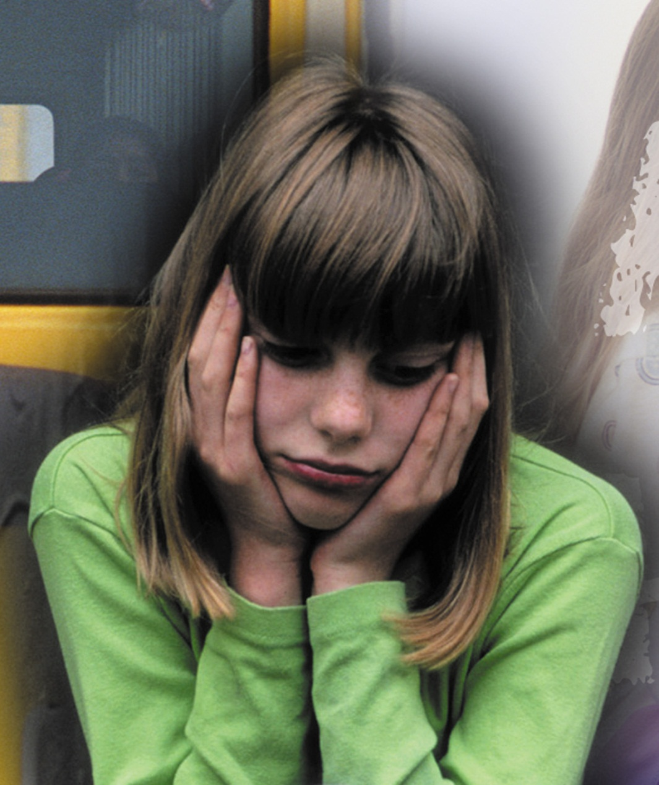
“I Don’t Deserve This”
There are many things we do NOT deserve!!
Statement often spoken in the form of a complaint . . .
Notes:
“But I don’t deserve THIS!”
It is easy to grumble and complain about what happens to us. Things don’t go our way. We lose friends, lose our jobs…lose our status or health.
“She didn’t lift a finger to help, but she gets all the credit. I organized this whole affair! I deserve some recognition!”
“I have always tried to eat right and exercise. I don’t deserve this diagnosis.”
We either think that we didn’t get what we do deserve, or we did get what we didn’t deserve.
Well, that is what grace and mercy is all about folks. In our fallen state, we deserve hell and damnation. But instead, we are given mercy and grace. Once we confess our sins and call on God, He is quick to forgive us and save us from our helpless estate. What a merciful Father! What a gracious Savior!
“Grace is when I do get what I don't deserve. Mercy is when I don't get what I do deserve.” ~Gloria Gather
On my worse days, when I’ve had a seizure and I can’t seem to escape the fog or shake the relentless headache…when I am lonely and miss my work…when I am worried about what the future holds, when I allow myself for one minute to question my circumstances and God's Will for me; I think about my blessings. I am blessed beyond measure. Blessed far beyond what I deserve.
I have always loved the song, “Why Me, Lord” by Kris Kristofferson. It just sums up this notion so well:

Slide 2
“I Don’t Deserve This”
There Are Many Things We Do NOT Deserve!!
Salvation – (and every spiritual blessing )– “we are saved by grace through faith” – Eph. 2:8; Rom 3:23; 1 Cor 15:10;
Physical blessings – health, lot in life, length of life, etc. . . . Eccl. 9:11,12

Slide 3
“I Don’t Deserve This”
The Age of Entitlement

Slide 4
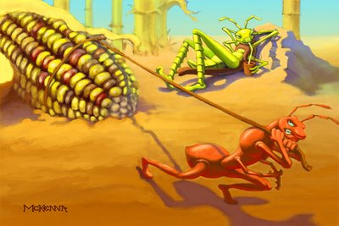
The sluggard – Prov 6:6-9; Mat 25:26; 2 Thes 3:10
The selfish – Luke 12:13-21; 1 Tim 6:7-10; 2 Tim 3:2
Æsop. (Sixth century B.C.) Fables. The Harvard Classics. 1909–14.
Notes:
Æsop. (Sixth century B.C.) Fables. The Harvard Classics. 1909–14. The Ant and the Grasshopper IN a field one summer’s day a Grasshopper was hopping about, chirping and singing to its heart’s content. An Ant passed by, bearing along with great toil an ear of corn he was taking to the nest. 1 “Why not come and chat with me,” said the Grasshopper, “instead of toiling and moiling in that way?” 2 “I am helping to lay up food for the winter,” said the Ant, “and recommend you to do the same.” 3 “Why bother about winter?” said the Grasshopper; “we have got plenty of food at present.” But the Ant went on its way and continued its toil. When the winter came the Grasshopper had no food, and found itself dying of hunger, while it saw the ants distributing every day corn and grain from the stores they had collected in the summer. Then the Grasshopper knew: “IT IS BEST TO PREPARE FOR THE DAYS OF NECESSITY.”

Slide 5
“I Deserve This”
The Age of Entitlement
Injustices should be fought against – James 4:17; Mat 25:34-40
But we must also remember – there will always be those less fortunate – there will always be injustice – Mat 26:11; Mark 14:7; Deut 15:11; Eccl. 7:8-15

Slide 6
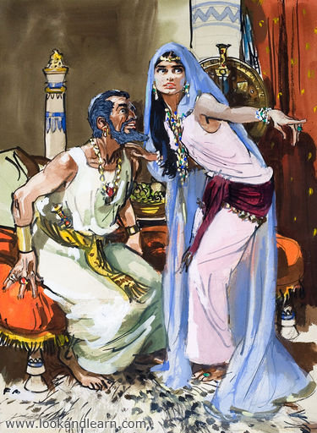
“I Deserve This”
The Attitude of Entitlement
Eve – Gen 3:1-6
Cain – Gen 4:3-8
Esau – Heb 12:16,17
Achan – Joshua 7:20,21
Korah – Num 16:1-3; Jude 11
Ahab – 1 Kings 21:1-16
Scribes & Pharisees – Mat 23:5,6
Jews – Rom 11:6

Slide 7
“I Deserve This”
The Attitude of Entitlement
Pr 16:18,19 — Pride goeth before destruction, and an haughty spirit before a fall. Better it is to be of an humble spirit with the lowly, than to divide the spoil with the proud.
Pr 18:12 — Before destruction the heart of man is haughty, and before honour is humility.
Pr 29:23 — A man's pride shall bring him low: but honour shall uphold the humble in spirit.

Slide 8
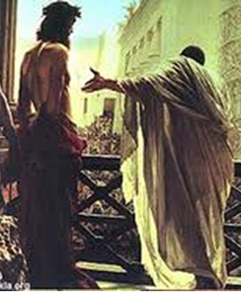
“I Don’t Deserve This”
The Attitude of Contentment
Job – Job 1,2; James 5:11
Joseph – Gen 37; 39; 40
Paul – 1 Cor 15:10; 2 Cor. 4:7-18; 12:7-10; Phili 3:1-11; 4:4-13
Jesus – (Birth - Luke 2:7; Life - 9:57,58; Betrayal - John 13:21; Suffering - Luke 22:39-45; Trial – Luke 22:47-53,63-71; 23:1-25; Crucified – Luke 23:26-56)

Slide 9
“I Don’t Deserve This”
The Attitude of Contentment
It is easy to grumble, complain and worry when something happens to us that we perceive as unfair – Mat 6:19-34; 1 Pet 5:7
It is easy to be jealous, envious and even bitter – Eph 4:31
There will be times when things don’t go our way. (We lose friends, a spouse, our job, our health . . .) – Eccl. 4:1-16
Life isn’t fair – Eccl 9:1-12

Slide 10
“I Don’t Deserve This”
The Attitude of Contentment
Philippians 4:11-13 (NKJV) ¹¹ Not that I speak in regard to need, for I have learned in whatever state I am, to be content: ¹² I know how to be abased, and I know how to abound. Everywhere and in all things I have learned both to be full and to be hungry, both to abound and to suffer need. ¹³ I can do all things through Christ who strengthens me.

Slide 11
“I Don’t Deserve This”
The Attitude of Contentment
Hebrews 13:5-6 (NKJV) ⁵ Let your conduct be without covetousness; be content with such things as you have. For He Himself has said, "I will never leave you nor forsake you." ⁶ So we may boldly say: "The LORD is my helper; I will not fear. What can man do to me?"

Slide 12
“I Don’t Deserve This”
The Attitude of Faith
What happens TO US is not the issue – but HOW we respond –
Does God care?
Why me Lord?
This isn’t fair!!
I don’t deserve this!!
Trust the Lord . . .

Slide 13
“I Don’t Deserve This”
The Attitude of Faith
The Battle Is NOT EXTERNAL BUT INTERNAL! - 2 Cor. 11:24-28; Job 14:1;
Understand the purpose of trials – Jam 1:2-5; 1 Pet 1:5-9
Don’t blame God - Job 1:22
Look to the reward – 2 Cor. 4:16-18; 1 Pet 1:9

Slide 15
“I Don’t Deserve This”
Charts by Don McClain
Prepared December 8-10, 2011
Preached December 11, 2011
West 65th Street church of Christ
P.O. Box 190062
Little Rock AR 72219
501-568-1062
Prepared using PPT 2010
Email – donmcclain@sbcglobal.net
More PPT & Audio Sermons:
http://w65stchurchofchrist.org/donmaccla/2010SermonPage.html
Note – Many of the transition effects used in this presentation may be lost using PPT 2007 Viewer
http://www.microsoft.com/downloads/details.aspx?FamilyID=cb9bf144-1076-4615-9951-294eeb832823&displaylang=en

Slide 16
Job 1:13-22 (NKJV) ¹³ Now there was a day when his sons and daughters were eating and drinking wine in their oldest brother's house; ¹⁴ and a messenger came to Job and said, "The oxen were plowing and the donkeys feeding beside them, ¹⁵ when the Sabeans raided them and took them away--indeed they have killed the servants with the edge of the sword; and I alone have escaped to tell you!"

Slide 17
Job 1:13-22 (NKJV) ¹⁶ While he was still speaking, another also came and said, "The fire of God fell from heaven and burned up the sheep and the servants, and consumed them; and I alone have escaped to tell you!" ¹⁷ While he was still speaking, another also came and said, "The Chaldeans formed three bands, raided the camels and took them away, yes, and killed the servants with the edge of the sword; and I alone have escaped to tell you!"

Slide 18
Job 1:13-22 (NKJV) ¹⁸ While he was still speaking, another also came and said, "Your sons and daughters were eating and drinking wine in their oldest brother's house, ¹⁹ and suddenly a great wind came from across the wilderness and struck the four corners of the house, and it fell on the young people, and they are dead; and I alone have escaped to tell you!“

Slide 19
Job 1:13-22 (NKJV) ²⁰ Then Job arose, tore his robe, and shaved his head; and he fell to the ground and worshiped. ²¹ And he said: "Naked I came from my mother's womb, And naked shall I return there. The LORD gave, and the LORD has taken away; Blessed be the name of the LORD." ²² In all this Job did not sin nor charge God with wrong.

