Slide 1
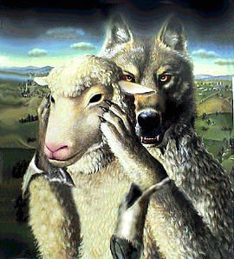
Perverting
The Gospel of Christ
Galatians 1:2-12

Slide 2
Perverting The Gospel of Christ
Galatians 1:2-12 (NKJV) ² and all the brethren who are with me, To the churches of Galatia: ³ Grace to you and peace from God the Father and our Lord Jesus Christ, ⁴ who gave Himself for our sins, that He might deliver us from this present evil age, according to the will of our God and Father, ⁵ to whom be glory forever and ever. Amen. ⁶ I marvel that you are turning away so soon from Him who called you in the grace of Christ, to a different gospel,

Slide 3
Perverting The Gospel of Christ
Galatians 1:2-12 (NKJV) ⁷ which is not another; but there are some who trouble you and want to pervert the gospel of Christ. ⁸ But even if we, or an angel from heaven, preach any other gospel to you than what we have preached to you, let him be accursed. ⁹ As we have said before, so now I say again, if anyone preaches any other gospel to you than what you have received, let him be accursed.

Slide 4
Perverting The Gospel of Christ
Galatians 1:2-12 (NKJV) ¹⁰ For do I now persuade men, or God? Or do I seek to please men? For if I still pleased men, I would not be a bondservant of Christ. ¹¹ But I make known to you, brethren, that the gospel which was preached by me is not according to man. ¹² For I neither received it from man, nor was I taught it, but it came through the revelation of Jesus Christ.

Slide 5
Perverting The Gospel of Christ
Paul was shocked – WHY? - Gal. 1:6 (Brethren had been bewitched / fooled by a perverted gospel - Gal 3:1; 5:4)
The Judaizing teachers - Demanded Gentiles be circumcised, and keep the Law of Moses in order to be justified – (Gal 2:16; Acts 15:1-5)
There is but ONE gospel that saves – (Gal 1:7; 3:1; John 17:17; Eph 4:4-6; Jude 1:3; 2 John 1:9,10; 2 Cor. 11:4)
These false brethren were accursed from Christ and troubling the church - (Gal 1:8,9; 5:1-4; 2 Pet 2).

Slide 6
Perverting The Gospel of Christ
Sadly, there are still false teachers who pervert the gospel of Christ,
Destroying its simplicity – (2 Cor 11:3)
Denying its power – (2 Tim 3:5)
Using a perverted gospel as a means of gain – (1 Tim 6:5; 2 Pet 2:3; Rom 16:17,18)
Disguising themselves under the cloak of grace – (2 Pet 2:18,19)
We must be ready, and willing to stand up to for the truth - (Gal 2:14; Jude 3)

Slide 7
Perverting The Gospel of Christ
Seeking Unity in the Name of Grace - v 6
The true gospel demands unity - NOT unity in diversity of doctrine – but unity based on the truth - (John 17:17-22; 1 Cor. 1:10; Eph 4:1-6; Phili 1:27)
United in denominational error – (1 Cor. 1:11-13; Jn 8:32)
United in undenominational error – (2 Tim 4:3,4)
United in unscriptural practices – (Col. 3:17)

Slide 8
Perverting The Gospel of Christ
Seeking Unity in the Name of Grace - v 6
Shift in preaching and teaching from substance, and doctrine to shallow, superficial topics.
Refusal to talk about certain topics, (institutionalism, denominationalism, IM, MDR, modesty, social drinking, etc.)
Changing the sign . . .
Promoting unity in the name of grace while dismissing doctrine.
Something doesn’t seem right, but I just can’t put my finger on it!
Notes:
Seeks Unity in the Name of Grace - v 6
The New Testament church is certainly commanded to have unity - Eph 4:3
However, this unity is based on speaking the same thing, and having the same mind, and judgment - 1 Cor 1:10
There has been a clear shift in preaching and teaching from substance, and doctrine to shallow, superficial topics.
A part of the new emphasis in preaching is a view of grace, and love of God being accepting of everyone.
Refusal to talk about controversial topics, e.g., institutionalism, denominationalism, premillennialism, instrumental music, necessity of water baptism, MDR, modesty, social drinking, other moral issues, etc.
Churches have begun to change their name on their signs.
Promoters of changing the name of the church say they want to make a distinction.
What distinction? A distinction from brethren that have stood for the truth? A distinction from the doctrine and commandments of Christ?
People are clearly not ashamed of “church” but maybe they are ashamed of being followers of Christ.
These change agents also try to promote unity in the name of grace, but at the cost of doctrine.
These people are willing to accept people who have not even been baptized for the remission of their sins.
Some have even suggested that all that is necessary is belief in the birth, life, death, burial, resurrection, and ascension of Jesus Christ in order to establish unity.
These people are perverting the grace of God and are preaching another gospel!

Slide 9
Perverting The Gospel of Christ
Seeks Confusion Over Clarity - v 7
Pervert - μεταστρέφω, metastrephō - "to transform into something of an opposite character"— Vine's Exp. Dict.
Must question & change the meaning of words – (for; everlasting; became flesh)
Must stretch and distort the context of Scripture – (2 Pet 3:16)
There are difficult passages, but the truth always fits w/ truth.
Notes:
Seeks Confusion Over Clarity - v 7
The idea of perverting the gospel is distorting it, and transforming it into something of an opposite character.
The Judaizers were perverting the gospel into a system of works (law keeping), rather than a system of grace and faith.
Every false teacher who is promoting some false doctrine must change the meaning of words, and stretch and distort the context of Scripture in order to arrive at their false views and notions.
Attempts to show that baptism is not necessary for the forgiveness of sins by misinterpreting the word ‘eis’ (for) to mean “in view of, or because of” instead of the true meaning of in order to accomplish, and attain a certain end - Acts 2:38
These false teachers ignore all scholarship, and context of Scripture - Mk 16:16
The argument usually goes like: since we are only condemned for unbelief, we must not have to be baptized since we won’t be condemned for not being baptized.
This completely ignores the plain teaching of Scripture.
False teachers’ accomplish their goals if they cast doubt on those who they are preaching to. Causing confusion through their espousal of false doctrine is their ultimate goal.
It has been said “truth just makes sense” - the truth fits together. There certainly may be difficult passages, but the truth always makes sense. If someone brings in some new idea that seems to stretch the meaning of a context be careful.

Slide 10
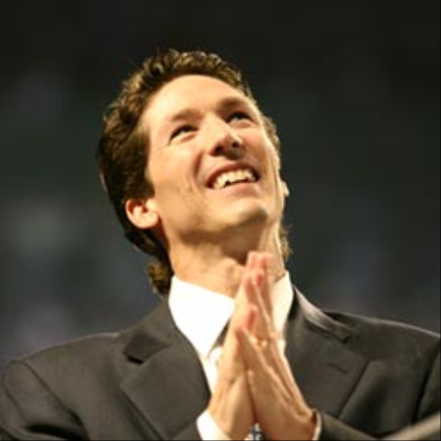
Perverting The Gospel of Christ
Seeks the Favor of Men, Rather than the Favor of God - v 10
You can get more people that way! – (2 Tim. 4:3)
Stressing emotion rather than truth – attempting to stimulate themselves through vain worship and externals - (Prov. 14:12; Jer. 10:23; Mat. 15:7-9)
A positive-emotional-feel good type of preaching – (Jer 23:14,17; 1 Cor. 2:1-5; 2 Tim 4:3,4)
Notes:
Seeks the Favor of Men, Rather than the Favor of God - v 10
Too often people would much rather please themselves while ignoring God.
People become all too concerned about the emotions of worship that they attempt to only stimulate themselves through vain worship.
Churches have begun dimming the lights during worship to try to create an atmosphere that is more emotional, and “spiritual.”
Casualness is considered acceptable in worship to God because it makes people more comfortable. Dress that wouldn’t be acceptable at a sporting event is accepted in the worship assembly.
Creating an atmosphere of pleasure, hand clapping, snapping, humming, and other things have been introduced into singing.
Churches are providing all sorts of social and recreational activities, and have begun to make them a part of the work of the local church. Even if there are distinct collections that are taken, but if they are announcing these things in the assembly, and on websites, then it becomes a part of the local church. The errors of institutionalism will not be discussed.
Preaching in these churches become a positive-mental-feel good type of preaching which seeks to please men, not pleasing God. If we are worried about offending people then where is our main concern - on pleasing men?
There is a certain dignity that comes along with preaching and teaching the gospel. When sermons such as “Who’s Your Daddy?” and “UPS Man Kind of Love” are taught these things are irreverent at best, and blasphemous at worst.
Churches of Christ are trying to appeal to the church of Culture, and ignoring the intentions which God has. How do these things differ from the denominational world?

Slide 11
Perverting The Gospel of Christ
Would Paul be shocked today if he walked in MOST church buildings today? – WHY? - Gal. 1:6
There are still Judaizing teachers – but there are even more perverting the Gospel by ignoring or loosening its demands! -
There is STILL ONLY ONE gospel that saves – (Gal 1:7; 3:1; John 17:17; Eph 4:4-6; Jude 1:3; 2 John 1:9,10; 2 Cor. 11:4)
People are still accursed from Christ and troubling the church - (Gal 1:8,9; 5:1-4; 2 Pet 2).

Slide 12
Perverting The Gospel of Christ
Philippians 1:27 (NKJV) ²⁷ Only let your conduct be worthy of the gospel of Christ, so that whether I come and see you or am absent, I may hear of your affairs, that you stand fast in one spirit, with one mind striving together for the faith of the gospel,

Slide 13
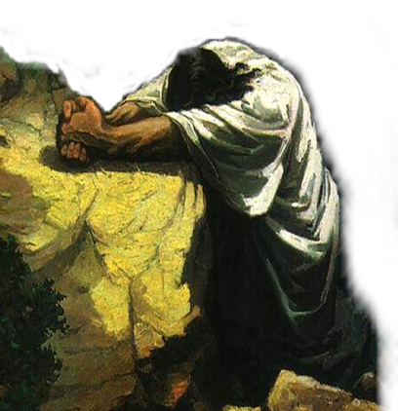
Proclaiming The Gospel of Christ
Facts To Believe – 1 Cor. 15:1-8
Commands To Obey – Mark 16:16; Acts 2:36-38; Rom 6:16-18; 10:16; 2 Thes 1:7-9; Heb. 5:8,9; Jam 2:14-26
Promises To Be Enjoyed – Col 1:5, 23; 1 Pet. 1:3-12

Slide 15
Perverting The Gospel of Christ
Charts by Don McClain
Prepared February 25,26, 2011
Preached February 27, 2011
West 65th Street church of Christ
P.O. Box 190062
Little Rock AR 72219
501-568-1062
Prepared using PPT 2010 –
Email – donmcclain@sbcglobal.net
More PPT & Audio Sermons:
http://w65stchurchofchrist.org/donmaccla/2010SermonPage.html
Note – Many of the transition effects used in this presentation are lost using PPT 2007 Viewer
To view transitions you can download PPT 2010 viewer:
http://www.microsoft.com/downloads/en/details.aspx?displaylang=en&FamilyID=cb9bf144-1076-4615-9951-294eeb832823

