Slide 1

Some Things Those Who Go To Hell
Will Not Have To Do

Slide 2
Is There A Hell
Survey Says…
LESS THAN 50% BELIEVE IN HELL
“We Believe in…”
GOD
SATAN
HELL
UNITED STATES
62.8%
45.4%
49.6%
GREAT BRITAIN
23.8%
12.7%
12.8%
NORWAY
20.1%
13.1%
11.4%
WEST GERMANY
27.3%
9.5%
9.3%
SOURCE: INTERNATIONAL SOCIAL SURVEY PROGRAM (1991)

Slide 3
Many False Views of Hell
Atheist / Humanist – No such thing - - -
Buddhist - Hell is temporary for its inhabitants – Life is cyclic.
Jehovah’s Witnesses - Teach that man does not have an eternal soul –
Seventh Day Adventist’s – Teach that eternal existence is conditional.
Catholicism – Purgatory - Second chance -

Slide 4

The Bible Teaches That Hell Is A Real Place
In order to be a faithful steward of the Gospel as an evangelist, one must preach “all the counsel of God” (Acts 20:27).
“All the counsel of God” includes Bible teaching about Hell – (Mark 9:44,45,46; Mat 25:41,46; 2 Thes. 1:8,9; Rev. 20:10 )

Slide 5
The Term “Hell” Is Found 23 Times In the KJV of The N.T.
Three different Greek words for the term hell in the KJV:
  Hades –(11) The unseen realm – realm of disembodied spirits - Ac 2:27, 31; Rev 20:13
  Tartarus – (1) chains of darkness, to be reserved for judgment; 2Pe 2:4
  Gehenna - (12) Mt 10:28; Mk 9:43,45,47

Slide 6
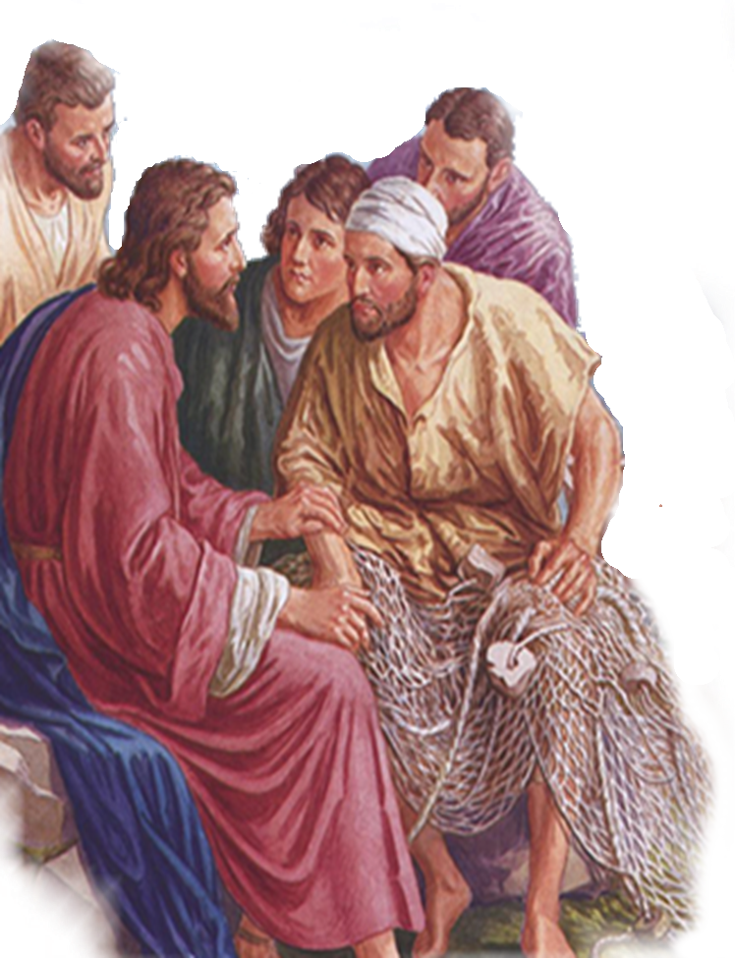
The Lord Taught That Hell Is Real
Matthew 5:29
Matthew 7:13
Matthew 8:12
Matthew 10:28
Matthew 13:41-50
Matthew 25:41-46
Mark 9:44-48
John 15:6
Of The 12 Occurrences Of Gehenna, Jesus Used It 11 Times.
Notes:
Matthew 5:22 (KJV)
22 But I say unto you, That whosoever is angry with his brother without a cause shall be in danger of the judgment: and whosoever shall say to his brother, Raca, shall be in danger of the council: but whosoever shall say, Thou fool, shall be in danger of hell fire.
Matthew 5:29 (KJV)
29 And if thy right eye offend thee, pluck it out, and cast it from thee: for it is profitable for thee that one of thy members should perish, and not that thy whole body should be cast into hell.
Matthew 5:30 (KJV)
30 And if thy right hand offend thee, cut it off, and cast it from thee: for it is profitable for thee that one of thy members should perish, and not that thy whole body should be cast into hell.
Matthew 10:28 (KJV)
28 And fear not them which kill the body, but are not able to kill the soul: but rather fear him which is able to destroy both soul and body in hell.
Matthew 18:9 (KJV)
9 And if thine eye offend thee, pluck it out, and cast it from thee: it is better for thee to enter into life with one eye, rather than having two eyes to be cast into hell fire.
Matthew 23:15 (KJV)
15 Woe unto you, scribes and Pharisees, hypocrites! for ye compass sea and land to make one proselyte, and when he is made, ye make him twofold more the child of hell than yourselves.
Matthew 23:33 (KJV)
33 Ye serpents, ye generation of vipers, how can ye escape the damnation of hell?
Mark 9:43 (KJV)
43 And if thy hand offend thee, cut it off: it is better for thee to enter into life maimed, than having two hands to go into hell, into the fire that never shall be quenched:
Mark 9:45 (KJV)
45 And if thy foot offend thee, cut it off: it is better for thee to enter halt into life, than having two feet to be cast into hell, into the fire that never shall be quenched:
Mark 9:47 (KJV)
47 And if thine eye offend thee, pluck it out: it is better for thee to enter into the kingdom of God with one eye, than having two eyes to be cast into hell fire:
Luke 12:5 (KJV)
5 But I will forewarn you whom ye shall fear: Fear him, which after he hath killed hath power to cast into hell; yea, I say unto you, Fear him.
James 3:6 (KJV)
6 And the tongue is a fire, a world of iniquity: so is the tongue among our members, that it defileth the whole body, and setteth on fire the course of nature; and it is set on fire of hell.

Slide 7
The Lord Taught That Hell Is Real
A Place of Torment – Luke 16:23,28; Rev. 20:10
A Place of outer darkness – Mt 8:12; 22:13; 25:30;
A place of unquenchable fire - Mark 9:44,45,46; Mt 13:50
Everlasting punishment - Mat 25:41,46; 2 Thes. 1:8,9
Of The 12 Occurrences Of Gehenna, Jesus Used It 11 Times.
Notes:
Matthew 5:22 (KJV)
22 But I say unto you, That whosoever is angry with his brother without a cause shall be in danger of the judgment: and whosoever shall say to his brother, Raca, shall be in danger of the council: but whosoever shall say, Thou fool, shall be in danger of hell fire.
Matthew 5:29 (KJV)
29 And if thy right eye offend thee, pluck it out, and cast it from thee: for it is profitable for thee that one of thy members should perish, and not that thy whole body should be cast into hell.
Matthew 5:30 (KJV)
30 And if thy right hand offend thee, cut it off, and cast it from thee: for it is profitable for thee that one of thy members should perish, and not that thy whole body should be cast into hell.
Matthew 10:28 (KJV)
28 And fear not them which kill the body, but are not able to kill the soul: but rather fear him which is able to destroy both soul and body in hell.
Matthew 18:9 (KJV)
9 And if thine eye offend thee, pluck it out, and cast it from thee: it is better for thee to enter into life with one eye, rather than having two eyes to be cast into hell fire.
Matthew 23:15 (KJV)
15 Woe unto you, scribes and Pharisees, hypocrites! for ye compass sea and land to make one proselyte, and when he is made, ye make him twofold more the child of hell than yourselves.
Matthew 23:33 (KJV)
33 Ye serpents, ye generation of vipers, how can ye escape the damnation of hell?
Mark 9:43 (KJV)
43 And if thy hand offend thee, cut it off: it is better for thee to enter into life maimed, than having two hands to go into hell, into the fire that never shall be quenched:
Mark 9:45 (KJV)
45 And if thy foot offend thee, cut it off: it is better for thee to enter halt into life, than having two feet to be cast into hell, into the fire that never shall be quenched:
Mark 9:47 (KJV)
47 And if thine eye offend thee, pluck it out: it is better for thee to enter into the kingdom of God with one eye, than having two eyes to be cast into hell fire:
Luke 12:5 (KJV)
5 But I will forewarn you whom ye shall fear: Fear him, which after he hath killed hath power to cast into hell; yea, I say unto you, Fear him.
James 3:6 (KJV)
6 And the tongue is a fire, a world of iniquity: so is the tongue among our members, that it defileth the whole body, and setteth on fire the course of nature; and it is set on fire of hell.

Slide 8
After Death – What Then?
Soul
Righteous
Soul
Comfort
Luke 16:22
Luke 23:43
JUDGMENT
BODY
DEATH
BODY
HADES
Luke 16:25,26; Rev 1:18; 20:13
GRAVE
Resurrection
Reunion of Soul & Body
BODY
Torment
Tartarus
Luke 16:23,24; 2 Peter 2:4
Wicked
Soul
Soul
Notes:
Revelation 20:13
The sea gave up the dead—Those who had been drowned in it, and those millions slain in naval contests, who had no other grave.
And death—All who died by any kind of disease. Death is here personified, and represented as a keeper of defunct human beings; probably no more than earth or the grave is meant, as properly belonging to the empire of death.
And hell—Ἁιδης, Hades, the place of separate spirits. The sea and death have the bodies of all human beings; hades has their spirits. That they may be judged, and punished or rewarded according to their works, their bodies and souls must be reunited; hades, therefore, gives up the spirits; and the sea and the earth give up the bodies.
Revelation 20:14
And death and hell were cast into the lake—Death himself is now abolished, and the place for separate spirits no longer needful. All dead bodies and separated souls being rejoined, and no more separation of bodies and souls by death to take place, consequently the existence of these things is no farther necessary.
—Adam Clarke's Commentary

Slide 9
After Death – What Then?
Righteous
Soul
Body & Soul
Righteous
Soul
Comfort
Luke 16:22
Luke 23:43
JUDGMENT
BODY
HEAVEN
DEATH
BODY
HADES
Luke 16:25,26; Rev 1:18; 20:13
Eternity
GRAVE
Resurrection
Reunion of Soul & Body
HELL
BODY
Gehenna
Mk 9:43
Torment
Tartarus
Luke 16:23,24; 2 Peter 2:4
Wicked
Soul
Body & Soul
Wicked
Soul
Notes:
Revelation 20:13
The sea gave up the dead—Those who had been drowned in it, and those millions slain in naval contests, who had no other grave.
And death—All who died by any kind of disease. Death is here personified, and represented as a keeper of defunct human beings; probably no more than earth or the grave is meant, as properly belonging to the empire of death.
And hell—Ἁιδης, Hades, the place of separate spirits. The sea and death have the bodies of all human beings; hades has their spirits. That they may be judged, and punished or rewarded according to their works, their bodies and souls must be reunited; hades, therefore, gives up the spirits; and the sea and the earth give up the bodies.
Revelation 20:14
And death and hell were cast into the lake—Death himself is now abolished, and the place for separate spirits no longer needful. All dead bodies and separated souls being rejoined, and no more separation of bodies and souls by death to take place, consequently the existence of these things is no farther necessary.
—Adam Clarke's Commentary

Slide 10
The Bible Teaches That Hell Is A Real Place
Many Will Go There
Matthew 25:41-46 (NKJV)
⁴¹ Then He will also say to those on the left hand, 'Depart from Me, you cursed, into the everlasting fire prepared for the devil and his angels: . . .

Slide 11
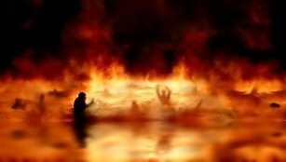
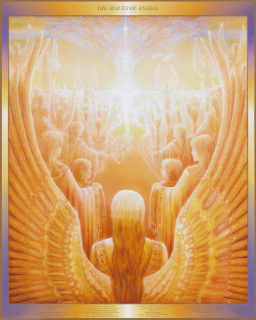
The Bible Teaches That Hell Is A Real Place
Many Will Go There
“And these will go away into everlasting punishment, but the righteous into eternal life." - Matt. 25:46
Everlasting Punishment In Hell
Eternal
Everlasting Life In Heaven
You will be in one of these two places for all eternity - Where will you be? (Mat 7:13,14)

Slide 12
The Bible Teaches That Hell Is A Real Place
Many Will Go There
Revelation 21:8 (NKJV)
⁸ But the cowardly, unbelieving, abominable, murderers, sexually immoral, sorcerers, idolaters, and all liars shall have their part in the lake which burns with fire and brimstone, which is the second death."

Slide 13
The Bible Teaches That Hell Is A Real Place
Many Will Go There
2 Thessalonians 1:6-9 (NKJV)
⁷ . . . when the Lord Jesus is revealed from heaven with His mighty angels, ⁸ in flaming fire taking vengeance on those who do not know God, and on those who do not obey the gospel of our Lord Jesus Christ. ⁹ These shall be punished with everlasting destruction from the presence of the Lord and from the glory of His power,

Slide 14
Some Things Those In Hell
Will Not Have To Do . . .
Is obeying God a BURDEN to you?
1 John 5:2,3; Jer. 23:33-38
No more need or opportunities to learn God’s will – 2 Tim 2:15; Eph 5:17; Prov. 14:8
No more choices between good and evil – Lk 16:25; Heb 9:27; 2 Cor. 5:10,11
No free will - Luke 16:19-31

Slide 15
Some Things Those In Hell
Will Not Have To Do . . .
Is obeying God a BURDEN to you?
1 John 5:2,3; Jer. 23:33-38
Establishing authority for all we do - (Col 3:17; Mat 7:21-23)
Being salt and light of the world – (Mat 5:13,14)
Fighting the good fight of faith – (2 Tim 4:6-8)
Offending your friends with the truth – (Gal 4:16)

Slide 16
Some Things Those In Hell
Will Not Have To Do . . .
Is Worship a WASTE of TIME to you?
John 4:24; Hebrews 10:24,25
No more singing
No more having to pray
No more Lord’s Supper
No more contributions -
No more sermons / Bible studies
No encouraging words . . .

Slide 17
Some Things Those In Hell
Will Not Have To Do . . .
Some View Holy Living As “No FUN”
2 Cor. 6:14-7:1; 1 Peter 1:13-21; Hebrews 12:14
Existing forever and ever along side the most unholy beings imaginable – Mat 25:41
If you lift up your eyes in hell – how much will all the “fun” you had on earth mean to you then? – 2 Tim 3:4

Slide 18
Some Things Those In Hell
Will Not Have To Do . . .
Some See Sacrificing Material Things To Gain Spiritual Life A Dumb Investment
Luke 9:23-26; Luke 12:13-21; 2 Cor. 8,9
Our duty to financially support God’s work – Mal. 3:8,9; 1 Cor. 16:1,2; Rom 15:27; Acts 20:35
Supporting the preaching of the gospel – 1 Cor. 9:11
Helping those in need – Acts 2:44,46; 4:32; 2 Cor. 9:6-15

Slide 19
Some Things Those In Hell
Will Not Have To Do . . .
Some See Sacrificing Material Things To Gain Spiritual Life A Dumb Investment
Luke 9:23-26; Luke 12:13-21; 2 Cor. 8,9
Matthew 16:26 (NKJV)
²⁶ For what profit is it to a man if he gains the whole world, and loses his own soul? Or what will a man give in exchange for his soul?

Slide 20
The Bible Teaches That Hell Is A Real Place
Many Will Go There
Revelation 20:10-15 (NKJV)
¹⁰ The devil, who deceived them, was cast into the lake of fire and brimstone where the beast and the false prophet are. And they will be tormented day and night forever and ever. . . . ¹³ The sea gave up the dead who were in it, and Death and Hades delivered up the dead who were in them. . . .

Slide 21
The Bible Teaches That Hell Is A Real Place
Many Will Go There
Revelation 20:10-15 (NKJV)
And they were judged, each one according to his works. ¹⁴ Then Death and Hades were cast into the lake of fire. This is the second death. ¹⁵ And anyone not found written in the Book of Life was cast into the lake of fire.

Slide 22
If Your Name Is Not
In The Book of Life
No More Demands On Your Loyalty
No More Demands On Your Time
No More Demands On Your Relationships
No More Demands On Your Self-Control

Slide 23

Your Name Can Be Written
In The Book of Life
Obey the Gospel (2 Thess. 1:7-10)
  “Hear the word” (Rom. 10:17)
  “Believe the truth” (Mk. 16:15, 16)
  “Repent” (Acts 2:38)
  “Confess Jesus” (Acts 8:37; Rom. 10:8, 9)
  “Be baptized into Christ” (Acts 2:41)
Patiently continue (Rom. 2:7)

Slide 24
Your Name Can Be Written
In The Book of Life
The Opportunity To Choose Heaven Is A Great Blessing!
If you miss heaven it will be your fault!!

Slide 25
Your Name Can Be Written
In The Book of Life
Need to make some changes? - 2 Cor 6:2
Heaven or hell is your choice! – Deut 30:19; 2 Pet. 3:9
Will You Regret for ALL Eternity That You Rejected The Gospel?

Slide 27
Some Things Those In Hell
Will Not Have To Do . . .
Charts by Don McClain
Prepared September 16,17, 2011
Preached September 18, 2011
West 65th Street church of Christ
P.O. Box 190062
Little Rock AR 72219
501-568-1062
Prepared using PPT 2010
Email – donmcclain@sbcglobal.net
More PPT & Audio Sermons:
http://w65stchurchofchrist.org/donmaccla/2010SermonPage.html
Note – Many of the transition effects used in this presentation may be lost using PPT 2007 Viewer
http://www.microsoft.com/downloads/details.aspx?FamilyID=cb9bf144-1076-4615-9951-294eeb832823&displaylang=en

Slide 28

Matthew 25:24-30 (NKJV)
²⁴ Then he who had received the one talent came and said, 'Lord, I knew you to be a hard man, reaping where you have not sown, and gathering where you have not scattered seed. ²⁵ And I was afraid, and went and hid your talent in the ground. Look, there you have what is yours.'

Slide 29
Matthew 25:24-30 (NKJV)
²⁶ But his lord answered and said to him, 'You wicked and lazy servant, you knew that I reap where I have not sown, and gather where I have not scattered seed. ²⁷ So you ought to have deposited my money with the bankers, and at my coming I would have received back my own with interest.

Slide 30
Matthew 25:24-30 (NKJV)
²⁸ Therefore take the talent from him, and give it to him who has ten talents. ²⁹ For to everyone who has, more will be given, and he will have abundance; but from him who does not have, even what he has will be taken away. ³⁰ And cast the unprofitable servant into the outer darkness. There will be weeping and gnashing of teeth.'

