Slide 1
2 Timothy 2:1-26
Be Strong In

Slide 2
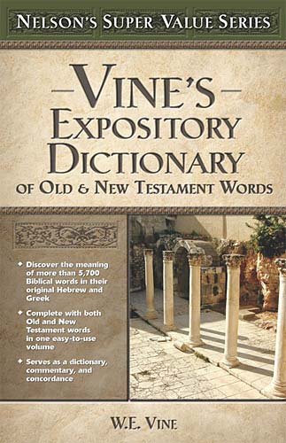
Be Strong In Grace
. . . the friendly disposition from which the kindly act proceeds, graciousness, loving-kindness, goodwill generally, e.g., Acts 7:10; especially with reference to the Divine favor or "grace," e.g., Acts 14:26; in this respect there is stress on its freeness and universality, its spontaneous character, as in the case of God's redemptive mercy, and the pleasure or joy He designs for the recipient; thus it is set in contrast with debt, Rom. 4:4, 16, . . .

Slide 3
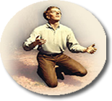
Be Strong In Grace
The
Basis of
Salvation
God's Universal Kindness, Love &
Mercy.
The Gracious
Gift of God’s Son & The Gospel
The
Conditions
of
Salvation
The
Provision
of
Salvation
Faith – Repentance – Confession – Baptism - Faithfulness
Notes:
Keys to Understanding the Issue

Slide 4
Be Strong In Grace
2 Timothy 2:1-26 (NKJV) ¹ You therefore, my son, be strong in the grace that is in Christ Jesus. ² And the things that you have heard from me among many witnesses, commit these to faithful men who will be able to teach others also. ³ You therefore must endure hardship as a good soldier of Jesus Christ. ⁴ No one engaged in warfare entangles himself with the affairs of this life, that he may please him who enlisted him as a soldier.

Slide 5
Be Strong In Grace
2 Timothy 2:1-26 (NKJV) ⁵ And also if anyone competes in athletics, he is not crowned unless he competes according to the rules. ⁶ The hard-working farmer must be first to partake of the crops. ⁷ Consider what I say, and may the Lord give you understanding in all things. ⁸ Remember that Jesus Christ, of the seed of David, was raised from the dead according to my gospel,

Slide 6
Be Strong In Grace
2 Timothy 2:1-26 (NKJV) ⁹ for which I suffer trouble as an evildoer, even to the point of chains; but the word of God is not chained. ¹⁰ Therefore I endure all things for the sake of the elect, that they also may obtain the salvation which is in Christ Jesus with eternal glory. ¹¹ This is a faithful saying: For if we died with Him, We shall also live with Him. ¹² If we endure, We shall also reign with Him. If we deny Him, He also will deny us.

Slide 7
Be Strong In Grace
2 Timothy 2:1-26 (NKJV) ¹³ If we are faithless, He remains faithful; He cannot deny Himself. ¹⁴ Remind them of these things, charging them before the Lord not to strive about words to no profit, to the ruin of the hearers. ¹⁵ Be diligent to present yourself approved to God, a worker who does not need to be ashamed, rightly dividing the word of truth. ¹⁶ But shun profane and idle babblings, for they will increase to more ungodliness.

Slide 8
Be Strong In Grace
2 Timothy 2:1-26 (NKJV) ¹⁷ And their message will spread like cancer. Hymenaeus and Philetus are of this sort, ¹⁸ who have strayed concerning the truth, saying that the resurrection is already past; and they overthrow the faith of some. ¹⁹ Nevertheless the solid foundation of God stands, having this seal: "The Lord knows those who are His," and, "Let everyone who names the name of Christ depart from iniquity."

Slide 9
Be Strong In Grace
2 Timothy 2:1-26 (NKJV) ²⁰ But in a great house there are not only vessels of gold and silver, but also of wood and clay, some for honor and some for dishonor. ²¹ Therefore if anyone cleanses himself from the latter, he will be a vessel for honor, sanctified and useful for the Master, prepared for every good work. ²² Flee also youthful lusts; but pursue righteousness, faith, love, peace with those who call on the Lord out of a pure heart.

Slide 10
Be Strong In Grace
2 Timothy 2:1-26 (NKJV) ²³ But avoid foolish and ignorant disputes, knowing that they generate strife. ²⁴ And a servant of the Lord must not quarrel but be gentle to all, able to teach, patient, ²⁵ in humility correcting those who are in opposition, if God perhaps will grant them repentance, so that they may know the truth, ²⁶ and that they may come to their senses and escape the snare of the devil, having been taken captive by him to do his will.

Slide 11
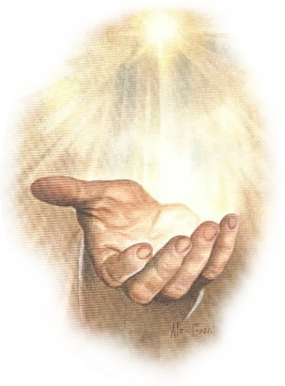
Be Strong In Grace
Be Strong In Grace
We stand in GRACE by faith – 1:5; Rom. 5:1,2; 1 Cor. 1:24
Standing in the “true grace of God” is conditional - 1 Peter 5:6-12; (see entire context of 1 Peter); Acts 13:43; Gal. 5:4
We are to grow in grace – 2 Peter 1:2-11; 3:14-17

Slide 12
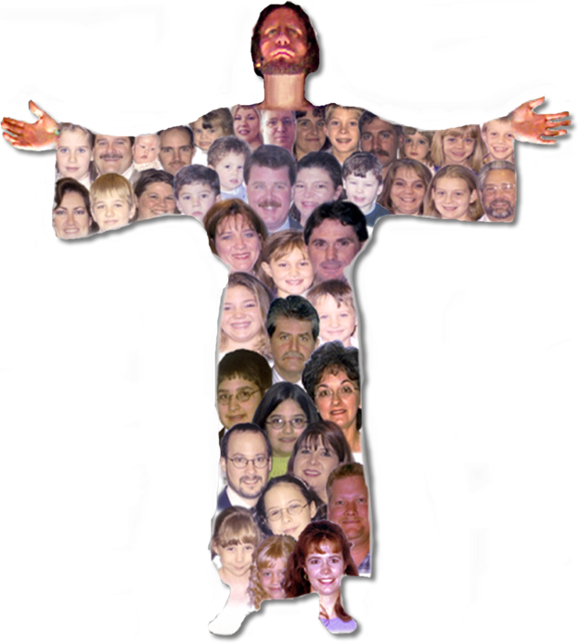
Be Strong In Grace
That Is In Christ Jesus
One cannot be “strong in grace” and not be in Christ – Rom. 8:1,2; 2 Cor. 5:17
All spiritual blessings are in Christ – Ephesians 1 (therefore, there are no spiritual blessings outside of Christ)

Slide 13
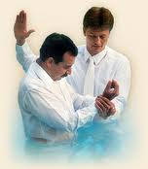
Be Strong In Grace
“That Is In Christ Jesus” – (2:1)
Ephesians 1
Outside Christ
Lost Without Hope
NO spiritual blessings
NOT chosen
NOT children of God
NOT accepted
NO redemption
NO forgiveness
NO heavenly Inheritance
Inside Christ
Saved / Hope
ALL spiritual blessings
Chosen
A child of God
Accepted
Redeemed
Forgiven
A Heavenly Inheritance
Baptized
Into
Rom. 6:3-6
Gal. 3:26,27
Acts 2:38,47

Slide 14
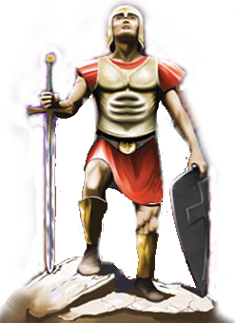
Be Strong In Grace
Things Necessary In Context
Share gospel with others – (2:2; [sound words; pattern; doctrine; source – 1:13; 3:10,14] cf. Acts 8:4; 1 Thes. 1:8)
Endure hardship as a good soldier – (2:3,4; 1:18; 1 Tim 6:9-12; 2 Cor. 10:3-5; Eph. 6:10-18)
Compete according to the rules – (2:5; 4:7,8; 1 Cor. 9:24-27; Heb. 12:1-3)
Work hard like a farmer – (2:6-13; 1 Cor. 3:6-9; 9:7-11; [Labor precedes reward – Luke 8:15; Rom. 2:7; Gal. 6:9; Heb 6:15; 10:36; James 5:7-11; 1 Pet 5:10]

Slide 15
Be Strong In Grace
Things Necessary In Context
Diligence – rightly dividing the word of truth – (2:15; 4:12-16; 2 Cor. 5:9; Heb 5:11-14)
Resist error – correcting error in humility – (2:14,16-18,23-26; 4:2-5; Gal. 2:4,5,11-14,21; 5:12; Jude 1:3,4)
Depart from lawlessness – (2:19; Tit 2:14; Mat. 7:21-23; Jn 14:15,21,23,24; Rom 6:1,16-23; 8:1,2; [follow truth – 1:13; 3:10,14-17]).
Flee youthful lust – (2:22; 1 Cor. 3:6-9; 9:7-11; [Note contrast – pursue righteousness, faith, love, peace, calling with a pure heart]

Slide 16
Be Strong In Grace
Are You In Christ?
(Have you by faith been baptized into Him?)
Romans 6:3,4
1Corinthians 12:13
Galatians 3:26,27
Colossians 2:11-13

Slide 17
Be Strong In Grace
Are You Doing What’s Necessary to Stand Strong In The Unmerited Favor of God?
Sharing the gospel –
Enduring hardship as a good soldier
Competing according to the rules
Working hard like a farmer
Diligently seeking to be approved by God – rightly dividing the word of truth
Resisting error – correcting error in humility
Departing from lawlessness
Fleeing lust

Slide 19
Charts by Don McClain
Prepared May 18-21, 2011;
Preached May 22, 2011
West 65th Street church of Christ
P.O. Box 190062
Little Rock AR 72219
501-568-1062
Prepared using PPT 2010
http://w65stchurchofchrist.org/donmaccla/2011SermonPage.html
Email – donmcclain@sbcglobal.net
You can download Power Point Viewer for free:
http://www.microsoft.com/downloads/en/details.aspx?FamilyID=cb9bf144-1076-4615-9951-294eeb832823

