Slide 1
The Point of No Return
Is there A Line That One Can Cross That Returning To God Is Impossible?
Notes:
Crossing the Rubicon is a metaphor for deliberately proceeding past a point of no return. The phrase originates with Julius Caesar's invasion of Ancient Rome (January 10, 49 BC), when he led his army across the Rubicon River in violation of law, thus making conflict inevitable. Therefore the term "the Rubicon" is used as a synonym to the "point of no return". Alea iacta est ("The dice is cast"), which is reportedly what Caesar said during the aforementioned crossing of the Rubicon. The equivalent expressions Burn one's bridges. The expression is derived from the idea of burning down a bridge after crossing it during a military campaign, leaving no option but to win, and motivating those who otherwise might want to retreat. This expression can also be used figuratively, as in, "On my last day at my old job, I told my boss what I really think about the company. I guess I burned my bridges."
Burn one's boats, a variation of burning one's bridges. The Muslim commander Tariq ibn Ziyad, upon setting foot on the Iberian Peninsula (711 AD), ordered his ships to be burnt, so that his men had no choice but to thrust forward and conquer the peninsula. The same strategy was used by Hernan Cortes (1485-1547), who burned and sank his boats, so no other option was left than to advance into Aztec territory. It happened several times in World history such as the famous Mutiny_on_the_Bounty#Mutineers_on_Pitcairn_Island.
"Break the woks and sink the boats (破釜沉舟)", an ancient Chinese saying referring to Xiang Yu's order at the Battle of Julu (207 BC); by fording a river and destroying all means of re-crossing it, he committed his army to a struggle to the end with the Qin and eventually achieved victory.

Slide 2
The Point of No Return
“Crossing the Rubicon” - Julius Caesar's invasion of Ancient Rome (Jan 10, 49 BC),
“Burn one's bridges” – Military expression – the point of no retreat.
“Burn one's boats” - Tariq ibn Ziyad, upon setting foot on the Iberian Peninsula (711 AD), - Hernan Cortes (1485-1547),
"Break the woks and sink the boats” - Xiang Yu's order at the Battle of Julu (207 BC);
Notes:
Crossing the Rubicon is a metaphor for deliberately proceeding past a point of no return. The phrase originates with Julius Caesar's invasion of Ancient Rome (January 10, 49 BC), when he led his army across the Rubicon River in violation of law, thus making conflict inevitable. Therefore the term "the Rubicon" is used as a synonym to the "point of no return". Alea iacta est ("The dice is cast"), which is reportedly what Caesar said during the aforementioned crossing of the Rubicon. The equivalent expressions Burn one's bridges. The expression is derived from the idea of burning down a bridge after crossing it during a military campaign, leaving no option but to win, and motivating those who otherwise might want to retreat. This expression can also be used figuratively, as in, "On my last day at my old job, I told my boss what I really think about the company. I guess I burned my bridges."
Burn one's boats, a variation of burning one's bridges. The Muslim commander Tariq ibn Ziyad, upon setting foot on the Iberian Peninsula (711 AD), ordered his ships to be burnt, so that his men had no choice but to thrust forward and conquer the peninsula. The same strategy was used by Hernan Cortes (1485-1547), who burned and sank his boats, so no other option was left than to advance into Aztec territory. It happened several times in World history such as the famous Mutiny_on_the_Bounty#Mutineers_on_Pitcairn_Island.
"Break the woks and sink the boats (破釜沉舟)", an ancient Chinese saying referring to Xiang Yu's order at the Battle of Julu (207 BC); by fording a river and destroying all means of re-crossing it, he committed his army to a struggle to the end with the Qin and eventually achieved victory.

Slide 3
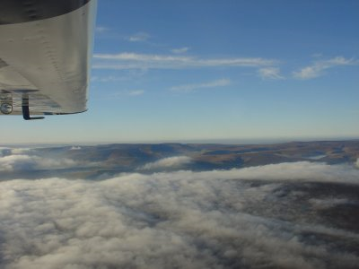
The Point of No Return
"Radius of Action Formula"—originated as a technical term in air navigation to refer to the point on a flight at which, due to fuel consumption, a plane is no longer capable of returning to its airfield of original takeoff.

Slide 4
The Point of No Return
Pharaoh –
Exodus 4:21; 7:3,4,13, 14; 8:15,19,32; 9:7,34,35; 10:1
Saul –
1 Samuel 15:23,26;
Israel –
Isaiah 48:4; 44:18,20
Judah –
Jeremiah 7:16-24

Slide 5
The Point of No Return
Proverbs 29:1 (NKJV) ¹ He who is often rebuked, and hardens his neck, Will suddenly be destroyed, and that without remedy.

Slide 6
The Point of No Return
“He who is often rebuked”
Rejection of Spiritual Instruction
Physical evidence – (Rom 1:20; Ps 19:1; 94:9; 143:5)
Circumstances – (death of loved one / Birth / hardships / moments of decision)
God’s word – (Prov. 1:14-31; John 5,6,8; 12:44-50)

Slide 7
The Point of No Return
“and hardens his neck,”
Stubborn Disobedience
Openly defiant – (Psalm 14:1)
Pride – (Neh 9:16,29; Jer. 13:15-17; 44:10,16,17; Jam 4:6-10)
Covetousness – (Ez 33:31)
Pleasure of sin – (2 Tim 3:4; Eph 4:17-19; 2 Thes 2:10-12)
Procrastination - (Prov 27:1; Acts 24:22-27; James 4:13-17; 2 Cor. 6:1; Heb 3:7; 4:7)
Notes:
When a man has pleasure in unrighteousness – he chooses that which is deceptive – it is wrapped in delusion – It is part of God’s righteous judgment that those who choose the delusion instead of the truth that they receive what they want – A man wants his pleasure – so here comes a preacher preaching he can be saved while continuing in his sinful life – he joyfully believes him.

Slide 8
The Point of No Return
“and hardens his neck,”
Stubborn Disobedience
"The difference between perseverance and obstinacy is that one comes from a strong will, and the other from a strong won't."
~ Henry Ward Beecher ~
Notes:
When a man has pleasure in unrighteousness – he chooses that which is deceptive – it is wrapped in delusion – It is part of God’s righteous judgment that those who choose the delusion instead of the truth that they receive what they want – A man wants his pleasure – so here comes a preacher preaching he can be saved while continuing in his sinful life – he joyfully believes him.

Slide 9
The Point of No Return
“Will suddenly be destroyed,”
Sudden Destruction
Separated from God – (Isaiah 59:1,2; Prov. 6:15; 1 Tim 5:6)
Literally, “shall be broken” – (Pro 6:15 – Not instant physical death – but spiritually broken beyond the possibility of restoration – Jer. 19:11,15; 1 Tim. 4:2)
Strong delusion – (2 Thes. 2:10-12; Ps. 81:11,12; Isa. 29:9-24; Jhn 12:39-43; Rom 1:21-25,28)
Notes:
The door of penitence, to which earnest, well-meant admonition calls a man, does not always remain open. He who with stiff-necked persistence in sin and in self-delusion sets himself in opposition to all endeavours to save his soul, shall one day suddenly, and without the prospect and possibility of restoration (cf. Jer_19:11), become a wreck.
literally, “shall be broken” Pro_6:15.

Slide 10
The Point of No Return
“that without remedy.”
Without Remedy
God will not refuse the truly penitent – (Deut. 4:29,30; Ezek. 18:21-32; Rom. 2:4; 2 Pet. 3:9; Rev. 3:17-24)
But the heart can be so destroyed by ones own sin that he will not repent – (Jer. 7:13-16; Heb. 6:4-6; 10:26-31; 13:12-17; Luke 13:24)
Notes:
The door of penitence, to which earnest, well-meant admonition calls a man, does not always remain open. He who with stiff-necked persistence in sin and in self-delusion sets himself in opposition to all endeavours to save his soul, shall one day suddenly, and without the prospect and possibility of restoration (cf. Jer_19:11), become a wreck.
literally, “shall be broken” Pro_6:15.

Slide 11
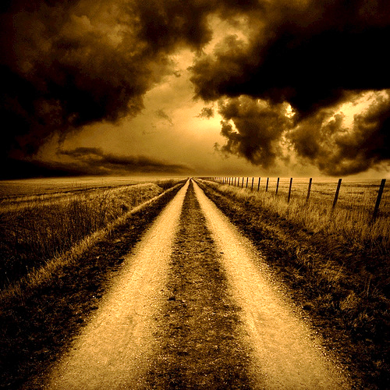
The Point of No Return
Sin / Repent
Stumble / Repent
Stumble / Repent
Attitude and Direction is the Difference

Slide 12
The Point of No Return
Sin / Sorrow, but refuses to repent
Sin more / Rejects God’s plea
Sins even more / hardens heart
Sins even more / Heart destroyed
Sin way of life / No remedy
Attitude and Direction is the Difference

Slide 13
The Point of No Return
“that without remedy.”
Without Remedy
There are some that preaching, pleading, and loving will not penetrate their calloused heart!
They have hardened their hearts against the truth –
They have destroyed their conscience so that they cannot feel their guilt and need –
They are without REMEDY
Notes:
The door of penitence, to which earnest, well-meant admonition calls a man, does not always remain open. He who with stiff-necked persistence in sin and in self-delusion sets himself in opposition to all endeavours to save his soul, shall one day suddenly, and without the prospect and possibility of restoration (cf. Jer_19:11), become a wreck.
literally, “shall be broken” Pro_6:15.

Slide 14
The Point of No Return
2 Peter 3:9 (NKJV) ⁹ The Lord is not slack concerning His promise, as some count slackness, but is longsuffering toward us, not willing that any should perish but that all should come to repentance.

Slide 15
The Point of No Return
Today is the day of salvation – 2 Cor. 6:2; Heb 3:7; 4:7; 2 Pet. 3:10-14
Jesus invites you to come – Mat. 11:28-30; Rev. 22:17
Satan wants you to resist, reject God and be destroyed!
How will you respond to God’s rebuke, mercy and LOVE?

Slide 16
The Point of No Return
There is a choice you have to make, In everything you do. And you must always keep in mind, The choice you make makes you.
In the little booklet, Bits and Pieces,

Slide 18
The Point of No Return
Charts by Don McClain
Prepared February 10-12, 2011
Preached February 13, 2011
West 65th Street church of Christ
P.O. Box 190062
Little Rock AR 72219
501-568-1062
Prepared using PPT 2010 –
Email – donmcclain@sbcglobal.net
More PPT & Audio Sermons:
http://w65stchurchofchrist.org/donmaccla/2010SermonPage.html
Note – Many of the transition effects used in this presentation are lost using PPT 2007 Viewer
To view transitions you can download PPT 2010 viewer:
http://www.microsoft.com/downloads/en/details.aspx?displaylang=en&FamilyID=cb9bf144-1076-4615-9951-294eeb832823

