Slide 1

What Does the Lord’s Supper Mean to You?

Slide 2
What Does the Lord’s Supper Mean to You?
Identified As ...
The Lord’s Supper (1 Cor 11:20)
Breaking bread (Acts 20:7; 2:42)
Communion (1 Cor 10:16)
Cup of the Lord (1 Cor 10:21)
The Lord’s Table (1 Cor 10:21)
Eating the bread & drinking the cup – (1 Cor 11:26-29)
Feast of Charity (Jude 12)

Slide 3
What Does the Lord’s Supper Mean to You?
Matthew 26:26-29 (NKJV)
²⁶ And as they were eating, Jesus took bread, blessed and broke it, and gave it to the disciples and said, "Take, eat; this is My body."
²⁷ Then He took the cup, and gave thanks, and gave it to them, saying, "Drink from it, all of you.
²⁸ For this is My blood of the new covenant, which is shed for many for the remission of sins.
²⁹ But I say to you, I will not drink of this fruit of the vine from now on until that day when I drink it new with you in My Father's kingdom."

Slide 4
What Does the Lord’s Supper Mean to You?
“Take eat . . . Drink from it all of you” (Mat. 26:26,27)
“Take eat” – a command for all Christians – (1 Cor 11:23,24)
“This is My body” – The unleavened bread signifies the flesh of Jesus — (Mat. 26:26; Mk 14:22; Lk 22:19; 1 Cor 11:24)
“This is My blood of the new covenant” – The fruit of the vine signifies the blood of the new covenant which was shed for our sins – (Mat 26:27,28; Mk 14:24; Luke 22:20; 1 Cor. 11:25)
Notes:
emblem or symbol to recall to their remembrance his sufferings.— Barnes' Notes on the New Testament
"Drink from it, all of you.
²⁸ For this is My blood of the new covenant, which is shed for many for the remission of sins

Slide 5
What Does the Lord’s Supper Mean to You?
“Take eat . . . Drink from it all of you” (Mat. 26:26,27)
To be Done with Reverence - Mat. 26:26-29; 1 Cor 11:27, 29
To be Done with Self-Examination - 1 Cor 11:28
In the assembly - Acts 20:7; 1 Cor 11:17,20,33; Heb 10:25
To be Done on the first day of the week - 1 Cor 16:1-2; Acts 20:7

Slide 6
What Does the Lord’s Supper Mean to You?
Luke 22:19-20 (NKJV)
¹⁹ And He took bread, gave thanks and broke it, and gave it to them, saying, "This is My body which is given for you; do this in remembrance of Me."
²⁰ Likewise He also took the cup after supper, saying, "This cup is the new covenant in My blood, which is shed for you.

Slide 7
What Does the Lord’s Supper Mean to You?
“Do this in remembrance of Me” - (Luke 22:19; 1 Cor. 11:24,25)
A Memorial – (Luke 22:19; 1 Cor. 11:24,25; 1 Peter 1:12-15,18-21)
A Communion – (1 Cor. 10:16-17; 11:33-34)
A Proclamation – (1 Cor. 11:26; of God’s love - John 3:16; End of the Law - Heb 9:15-17; The establish -ment of the kingdom- Lk 22:29,30)
An Act of Anticipation – (1 Cor 11:26; 1 Thes 1:9,10; 2 Pet 3:9-15)

Slide 8
What Does the Lord’s Supper Mean to You?
“Do this in remembrance of Me” - (Luke 22:19; 1 Cor. 11:24,25)
The crucifixion - Lk 23:33-38
Sacrifice of Christ - Heb 9:11-15
Suffering Savior - Isaiah 53:3-8
Humility of Christ - Phil 2:5-8
Obedience of Christ - Heb 5:5-10
Example of Christ - 1 Pet 2:21-25
God’s love & grace - Rom 5:6-11
Reconciliation - 2 Cor 5:18-21
Satan defeated - Jno 12:27-31

Slide 9
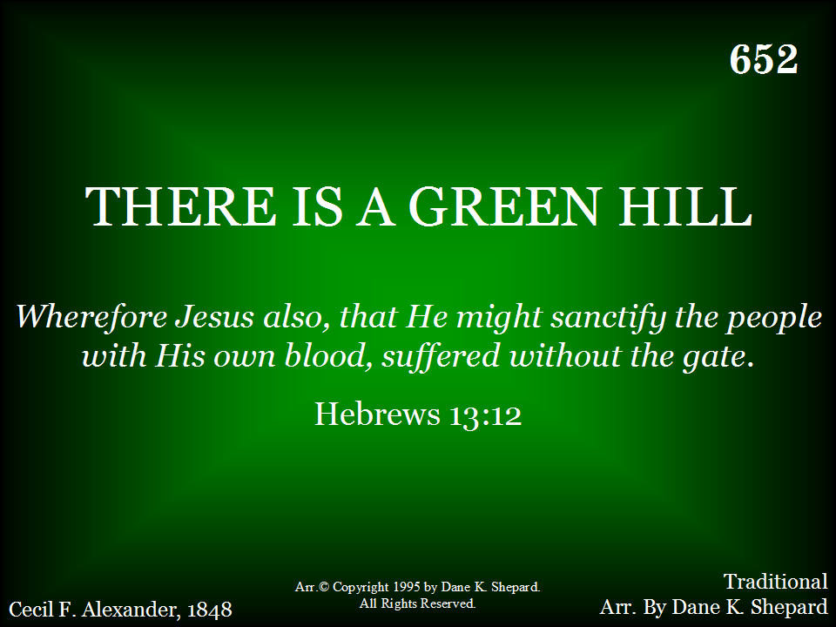
652 - There Is A Green Hill - Title

Slide 10
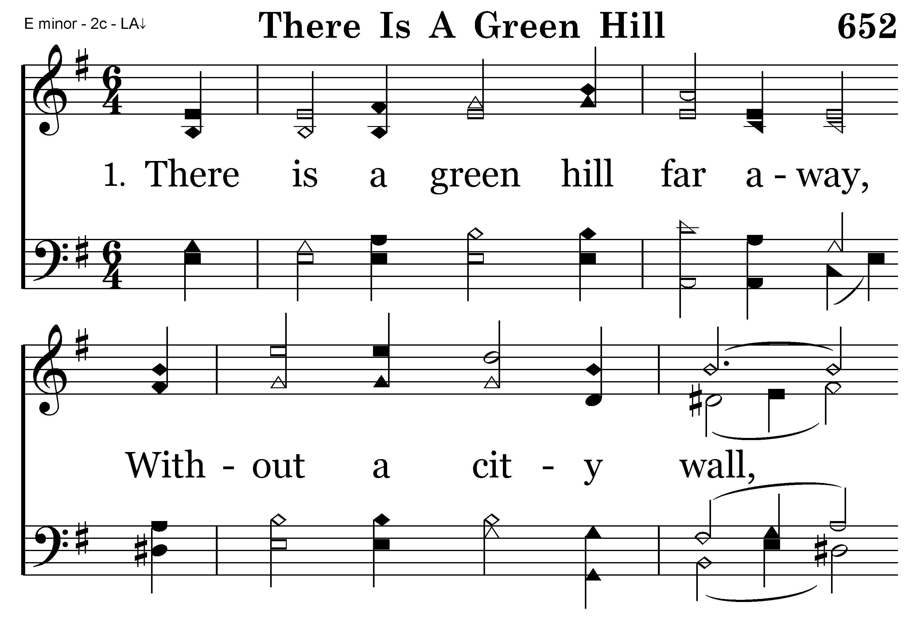
652 - There Is A Green Hill - 1.1

Slide 11
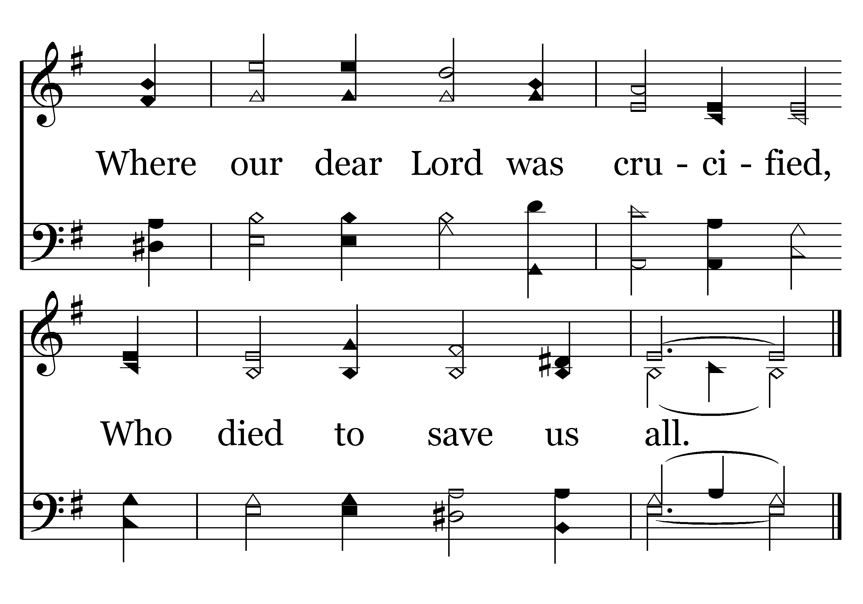
652 - There Is A Green Hill - 1.2
End of Verse 1

Slide 12
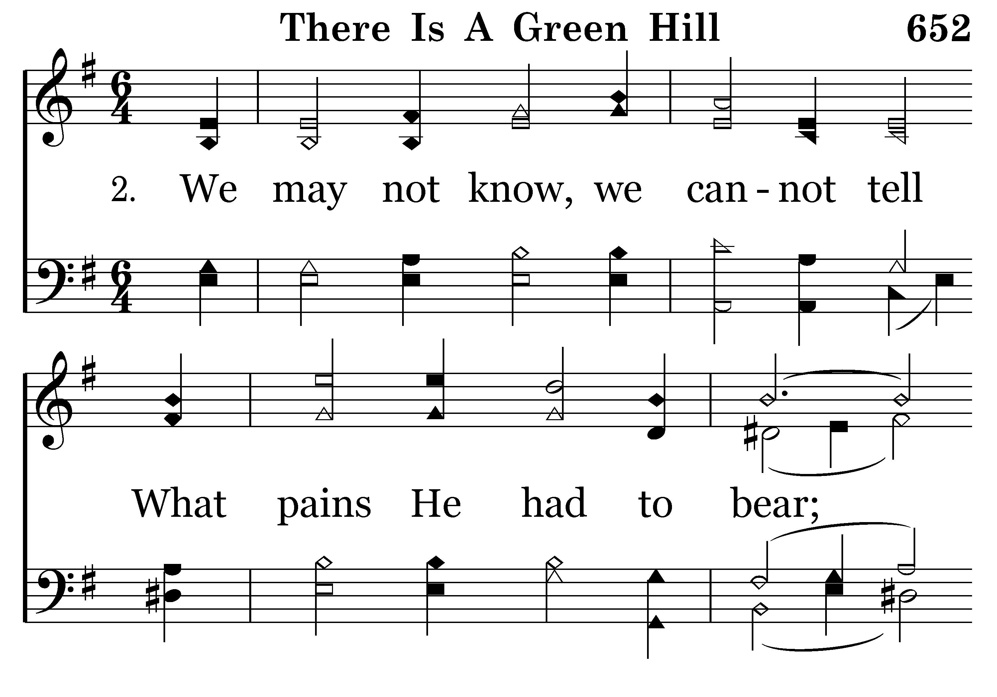
652 - There Is A Green Hill - 2.1

Slide 13
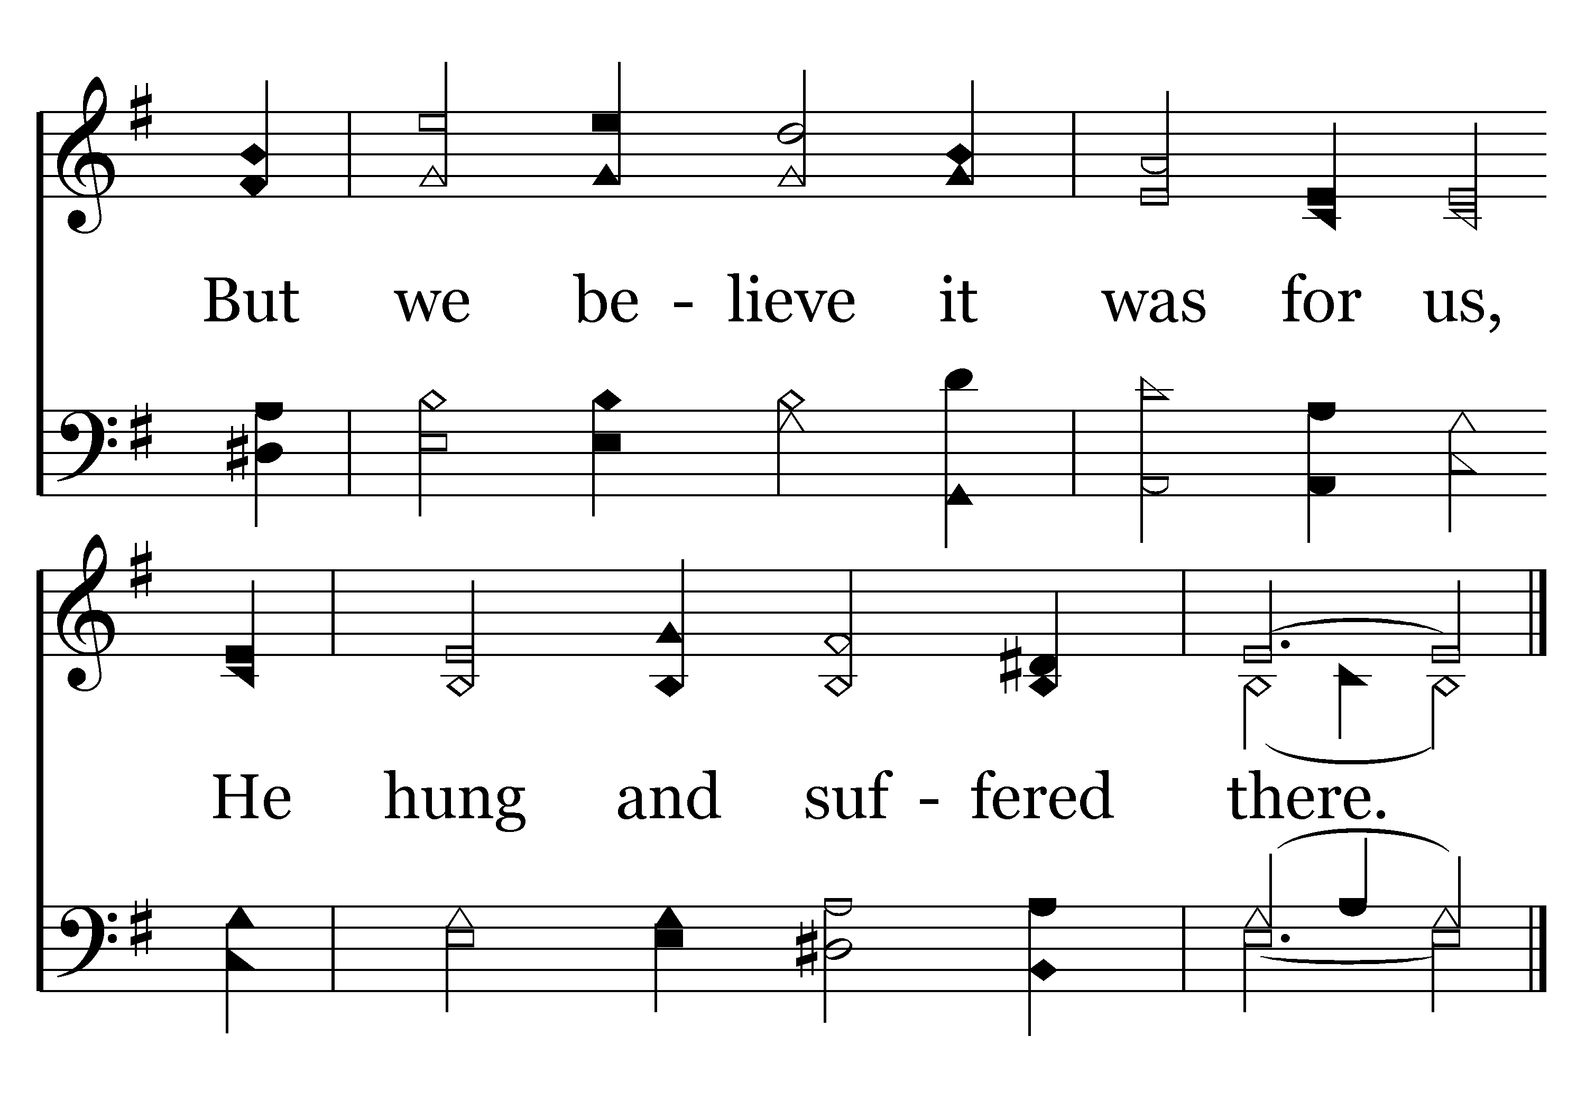
652 - There Is A Green Hill - 2.2
End of Verse 2

Slide 14
What Does the Lord’s Supper Mean to You?
Exodus 12:11-13 (NKJV)
¹¹ And thus you shall eat it: with a belt on your waist, your sandals on your feet, and your staff in your hand. So you shall eat it in haste. It is the LORD'S Passover.
¹² For I will pass through the land of Egypt on that night, and will strike all the firstborn in the land of Egypt, both man and beast; and against all the gods of Egypt I will execute judgment: I am the LORD.
¹³ Now the blood shall be a sign for you on the houses where you are. And when I see the blood, I will pass over you; and the plague shall not be on you to destroy you when I strike the land of Egypt.

Slide 15
What Does the Lord’s Supper Mean to You?
The Lord’s Supper Is A Judgment Against:
Human self-sufficiency & pride
The contention that sin isn’t that bad
Every attempt to approach God on purely human terms.
Every man-made religion or philosophy.
Human selfishness and self-absorption.
Every instance of grumbling and complaining
Every apathetic and half-hearted attempt to serve God

Slide 16
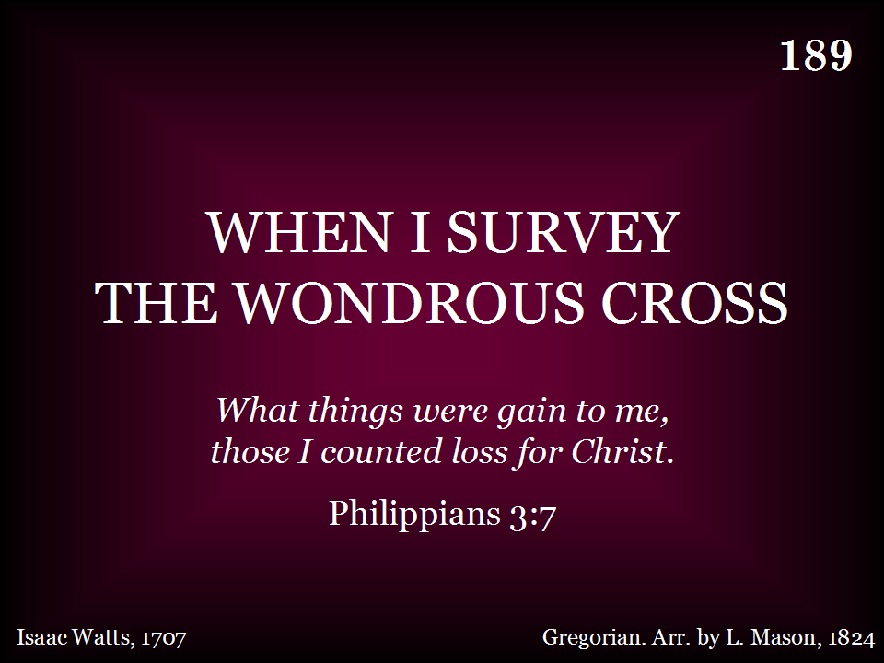
189 - When I Survey The Wondrous Cross - Title

Slide 17
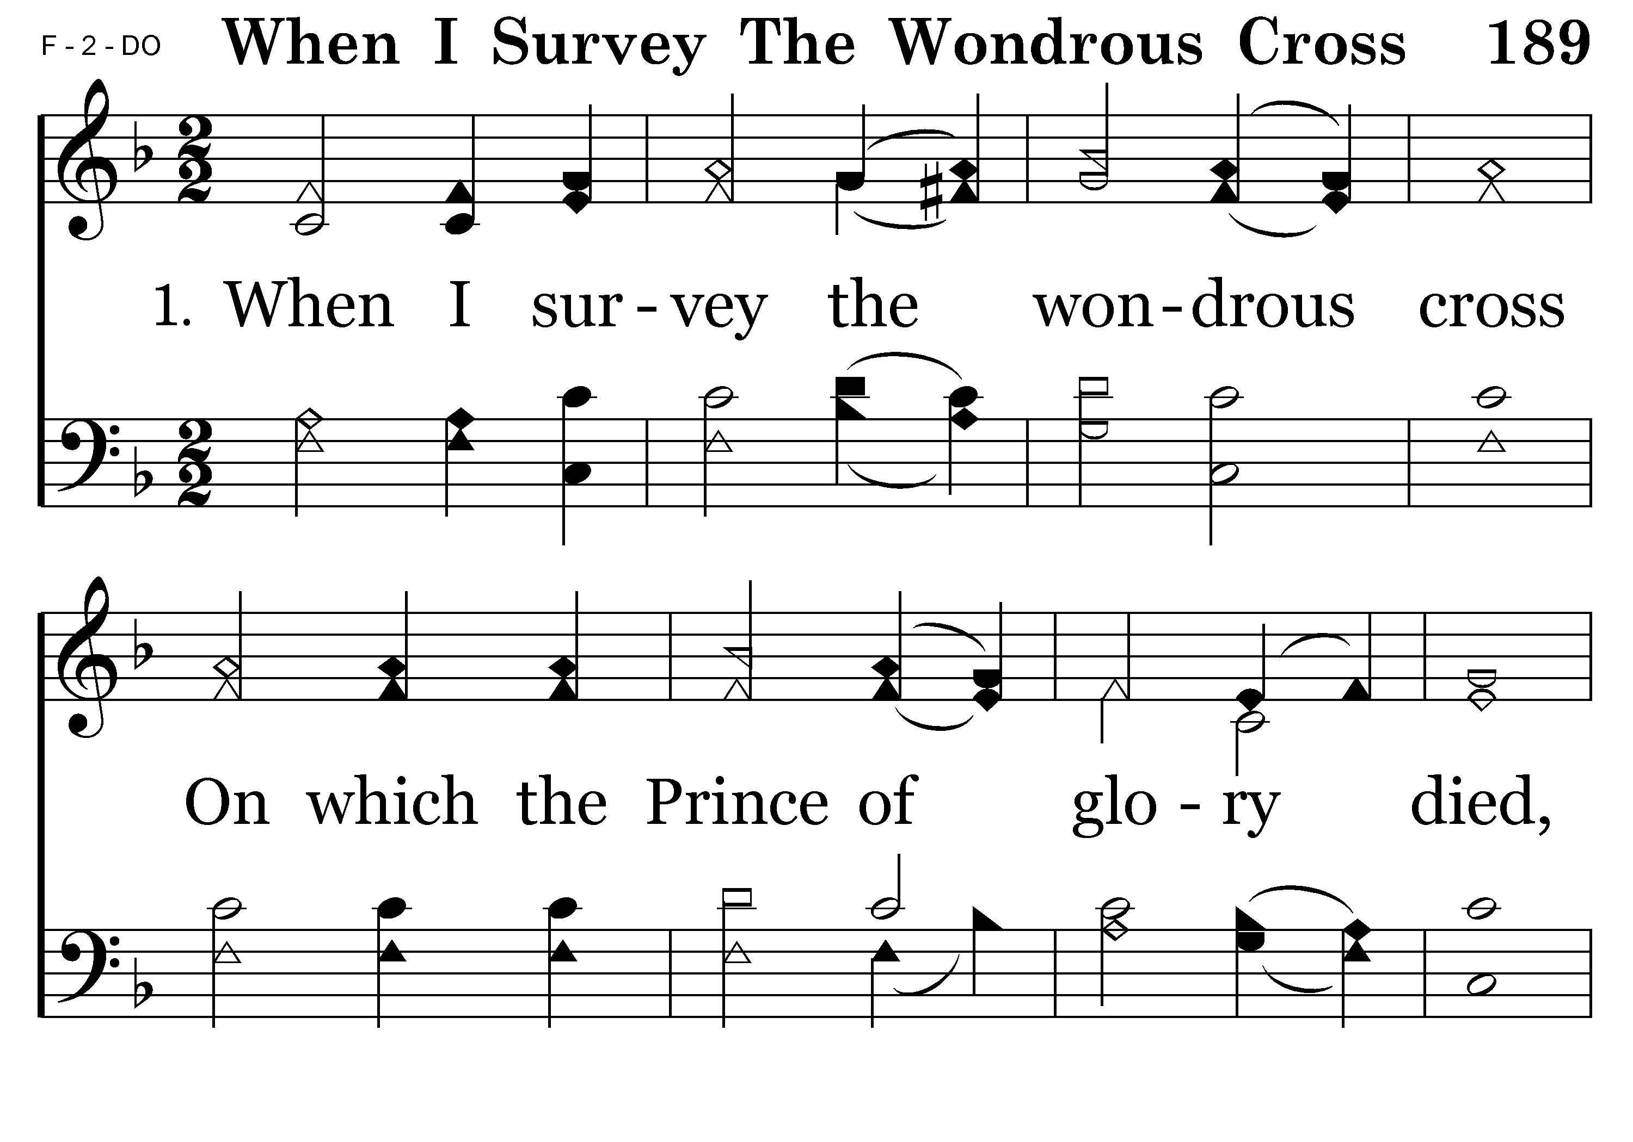
189 - When I Survey The Wondrous Cross - 1.1

Slide 18
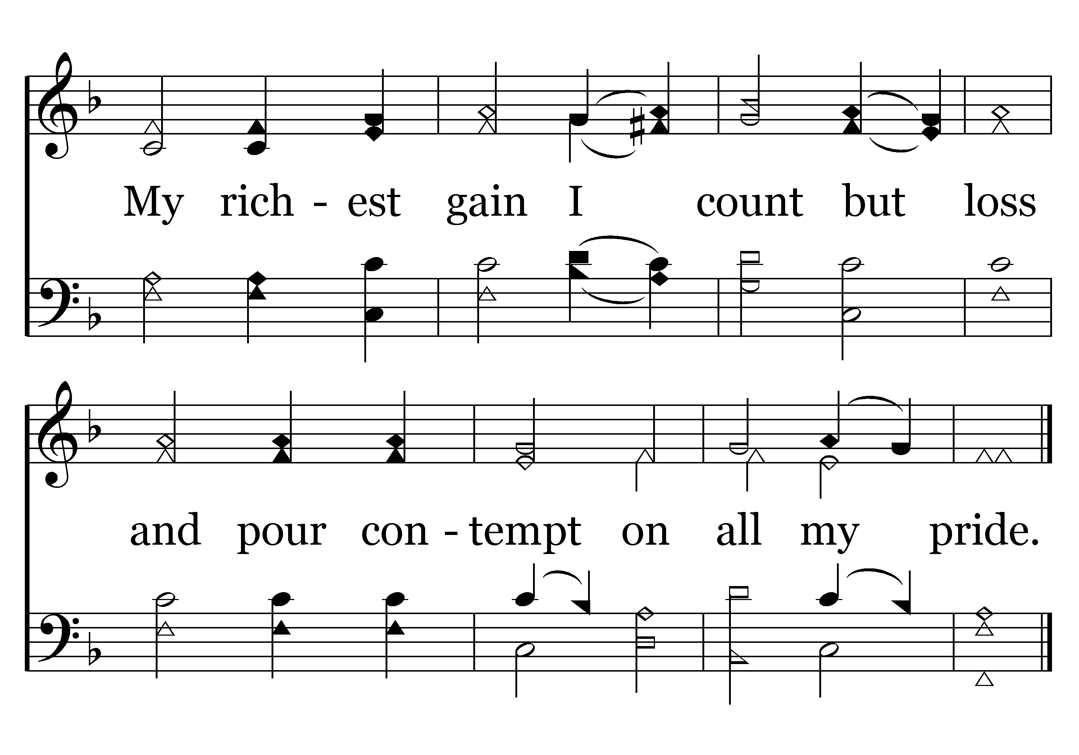
189 - When I Survey The Wondrous Cross - 1.2
End of Verse 1

Slide 19
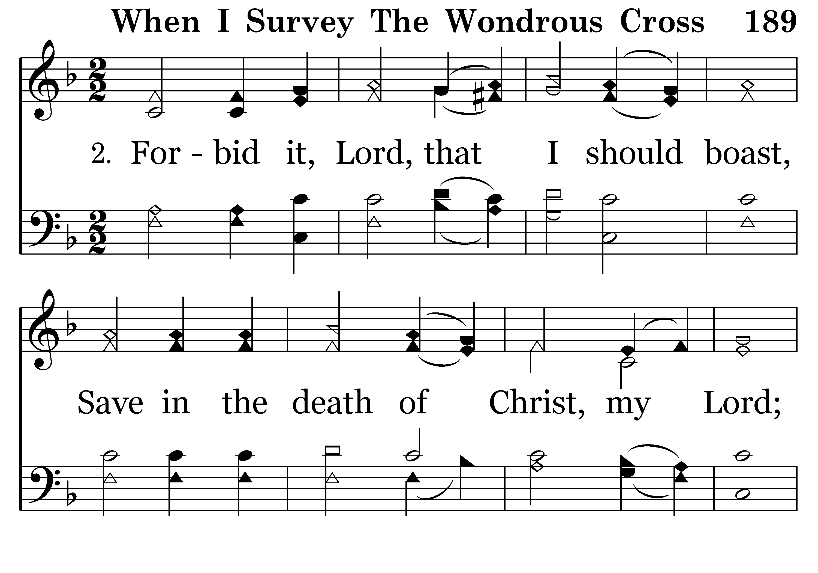
189 - When I Survey The Wondrous Cross - 2.1

Slide 20
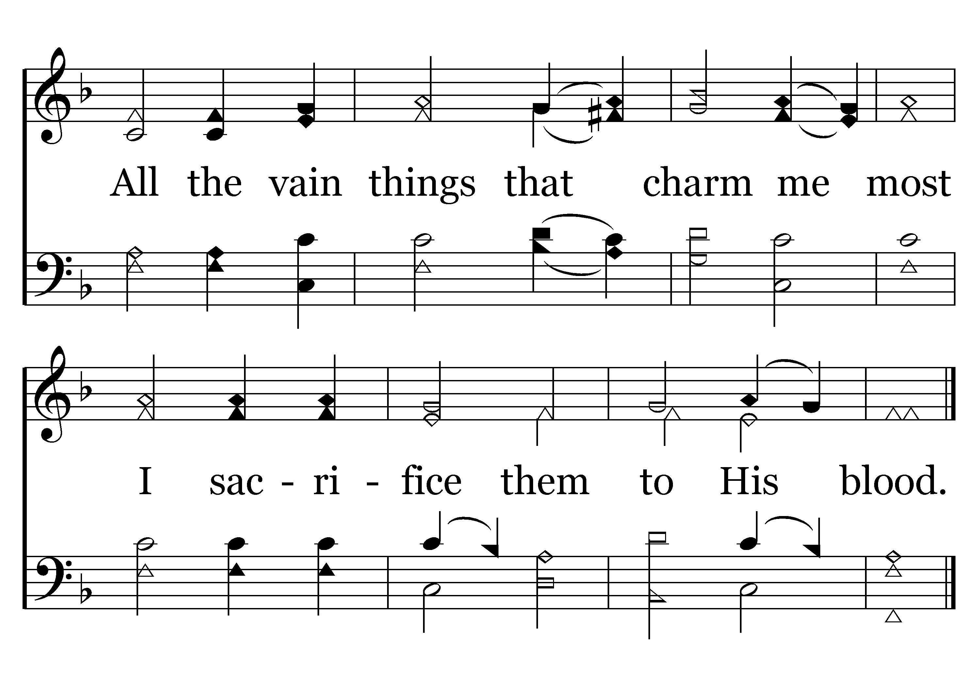
189 - When I Survey The Wondrous Cross - 2.2
End of Verse 2

Slide 21
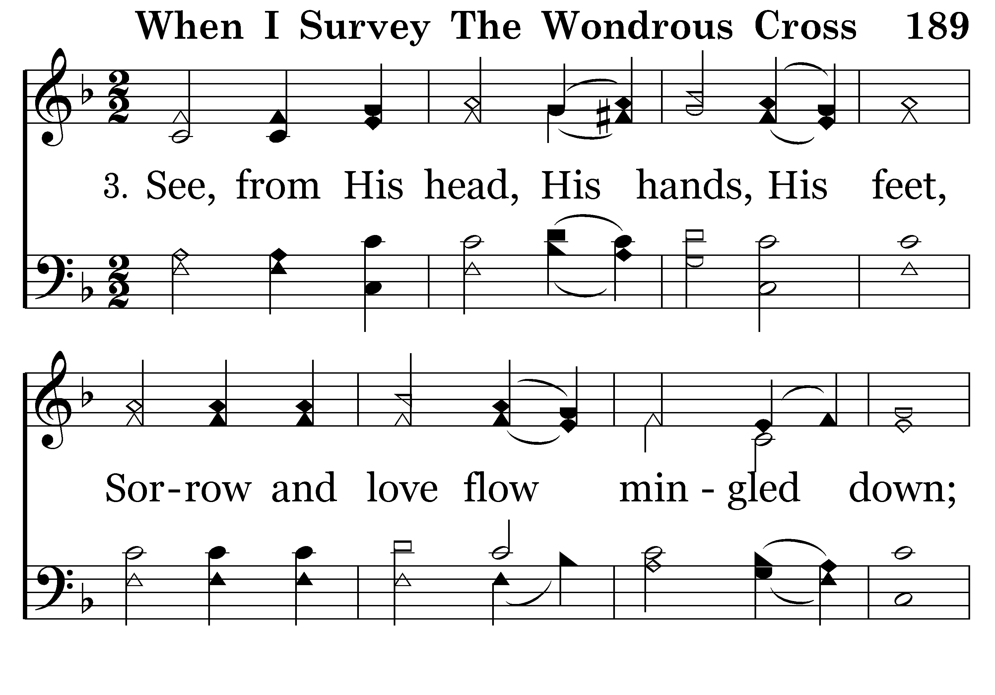
189 - When I Survey The Wondrous Cross - 3.1

Slide 22
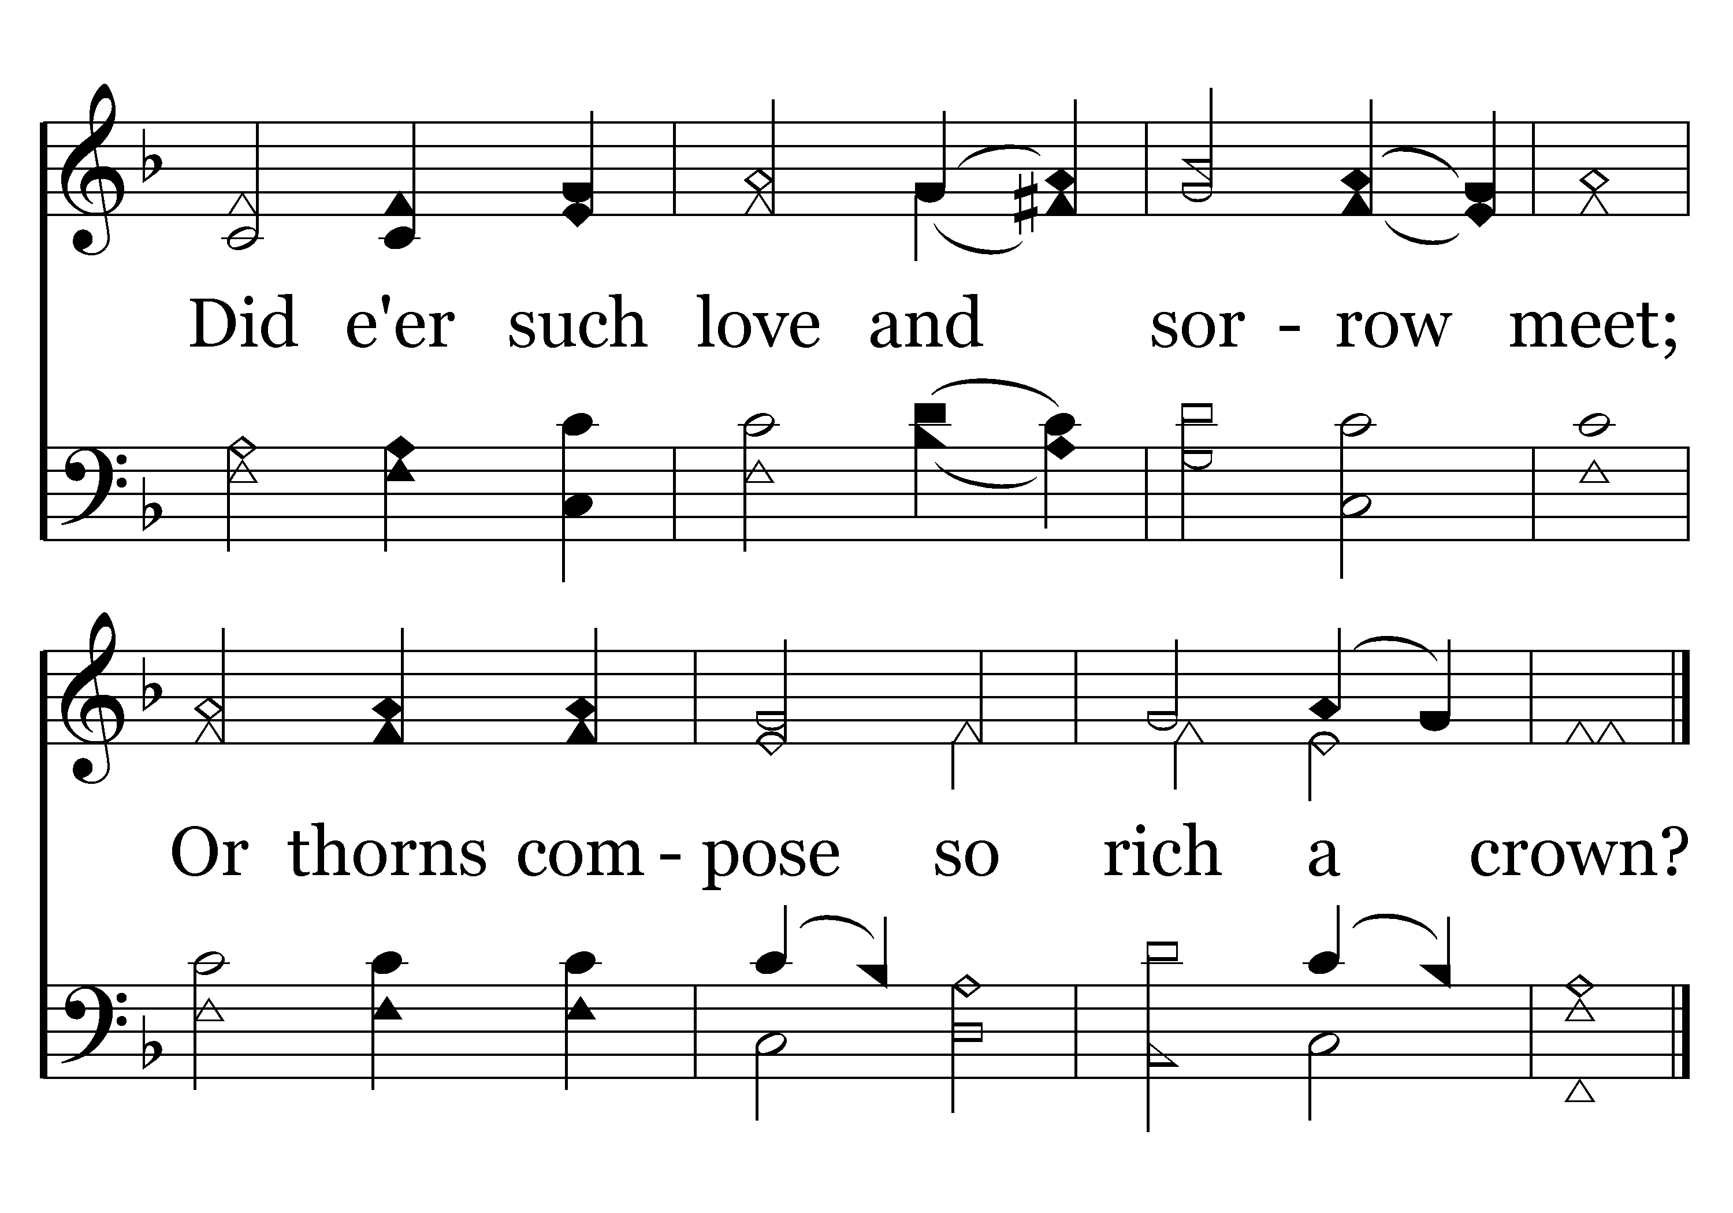
189 - When I Survey The Wondrous Cross - 3.2
End of Verse 3

Slide 23
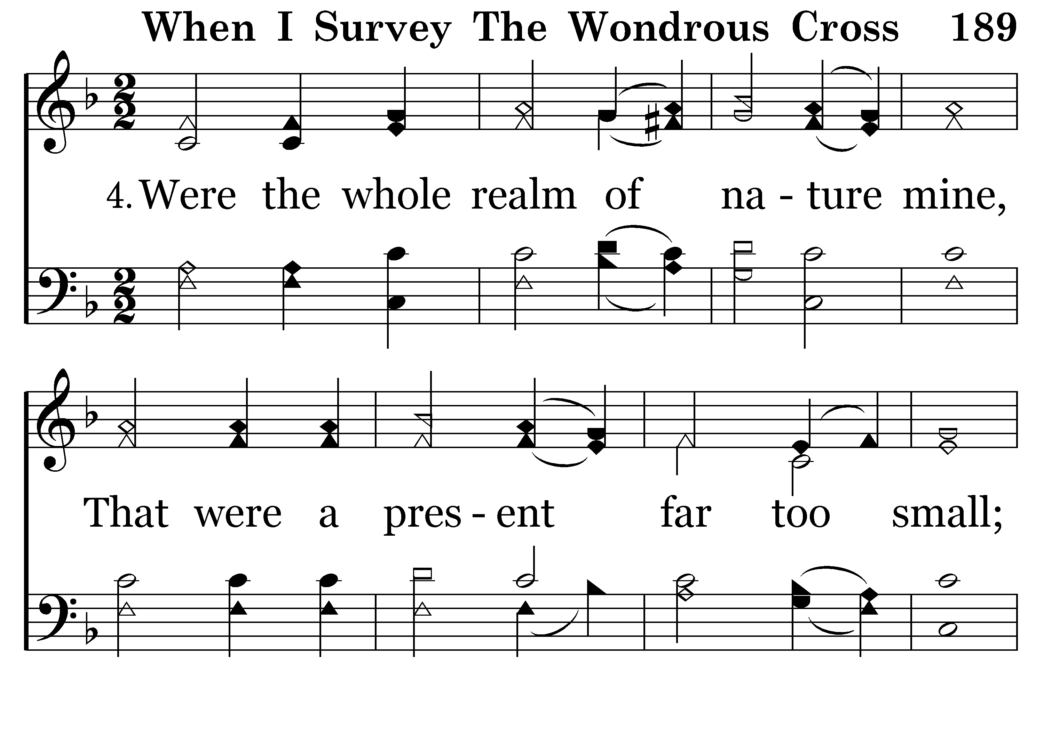
189 - When I Survey The Wondrous Cross - 4.1

Slide 24
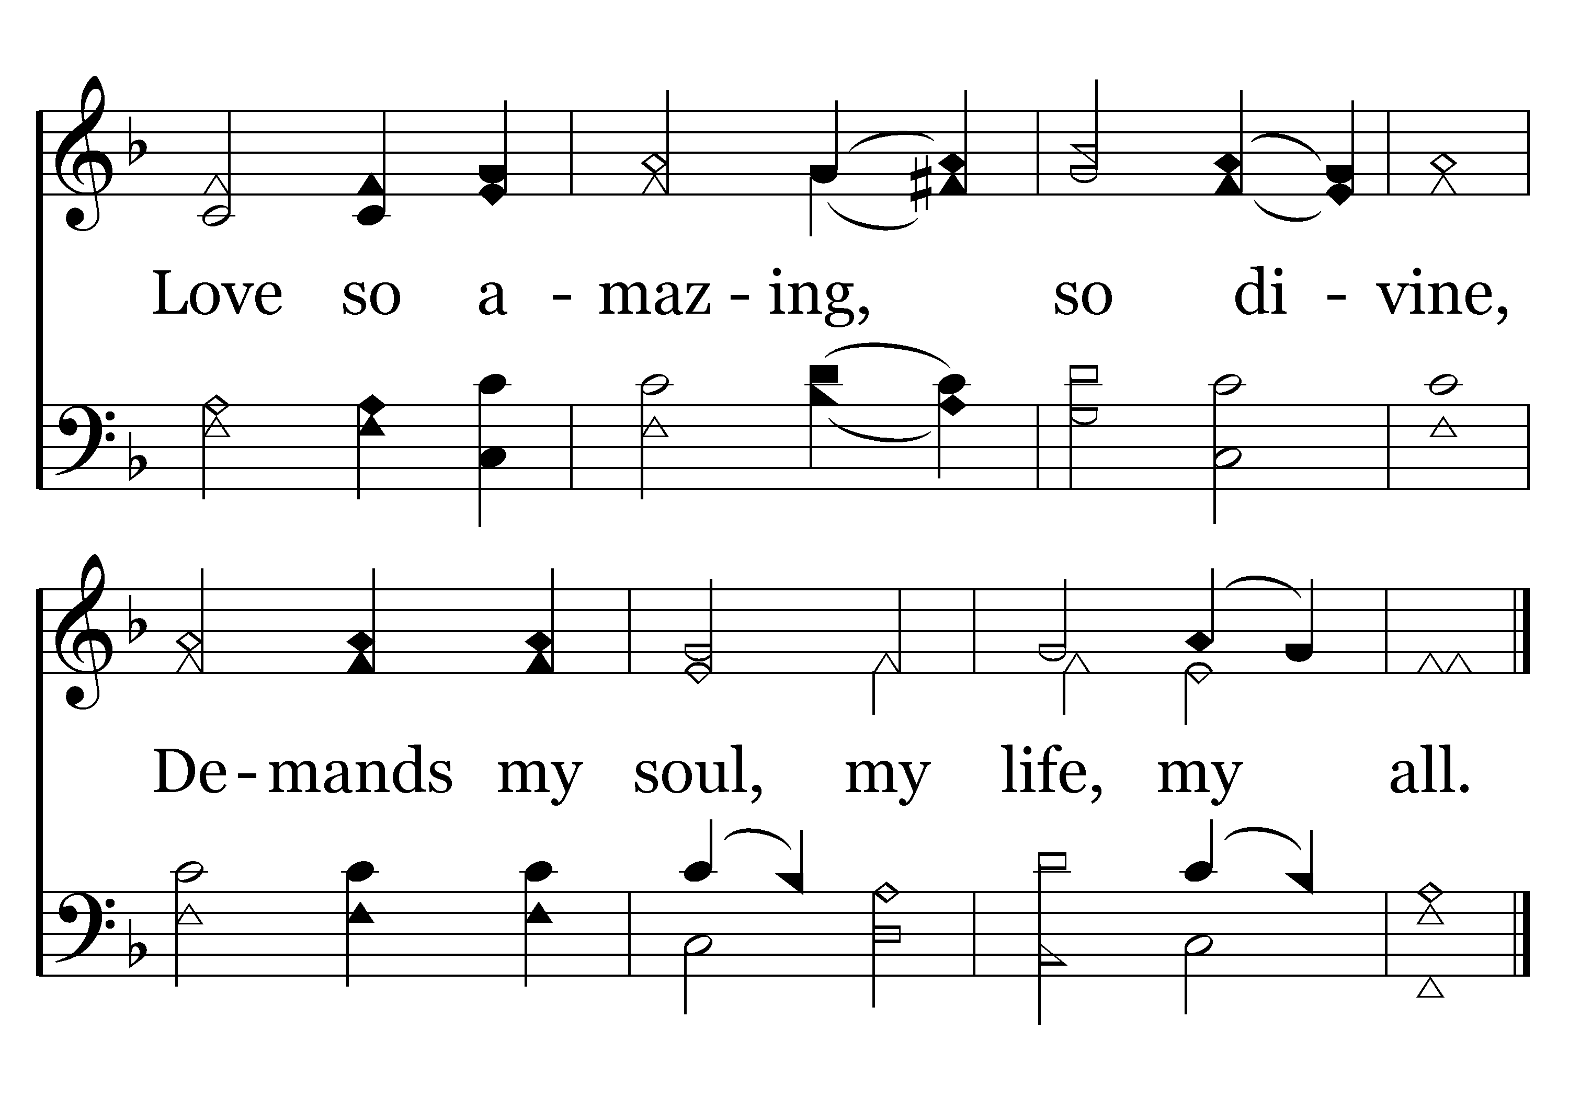
189 - When I Survey The Wondrous Cross - 4.2
End of Song

Slide 25
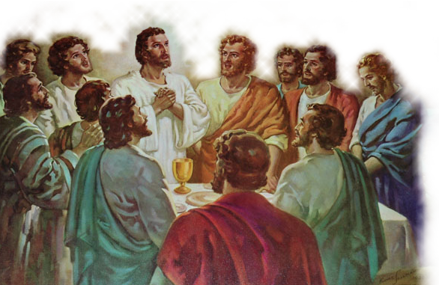
What Does the Lord’s Supper Mean to You?
The Lord’s Supper is:
A Memorial (1 Cor. 11:24-25)
A communion (1 Cor. 10:16; 11:33)
A proclamation & expression of hope - (1 Cor. 11:26)
A time of Examination (1 Cor. 11:27, 28)
A serious act – failure to properly discern the Lord’s body is to bring condemnation upon ourselves - (1 Cor 11:20-22; 27-30; 3:17)

Slide 26
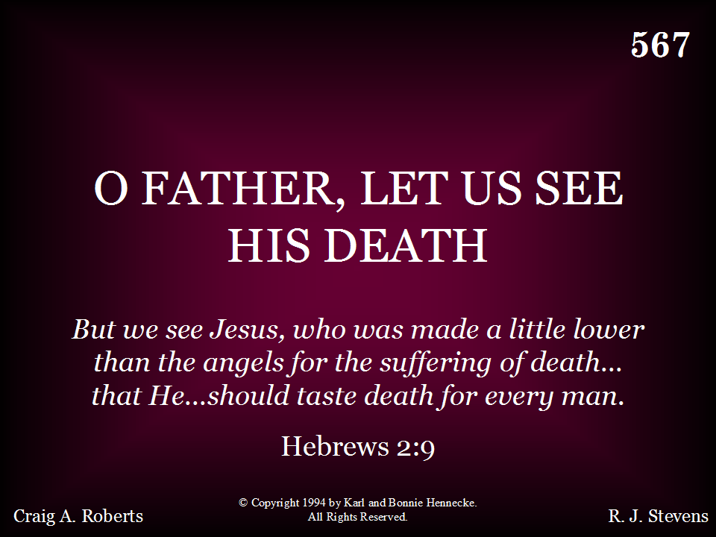
567 - O Father Let Us See His Death - Title

Slide 27
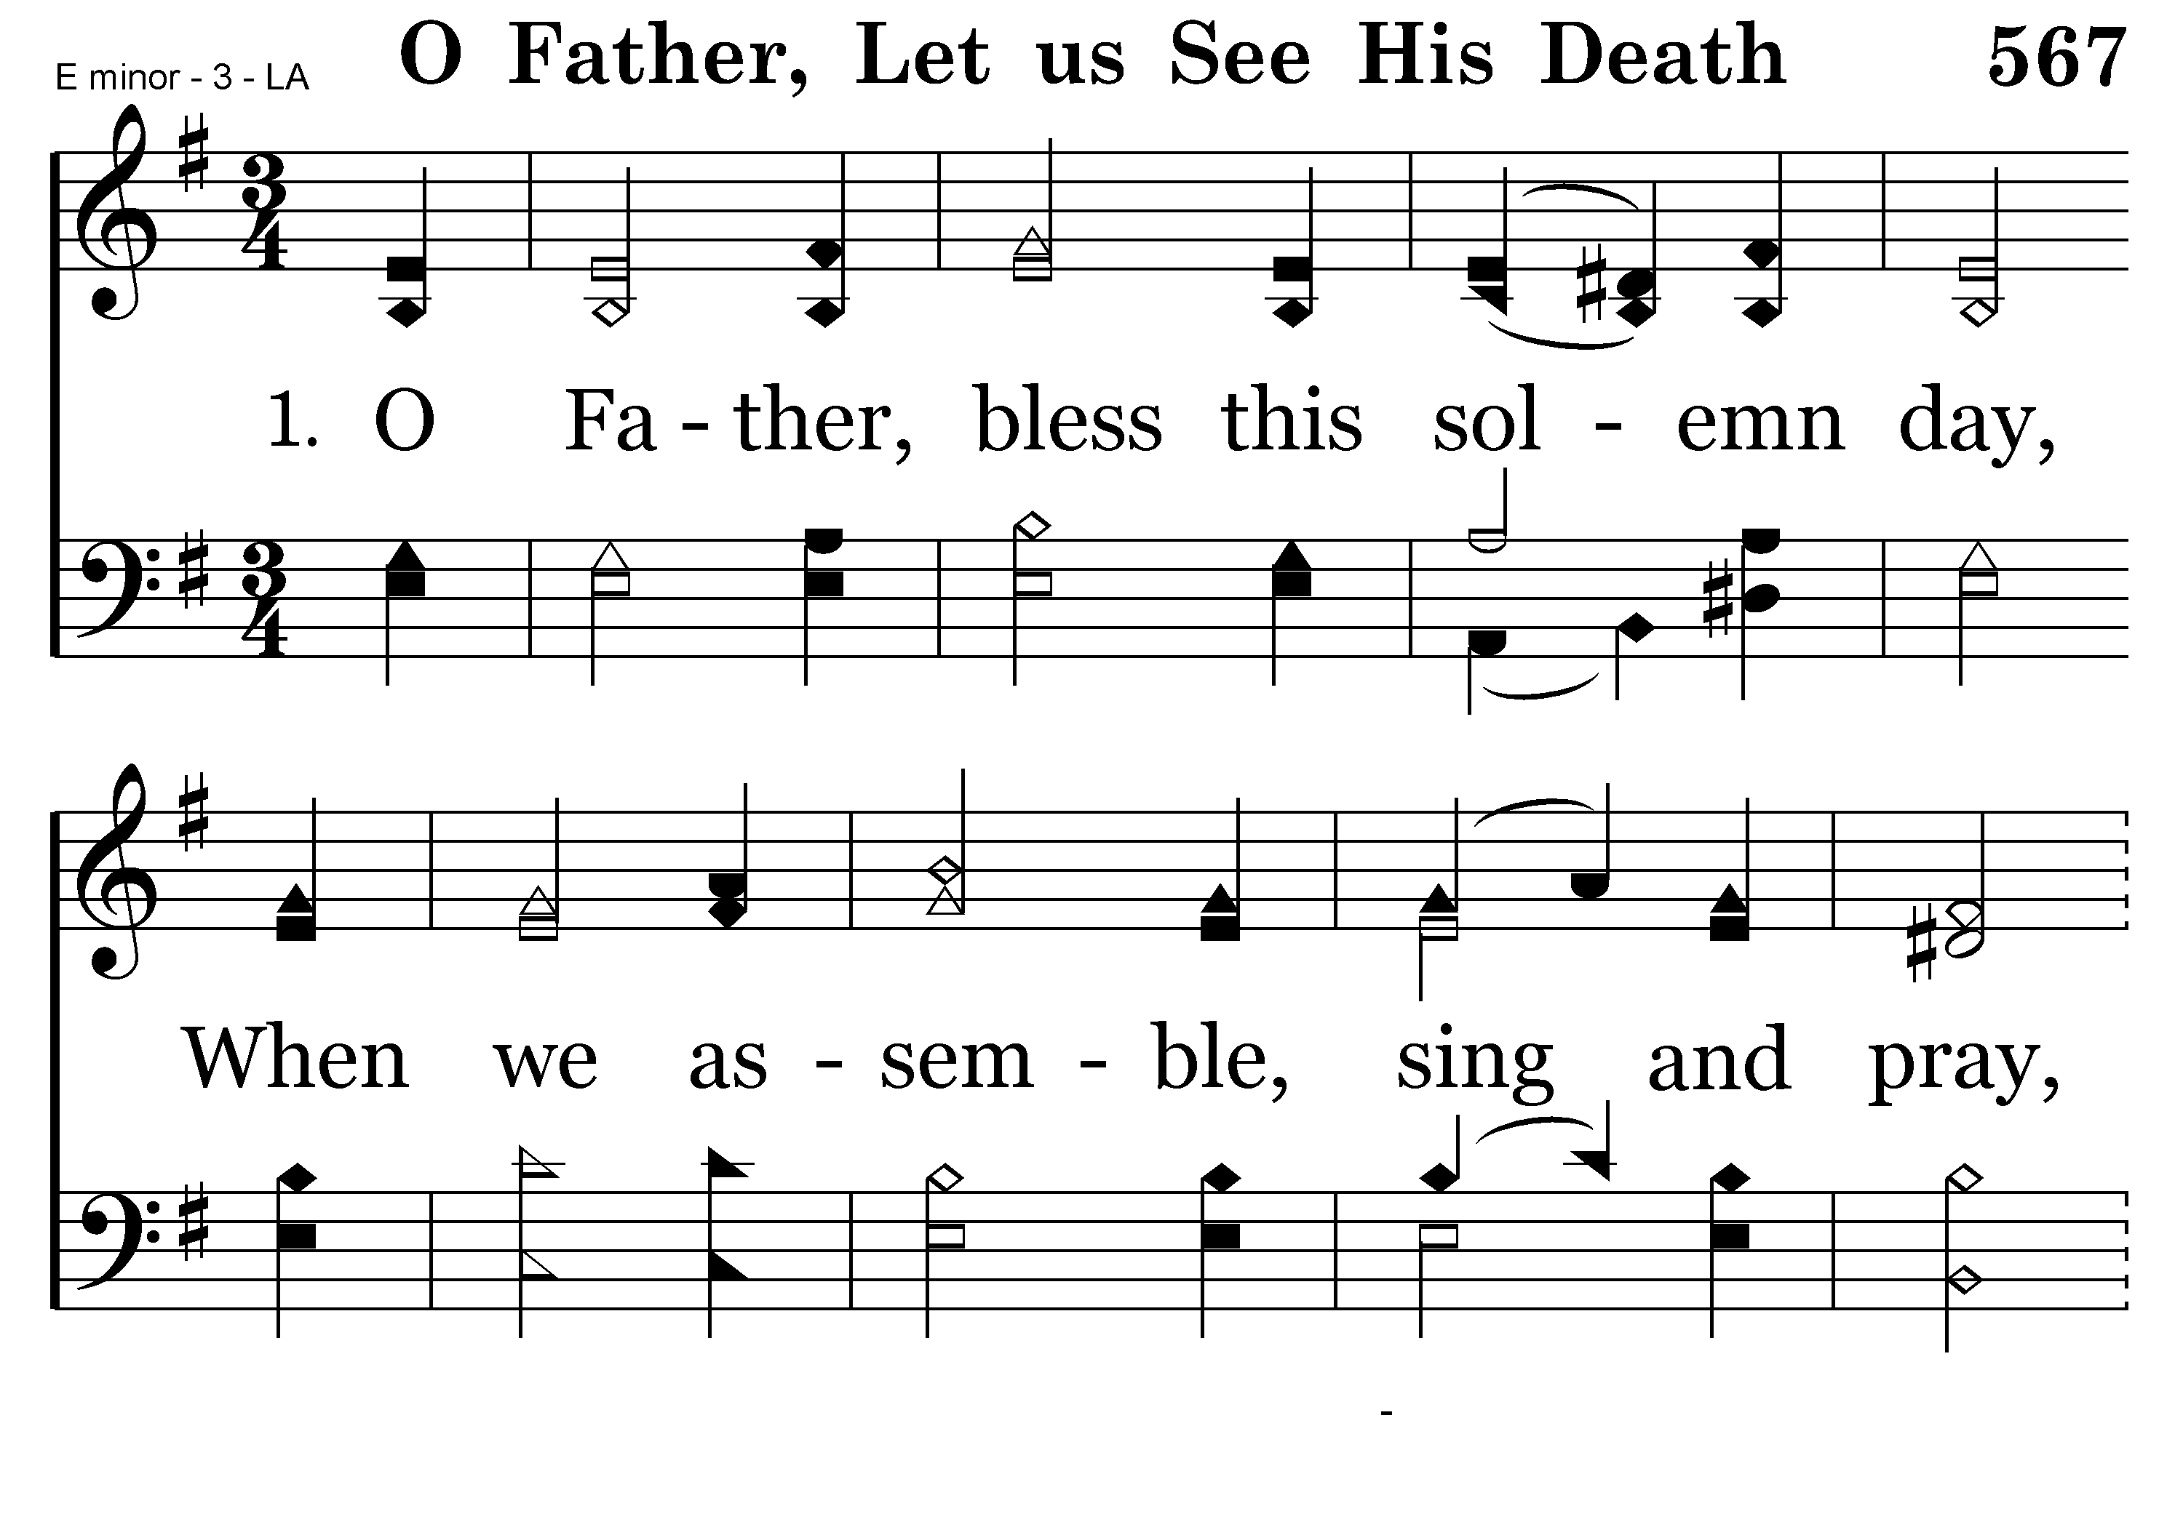
567 - O Father Let Us See His Death - 1.1

Slide 28
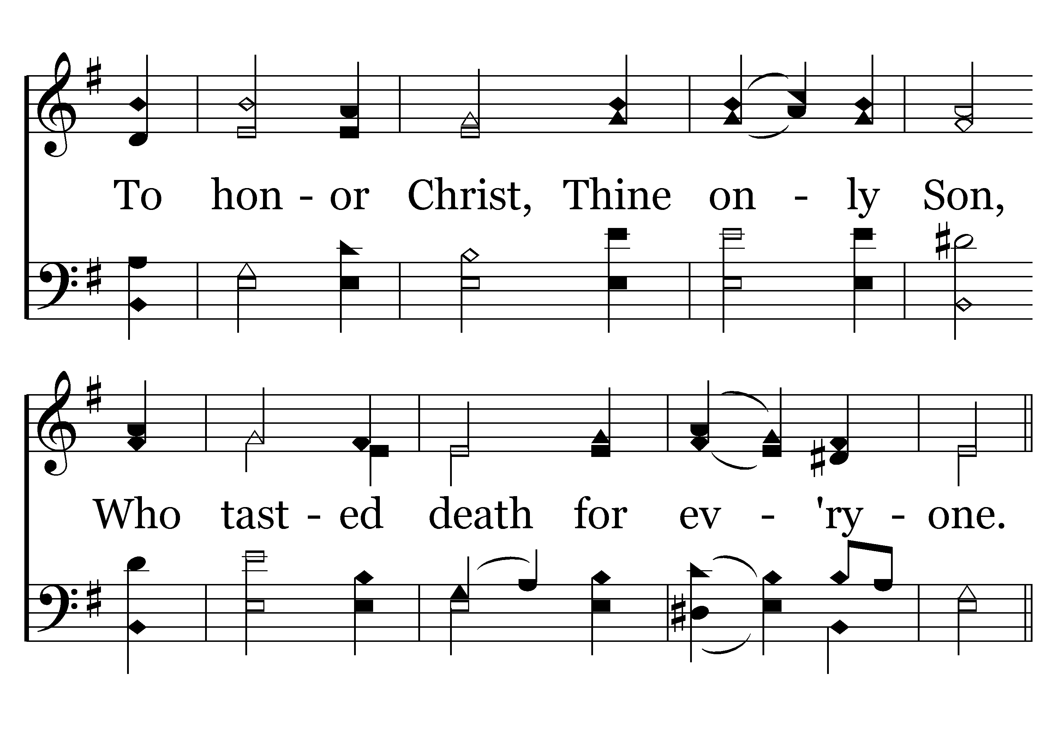
567 - O Father Let Us See His Death - 1.2
End of Verse 1

Slide 29
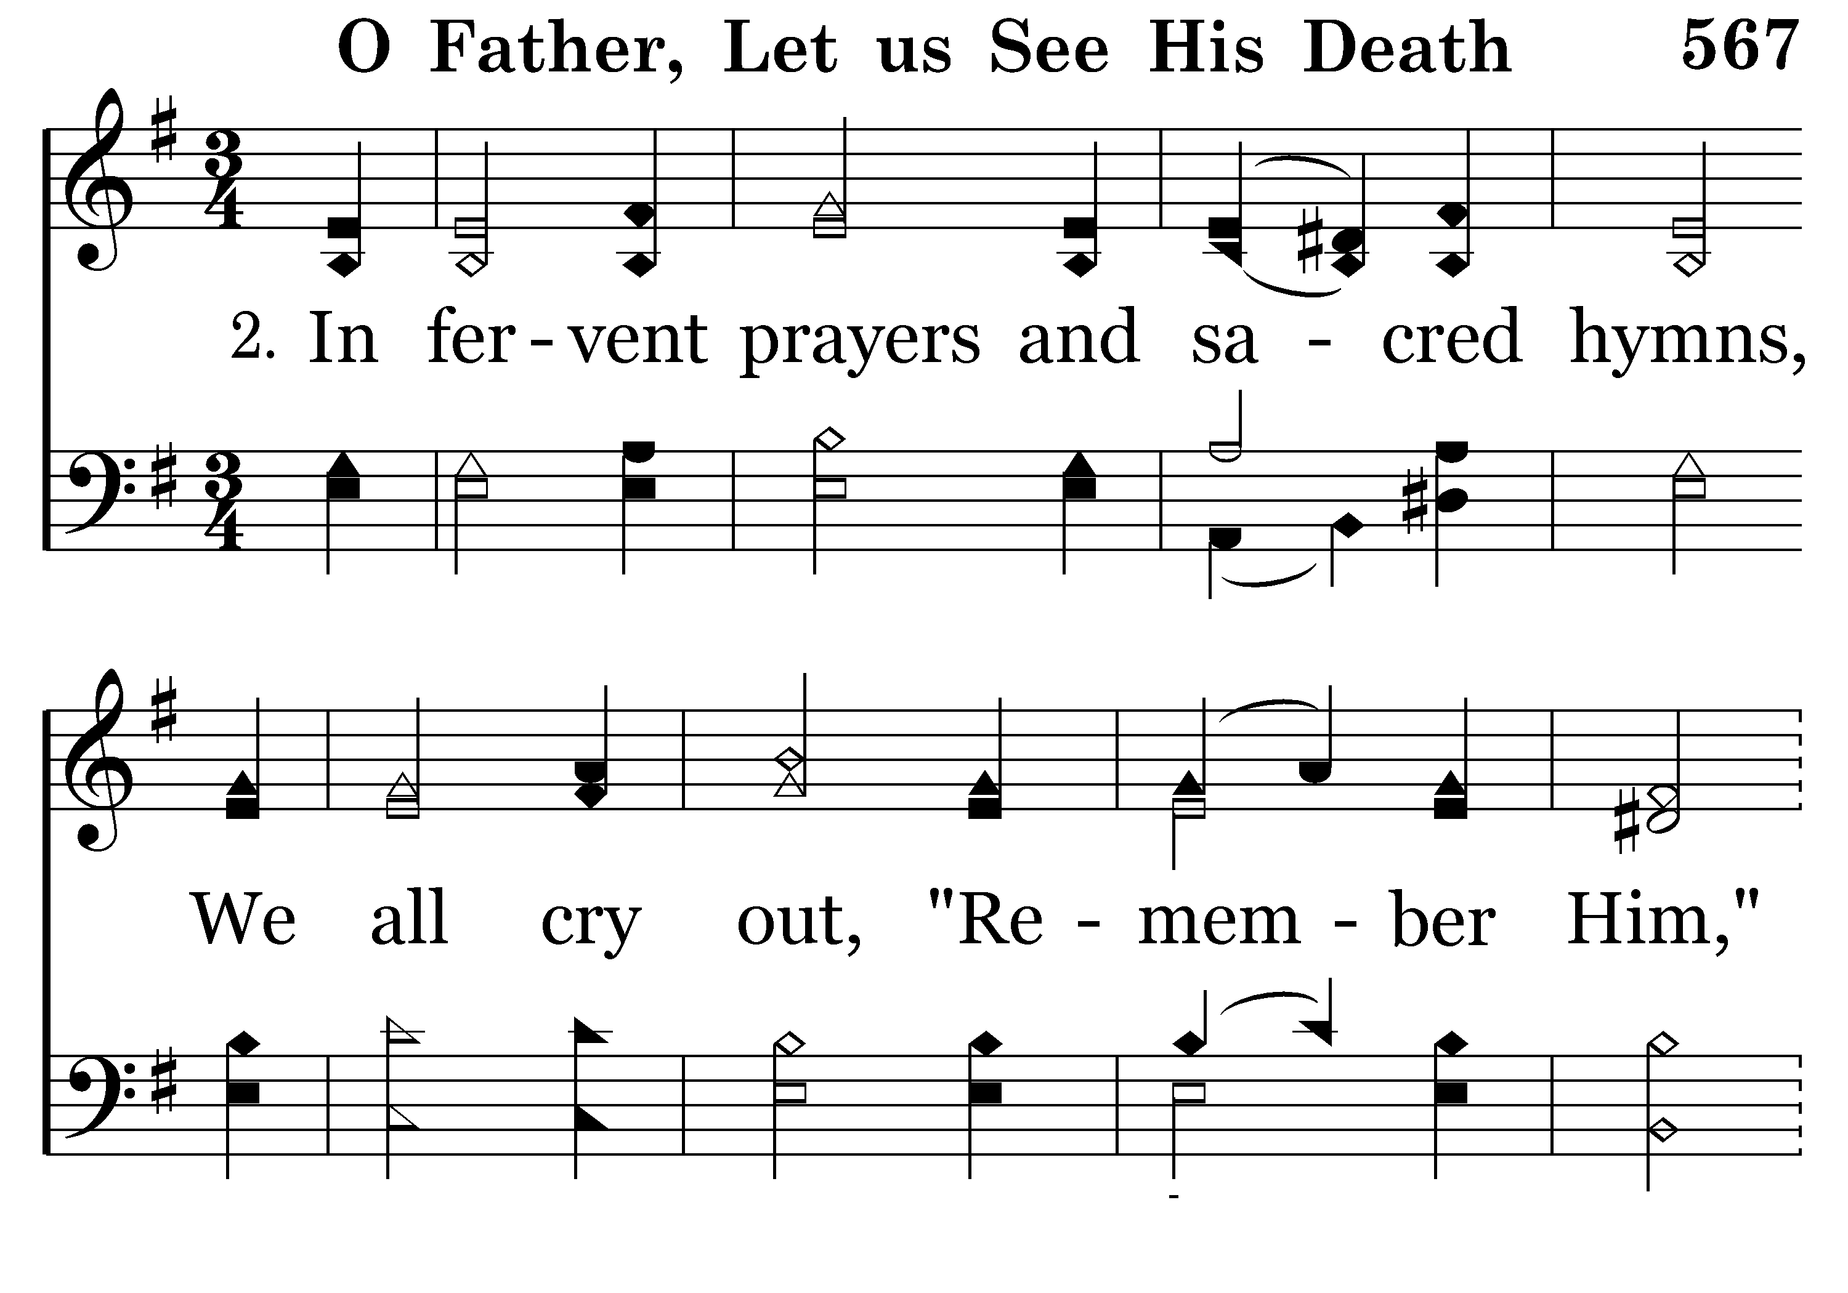
567 - O Father Let Us See His Death - 2.1

Slide 30
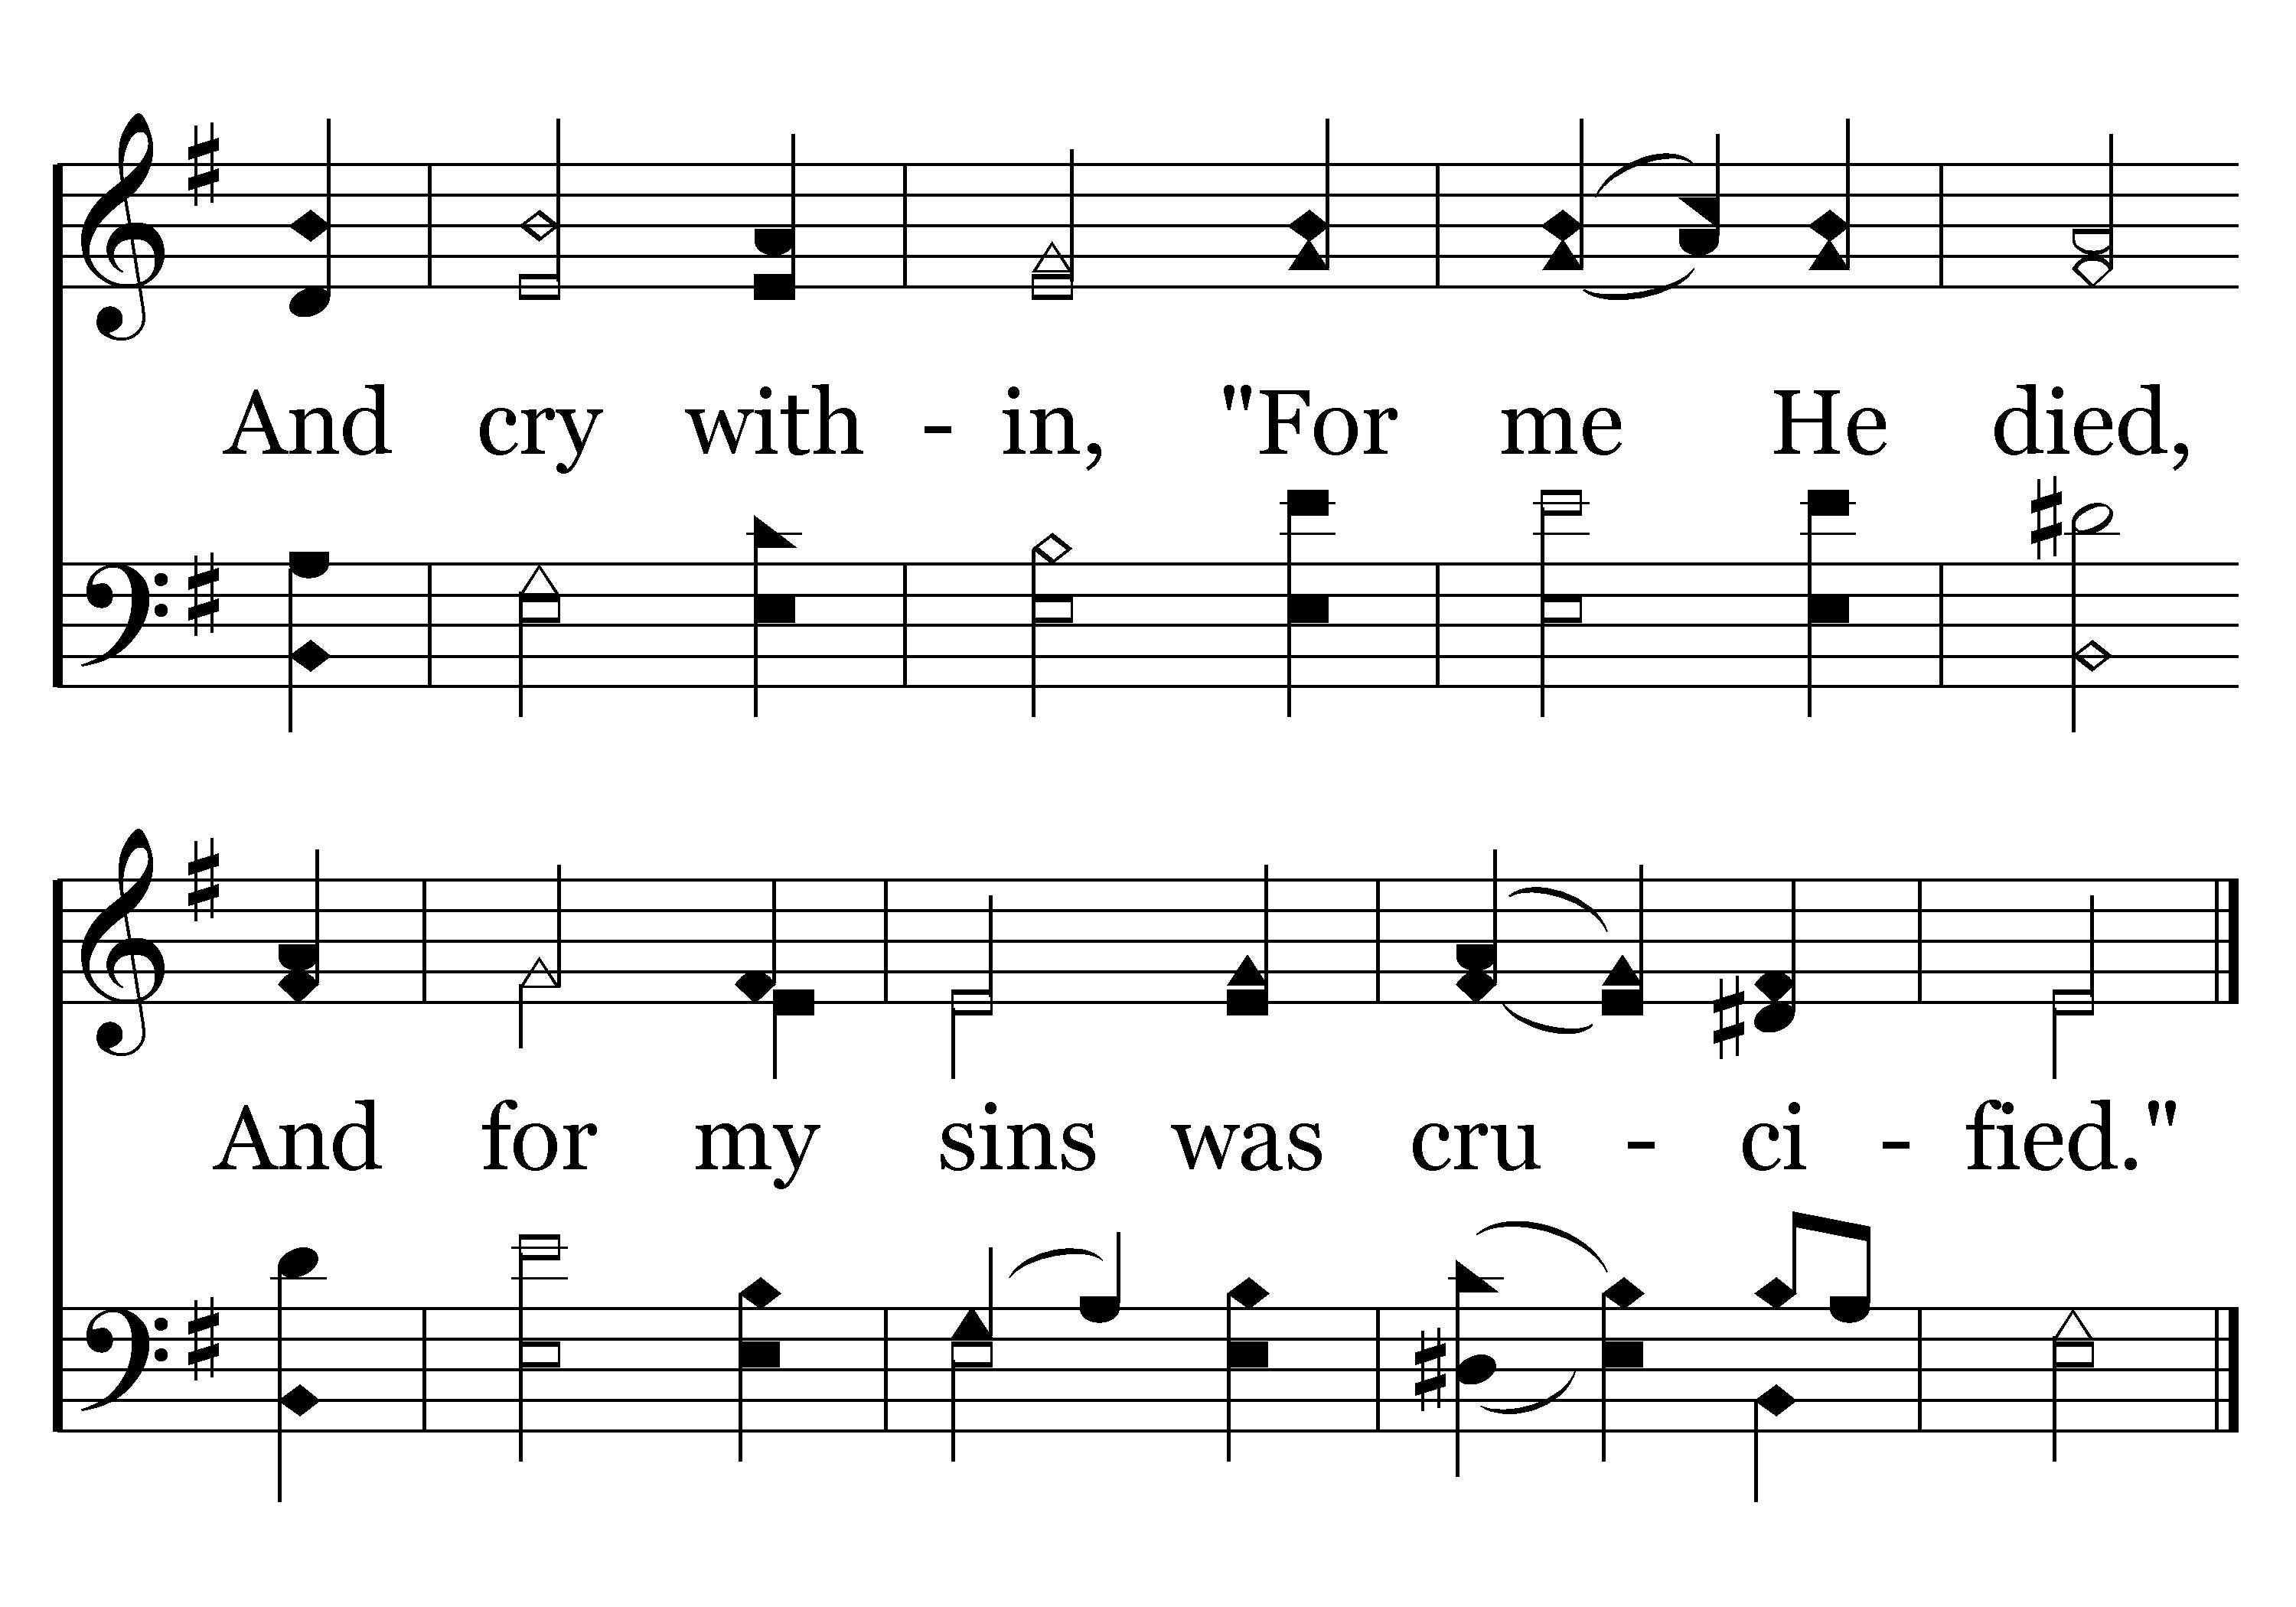
567 - O Father Let Us See His Death - 2.2
End of Verse 2

Slide 31
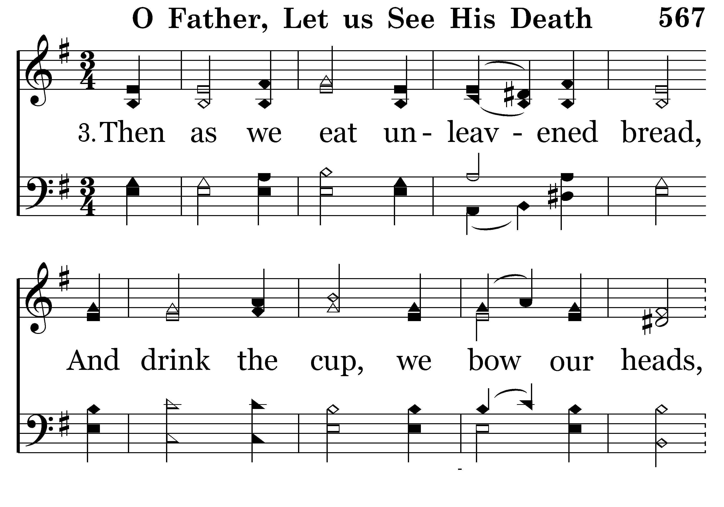
567 - O Father Let Us See His Death - 3.1

Slide 32
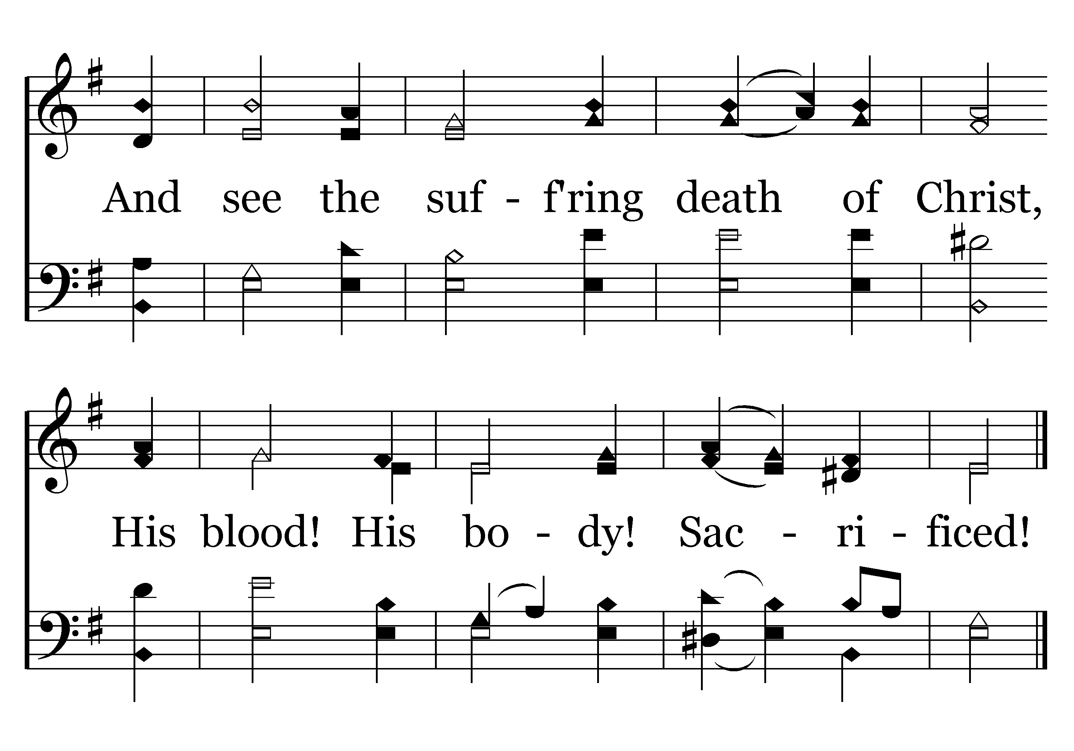
567 - O Father Let Us See His Death - 3.2
End of Verse 3

Slide 33
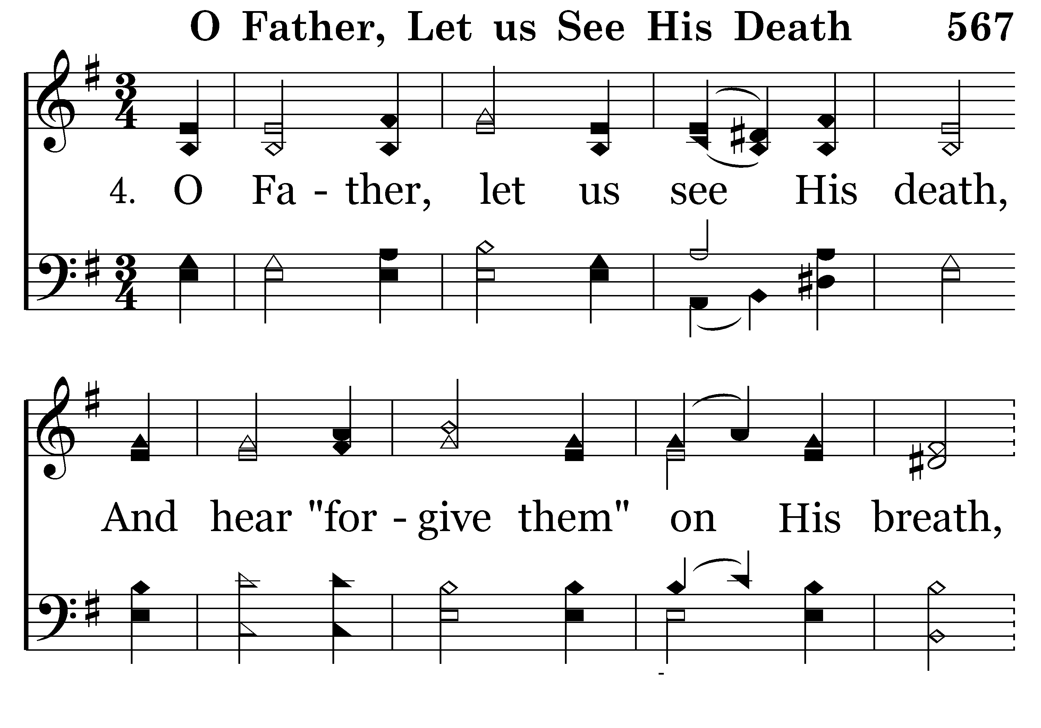
567 - O Father Let Us See His Death - 4.1

Slide 34
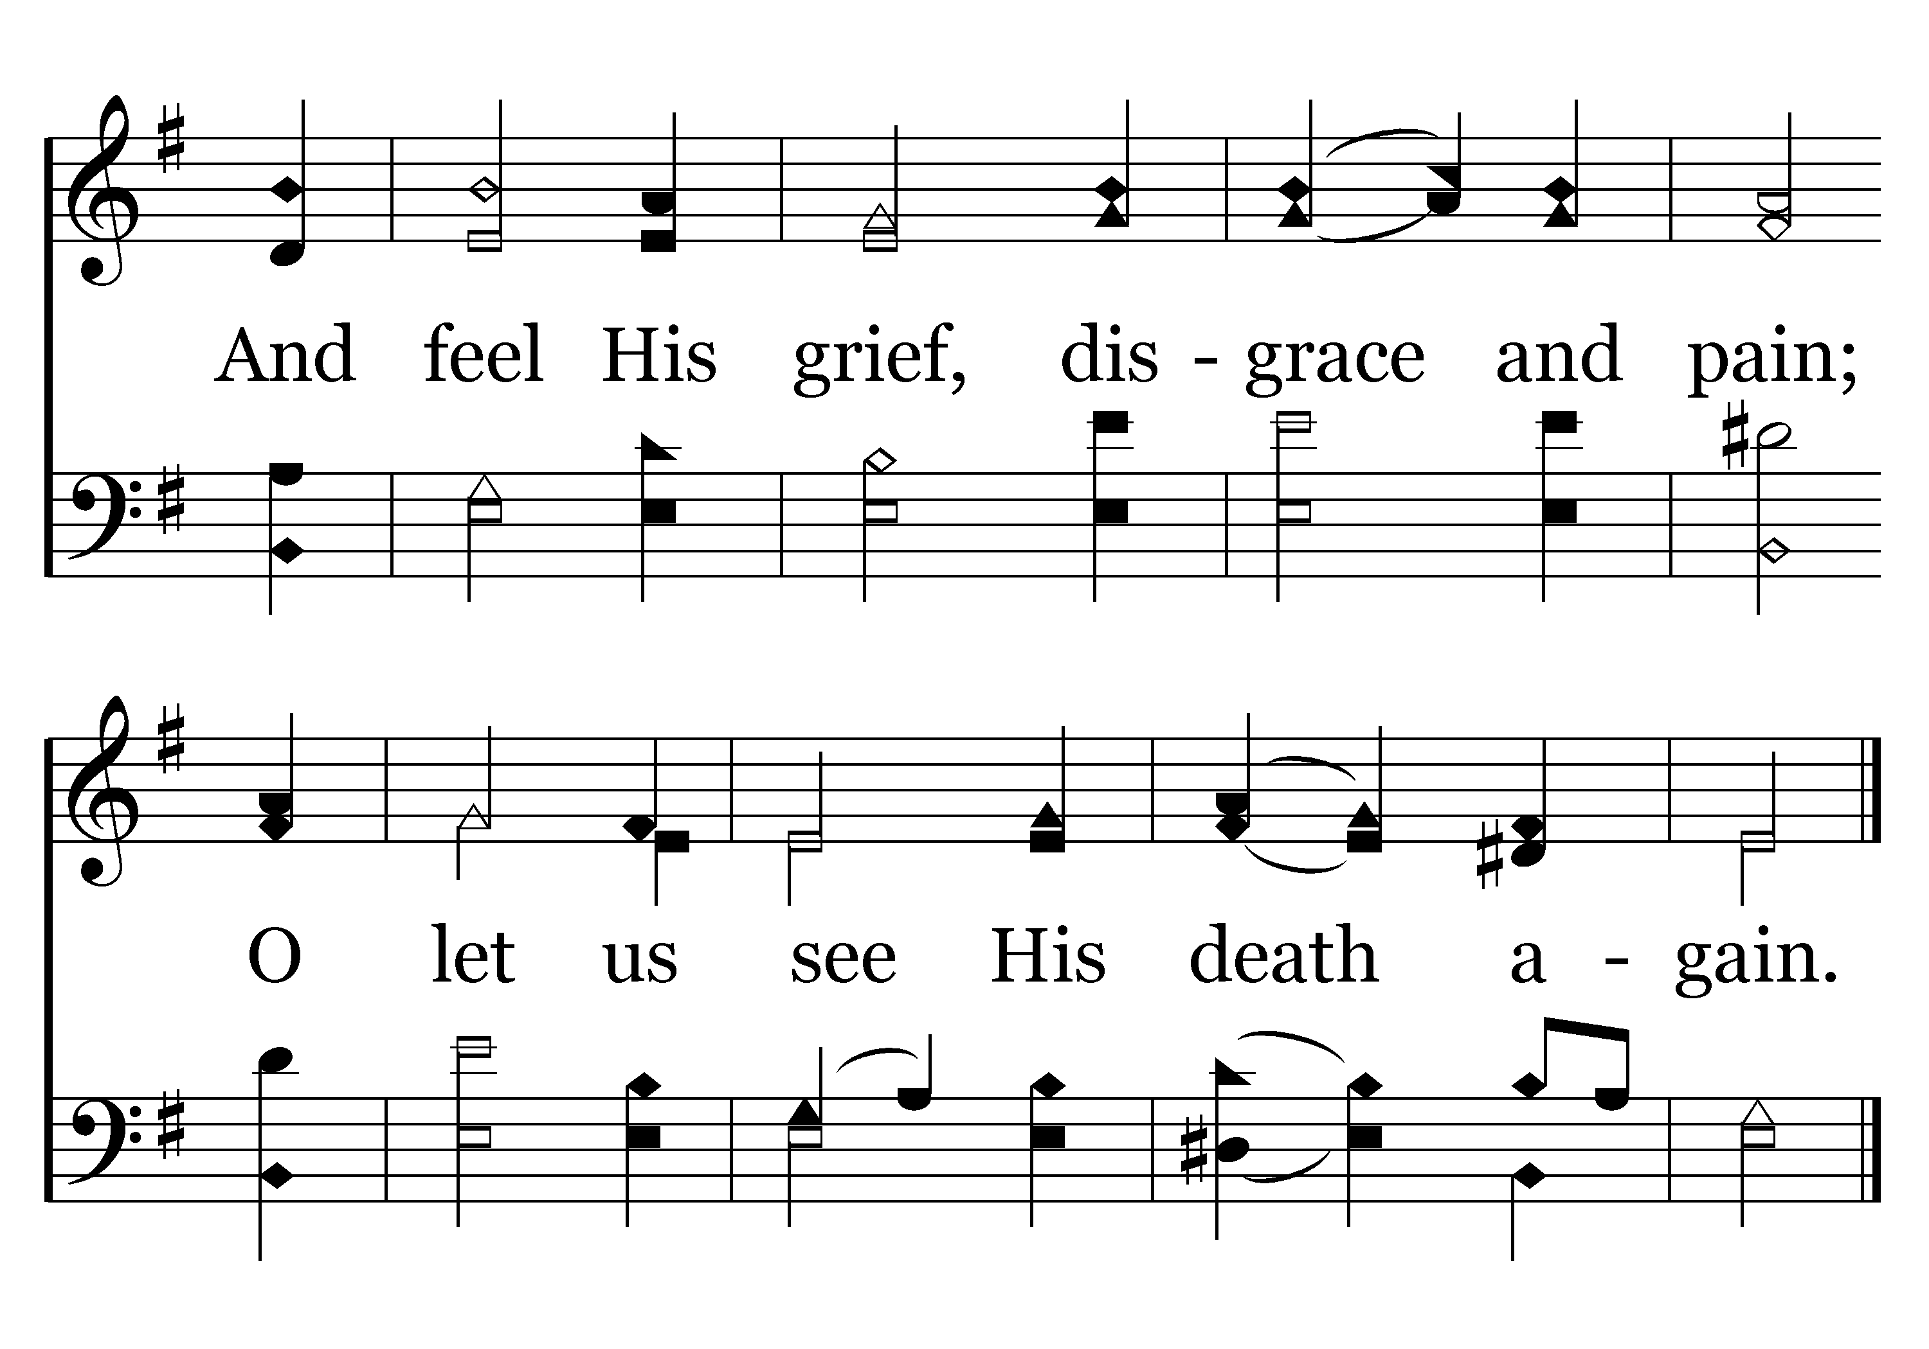
567 - O Father Let Us See His Death - 4.2
End of Song

Slide 35
What Does the Lord’s Supper Mean to You?
Isaiah 53:1-12 (NKJV)
¹ Who has believed our report? And to whom has the arm of the LORD been revealed? ² For He shall grow up before Him as a tender plant, And as a root out of dry ground. He has no form or comeliness; And when we see Him, There is no beauty that we should desire Him. ³ He is despised and rejected by men, A Man of sorrows and acquainted with grief. And we hid, as it were, our faces from Him; He was despised, and we did not esteem Him.

Slide 36
What Does the Lord’s Supper Mean to You?
Isaiah 53:1-12 (NKJV)
⁴ Surely He has borne our griefs And carried our sorrows; Yet we esteemed Him stricken, Smitten by God, and afflicted. ⁵ But He was wounded for our transgressions, He was bruised for our iniquities; The chastisement for our peace was upon Him, And by His stripes we are healed. ⁶ All we like sheep have gone astray; We have turned, every one, to his own way; And the LORD has laid on Him the iniquity of us all.

Slide 37
What Does the Lord’s Supper Mean to You?
Isaiah 53:1-12 (NKJV)
⁷ He was oppressed and He was afflicted, Yet He opened not His mouth; He was led as a lamb to the slaughter, And as a sheep before its shearers is silent, So He opened not His mouth. ⁸ He was taken from prison and from judgment, And who will declare His generation? For He was cut off from the land of the living; For the transgressions of My people He was stricken.

Slide 38
What Does the Lord’s Supper Mean to You?
Isaiah 53:1-12 (NKJV)
⁹ And they made His grave with the wicked-- But with the rich at His death, Because He had done no violence, Nor was any deceit in His mouth. ¹⁰ Yet it pleased the LORD to bruise Him; He has put Him to grief. When You make His soul an offering for sin, He shall see His seed, He shall prolong His days, And the pleasure of the LORD shall prosper in His hand.

Slide 39
What Does the Lord’s Supper Mean to You?
Isaiah 53:1-12 (NKJV)
¹¹ He shall see the labor of His soul, and be satisfied. By His knowledge My righteous Servant shall justify many, For He shall bear their iniquities. ¹² Therefore I will divide Him a portion with the great, And He shall divide the spoil with the strong, Because He poured out His soul unto death, And He was numbered with the transgressors, And He bore the sin of many, And made intercession for the transgressors.

Slide 41
What Does the Lord’s Supper Mean to You?
Charts by Don McClain
Prepared June 16-18, 2011
Preached June 19, 2011
West 65th Street church of Christ
P.O. Box 190062
Little Rock AR 72219
501-568-1062
Prepared using PPT 2010 –
Email – donmcclain@sbcglobal.net
More PPT & Audio Sermons:
http://w65stchurchofchrist.org/donmaccla/2011SermonPage.html

