Slide 1
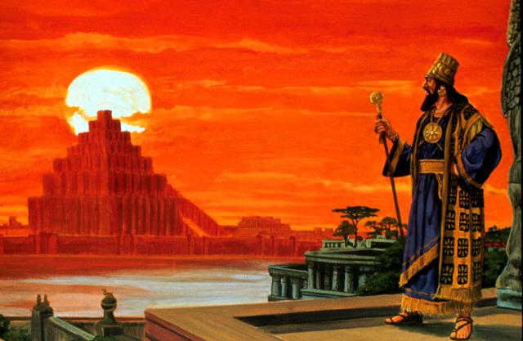
Daniel 4:17 (NKJV) ¹⁷ . . . In order that the living may know That the Most High rules in the kingdom of men, Gives it to whomever He will, And sets over it the lowest of men.'
The Lesson That All Men Need To Learn!

Slide 2
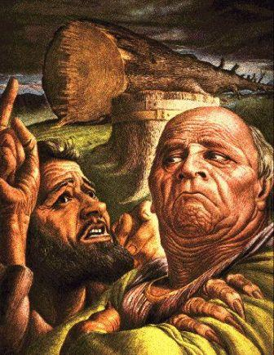
The Lesson That All Men Need To Learn!
Daniel 4
Prior events – Daniel 1-3
Nebuchadnezzar’s declaration:
A changed man – 1-3
His dream – 4-17
His charge to Daniel – 18,19a
Daniel gives the interpretation to Nebuchadnezzar – 19b-27
Nebuchadnezzar’s fall – 28-33
Nebuchadnezzar’s restoration & confession – 34-37
Notes:
Daniel 4:1-3 (NKJV) ¹ Nebuchadnezzar the king, To all peoples, nations, and languages that dwell in all the earth: Peace be multiplied to you. ² I thought it good to declare the signs and wonders that the Most High God has worked for me. ³ How great are His signs, And how mighty His wonders! His kingdom is an everlasting kingdom, And His dominion is from generation to generation.

Slide 3
Lessons That All Men Need To Learn!
Men Can & Do Change
What changed Nebuchadnezzar – Daniel 4:2,3,34-36
He learned that God is with those who serve Him – 1:19; 3:16-18,26-30
He learned that God knows the future and rules over men – 2:46-49; 4:3,9,18,34,35; 5:18-21
He learned that God is true and righteous – 4:37; Ps 119:75
Notes:
Daniel 4:1-3 (NKJV) ¹ Nebuchadnezzar the king, To all peoples, nations, and languages that dwell in all the earth: Peace be multiplied to you. ² I thought it good to declare the signs and wonders that the Most High God has worked for me. ³ How great are His signs, And how mighty His wonders! His kingdom is an everlasting kingdom, And His dominion is from generation to generation.

Slide 4
Lessons That All Men Need To Learn!
Pride Brings Judgment
When Nebuchadnezzar’s heart was lifted up with pride he was dethroned – Daniel 4:28-31
Pride precedes destruction – (Dan. 5:18-23; Prov. 16:18; Isa. 2:12; Est. 3:5; 6:6; 7:10; 1 Cor. 10:12; Luke 12:16-21)
The proud refuse to seek the Lord – (Ps. 10:3,4; Jer. 49:16; Prov. 30:9)
Notes:
Daniel 4:1-3 (NKJV) ¹ Nebuchadnezzar the king, To all peoples, nations, and languages that dwell in all the earth: Peace be multiplied to you. ² I thought it good to declare the signs and wonders that the Most High God has worked for me. ³ How great are His signs, And how mighty His wonders! His kingdom is an everlasting kingdom, And His dominion is from generation to generation.

Slide 5
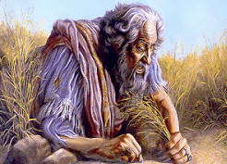
Lessons That All Men Need To Learn!
Humility Comes Before True Honor
Nebuchadnezzar learned humility – Daniel 4:25,30-33; 5:20,21
What was the difference between Nebuchadnezzar and Pharaoh? – (Ex. 7:1-4; 9:35)
God will exalt the humble, (those who fear, exalt, hear and obey Him) – Luke 14:11
Notes:
Daniel 4:1-3 (NKJV) ¹ Nebuchadnezzar the king, To all peoples, nations, and languages that dwell in all the earth: Peace be multiplied to you. ² I thought it good to declare the signs and wonders that the Most High God has worked for me. ³ How great are His signs, And how mighty His wonders! His kingdom is an everlasting kingdom, And His dominion is from generation to generation.

Slide 6
Lessons That All Men Need To Learn!
Humility Comes Before True Honor
Proverbs 18:12 (NKJV) ¹² Before destruction the heart of a man is haughty, And before honor is humility.
Notes:
Daniel 4:1-3 (NKJV) ¹ Nebuchadnezzar the king, To all peoples, nations, and languages that dwell in all the earth: Peace be multiplied to you. ² I thought it good to declare the signs and wonders that the Most High God has worked for me. ³ How great are His signs, And how mighty His wonders! His kingdom is an everlasting kingdom, And His dominion is from generation to generation.

Slide 7
Lessons That All Men Need To Learn!
Humility Comes Before True Honor
Proverbs 11:2 (NKJV) ² When pride comes, then comes shame; But with the humble is wisdom.
Notes:
Daniel 4:1-3 (NKJV) ¹ Nebuchadnezzar the king, To all peoples, nations, and languages that dwell in all the earth: Peace be multiplied to you. ² I thought it good to declare the signs and wonders that the Most High God has worked for me. ³ How great are His signs, And how mighty His wonders! His kingdom is an everlasting kingdom, And His dominion is from generation to generation.

Slide 8
Lessons That All Men Need To Learn!
Humility Comes Before True Honor
Proverbs 15:32-33 (NKJV) ³² He who disdains instruction despises his own soul, But he who heeds rebuke gets understanding. ³³ The fear of the LORD is the instruction of wisdom, And before honor is humility.
Notes:
Daniel 4:1-3 (NKJV) ¹ Nebuchadnezzar the king, To all peoples, nations, and languages that dwell in all the earth: Peace be multiplied to you. ² I thought it good to declare the signs and wonders that the Most High God has worked for me. ³ How great are His signs, And how mighty His wonders! His kingdom is an everlasting kingdom, And His dominion is from generation to generation.

Slide 9
Lessons That All Men Need To Learn!
Humility Comes Before True Honor
James 1:21 (NKJV) ²¹ Therefore lay aside all filthiness and overflow of wickedness, and receive with meekness the implanted word, which is able to save your souls.
(cf. James 4:6-10)
Notes:
Daniel 4:1-3 (NKJV) ¹ Nebuchadnezzar the king, To all peoples, nations, and languages that dwell in all the earth: Peace be multiplied to you. ² I thought it good to declare the signs and wonders that the Most High God has worked for me. ³ How great are His signs, And how mighty His wonders! His kingdom is an everlasting kingdom, And His dominion is from generation to generation.

Slide 10
Lessons That All Men Need To Learn!
Humility Comes Before True Honor
We must realize our hopeless state apart from God! – Rom 3:23; 6:23; Eph. 2:12
The prodigal son - Luke 15:11-24
Those on Pentecost – Acts 2:36-38
The Philippian jailor – Acts 16:30
Notes:
People may search for happiness in the world - they may even think they find it sometimes - but it will never truly satisfy - it will always slip away from them - it will always turn into sorrow and heartbreak !!!! If you want to find real happiness - true joy - and the peace that passes understanding - humble yourself and commit your ways and your heart to the Lord Jesus Christ - He alone can save and give you what you really need!

Slide 11
The Lesson That All Men Need To Learn!
Daniel 4:36-37 (NKJV) ³⁶ At the same time my reason returned to me, and for the glory of my kingdom, my honor and splendor returned to me. My counselors and nobles resorted to me, I was restored to my kingdom, and excellent majesty was added to me. ³⁷ Now I, Nebuchadnezzar, praise and extol and honor the King of heaven, all of whose works are truth, and His ways justice. And those who walk in pride He is able to put down.

Slide 12
The Lesson That All Men Need To Learn!
The person who comes to know who God is and what God’s will is – is the one who has true understanding -
God saves and restores far more than what He ask us to give up in this life –
God is indeed worthy of exaltation and praise – worthy of our worship, obedience and trust!

Slide 13
The Lesson That All Men Need To Learn!
Daniel 4:37
Now I, Nebuchadnezzar, praise and extol and honor the King of heaven, all of whose works are truth, and His ways justice. And those who walk in pride He is able to put down.
Have you come to learn the lesson Nebuchadnezzar learned?

Slide 15
The Lesson That All Men Need To Learn!
Charts by Don McClain
Prepared March 30-April 7-9, 2011
Preached April 10, 2011
West 65th Street church of Christ
P.O. Box 190062; Little Rock AR 72219
501-568-1062
Prepared using PPT 2010 –
Email – donmcclain@sbcglobal.net
More PPT & Audio Sermons:
http://w65stchurchofchrist.org/donmaccla/2011SermonPage.html

