Slide 1
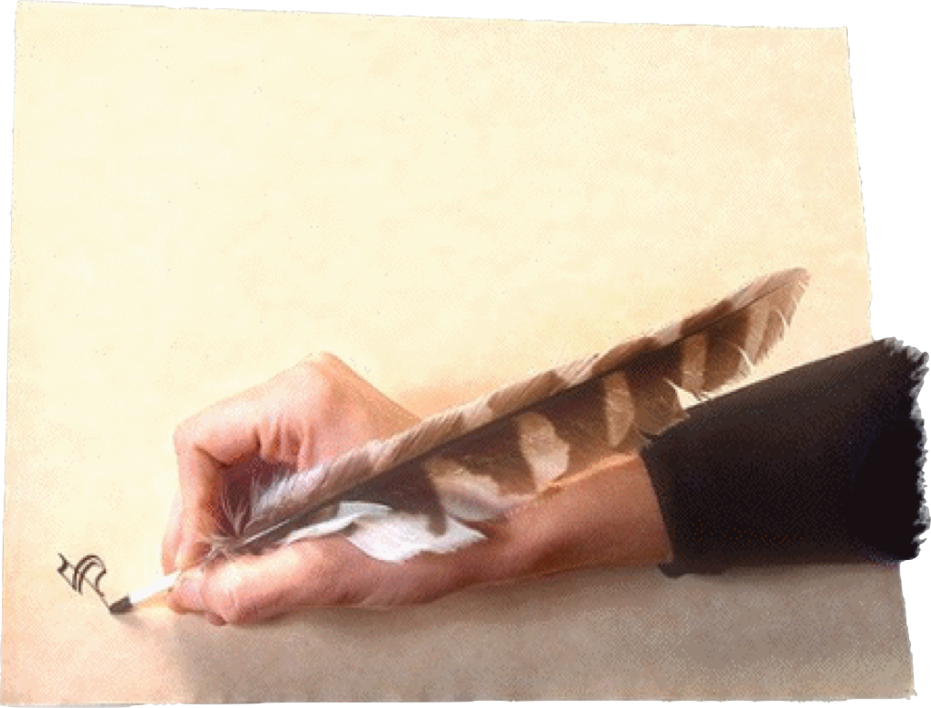
James 2:14 (NKJV)
“What does it profit, my brethren, if someone says he has faith but does not have works? Can faith save him?”
“There Is Faith That Cannot Save & Only One Kind of Faith That Does”—James 2:14-26

Slide 2
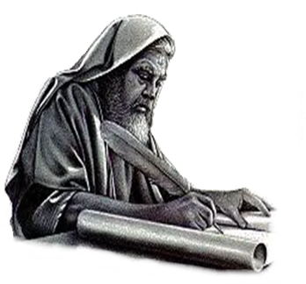
“There Is Faith That Cannot Save”
“What does it profit, my brethren, if someone says he has faith but does not have works? Can faith save him?” (2:14)
Joy in trials, and enduring them through faith - 1:1-12
Overcoming temptation to do evil through faith - 1:13-16
Overcoming anger through faith - 1:17-19
Being doers of the word by faith - 1:20-27
The matter of “favoritism” or “prejudice” - 2:1-13
The faith that does not save and the kind of faith that does - 2:14-26
Notes:
The practice of showing partiality to the rich discriminates against the poor and is evil (2:1–4). It is also strange, as the rich rather than the poor exploit Christians and slander that name (vv. 5–7). Worst of all, it is sin, for God’s Law calls on everyone to love a neighbor as yourself. Breaking that Law is the same as indulging in the more “serious” sins, for law is like a balloon: Stick a pin in one part and the whole thing breaks (vv. 8–11). We are to speak and act as those who are freed by the law of love from the law of rules. We will be evaluated on this basis: He who has received mercy must show himself merciful (vv. 12–13).0

Slide 3
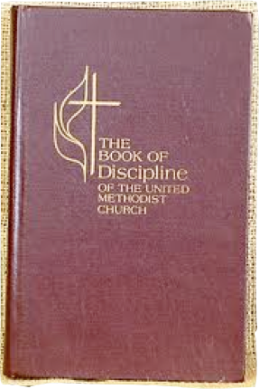
“There Is Faith That Cannot Save”
“What does it profit, my brethren, if someone says he has faith but does not have works? Can faith save him?” (2:14)
"Wherefore, that we are justified by faith, only, is a most wholesome doctrine and very full of comfort" -
The Book of Discipline of the United Methodist Church,
1972 Edition, p. 55.

Slide 4
“There Is Faith That Cannot Save”
Thus also faith by itself, if it does not have works, is dead. (2:17)
If a person is saved, he is saved by faith - (Eph. 2:8; John 8:24; Rom. 5:1; Heb 11:1,6)
Our text teaches us that there are different kinds of faith - kinds that will not save and the only kind that will.
Faith that does not respect, love and trust the Lord enough to obey Him - will not and cannot save me or you!
Only faith that respects, loves and trusts the Lord enough to obey Him will save me or anyone else!
Notes:
The practice of showing partiality to the rich discriminates against the poor and is evil (2:1–4). It is also strange, as the rich rather than the poor exploit Christians and slander that name (vv. 5–7). Worst of all, it is sin, for God’s Law calls on everyone to love a neighbor as yourself. Breaking that Law is the same as indulging in the more “serious” sins, for law is like a balloon: Stick a pin in one part and the whole thing breaks (vv. 8–11). We are to speak and act as those who are freed by the law of love from the law of rules. We will be evaluated on this basis: He who has received mercy must show himself merciful (vv. 12–13).0

Slide 5
“There Is Faith That Cannot Save”
James 2:14–26 (NKJV)
¹⁴ What does it profit, my brethren, if someone says he has faith but does not have works? Can faith save him? ¹⁵ If a brother or sister is naked and destitute of daily food, ¹⁶ and one of you says to them, “Depart in peace, be warmed and filled,” but you do not give them the things which are needed for the body, what does it profit?

Slide 6
“There Is Faith That Cannot Save”
James 2:14–26 (NKJV)
¹⁷ Thus also faith by itself, if it does not have works, is dead. ¹⁸ But someone will say, “You have faith, and I have works.” Show me your faith without your works, and I will show you my faith by my works. ¹⁹ You believe that there is one God. You do well. Even the demons believe—and tremble! ²⁰ But do you want to know, O foolish man, that faith without works is dead?

Slide 7
“There Is Faith That Cannot Save”
James 2:14–26 (NKJV)
²¹ Was not Abraham our father justified by works when he offered Isaac his son on the altar? ²² Do you see that faith was working together with his works, and by works faith was made perfect? ²³ And the Scripture was fulfilled which says, “Abraham believed God, and it was accounted to him for righteousness.” And he was called the friend of God.

Slide 8
“There Is Faith That Cannot Save”
James 2:14–26 (NKJV)
²⁴ You see then that a man is justified by works, and not by faith only. ²⁵ Likewise, was not Rahab the harlot also justified by works when she received the messengers and sent them out another way? ²⁶ For as the body without the spirit is dead, so faith without works is dead also.

Slide 9
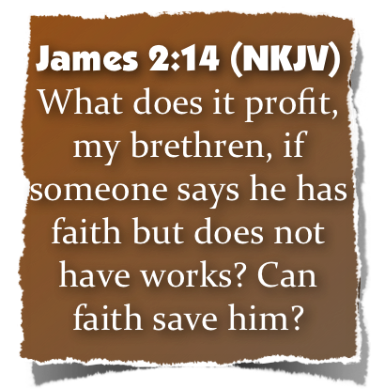
“There Is Faith That Cannot Save”
Defining Faith
4102. πίστις pistis, pis´-tis; from 3982; persuasion, i.e. credence; mor. conviction (of religious truth, or the truthfulness of God or a religious teacher), espec. reliance upon Christ for salvation; abstr. constancy in such profession; by extens. the system of religious (Gospel) truth itself:—assurance, belief, believe, faith, fidelity.
Strong, J. (2009). A Concise Dictionary of the Words in the Greek Testament and The Hebrew Bible. Bellingham, WA: Logos Bible Software.
Notes:
b. As to Obey. The fact that “to believe” is “to obey,” as in the OT (→ 199, 19 ff.), is particularly emphasised in Hb. 11. Here the πιστεύειν of OT characters has in some instances the more or less explicit sense of obedience.²³⁷ How naturally πιστεύειν includes obeying may be seen from the use of πείθεσθαι rather than πιστεύειν for receiving the Christian message, → 4, 18 ff. Unbelief can be denoted not merely by ἀπιστεῖν but also by ἀπειθεῖν, → 11, 16 ff. Paul in particular stresses the element of obedience in faith. For him πίστις is indeed ὑπακοή, as comparison of R. 1:8; 1 Th. 1:8 with R. 15:18; 16:19, or 2 C. 10:5 f. with 10:15, shows. Faith is for Paul ὑπακούειν τῷ εὐαγγελίῳ, R. 10:16. To refuse to believe is not to obey the righteousness which the Gospel offers for faith, R. 10:3. Paul can call believing confession of the Gospel the ὑποταγὴ τῆς ὁμολογίας εἰς τὸ εὐαγγέλιον τοῦ Χριστοῦ, 2 C. 9:13. He coins the combination ὑπακοὴ πίστεως, R. 1:5. On the theological interpretation of faith contained herein → 217, 35 ff.
Theological dictionary of the New Testament. 1964- (G. Kittel, G. W. Bromiley & G. Friedrich, Ed.) (electronic ed.). Grand Rapids, MI: Eerdmans.

Slide 10
“There Is Faith That Cannot Save”
Defining Faith
4102. πίστις pistis, pis´-tis;
The fact that “to believe” is “to obey,” as in the OT . . . , is particularly emphasised in Hb. 11. Here the πιστεύειν of OT characters has in some instances the more or less explicit sense of obedience.237 How naturally πιστεύειν includes obeying may be seen from the use of πείθεσθαι rather than πιστεύειν for receiving the Christian message, -
Theological dictionary of the New Testament. 1964- (G. Kittel, G. W. Bromiley & G. Friedrich, Ed.) (electronic ed.). Grand Rapids, MI: Eerdmans.
Notes:
INTRODUCTION
1. Perhaps you have seen the bumper sticker: "When life hands you a lemon, make lemonade!"
2. It is easier to smile at that statement than to practice it, but the basic philosophy is sound
a. In fact, it is Biblical
b. Throughout the Bible are people who turned defeat into victory and trials into triumph
c. Instead of being VICTIMS, they became VICTORS
3. The Epistle of James tells us that we can have this same experience today!
a. Whether we are dealing with trials on the outside
b. Or temptations on the inside
- Through faith in God and Jesus Christ we CAN experience victory!
4. The KEY to turning trials into triumph is to obey four imperatives:
a. COUNT - 1:2 - to consider, deem, account, think (Thayer)
“count it all joy when you fall into various trials,”
b. KNOW - 1:3 - to know, understand, perceive, have knowledge of - (Thayer)
“knowing that the testing of your faith produces patience.”
c. LET - 1:4 - to hold one's self to a thing, to lay hold of a thing, to adhere or cling - (Thayer)
“⁴But let patience have its perfect work, that you may be perfect and complete,”
d. ASK FOR WISDOM - 1:5-8
“⁵If any of you lacks wisdom, let him ask of God, . . . ⁶But let him ask in faith,

Slide 11
“There Is Faith That Cannot Save”
Defining Faith
Hebrews 11:1 (NKJV)
¹ Now faith is the substance of things hoped for, the evidence of things not seen.
Notes:
INTRODUCTION
1. Perhaps you have seen the bumper sticker: "When life hands you a lemon, make lemonade!"
2. It is easier to smile at that statement than to practice it, but the basic philosophy is sound
a. In fact, it is Biblical
b. Throughout the Bible are people who turned defeat into victory and trials into triumph
c. Instead of being VICTIMS, they became VICTORS
3. The Epistle of James tells us that we can have this same experience today!
a. Whether we are dealing with trials on the outside
b. Or temptations on the inside
- Through faith in God and Jesus Christ we CAN experience victory!
4. The KEY to turning trials into triumph is to obey four imperatives:
a. COUNT - 1:2 - to consider, deem, account, think (Thayer)
“count it all joy when you fall into various trials,”
b. KNOW - 1:3 - to know, understand, perceive, have knowledge of - (Thayer)
“knowing that the testing of your faith produces patience.”
c. LET - 1:4 - to hold one's self to a thing, to lay hold of a thing, to adhere or cling - (Thayer)
“⁴But let patience have its perfect work, that you may be perfect and complete,”
d. ASK FOR WISDOM - 1:5-8
“⁵If any of you lacks wisdom, let him ask of God, . . . ⁶But let him ask in faith,

Slide 12
“There Is Faith That Cannot Save”
Defining Faith
Hebrews 11:6 (NKJV)
⁶ But without faith it is impossible to please Him, for he who comes to God must believe that He is, and that He is a rewarder of those who diligently seek Him.
Notes:
INTRODUCTION
1. Perhaps you have seen the bumper sticker: "When life hands you a lemon, make lemonade!"
2. It is easier to smile at that statement than to practice it, but the basic philosophy is sound
a. In fact, it is Biblical
b. Throughout the Bible are people who turned defeat into victory and trials into triumph
c. Instead of being VICTIMS, they became VICTORS
3. The Epistle of James tells us that we can have this same experience today!
a. Whether we are dealing with trials on the outside
b. Or temptations on the inside
- Through faith in God and Jesus Christ we CAN experience victory!
4. The KEY to turning trials into triumph is to obey four imperatives:
a. COUNT - 1:2 - to consider, deem, account, think (Thayer)
“count it all joy when you fall into various trials,”
b. KNOW - 1:3 - to know, understand, perceive, have knowledge of - (Thayer)
“knowing that the testing of your faith produces patience.”
c. LET - 1:4 - to hold one's self to a thing, to lay hold of a thing, to adhere or cling - (Thayer)
“⁴But let patience have its perfect work, that you may be perfect and complete,”
d. ASK FOR WISDOM - 1:5-8
“⁵If any of you lacks wisdom, let him ask of God, . . . ⁶But let him ask in faith,

Slide 13
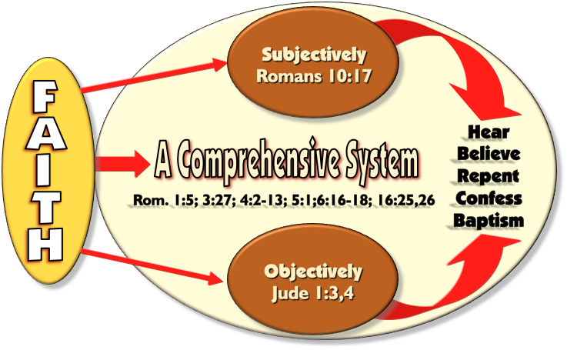
“There Is Faith That Cannot Save”
Defining Faith
Notes:
INTRODUCTION
1. Perhaps you have seen the bumper sticker: "When life hands you a lemon, make lemonade!"
2. It is easier to smile at that statement than to practice it, but the basic philosophy is sound
a. In fact, it is Biblical
b. Throughout the Bible are people who turned defeat into victory and trials into triumph
c. Instead of being VICTIMS, they became VICTORS
3. The Epistle of James tells us that we can have this same experience today!
a. Whether we are dealing with trials on the outside
b. Or temptations on the inside
- Through faith in God and Jesus Christ we CAN experience victory!
4. The KEY to turning trials into triumph is to obey four imperatives:
a. COUNT - 1:2 - to consider, deem, account, think (Thayer)
“count it all joy when you fall into various trials,”
b. KNOW - 1:3 - to know, understand, perceive, have knowledge of - (Thayer)
“knowing that the testing of your faith produces patience.”
c. LET - 1:4 - to hold one's self to a thing, to lay hold of a thing, to adhere or cling - (Thayer)
“⁴But let patience have its perfect work, that you may be perfect and complete,”
d. ASK FOR WISDOM - 1:5-8
“⁵If any of you lacks wisdom, let him ask of God, . . . ⁶But let him ask in faith,

Slide 14
“There Is Faith That Cannot Save”
Defining Works
(c) of believers, . . . "work of faith," here the initial act of faith at conversion (turning to God, 1 Thess. 1:9); . . . "every work of faith," RV, denotes every activity undertaken for Christ's sake; . . . frequent in James, as the effect of faith [in Jas. 1:25, AV, "(a doer) of the work," RV, "(a doer) that worketh"]
Vine's Expository Dictionary of Old Testament and New Testament Words.
Notes:
INTRODUCTION
1. Perhaps you have seen the bumper sticker: "When life hands you a lemon, make lemonade!"
2. It is easier to smile at that statement than to practice it, but the basic philosophy is sound
a. In fact, it is Biblical
b. Throughout the Bible are people who turned defeat into victory and trials into triumph
c. Instead of being VICTIMS, they became VICTORS
3. The Epistle of James tells us that we can have this same experience today!
a. Whether we are dealing with trials on the outside
b. Or temptations on the inside
- Through faith in God and Jesus Christ we CAN experience victory!
4. The KEY to turning trials into triumph is to obey four imperatives:
a. COUNT - 1:2 - to consider, deem, account, think (Thayer)
“count it all joy when you fall into various trials,”
b. KNOW - 1:3 - to know, understand, perceive, have knowledge of - (Thayer)
“knowing that the testing of your faith produces patience.”
c. LET - 1:4 - to hold one's self to a thing, to lay hold of a thing, to adhere or cling - (Thayer)
“⁴But let patience have its perfect work, that you may be perfect and complete,”
d. ASK FOR WISDOM - 1:5-8
“⁵If any of you lacks wisdom, let him ask of God, . . . ⁶But let him ask in faith,

Slide 15
“There Is Faith That Cannot Save”
Defining Works
. . . of those who seek justification by works, e.g., Rom. 9:32; Gal. 3:10; Eph. 2:9; described as the works of the law, e.g., Gal. 2:16; Gal. 3:2, 5; dead works, Heb. 6:1; Heb. 9:14;
Vine's Expository Dictionary of Old Testament and New Testament Words.
Notes:
INTRODUCTION
1. Perhaps you have seen the bumper sticker: "When life hands you a lemon, make lemonade!"
2. It is easier to smile at that statement than to practice it, but the basic philosophy is sound
a. In fact, it is Biblical
b. Throughout the Bible are people who turned defeat into victory and trials into triumph
c. Instead of being VICTIMS, they became VICTORS
3. The Epistle of James tells us that we can have this same experience today!
a. Whether we are dealing with trials on the outside
b. Or temptations on the inside
- Through faith in God and Jesus Christ we CAN experience victory!
4. The KEY to turning trials into triumph is to obey four imperatives:
a. COUNT - 1:2 - to consider, deem, account, think (Thayer)
“count it all joy when you fall into various trials,”
b. KNOW - 1:3 - to know, understand, perceive, have knowledge of - (Thayer)
“knowing that the testing of your faith produces patience.”
c. LET - 1:4 - to hold one's self to a thing, to lay hold of a thing, to adhere or cling - (Thayer)
“⁴But let patience have its perfect work, that you may be perfect and complete,”
d. ASK FOR WISDOM - 1:5-8
“⁵If any of you lacks wisdom, let him ask of God, . . . ⁶But let him ask in faith,

Slide 16
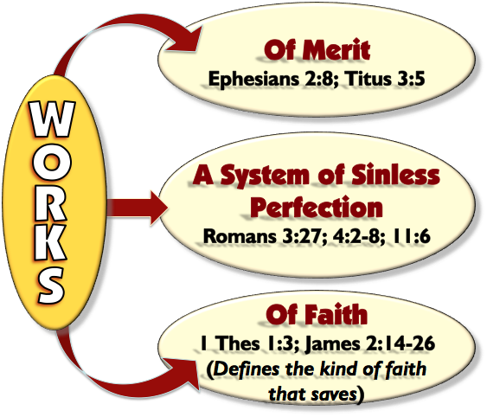
“There Is Faith That Cannot Save”
Defining Works
Includes:
Receiving the word
Confession
Repentance
Baptism
Faithfulness

Slide 17
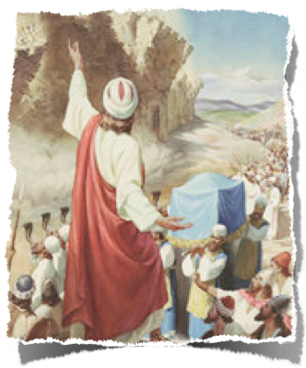
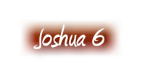
“There Is Faith That Cannot Save”
Defining Works
We Are NOT Saved By Works,
“WORKS used in two different senses or else a contradiction!
We Are Saved By Works,
Ephesians 2:8,9
Salvation by Grace
Salvation through faith
Salvation not of ourselves
Salvation NOT of works
James 2:14-26
17 - . . . faith by itself, if it does not have works, is dead.
24 - . . . justified by works, and not by faith only.
Notes:
Comparing Romans 4 & James 2

Slide 18
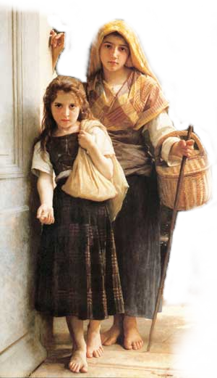
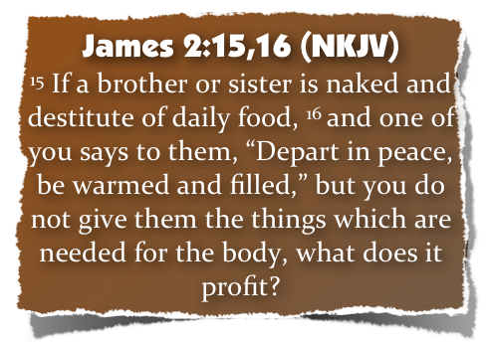
“There Is Faith That Cannot Save”
The First Illustration
What does it profit?
To know of their condition
To wish them well
To speak the right words
To take no action!

Slide 19
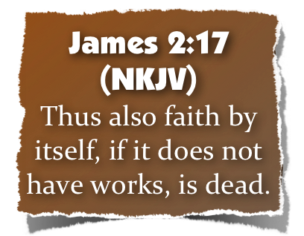
“There Is Faith That Cannot Save”
The First Illustration
Hearers - not doers - 1:22-25
Intellectual faith that will not confess - John 12:42
Professors but not followers - Luke 6:46
Those who say Lord, Lord, but do “their will” instead of the Lord’s will - Mat. 7:21-23

Slide 20
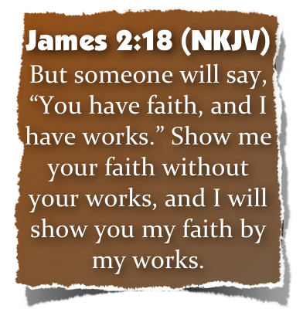
“There Is Faith That Cannot Save”
The Second Illustration
Faith and works are both insufficient “ALONE!”
A verbal declaration of faith (that is not evidenced by obedience) is a false declaration: A DEAD FAITH!
Dead faith is counterfeit faith and lulls the person into a false confidence, i.e., he deceives himself - 1:22

Slide 21
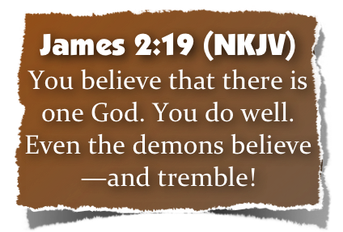
“There Is Faith That Cannot Save”
The Third Illustration
It is good to believe that there is one God - (Deut 6:4; Mark 12:29-31; 1 Cor. 8:4-6)
Demons believe in the one God - (Mark 1:24; 5:7; Luke 4:34; Ac. 19:15)
Demons believe in the deity of Jesus - (Mark 3:11,12; Luke 8:30,31)
They believe in hell - (Mat 8:29)
They believe Jesus is judge and will condemn - (Mark 5:1-13)

Slide 22
“There Is Faith That Cannot Save”
The Third Illustration
The demons’ faith extends beyond mere intellectual faith to emotional faith - They tremble!
Men make their easy professions of faith and live their worldly lives as if there were not God at all.
Why do demons tremble, while sinners can sail on in blissful unconcern? - They know that judgment is real & coming!

Slide 23
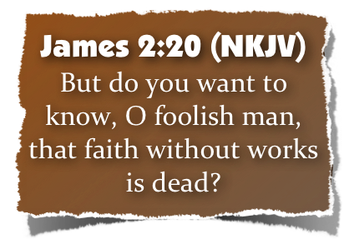
“There Is Faith That Cannot Save”
The Third Illustration
A demons faith, as it were, cannot save them!
One with such faith is empty, (foolish)
To have faith without works is powerless - it is dead, useless - it cannot save!

Slide 24
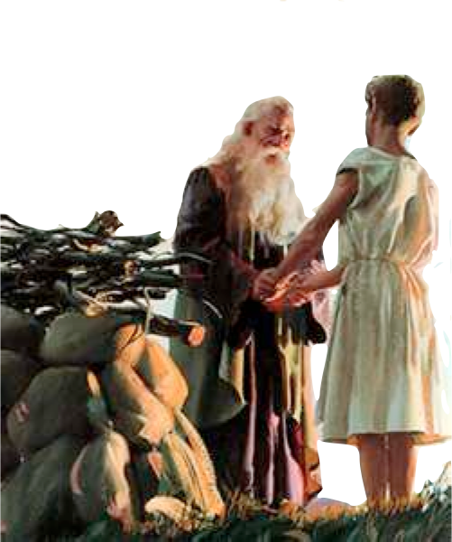
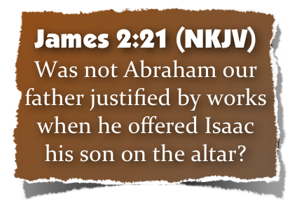
“There Is Faith That Cannot Save”
The Example of Abraham - (21-24)
Abraham was JUSTIFIED by works - (justified, [dikaiosune - δικαιοσύνη] same term as in Rom 4:2,3,5,6; 6:16)
When he obeyed God by offering Isaac - (Gen 22:1-19)
Abraham trusted God to the max! - (Heb 11:17; Rom 4:19-22)
The only viable faith is the faith that obeys God! - (Mark 16:16; Acts 2:37,38,41; Rom 4:12,23, 6:16-19)

Slide 25
“There Is Faith That Cannot Save”
The Example of Abraham - (21-24)
Faith motivated Abraham’s obedience - (22a; Heb 11:17-19)
Faith plus works make faith complete! - (vs. 22b; Gal 5:6)
Righteousness was credited to Abraham by faith when he obeyed! - (23a; Gen 15:6; Rom 4:3; Gal. 3:6-8)
Abraham was called the friend of God! - (23b; Is 41:8; 2 Chron 20:7)

Slide 26
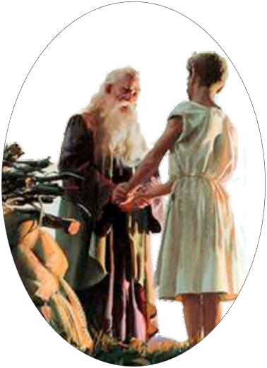
“There Is Faith That Cannot Save”
The Example of Abraham - (21-24)
We Are NOT Saved By Works,
“WORKS used in two different senses or else a contradiction!
We Are Saved By Works,
Romans 4:1-6
Justified
Counted for righteousness
Fulfilled Genesis 15:6
Strong
Not of works
James 2:21-24
Justified
Counted for righteousness
Fulfilled Genesis 15:6
Perfect
By works
Notes:
Comparing Romans 4 & James 2

Slide 27
“There Is Faith That Cannot Save”
The Example of Abraham - (21-24)
Romans 4:12 (NKJV)
and the father of circumcision to those who not only are of the circumcision, but who also walk in the steps of the faith which our father Abraham had while still uncircumcised.

Slide 28
“There Is Faith That Cannot Save”
The Example of Abraham - (21-24)
James 2:24 (NKJV)
²⁴ You see then that a man is justified by works, and not by faith only.

Slide 29
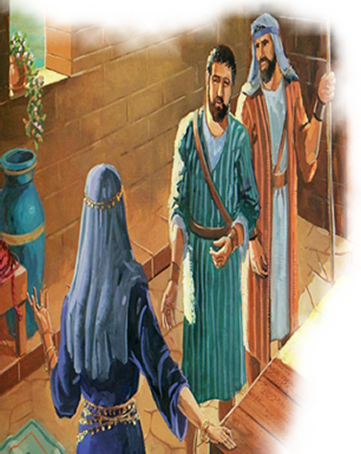
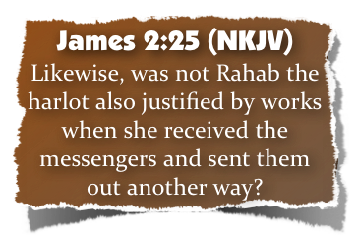
“There Is Faith That Cannot Save”
The Example of Rahab - (25)
Listed among the heroes of faith - (Heb 11:31)
Great grandmother of David and in the lineage of Jesus - (Mat 1:5,6)
She helped the spies escape at the risk of her own life! - (Joshua 2:10,11)
When Jericho was destroyed - she, & her household were saved - (Josh 6:25; Heb 11:31)

Slide 30
“There Is Faith That Cannot Save”
“What does it profit, my brethren, if someone says he has faith but does not have works? Can faith save him?”2:14

Slide 31
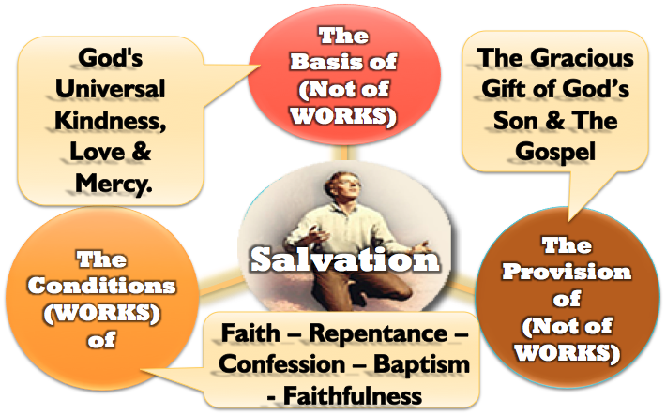
“There Is Faith That Cannot Save”

Slide 32
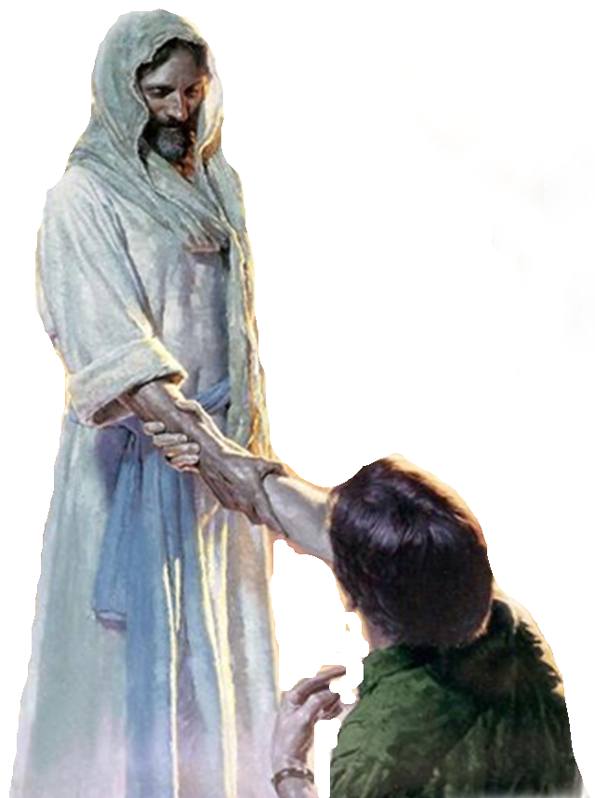
“There Is Faith That Cannot Save”
Faith without works is useless
Faith without works cannot be demonstrated
Faith without works is incomplete faith
Faith without works is dead
Faith that saves is the faith that obeys!
Notes:
INTRODUCTION
1. Perhaps you have seen the bumper sticker: "When life hands you a lemon, make lemonade!"
2. It is easier to smile at that statement than to practice it, but the basic philosophy is sound
a. In fact, it is Biblical
b. Throughout the Bible are people who turned defeat into victory and trials into triumph
c. Instead of being VICTIMS, they became VICTORS
3. The Epistle of James tells us that we can have this same experience today!
a. Whether we are dealing with trials on the outside
b. Or temptations on the inside
- Through faith in God and Jesus Christ we CAN experience victory!
4. The KEY to turning trials into triumph is to obey four imperatives:
a. COUNT - 1:2 - to consider, deem, account, think (Thayer)
“count it all joy when you fall into various trials,”
b. KNOW - 1:3 - to know, understand, perceive, have knowledge of - (Thayer)
“knowing that the testing of your faith produces patience.”
c. LET - 1:4 - to hold one's self to a thing, to lay hold of a thing, to adhere or cling - (Thayer)
“⁴But let patience have its perfect work, that you may be perfect and complete,”
d. ASK FOR WISDOM - 1:5-8
“⁵If any of you lacks wisdom, let him ask of God, . . . ⁶But let him ask in faith,

Slide 33
“There Is Faith That Cannot Save”
We are NOT saved by faith ALONE!
We are NOT saved by works ALONE!
We are saved by faith that works!
We Cannot Be Saved Without Obeying The Lord By Faith
Notes:
How Then Can Baptism Be Essential For Salvation?

Slide 35
Charts by Don McClain
Prepared May 12,13, 2012
Preached May 13, 2012
West 65th Street church of Christ
P.O. Box 190062
Little Rock AR 72219
501-568-1062
Prepared using PPT 2010
Email – donmcclain@sbcglobal.net
More PPT & Audio Sermons:
http://w65stchurchofchrist.org/donmaccla/2010SermonPage.html
Note – Many of the transition effects used in this presentation may be lost using PPT 2007 Viewer
http://www.microsoft.com/downloads/details.aspx?FamilyID=cb9bf144-1076-4615-9951-294eeb832823&displaylang=en

Slide 36
Matthew 7:21–27 (NKJV)
²¹ “Not everyone who says to Me, ‘Lord, Lord,’ shall enter the kingdom of heaven, but he who does the will of My Father in heaven. ²² Many will say to Me in that day, ‘Lord, Lord, have we not prophesied in Your name, cast out demons in Your name, and done many wonders in Your name?’ ²³ And then I will declare to them, ‘I never knew you; depart from Me, you who practice lawlessness!’

Slide 37
Matthew 7:21–27 (NKJV)
²⁴ “Therefore whoever hears these sayings of Mine, and does them, I will liken him to a wise man who built his house on the rock: ²⁵ and the rain descended, the floods came, and the winds blew and beat on that house; and it did not fall, for it was founded on the rock.

Slide 38
Matthew 7:21–27 (NKJV)
²⁶ “But everyone who hears these sayings of Mine, and does not do them, will be like a foolish man who built his house on the sand: ²⁷ and the rain descended, the floods came, and the winds blew and beat on that house; and it fell. And great was its fall.”

