Slide 1
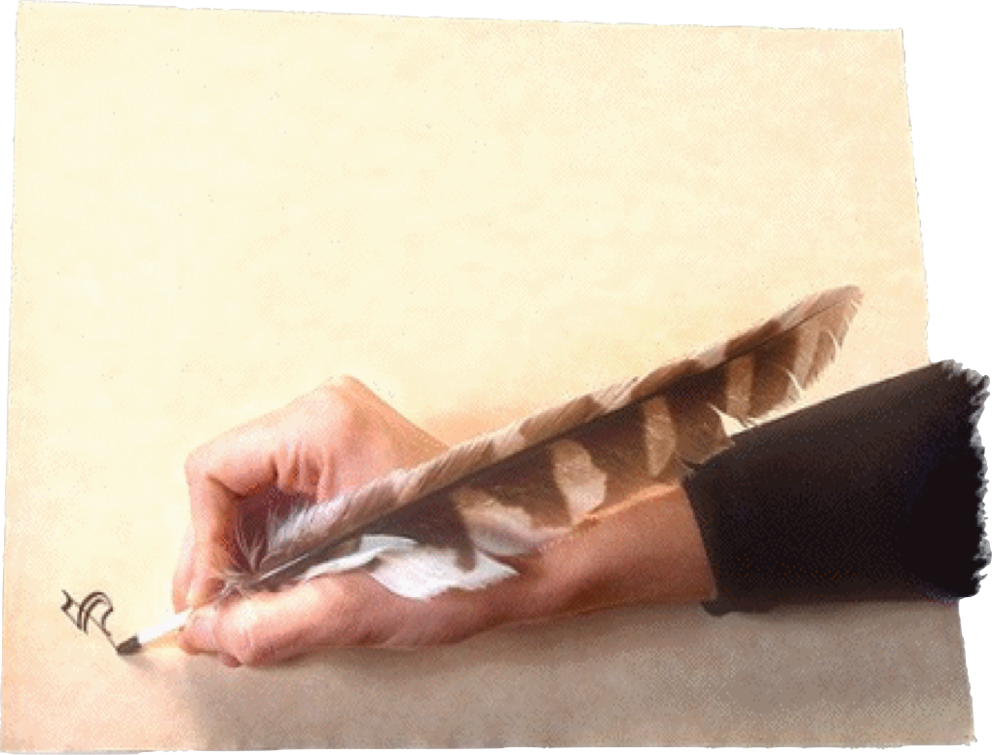
James 3:13 (NKJV)
“Who is wise and understanding among you? Let him show by good conduct that his works are done in the meekness of wisdom.”
“Two Wisdoms”
Heavenly? or Earthly, Sensual, Demonic?
James 3:13-18

Slide 2
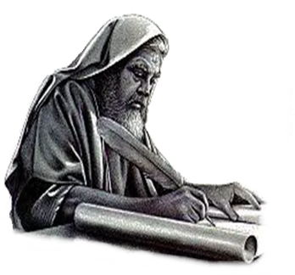
“Two Wisdoms”
Heavenly? or Earthly, Sensual, Demonic?
Enduring trials through faith - 1:1-12
Overcoming temptation to do evil through faith - 1:13-16
Overcoming anger through faith - 1:17-19
Being doers of the word by faith - 1:20-27
The sin of favoritism / prejudice - 2:1-13
The faith that does not save and the ONLY kind of faith that does - 2:14-26
The power of the tongue and our need to control it - 3:1-12
Notes:
The practice of showing partiality to the rich discriminates against the poor and is evil (2:1–4). It is also strange, as the rich rather than the poor exploit Christians and slander that name (vv. 5–7). Worst of all, it is sin, for God’s Law calls on everyone to love a neighbor as yourself. Breaking that Law is the same as indulging in the more “serious” sins, for law is like a balloon: Stick a pin in one part and the whole thing breaks (vv. 8–11). We are to speak and act as those who are freed by the law of love from the law of rules. We will be evaluated on this basis: He who has received mercy must show himself merciful (vv. 12–13).0

Slide 3
“Two Wisdoms”
Heavenly? or Earthly, Sensual, Demonic?
We should all want to have wisdom. - “Wisdom is the principal thing; Therefore get wisdom. And in all your getting, get understanding.” - Prov 4:7
How do we know whether or not we have true wisdom?
Wisdom is known by deeds rather than words. - James 3:13
Notes:
The practice of showing partiality to the rich discriminates against the poor and is evil (2:1–4). It is also strange, as the rich rather than the poor exploit Christians and slander that name (vv. 5–7). Worst of all, it is sin, for God’s Law calls on everyone to love a neighbor as yourself. Breaking that Law is the same as indulging in the more “serious” sins, for law is like a balloon: Stick a pin in one part and the whole thing breaks (vv. 8–11). We are to speak and act as those who are freed by the law of love from the law of rules. We will be evaluated on this basis: He who has received mercy must show himself merciful (vv. 12–13).0

Slide 4
“Two Wisdoms”
Heavenly? or Earthly, Sensual, Demonic?
James 3:13-18 (NKJV)
¹³ Who is wise and understanding among you? Let him show by good conduct that his works are done in the meekness of wisdom. ¹⁴ But if you have bitter envy and self-seeking in your hearts, do not boast and lie against the truth.

Slide 5
“Two Wisdoms”
Heavenly? or Earthly, Sensual, Demonic?
James 3:13-18 (NKJV)
¹⁵ This wisdom does not descend from above, but is earthly, sensual, demonic. ¹⁶ For where envy and self-seeking exist, confusion and every evil thing are there.

Slide 6
“Two Wisdoms”
Heavenly? or Earthly, Sensual, Demonic?
James 3:13-18 (NKJV)
¹⁷ But the wisdom that is from above is first pure, then peaceable, gentle, willing to yield, full of mercy and good fruits, without partiality and without hypocrisy. ¹⁸ Now the fruit of righteousness is sown in peace by those who make peace.

Slide 7
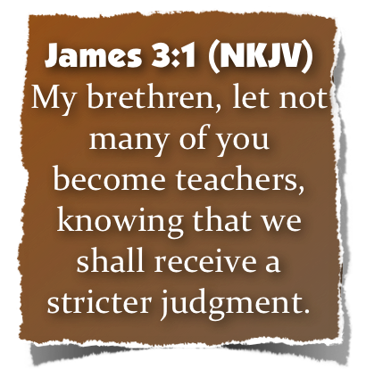
“Two Wisdoms”
Heavenly? or Earthly, Sensual, Demonic?
A Warning To Teachers
“Among the Jews, Sophos (“wise”) was a technical term for the teacher, the scribe, the Rabbi” (Theological Dictionary of the New Testament. 7:505)
The Jewish disciples wanted to be teachers. - James 3:1
James is still dealing with the tongue - but goes beyond the sins of the tongue to the source of those sins.
Notes:
The practice of showing partiality to the rich discriminates against the poor and is evil (2:1–4). It is also strange, as the rich rather than the poor exploit Christians and slander that name (vv. 5–7). Worst of all, it is sin, for God’s Law calls on everyone to love a neighbor as yourself. Breaking that Law is the same as indulging in the more “serious” sins, for law is like a balloon: Stick a pin in one part and the whole thing breaks (vv. 8–11). We are to speak and act as those who are freed by the law of love from the law of rules. We will be evaluated on this basis: He who has received mercy must show himself merciful (vv. 12–13).0

Slide 8
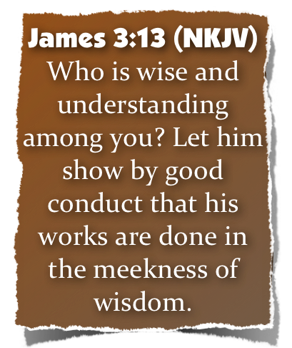
“Two Wisdoms”
Heavenly? or Earthly, Sensual, Demonic?
A Warning To Teachers
What qualifications should one meet to be a teacher? - cf. Deut 1:13
Wisdom in handling the scriptures would certainly be an important quality - 2 Tim 2:15; 2 Pet. 3:16-18
Wisdom in handling difficult situations would be important - Jude 1:22,23; James 1:5
Wisdom is necessary in promoting unity & harmony - Jam 3:13-18
Notes:
The practice of showing partiality to the rich discriminates against the poor and is evil (2:1–4). It is also strange, as the rich rather than the poor exploit Christians and slander that name (vv. 5–7). Worst of all, it is sin, for God’s Law calls on everyone to love a neighbor as yourself. Breaking that Law is the same as indulging in the more “serious” sins, for law is like a balloon: Stick a pin in one part and the whole thing breaks (vv. 8–11). We are to speak and act as those who are freed by the law of love from the law of rules. We will be evaluated on this basis: He who has received mercy must show himself merciful (vv. 12–13).0

Slide 9
“Two Wisdoms”
Heavenly? or Earthly, Sensual, Demonic?
Defining Wisdom
Thayer Definition:
G4678 – σοφία - sophia
1) wisdom, broad and full of intelligence; used of the knowledge of very diverse matters - 1a) . . . acquired by acuteness and experience, . . . 1a5) skill in the management of affairs - 1a6) devout and proper prudence . . . 1a7) the knowledge and practice of the requisites for godly and upright living
Notes:
The practice of showing partiality to the rich discriminates against the poor and is evil (2:1–4). It is also strange, as the rich rather than the poor exploit Christians and slander that name (vv. 5–7). Worst of all, it is sin, for God’s Law calls on everyone to love a neighbor as yourself. Breaking that Law is the same as indulging in the more “serious” sins, for law is like a balloon: Stick a pin in one part and the whole thing breaks (vv. 8–11). We are to speak and act as those who are freed by the law of love from the law of rules. We will be evaluated on this basis: He who has received mercy must show himself merciful (vv. 12–13).0

Slide 10
“Two Wisdoms”
Heavenly? or Earthly, Sensual, Demonic?
True Wisdom Expressed
Wisdom pertains not ONLY to that which is spoken - but to that which is done –
“Good conversation” (KJV); - “good conduct” (NKJV); “good behavior” - (NASB) - (cf. Eph 5:15-17; 1 Tim 4:12-16)
Works - (Mt 7:24; Tit 2:14 - in contrast cf. Mat. 6:1-18; 23:2-5; Tit 1:16)
Meekness - the opposite of arrogance - (Mat 20:25-28; Gal. 6:1; 1 Tim 6:11)
Notes:
The practice of showing partiality to the rich discriminates against the poor and is evil (2:1–4). It is also strange, as the rich rather than the poor exploit Christians and slander that name (vv. 5–7). Worst of all, it is sin, for God’s Law calls on everyone to love a neighbor as yourself. Breaking that Law is the same as indulging in the more “serious” sins, for law is like a balloon: Stick a pin in one part and the whole thing breaks (vv. 8–11). We are to speak and act as those who are freed by the law of love from the law of rules. We will be evaluated on this basis: He who has received mercy must show himself merciful (vv. 12–13).0

Slide 11
“Two Wisdoms”
Heavenly? or Earthly, Sensual, Demonic?
Evidence of Ungodly Wisdom - 3:14
“Bitter envying” - “an envious and contentious rivalry, jealousy” - (Thayer. 271)
1 Cor 3:3 - For where there are envy, strife, and divisions among you, are you not carnal and behaving like mere men?
Galatians 5:20 - . . . contentions, jealousies, outbursts of wrath, selfish ambitions, dissensions, heresies,
Rom. 13:13 - Let us walk properly . . . not in strife and envy. .
Notes:
The practice of showing partiality to the rich discriminates against the poor and is evil (2:1–4). It is also strange, as the rich rather than the poor exploit Christians and slander that name (vv. 5–7). Worst of all, it is sin, for God’s Law calls on everyone to love a neighbor as yourself. Breaking that Law is the same as indulging in the more “serious” sins, for law is like a balloon: Stick a pin in one part and the whole thing breaks (vv. 8–11). We are to speak and act as those who are freed by the law of love from the law of rules. We will be evaluated on this basis: He who has received mercy must show himself merciful (vv. 12–13).0

Slide 12
“Two Wisdoms”
Heavenly? or Earthly, Sensual, Demonic?
Evidence of Ungodly Wisdom - 3:14
“Self seeking” - “faction” (ASV), “strife - (KJV), “selfish ambition” - (NASB), - “denotes ambition, self-seeking, rivalry, self-will being an underlying idea in the word; hence it denotes party-making” (Vine. 2:68).
One who is interested in promoting a party or hobby
One who is interested in climbing the preacher ladder
Selfishness or self-promoting
Notes:
The practice of showing partiality to the rich discriminates against the poor and is evil (2:1–4). It is also strange, as the rich rather than the poor exploit Christians and slander that name (vv. 5–7). Worst of all, it is sin, for God’s Law calls on everyone to love a neighbor as yourself. Breaking that Law is the same as indulging in the more “serious” sins, for law is like a balloon: Stick a pin in one part and the whole thing breaks (vv. 8–11). We are to speak and act as those who are freed by the law of love from the law of rules. We will be evaluated on this basis: He who has received mercy must show himself merciful (vv. 12–13).0

Slide 13
“Two Wisdoms”
Heavenly? or Earthly, Sensual, Demonic?
Evidence of Ungodly Wisdom - 3:14
“If there is bitterness in the heart, let there be no boasting of your goodness. That would be to lie against the truth.” - [Johnson's Notes on the New Testament].
This is nothing to glory about. To boast (lit., “exult,” katakauchasthe) in such attitudes is to deny, or “lie against,” the truth. - [The Bible Knowledge Commentary: An Exposition of the Scriptures by Dallas Seminary Faculty].
Notes:
The practice of showing partiality to the rich discriminates against the poor and is evil (2:1–4). It is also strange, as the rich rather than the poor exploit Christians and slander that name (vv. 5–7). Worst of all, it is sin, for God’s Law calls on everyone to love a neighbor as yourself. Breaking that Law is the same as indulging in the more “serious” sins, for law is like a balloon: Stick a pin in one part and the whole thing breaks (vv. 8–11). We are to speak and act as those who are freed by the law of love from the law of rules. We will be evaluated on this basis: He who has received mercy must show himself merciful (vv. 12–13).0

Slide 14
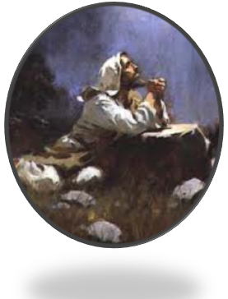
“Two Wisdoms”
Heavenly? or Earthly, Sensual, Demonic?
Wisdom Is NOT Envious Or Selfish
Philippians 2:1-4 (NKJV)
¹ Therefore if there is any consolation in Christ, if any comfort of love, if any fellowship of the Spirit, if any affection and mercy, ² fulfill my joy by being like-minded, having the same love, being of one accord, of one mind. ³ Let nothing be done through selfish ambition or conceit, but in lowliness of mind let each esteem others better than himself. ⁴ Let each of you look out not only for his own interests, but also for the interests of others.
Phili 2:5-8
Notes:
The practice of showing partiality to the rich discriminates against the poor and is evil (2:1–4). It is also strange, as the rich rather than the poor exploit Christians and slander that name (vv. 5–7). Worst of all, it is sin, for God’s Law calls on everyone to love a neighbor as yourself. Breaking that Law is the same as indulging in the more “serious” sins, for law is like a balloon: Stick a pin in one part and the whole thing breaks (vv. 8–11). We are to speak and act as those who are freed by the law of love from the law of rules. We will be evaluated on this basis: He who has received mercy must show himself merciful (vv. 12–13).0

Slide 15
“Two Wisdoms”
Heavenly? or Earthly, Sensual, Demonic?
Source of Ungodly Wisdom - 3:15
Origin: “Earthly” - “existing upon the earth, earthly, terrestrial... the wisdom of man, liable to error and misleading” - (Thayer. 236-7). - cf. Phili. 3:18-20
Wisdom that is according to the world's standards cannot be applied to Spiritual things and relationships
Such use of earthly wisdom is foolishness to God - cf. - 1 Cor 1:20-24,25.26; 2 Cor. 4:4; 1 John 2:15
Notes:
The practice of showing partiality to the rich discriminates against the poor and is evil (2:1–4). It is also strange, as the rich rather than the poor exploit Christians and slander that name (vv. 5–7). Worst of all, it is sin, for God’s Law calls on everyone to love a neighbor as yourself. Breaking that Law is the same as indulging in the more “serious” sins, for law is like a balloon: Stick a pin in one part and the whole thing breaks (vv. 8–11). We are to speak and act as those who are freed by the law of love from the law of rules. We will be evaluated on this basis: He who has received mercy must show himself merciful (vv. 12–13).0

Slide 16
“Two Wisdoms”
Heavenly? or Earthly, Sensual, Demonic?
Source of Ungodly Wisdom - 3:15
Appeal: “Sensual” - “a. having the nature and characteristics of the . . . principle of animal life, which men have in common with the brutes. b. governed by the. . . the sensuous nature with its subjection to appetite and passion” (Thayer. 677-8). - cf. Jude 17-19
Appealing to the senses, the emotions, the passions
The reasoning used for perversions in the worship and work of the church –
When men follow such wisdom - carnality is increased and spirituality is decreased!
Notes:
The practice of showing partiality to the rich discriminates against the poor and is evil (2:1–4). It is also strange, as the rich rather than the poor exploit Christians and slander that name (vv. 5–7). Worst of all, it is sin, for God’s Law calls on everyone to love a neighbor as yourself. Breaking that Law is the same as indulging in the more “serious” sins, for law is like a balloon: Stick a pin in one part and the whole thing breaks (vv. 8–11). We are to speak and act as those who are freed by the law of love from the law of rules. We will be evaluated on this basis: He who has received mercy must show himself merciful (vv. 12–13).0

Slide 17
“Two Wisdoms”
Heavenly? or Earthly, Sensual, Demonic?
Source of Ungodly Wisdom - 3:15
Nature: “devilish” - “resembling or proceeding from an evilspirit, demon-like" (Thayer. 124) - cf. John 8:44
Does not require a denial of God and spiritual things, just a promotion of worldly, carnal and sensual things and aspirations above the spiritual.
The devil did not seek to make Eve an atheist, he just wanted God to be demoted in her mind (Gen 3)
This kind of wisdom thrives upon pride -Proverbs 3:7
Notes:
The practice of showing partiality to the rich discriminates against the poor and is evil (2:1–4). It is also strange, as the rich rather than the poor exploit Christians and slander that name (vv. 5–7). Worst of all, it is sin, for God’s Law calls on everyone to love a neighbor as yourself. Breaking that Law is the same as indulging in the more “serious” sins, for law is like a balloon: Stick a pin in one part and the whole thing breaks (vv. 8–11). We are to speak and act as those who are freed by the law of love from the law of rules. We will be evaluated on this basis: He who has received mercy must show himself merciful (vv. 12–13).0

Slide 18
“Two Wisdoms”
Heavenly? or Earthly, Sensual, Demonic?
Results of Ungodly Wisdom - 3:16
Confusion - “instability..., denotes a state of disorder, disturbance, confusion, tumult ... revolution or anarchy” (Vine. 1:227)
Every evil work - worthless, vile, wicked, base
1 Cor. 3:3 — for you are still carnal. For where there are envy, strife, and divisions among you, are you not carnal and behaving like mere men?
Notes:
The practice of showing partiality to the rich discriminates against the poor and is evil (2:1–4). It is also strange, as the rich rather than the poor exploit Christians and slander that name (vv. 5–7). Worst of all, it is sin, for God’s Law calls on everyone to love a neighbor as yourself. Breaking that Law is the same as indulging in the more “serious” sins, for law is like a balloon: Stick a pin in one part and the whole thing breaks (vv. 8–11). We are to speak and act as those who are freed by the law of love from the law of rules. We will be evaluated on this basis: He who has received mercy must show himself merciful (vv. 12–13).0

Slide 19
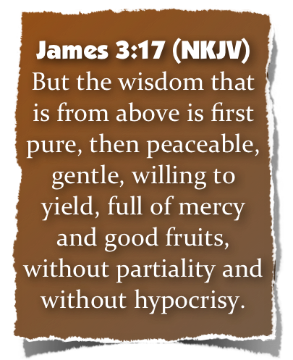
“Two Wisdoms”
Heavenly? or Earthly, Sensual, Demonic?
Wisdom From Above - 3:17-18
God is it's source and is attained from:
God - 1 Kings 4:29
A respect for God - Ps 111:10
Bible Study - Ps 119:97,98
Obedience to God's will - Ps 107:43
Maturity - Heb 5:14
There are Two sources of wisdom - just as there are two sources of Authority - Mat 21:23-27
Notes:
The practice of showing partiality to the rich discriminates against the poor and is evil (2:1–4). It is also strange, as the rich rather than the poor exploit Christians and slander that name (vv. 5–7). Worst of all, it is sin, for God’s Law calls on everyone to love a neighbor as yourself. Breaking that Law is the same as indulging in the more “serious” sins, for law is like a balloon: Stick a pin in one part and the whole thing breaks (vv. 8–11). We are to speak and act as those who are freed by the law of love from the law of rules. We will be evaluated on this basis: He who has received mercy must show himself merciful (vv. 12–13).0

Slide 20
“Two Wisdoms”
Heavenly? or Earthly, Sensual, Demonic?
Wisdom From Above - 3:17-18
The nature of heavenly wisdom
Pure - "pure from defilement, not contaminated” (Vine. 3:231); cf. Mat 5:8; 1 John 3:3; Gal 1:8-9
Peaceable - cf. Matthew 5:9
Gentle - “equitable, fair, moderate, forbearing, . . . it expresses that considerateness that looks humanely and reasonably at the facts of a case” (Vine. 2:144-5).; cf. Phil 4:5
Notes:
The practice of showing partiality to the rich discriminates against the poor and is evil (2:1–4). It is also strange, as the rich rather than the poor exploit Christians and slander that name (vv. 5–7). Worst of all, it is sin, for God’s Law calls on everyone to love a neighbor as yourself. Breaking that Law is the same as indulging in the more “serious” sins, for law is like a balloon: Stick a pin in one part and the whole thing breaks (vv. 8–11). We are to speak and act as those who are freed by the law of love from the law of rules. We will be evaluated on this basis: He who has received mercy must show himself merciful (vv. 12–13).0

Slide 21
“Two Wisdoms”
Heavenly? or Earthly, Sensual, Demonic?
Wisdom From Above - 3:17-18
The nature of heavenly wisdom
Willing to yield - Does not yield faith - but opinions - considers the evidence & yields to the truth
Mercy - “kindness or good will towards the miserable and afflicted, joined with a desire to relieve them” - cf. Mat 5:7
Good fruits - cf. Galatians 5:22-24
Without partiality - cf. James 2:1
Without hypocrisy - genuine, sincere
Notes:
The practice of showing partiality to the rich discriminates against the poor and is evil (2:1–4). It is also strange, as the rich rather than the poor exploit Christians and slander that name (vv. 5–7). Worst of all, it is sin, for God’s Law calls on everyone to love a neighbor as yourself. Breaking that Law is the same as indulging in the more “serious” sins, for law is like a balloon: Stick a pin in one part and the whole thing breaks (vv. 8–11). We are to speak and act as those who are freed by the law of love from the law of rules. We will be evaluated on this basis: He who has received mercy must show himself merciful (vv. 12–13).0

Slide 22
“Two Wisdoms”
Heavenly? or Earthly, Sensual, Demonic?
Wisdom From Above - 3:17-18
The result of heavenly wisdom
The fruit of righteousness is sown - Ephesians 2:10
In peace - Romans 12:18
By them that make peace - cf. Matthew 5:9; Romans 5:1; 1:16-17; Ephesians 4:1-3; Philippians 4:7
Notes:
The practice of showing partiality to the rich discriminates against the poor and is evil (2:1–4). It is also strange, as the rich rather than the poor exploit Christians and slander that name (vv. 5–7). Worst of all, it is sin, for God’s Law calls on everyone to love a neighbor as yourself. Breaking that Law is the same as indulging in the more “serious” sins, for law is like a balloon: Stick a pin in one part and the whole thing breaks (vv. 8–11). We are to speak and act as those who are freed by the law of love from the law of rules. We will be evaluated on this basis: He who has received mercy must show himself merciful (vv. 12–13).0

Slide 23
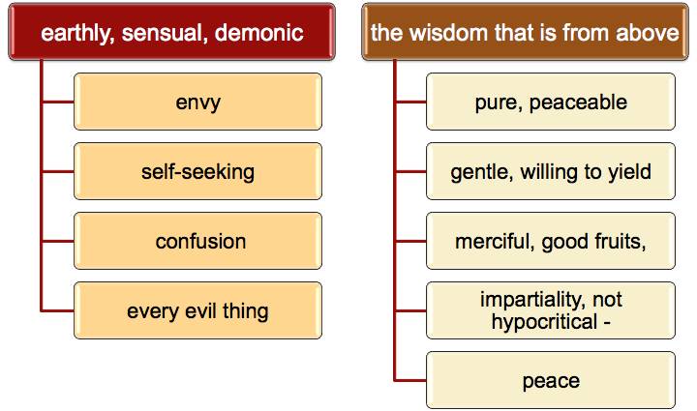
“Two Wisdoms”
Heavenly? or Earthly, Sensual, Demonic?
James 3:13-18
Two Kinds of Wisdom / Two Kinds of Fruit

Slide 24
“Two Wisdoms”
Heavenly? or Earthly, Sensual, Demonic?
Wisdom Is Proven By Its Fruit
Which Do We Exhibit?

Slide 26
“Two Wisdoms”
Heavenly? or Earthly, Sensual, Demonic?
Charts by Don McClain
Prepared June 17, 2012
Preached June 17, 2012
West 65th Street church of Christ
P.O. Box 190062
Little Rock AR 72219
501-568-1062
Prepared using PPT 2010
Email – donmcclain@sbcglobal.net
More PPT & Audio Sermons:
http://w65stchurchofchrist.org/donmaccla/2010SermonPage.html
Note – Many of the transition effects used in this presentation may be lost using PPT 2007 Viewer
http://www.microsoft.com/downloads/details.aspx?FamilyID=cb9bf144-1076-4615-9951-294eeb832823&displaylang=en

Slide 27
Isaiah 11:2–9 (NKJV)
² The Spirit of the Lord shall rest upon Him, The Spirit of wisdom and understanding, The Spirit of counsel and might, The Spirit of knowledge and of the fear of the Lord. ³ His delight is in the fear of the Lord,
And He shall not judge by the sight of His eyes, Nor decide by the hearing of His ears;

Slide 28
Isaiah 11:2–9 (NKJV)
⁴ But with righteousness He shall judge the poor, And decide with equity for the meek of the earth; He shall strike the earth with the rod of His mouth, And with the breath of His lips He shall slay the wicked.
⁵ Righteousness shall be the belt of His loins, And faithfulness the belt of His waist.

Slide 29
Isaiah 11:2–9 (NKJV)
⁶ “The wolf also shall dwell with the lamb, The leopard shall lie down with the young goat, The calf and the young lion and the fatling together; And a little child shall lead them. ⁷ The cow and the bear shall graze; Their young ones shall lie down together; And the lion shall eat straw like the ox.

Slide 30
Isaiah 11:2–9 (NKJV)
⁸ The nursing child shall play by the cobra’s hole, And the weaned child shall put his hand in the viper’s den. ⁹ They shall not hurt nor destroy in all My holy mountain,
For the earth shall be full of the knowledge of the Lord As the waters cover the sea.

