Slide 1
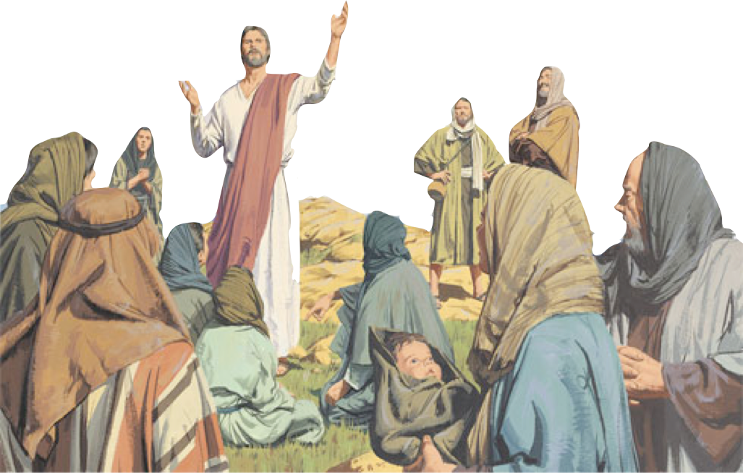
Our need to respond to the DEMANDS of the King in every respect - (Mt 7:13-27)

Slide 2
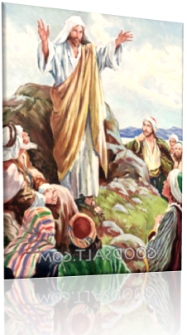
2
The CHARACTER and BLESSEDNESS of the citizens of the kingdom - (Mt 5:3-16)
The RIGHTEOUSNESS expected of its citizens - (Mt 5:17-7:12)
Our need to respond to the DEMANDS of the King in every respect - (Mt 7:13-27)

Slide 3
The Challenge To Choose
The Choice Is Ours!
¹³ "Enter by the narrow gate . . .”
And It Is A Choice We Will & MUST Make
The way of Trust and Submission
The way of rejection and rebellion.
Matthew 7:13,14 (NKJV) "Enter by the narrow gate; for wide is the gate and broad is the way that leads to destruction, and there are many who go in by it.

Slide 4
The Challenge To Choose
The Choice Is Ours!
²¹ "he who does the will of My Father in heaven.”
And It Is A Choice We Will & MUST Make
The way of Trust and Submission
The way of rejection and rebellion.
Matthew 7:21 (NKJV) "Not everyone who says to Me, 'Lord, Lord,' shall enter the kingdom of heaven, but he who does the will of My Father in heaven.

Slide 5
The Challenge To Choose
The Choice Is Ours!
²¹ "he who does the will of My Father in heaven.”
And It Is A Choice We Will & MUST Make
The way of Trust and Submission
The way of rejection and rebellion.
Speaks to the Understanding & Will
The need to learn of the way & yield to it’s requirements
You CHOOSE YOUR DESTINY

Slide 6
Building A Life That Will Last
6
Matthew 7:24-27 (NKJV)
²⁴ "Therefore whoever hears these sayings of Mine, and does them, I will liken him to a wise man who built his house on the rock: ²⁵ and the rain descended, the floods came, and the winds blew and beat on that house; and it did not fall, for it was founded on the rock.

Slide 7
Building A Life That Will Last
7
Matthew 7:24-27 (NKJV)
²⁶ But everyone who hears these sayings of Mine, and does not do them, will be like a foolish man who built his house on the sand: ²⁷ and the rain descended, the floods came, and the winds blew and beat on that house; and it fell. And great was its fall."

Slide 8
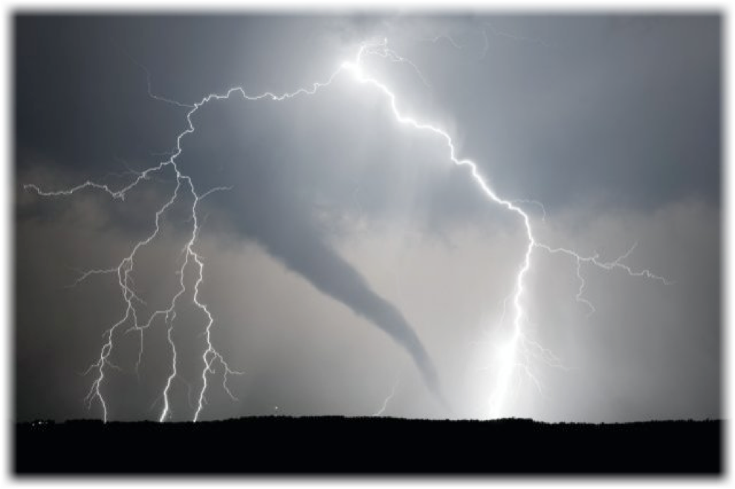
Building A Life That Will Last
It’s Not Just Hearing Jesus, But Doing What He Says!
The way of rejection and rebellion.
The way of Trust and Submission
Two Kinds of Righteousness,
False
True
Two Kinds of Service,
Hypocrisy
Sincerity
Two Kinds of Treasure,
Material
Spiritual
Two Different Ways,
Broad
Narrow
Our will – or - God's will?
Rebellion
Submission
Two Different Ends,
Destruction
Salvation

Slide 9
Building A Life That Will Last
It’s Not Just Hearing Jesus, But Doing What He Says!
Contrasting The Two Builders
a wise man who built his house on the rock: . . Thus it withstood the storms.
"Therefore whoever hears these sayings of Jesus, and does them, . . .”
Is Like
a foolish man who built his house on the sand: . . . thus it fell. And great was its fall
But everyone who hears these sayings of Mine, and does not do them,
Is Like

Slide 10
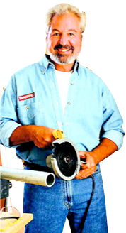
Building A Life That Will Last
It’s Not Just Hearing Jesus, But Doing What He Says!
Contrasting The Two Builders
a wise man who built his house on the rock
a foolish man who built his house on the sand
Similarities. Built the same thing
Each built his own Both houses were tested by the same storm.

Slide 11
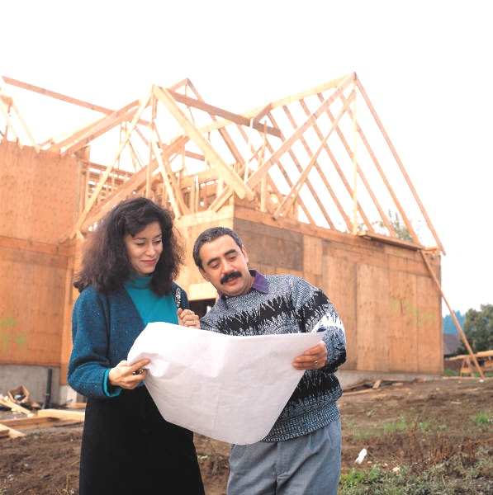
Building A Life That Will Last
It’s Not Just Hearing Jesus, But Doing What He Says!
Contrasting The Two Builders
a wise man who built his house on the rock
a foolish man who built his house on the sand
The Difference
Chose the more difficult, expensive & long term course
Luke 6:48
Chose the easiest, cheapest & quickest course
Luke 6:49

Slide 12
Building A Life That Will Last
It’s Not Just Hearing Jesus, But Doing What He Says!
Contrasting The Two Builders
a wise man who built his house on the rock
a foolish man who built his house on the sand
The Difference
Took time and effort to build on a solid foundation.
Luke 6:48
Did NOT take time or effort to build on a solid foundation.
Luke 6:49

Slide 13
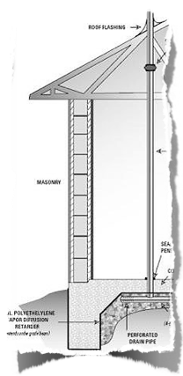
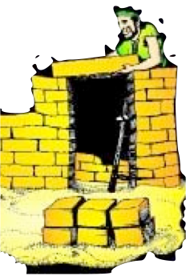
Building A Life That Will Last
It’s Not Just Hearing Jesus, But Doing What He Says!
Contrasting The Two Foundations
a wise man who built his house on the rock
a foolish man who built his house on the sand
Substantial
Would support his house long term
Unsubtantial
Would not support his house long term

Slide 14
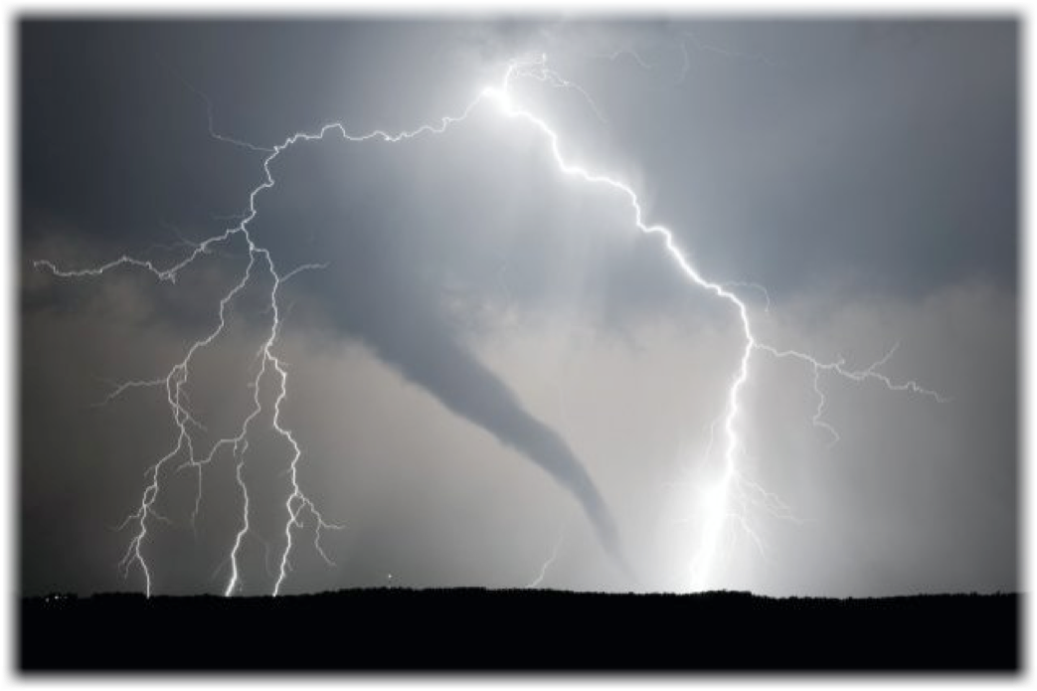
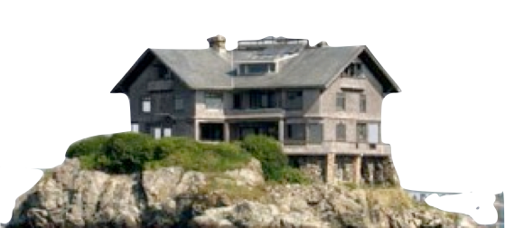
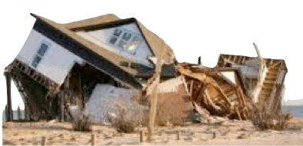
Building A Life That Will Last
It’s Not Just Hearing Jesus, But Doing What He Says!
Contrasting The Two Houses
a wise man who built his house on the rock
a foolish man who built his house on the sand
Were the results predictable?
Did NOT withstand the storm.
Lost everything!
Withstood the storm
Everything preserved

Slide 15
Building A Life That Will Last
It’s Not Just Hearing Jesus, But Doing What He Says!
Making Application
a wise man who built his house on the rock
a foolish man who built his house on the sand
We can understand The importance of being wise and NOT foolish in material [temporal] things.
We desperately NEED to understand the importance of being wise and NOT foolish in spiritual [eternal] things.

Slide 16
Building A Life That Will Last
It’s Not Just Hearing Jesus, But Doing What He Says!
Making Application
The Wise Man
Is
One Who Hears & Does
The Foolish Man
Is
One Who Hears & Does Not
House / Foundation
Is
One’s Life / Basis of One’s Life
Rock / Sand
Is
Christ’s Words / Other Words
The Storm
Is
Trials of Life / Judgment
The House Stood
Is
Life Perseveres / Saved
The House Fell
Is
Life Destroyed / Lost

Slide 17
Building A Life That Will Last
It’s Not Just Hearing Jesus, But Doing What He Says!
Building On The Unshakable Rock
We Are All Builders of Our OWN “Life!”Character –
Values –
Relationships –
Habits –
Affections -

Slide 18
Building A Life That Will Last
It’s Not Just Hearing Jesus, But Doing What He Says!
Building On The Unshakable Rock
How we define these things depend upon the standard or foundation upon which we have decided to build our life!
Hebrews 11:25
Defining “A Quality Life” depends on what we value!!!!
“Success?”
“Happiness, or joy?”
“Peace of mind?”
“Fulfillment?”

Slide 19
Building A Life That Will Last
It’s Not Just Hearing Jesus, But Doing What He Says!
Building On The Unshakable Rock
“Building A Life that will last” requires we hear the Lord & do what He says!
Real success - Ecc 12:13,14
Real Happiness - Lk 11:28
Real peace - Phili 4:7-9
Real fulfillment - 1 Thes 5:23; 1 Pt 1:7; 5:4; 1 Jn 2:28

Slide 20
Building A Life That Will Last
It’s Not Just Hearing Jesus, But Doing What He Says!
Building On The Unshakable Rock
By hearing the word from heaven and doing it one:
Ensures Self Preservation - (2 Peter 1:5-10)
Ensures Self protection – (John 10:27-29)

Slide 21
Building A Life That Will Last
It’s Not Just Hearing Jesus, But Doing What He Says!
Building On The Unshakable Rock
Obedience has never been the “BASIS” of salvation - Eph 2:8-10; Tit 3:3-5
The foundation is Christ Himself – which extends to His authority & to His Words
But, We build upon that foundation ONLY by obeying His words! – Lk 6:46; He 5:8,9

Slide 22
Building A Life That Will Last
It’s Not Just Hearing Jesus, But Doing What He Says!
Building On The Unshakable Rock
The life built upon what the Lord says BY DOING what the Lord says; WILL stand!
The life built upon
ANYTHING ELSE
will fall.

Slide 23
Building A Life That Will Last
It’s Not Just Hearing Jesus, But Doing What He Says!
Building Before the Storm
Both will appear to have succeeded Before The Storm –
In fact, the fool may seem even to have the better of it.
Those living worldly lives will appear to be happy, & probably think they are -

Slide 24
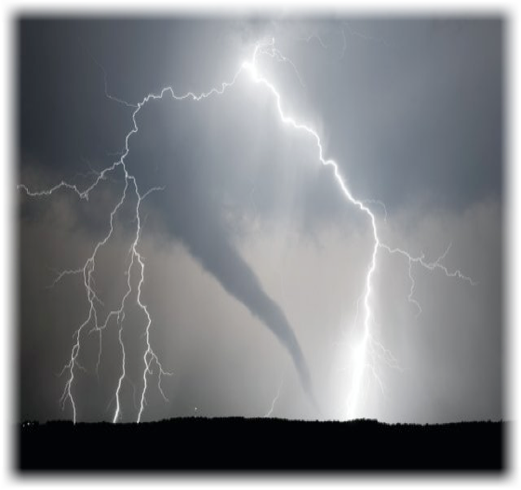
Building A Life That Will Last
It’s Not Just Hearing Jesus, But Doing What He Says!
Building Before the Storm
Both will appear to have succeeded Before The Storm –
But what happens when the storm hits?
Storms come in this life in a variety of forms, (loss, temptation, heartaches, illness, death of loved one, etc.)

Slide 25
Building A Life That Will Last
It’s Not Just Hearing Jesus, But Doing What He Says!
Building Before the Storm

Slide 26
Building A Life That Will Last
It’s Not Just Hearing Jesus, But Doing What He Says!
Building Before the Storm

Slide 27
The Consequences of Choosing Your Foundation
Jesus urges His hearers to consider soberly the consequences of the response they choose to give Him.
Indifference and neutrality are not an option.
We choose either to obey or not - we choose our destiny!

Slide 28
Building A Life That Will Last
It’s Not Just Hearing Jesus, But Doing What He Says!
Which Represents Us?
a wise man who built his house on the rock: . . Thus it withstood the storms.
"Therefore whoever hears these sayings of Jesus, and does them, . . .”
Is Like
a foolish man who built his house on the sand: . . . thus it fell. And great was its fall
But everyone who hears these sayings of Mine, and does not do them,
Is Like

Slide 29
Building A Life That Will Last
Charts by Don McClain
Prepared October 17-20, 2012
Preached October 21, 2012
West 65th Street church of Christ
P.O. Box 190062
Little Rock AR 72219
501-568-1062
Prepared using PPT 2010
Email – donmcclain@sbcglobal.net
More PPT & Audio Sermons:
http://w65stchurchofchrist.org/donmaccla/2010SermonPage.html
Note – Many of the transition effects used in this presentation may be lost using PPT 2007 Viewer
http://www.microsoft.com/downloads/details.aspx?FamilyID=cb9bf144-1076-4615-9951-294eeb832823&displaylang=en

Slide 30
30
Luke 6:46-49 (NKJV)
⁴⁶ "But why do you call Me 'Lord, Lord,' and do not do the things which I say? ⁴⁷ Whoever comes to Me, and hears My sayings and does them, I will show you whom he is like: ⁴⁸ He is like a man building a house, who dug deep and laid the foundation on the rock.

Slide 31
31
Luke 6:46-49 (NKJV)
And when the flood arose, the stream beat vehemently against that house, and could not shake it, for it was founded on the rock. ⁴⁹ But he who heard and did nothing is like a man who built a house on the earth without a foundation, against which the stream beat vehemently; and immediately it fell. And the ruin of that house was great."

