Slide 1
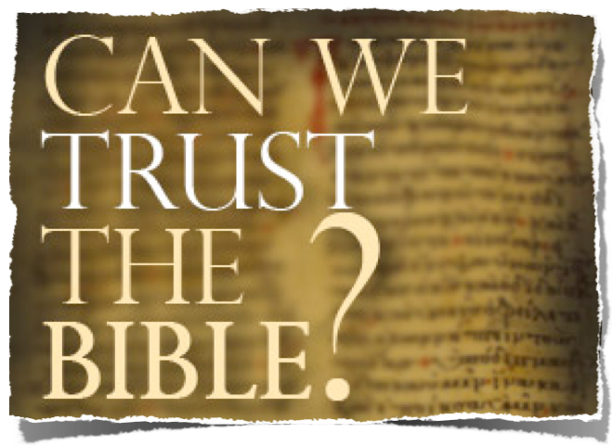
The Biblical Teaching About Inspiration

Slide 2
The Trustworthiness of The Scriptures
Can We Trust The Bible?
Is It True? Is It Accurate? Is It From God?
Where did the Bible come from?
How do we know the right books are in the Bible?
Does the Bible contain errors?
What are the oldest copies we have of the Bible?
How do we know that the Bible hasn't been changed over the years?
Why are there so many translations of the Bible, and which one should I use?

Slide 3
The Trustworthiness of The Scriptures
Can We Trust The Bible?
Is It True? Is It Accurate? Is It From God?
God Is!
God Has Provided Divine Confirmation!
It Answers Every Human Need!
It Is One Harmonious Thought!
It claims to be the word of God!

Slide 4
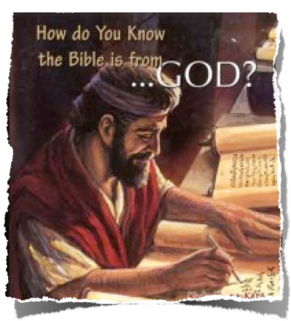
The Trustworthiness of The Scriptures
Can We Trust The Bible?
Is It True? Is It Accurate? Is It From God?
The Bible Could NOT be a product of man alone!!

Slide 5
The Trustworthiness of The Scriptures
Can We Trust The Bible?
Is It True? Is It Accurate? Is It From God?
It Answers Every Human Need!
Where did we come from? (Gen. 1:1)
Why are we here? (Ecc. 12:13)
How should we live? (Titus 2:11,12)
What about religion - (John 4:24)
What about life after death? (Ecc. 3:11; 12:14; Acts 17:26-31)

Slide 6
The Trustworthiness of The Scriptures
Can We Trust The Bible?
Is It True? Is It Accurate? Is It From God?
Harmonious In Thought!
66 different books –
Written by 40 different men –
Three different languages
Written over 1600 year span
YET - One Harmonious Thought!
Christ is coming! –
Christ has come! –
Christ is coming again!

Slide 7
The Trustworthiness of The Scriptures
Can We Trust The Bible?
Is It True? Is It Accurate? Is It From God?
The Claim it Makes
"Thus says the Lord" occurs 418 times in the NASB, 413 in the KJV
"God said" occurs 46 times in both the NASB and the KJV
God spoke through prophets - 1 Kings 14:18; 1 Pt 1:10-12; 2 Pt 1:16-21
The Spirit of the Lord spoke - 2 Sam 23:2; 1 Kings 22:24; 2 Chron 20:14,15
All scripture inspired - 2 Tim 3:16
Notes:
"Thus says the Lord" occurs 418 times in the NASB, 413 in the KJV
Exodus 4:22, "Then you shall say to Pharaoh, Thus says the Lord, 'Israel is My son, My first-born.'"
1 Kings 11:31, "And he said to Jeroboam, 'Take for yourself ten pieces; for thus says the Lord, the God of Israel, Behold, I will tear the kingdom out of the hand of Solomon and give you ten tribes.'"
Isaiah 7:7, "thus says the Lord God, 'It shall not stand nor shall it come to pass.'"
"God said" occurs 46 times in both the NASB and the KJV
Genesis 1:3, "Then God said, 'Let there be light'; and there was light."
Exodus 3:14, "And God said to Moses, 'I AM WHO I AM'; and He said, "Thus you shall say to the sons of Israel, I AM has sent me to you."
Exodus 6:2-3, "God spoke further to Moses and said to him, 'I am the Lord; and I appeared to Abraham, Isaac, and Jacob, as God Almighty, but by My name, Lord, I did not make Myself known to them.'"
God spoke through prophets
1 Kings 14:18, "And all Israel buried him and mourned for him, according to the word of the Lord which He spoke through His servant Ahijah the prophet."
2 Sam. 24:11-12, "When David arose in the morning, the word of the Lord came to the prophet Gad, David's seer, saying, ¹² 'Go and speak to David, Thus the Lord says, "I am offering you three things; choose for yourself one of them, which I may do to you."'"
Zech. 7:7, "Are not these the words which the Lord proclaimed by the former prophets, when Jerusalem was inhabited and prosperous with its cities around it, and the Negev and the foothills were inhabited?"
The Spirit of the Lord spoke through people
2 Sam. 23:2, "The Spirit of the Lord spoke by me, and His word was on my tongue."
1 Kings 22:24, "Then Zedekiah the son of Chenaanah came near and struck Micaiah on the cheek and said, 'How did the Spirit of the Lord pass from me to speak to you?'"
2 Chron. 20:14-15, "Then in the midst of the assembly the Spirit of the Lord came upon Jahaziel the son of Zechariah, the son of Benaiah, the son of Jeiel, the son of Mattaniah, the Levite of the sons of Asaph; 15 and he said, 'Listen, all Judah and the inhabitants of Jerusalem and King Jehoshaphat: thus says the Lord to you, Do not fear or be dismayed because of this great multitude, for the battle is not yours but God's.'"

Slide 8
The Trustworthiness of The Scriptures
Can We Trust The Bible?
Is It True? Is It Accurate? Is It From God?
The Claim it Makes
2 Timothy 3:16-17 (NKJV)
¹⁶ All Scripture is given by inspiration of God, and is profitable for doctrine, for reproof, for correction, for instruction in righteousness, ¹⁷ that the man of God may be complete, thoroughly equipped for every good work.
Notes:
"Thus says the Lord" occurs 418 times in the NASB, 413 in the KJV
Exodus 4:22, "Then you shall say to Pharaoh, Thus says the Lord, 'Israel is My son, My first-born.'"
1 Kings 11:31, "And he said to Jeroboam, 'Take for yourself ten pieces; for thus says the Lord, the God of Israel, Behold, I will tear the kingdom out of the hand of Solomon and give you ten tribes.'"
Isaiah 7:7, "thus says the Lord God, 'It shall not stand nor shall it come to pass.'"
"God said" occurs 46 times in both the NASB and the KJV
Genesis 1:3, "Then God said, 'Let there be light'; and there was light."
Exodus 3:14, "And God said to Moses, 'I AM WHO I AM'; and He said, "Thus you shall say to the sons of Israel, I AM has sent me to you."
Exodus 6:2-3, "God spoke further to Moses and said to him, 'I am the Lord; and I appeared to Abraham, Isaac, and Jacob, as God Almighty, but by My name, Lord, I did not make Myself known to them.'"
God spoke through prophets
1 Kings 14:18, "And all Israel buried him and mourned for him, according to the word of the Lord which He spoke through His servant Ahijah the prophet."
2 Sam. 24:11-12, "When David arose in the morning, the word of the Lord came to the prophet Gad, David's seer, saying, ¹² 'Go and speak to David, Thus the Lord says, "I am offering you three things; choose for yourself one of them, which I may do to you."'"
Zech. 7:7, "Are not these the words which the Lord proclaimed by the former prophets, when Jerusalem was inhabited and prosperous with its cities around it, and the Negev and the foothills were inhabited?"
The Spirit of the Lord spoke through people
2 Sam. 23:2, "The Spirit of the Lord spoke by me, and His word was on my tongue."
1 Kings 22:24, "Then Zedekiah the son of Chenaanah came near and struck Micaiah on the cheek and said, 'How did the Spirit of the Lord pass from me to speak to you?'"
2 Chron. 20:14-15, "Then in the midst of the assembly the Spirit of the Lord came upon Jahaziel the son of Zechariah, the son of Benaiah, the son of Jeiel, the son of Mattaniah, the Levite of the sons of Asaph; 15 and he said, 'Listen, all Judah and the inhabitants of Jerusalem and King Jehoshaphat: thus says the Lord to you, Do not fear or be dismayed because of this great multitude, for the battle is not yours but God's.'"

Slide 9
The Trustworthiness of The Scriptures
Can We Trust The Bible?
Is It True? Is It Accurate? Is It From God?
The Claim it Makes
The logical implication of the statements within the Bible is that they are inerrant since they claim to be offered from God.
They either are or are not inspired of God. If they are not, then their claims of speaking for God are lies.
Notes:
"Thus says the Lord" occurs 418 times in the NASB, 413 in the KJV
Exodus 4:22, "Then you shall say to Pharaoh, Thus says the Lord, 'Israel is My son, My first-born.'"
1 Kings 11:31, "And he said to Jeroboam, 'Take for yourself ten pieces; for thus says the Lord, the God of Israel, Behold, I will tear the kingdom out of the hand of Solomon and give you ten tribes.'"
Isaiah 7:7, "thus says the Lord God, 'It shall not stand nor shall it come to pass.'"
"God said" occurs 46 times in both the NASB and the KJV
Genesis 1:3, "Then God said, 'Let there be light'; and there was light."
Exodus 3:14, "And God said to Moses, 'I AM WHO I AM'; and He said, "Thus you shall say to the sons of Israel, I AM has sent me to you."
Exodus 6:2-3, "God spoke further to Moses and said to him, 'I am the Lord; and I appeared to Abraham, Isaac, and Jacob, as God Almighty, but by My name, Lord, I did not make Myself known to them.'"
God spoke through prophets
1 Kings 14:18, "And all Israel buried him and mourned for him, according to the word of the Lord which He spoke through His servant Ahijah the prophet."
2 Sam. 24:11-12, "When David arose in the morning, the word of the Lord came to the prophet Gad, David's seer, saying, ¹² 'Go and speak to David, Thus the Lord says, "I am offering you three things; choose for yourself one of them, which I may do to you."'"
Zech. 7:7, "Are not these the words which the Lord proclaimed by the former prophets, when Jerusalem was inhabited and prosperous with its cities around it, and the Negev and the foothills were inhabited?"
The Spirit of the Lord spoke through people
2 Sam. 23:2, "The Spirit of the Lord spoke by me, and His word was on my tongue."
1 Kings 22:24, "Then Zedekiah the son of Chenaanah came near and struck Micaiah on the cheek and said, 'How did the Spirit of the Lord pass from me to speak to you?'"
2 Chron. 20:14-15, "Then in the midst of the assembly the Spirit of the Lord came upon Jahaziel the son of Zechariah, the son of Benaiah, the son of Jeiel, the son of Mattaniah, the Levite of the sons of Asaph; 15 and he said, 'Listen, all Judah and the inhabitants of Jerusalem and King Jehoshaphat: thus says the Lord to you, Do not fear or be dismayed because of this great multitude, for the battle is not yours but God's.'"

Slide 10
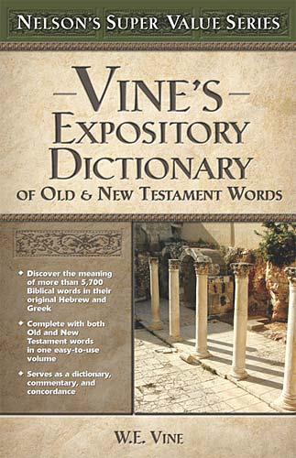
The Trustworthiness of The Scriptures
Inspiration Defined
Inspiration of God -Strong's Number: <G2315>Original Word: θεόπνευστος, theopneustosUsage Notes: "inspired by God" (Theos, "God," pneō, "to breathe"), is used in 2 Tim. 3:16, of the Scriptures as distinct from non-inspired writings.Vine's Expository Dictionary of Old Testament and New Testament Words.

Slide 11
The Trustworthiness of The Scriptures
Inspiration Defined
Inspiration \In`spi*ra"tion\, n.
1. The act of inspiring or breathing in; breath;
3. (Theol.) A supernatural divine influence on the prophets, apostles, or sacred writers, by which they were qualified to communicate moral or religious truth with authority; a supernatural influence which qualifies men to receive and communicate divine truth; also, the truth communicated.

Slide 12
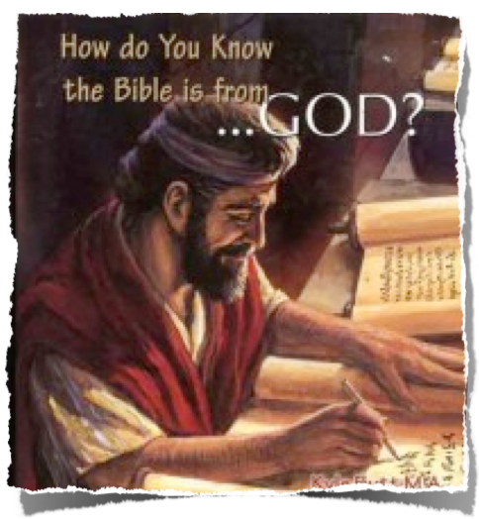
The Trustworthiness of The Scriptures
Inspiration Defined
2 Peter 1:20-21 (NKJV)
²⁰ knowing this first, that no prophecy of Scripture is of any private interpretation, ²¹ for prophecy never came by the will of man, but holy men of God spoke as they were moved by the Holy Spirit.

Slide 13
The Trustworthiness of The Scriptures
Inspiration Defined
Moved by the Holy Spirit Original Word: φέρω, pherōUsage Notes: "to bear, carry," is rendered "being moved" in 2 Pet. 1:21, signifying that they were "borne along," or impelled, by the Holy Spirit's power, not acting according to their own wills, or simply expressing their own thoughts, but expressing the mind of God in words provided and ministered by Him.Vine's Expository Dictionary of Old Testament and New Testament Words.

Slide 14
The Trustworthiness of The Scriptures
Inspiration Defined
“The Bible is inspired in the sense that Spirit-moved men wrote God breathed words that are divinely authoritative for Christian faith and practice . . . That God is the ultimate source and original cause of Biblical truth is the first and most fundamental factor in the doctrine of inspiration”
(From God To Us, How We Got Our Bible; Norman Geisler & William E. Nix; pg. 17)
Notes:
"Thus says the Lord" occurs 418 times in the NASB, 413 in the KJV
Exodus 4:22, "Then you shall say to Pharaoh, Thus says the Lord, 'Israel is My son, My first-born.'"
1 Kings 11:31, "And he said to Jeroboam, 'Take for yourself ten pieces; for thus says the Lord, the God of Israel, Behold, I will tear the kingdom out of the hand of Solomon and give you ten tribes.'"
Isaiah 7:7, "thus says the Lord God, 'It shall not stand nor shall it come to pass.'"
"God said" occurs 46 times in both the NASB and the KJV
Genesis 1:3, "Then God said, 'Let there be light'; and there was light."
Exodus 3:14, "And God said to Moses, 'I AM WHO I AM'; and He said, "Thus you shall say to the sons of Israel, I AM has sent me to you."
Exodus 6:2-3, "God spoke further to Moses and said to him, 'I am the Lord; and I appeared to Abraham, Isaac, and Jacob, as God Almighty, but by My name, Lord, I did not make Myself known to them.'"
God spoke through prophets
1 Kings 14:18, "And all Israel buried him and mourned for him, according to the word of the Lord which He spoke through His servant Ahijah the prophet."
2 Sam. 24:11-12, "When David arose in the morning, the word of the Lord came to the prophet Gad, David's seer, saying, ¹² 'Go and speak to David, Thus the Lord says, "I am offering you three things; choose for yourself one of them, which I may do to you."'"
Zech. 7:7, "Are not these the words which the Lord proclaimed by the former prophets, when Jerusalem was inhabited and prosperous with its cities around it, and the Negev and the foothills were inhabited?"
The Spirit of the Lord spoke through people
2 Sam. 23:2, "The Spirit of the Lord spoke by me, and His word was on my tongue."
1 Kings 22:24, "Then Zedekiah the son of Chenaanah came near and struck Micaiah on the cheek and said, 'How did the Spirit of the Lord pass from me to speak to you?'"
2 Chron. 20:14-15, "Then in the midst of the assembly the Spirit of the Lord came upon Jahaziel the son of Zechariah, the son of Benaiah, the son of Jeiel, the son of Mattaniah, the Levite of the sons of Asaph; 15 and he said, 'Listen, all Judah and the inhabitants of Jerusalem and King Jehoshaphat: thus says the Lord to you, Do not fear or be dismayed because of this great multitude, for the battle is not yours but God's.'"

Slide 15
The Trustworthiness of The Scriptures
False Theories of Inspiration
To get an idea by the natural thought process This eliminates God's involvement
A denial of scripture
2 Tim 3:16 - All Scripture is given by inspiration of God,
2 Peter 1:21 - holy men of God spoke as they were moved by the Holy Spirit.
2 Sam 23:2; “The Spirit of the Lord spoke by me, And His word was on my tongue.
Acts 1:16 this Scripture had to be fulfilled, which the Holy Spirit spoke before by the mouth of David . . .
Natural
Partial
Mechanical
Noematical

Slide 16
The Trustworthiness of The Scriptures
False Theories of Inspiration
Some inspired, some NOT inspired How can we know which is which???
A denial of scripture
2 Tim 3:16; All Scripture is given by inspiration of God,
Psalm 119:160 – “The entirety of Your word is truth, And every one of Your righteous judgments endures forever.”
Prov 30:5 Every word of God is pure; He is a shield to those who put their trust in Him.
Natural
Partial
Mechanical
Noematical

Slide 17
The Trustworthiness of The Scriptures
False Theories of Inspiration
Man was just a dictation machine Limits Man's Involvement
Literary styles do exist
Matthew (Jewish measurements); Mark (Roman); Luke (Greek).
The personalities of the writers come through: - Isaiah and Jeremiah. - Matthew and John, Paul & James. Etc.
The education of the writers comes through: I John is written in elementary school Greek. - Hebrews has graduate school vocabulary.
Natural
Partial
Mechanical
Noematical

Slide 18
The Trustworthiness of The Scriptures
False Theories of Inspiration
Natural
God supplied the thought and man expressed the thought in his own words - Men would decide what to say:
The very words & tenses of the words were “God breathed”
Prophets searched their own writings – (1 Peter 1:10-12)
Paul wrote things “Hard to understand” (2 Peter 3:14).
Requires confidence in men (I Cor 2:5).
Inspiration extended to the very words- (Mat 5:18; 22:32; 1 Cor 2:13).
Partial
Mechanical
Noematical

Slide 19
The Trustworthiness of The Scriptures
The Biblical Teaching About Inspiration
Plenary, verbal inspiration
Webster's Revised Unabridged Dictionary (1913)
Plenary inspiration (Theol.), Full; entire; complete; absolute; as, a plenary license; plenary authority. That kind of inspiration which excludes all defect in the utterance of the inspired message.
Verbal inspiration (Theol.), that kind of inspiration which extends to the very words and forms of expression of the divine message.

Slide 20
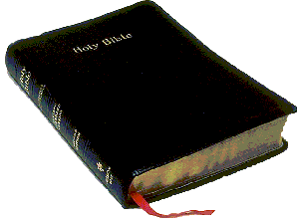
The Trustworthiness of The Scriptures
The Biblical Teaching About Inspiration
Plenary, verbal inspiration
The Word-Method of Revelation
God has revealed His will to us through words.
Words are vehicles of thought and convey concepts.

Slide 21
The Trustworthiness of The Scriptures
The Biblical Teaching About Inspiration
Verbal (2 Cor 2:11-13).
Plenary (2 Tim 3:16).
Unbreakable (John 10:35).
Smallest letter & Mark Irrevocable (Mat 5:18).
Final Authority (Mat 4:4; Gal. 1:6-9; Rev. 22:18,19).
The grammatical number is inspired (Gal 3:16).
Spelling is inspired (Mat 5:17-18).
Words are inspired (Mat 10:19-20).
Tense is inspired (Mat 22:31,32).

Slide 22
The Trustworthiness of The Scriptures
The Biblical Teaching About Inspiration
Plenary, verbal inspiration
The Very Words Of The Bible Are Inspired By God.
All of God’s Word Is Inspired
We accepts God’s will through accepting the words of Scripture.

Slide 23
The Trustworthiness of The Scriptures
The Biblical Teaching About Inspiration
Plenary, verbal inspiration
Baptism - “Baptizo” – immersion; “Rantizo” – sprinkling; “Cheo” –pouring.
For, - gar gar gar –for this cause, threfore; (Mat. 26:28)
For, - peri peri per-ee’ on account of, because of; (Mat. 26:28)
For, - eis - 1) into, unto, to, to-wards, for, among - (Mat. 26:28; Acts 2:38)

Slide 24
The Trustworthiness of The Scriptures
The Biblical Teaching About Inspiration
Plenary, verbal inspiration
When the Bible writers spoke or wrote, they did so by inspiration.
God gave them the idea and then selected and chose from their vocabulary the words to be used in making the idea known.
Both the thought and the words by which the thought was made known are equally inspired.

Slide 25
The Trustworthiness of The Scriptures
The Biblical Teaching About Inspiration
Plenary, verbal inspiration
Thus, every word in every part of the original manuscript is there because The Holy Spirit directed it to be there . . .

Slide 26
The Trustworthiness of The Scriptures
The Biblical Teaching About Inspiration
Plenary, verbal inspiration
Do you tremble at God’s word - Isaiah 66:2
God’s word will judge us - John 12:48
What is your attitude toward the word of God? - 1 Thes. 2:13

Slide 28
The Trustworthiness of The Scriptures
Can We Trust The Bible?
Is It True? Is It Accurate? Is It From God?
The Biblical Teaching About Inspiration
Charts by Don McClain
Prepared October 12-14, 2012
Preached October 14, 2012
West 65th Street church of Christ
P.O. Box 190062
Little Rock AR 72219
501-568-1062
Prepared using PPT 2010
Email – donmcclain@sbcglobal.net
More PPT & Audio Sermons:
http://w65stchurchofchrist.org/donmaccla/2010SermonPage.html
Note – Many of the transition effects used in this presentation may be lost using PPT 2007 Viewer
http://www.microsoft.com/downloads/details.aspx?FamilyID=cb9bf144-1076-4615-9951-294eeb832823&displaylang=en

