Slide 1
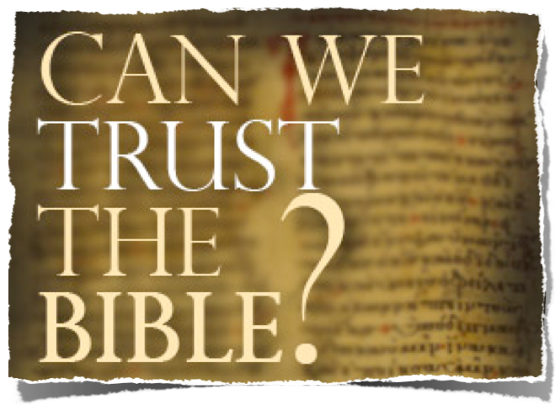

Slide 2
The Trustworthiness of The Scriptures
Can We Trust The Bible?
Is It True? Is It Accurate? Is It From God?
Where did the Bible come from?
How do we know the right books are in the Bible?
Does the Bible contain errors?
What are the oldest copies we have of the Bible?
How do we know that the Bible hasn't been changed over the years?
Why are there so many translations of the Bible, and which one should I use?

Slide 3
The Trustworthiness of The Scriptures
Can We Trust The Bible?
Is It True? Is It Accurate? Is It From God?
God Is!
God Has Provided Divine Confirmation!
It Answers Every Human Need!
It Is One Harmonious Thought!
It claims to be the word of God!

Slide 4
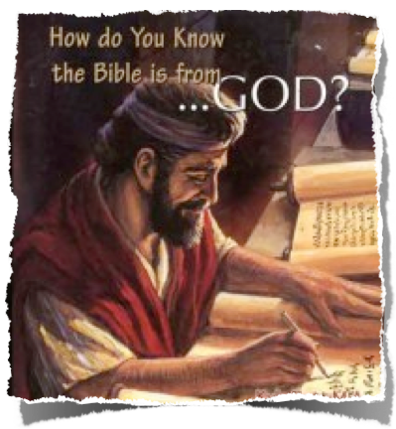
The Trustworthiness of The Scriptures
Can We Trust The Bible?
Is It True? Is It Accurate? Is It From God?
The Bible Could NOT be a product of man alone!!

Slide 5
The Trustworthiness of The Scriptures
Can We Trust The Bible?
Is It True? Is It Accurate? Is It From God?
Harmonious In Thought!
66 different books –
Written by 40 different men –
Three different languages
written over 1600 year span
YET - One Harmonious Thought!
Christ is coming! –
Christ has come! –
Christ is coming again!

Slide 6
The Trustworthiness of The Scriptures
The Biblical Teaching About Inspiration
Plenary, verbal inspiration
Thus, every word in every part of the original manuscript is there because The Holy Spirit directed it to be there . . .

Slide 7
The Trustworthiness of The Scriptures
From God To Us -
How Did We Get The Bible As It Is Today?
Inspiration / Revelation
Words of God Written & Copied
Canonization -

Slide 8
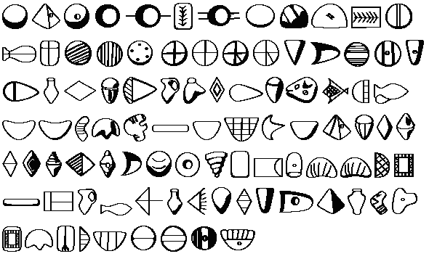
The Trustworthiness of The Scriptures
From God To Us -
How Did We Get The Bible As It Is Today?
History of Writing
Sumerian Tokens
Mesopotamia -3500 BC –
Cuneiform tablets of the Sumerians;
Temple tablets dating back to 2100 BC in the Ur of Chaldees.

Slide 9
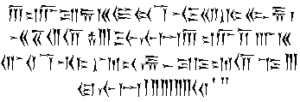
The Trustworthiness of The Scriptures
From God To Us -
How Did We Get The Bible As It Is Today?
History of Writing
Persian Cuneiform
Mesopotamia -3500 BC –
Cuneiform tablets of the Sumerians;
Temple tablets dating back to 2100 BC in the Ur of Chaldees.

Slide 10
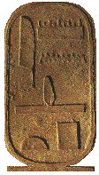
The Trustworthiness of The Scriptures
From God To Us -
How Did We Get The Bible As It Is Today?
History of Writing
Writing was clearly present in Egypt prior to the time of Abraham, (before the fifth Dynasty, 2500)

Slide 11
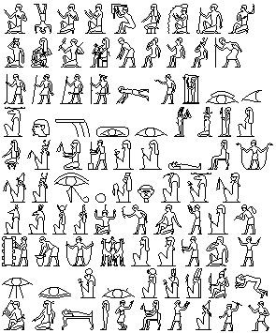
The Trustworthiness of The Scriptures
From God To Us -
How Did We Get The Bible As It Is Today?
History of Writing
Hieroglyphics,
Writing was clearly present in Egypt prior to the time of Abraham, (before the fifth Dynasty, 2500)
Egyptian discoveries – Hieroglyphics, 3500 BC – The teachings for Kagemni and Ptah-Hetep – 2700. . .

Slide 12
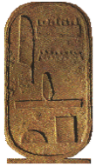
The Trustworthiness of The Scriptures
From God To Us -
How Did We Get The Bible As It Is Today?
History of Writing
Clay: The most writing material in Mesopotamia - commonly written upon in cuneiform.
Stone: In almost every region the earliest material on which writing has been found.
Wood and wax: (Num. 17:2-3; Ezek. 37:16-17).

Slide 13
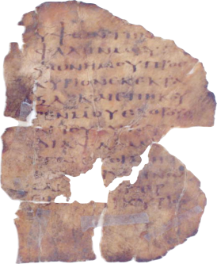
The Trustworthiness of The Scriptures
From God To Us -
How Did We Get The Bible As It Is Today?
History of Writing
parchment leaf from a small codex Greek (Psalms III 4-8) 5th Century AD P.Mich.Inv. 1573
Vellum or Parchment:
Vellum - calf or antelope skins
Parchment - sheep or goat skins
These skins were used to make copies of the Bible for over 1,000 years, (AD 300-1400)

Slide 14
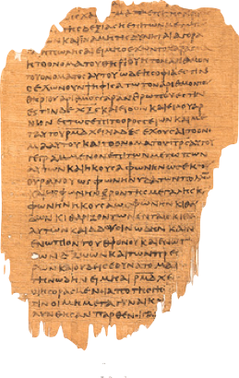
The Trustworthiness of The Scriptures
From God To Us -
How Did We Get The Bible As It Is Today?
History of Writing
Papyrus: used as a writing material in Egypt as early as 3500 B.C.
The earliest manuscripts of the New Testament were on papyrus, a plant found along the Nile River.
The manuscripts were copied by hand on scrolls (30ft long and 10 inches wide—average). The columns were usually 3 to 4 inches wide.
Scribes often wrote on both sides of the roll.

Slide 15
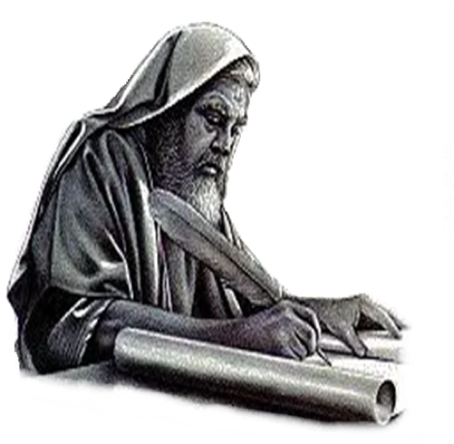
The Trustworthiness of The Scriptures
From God To Us -
How Did We Get The Bible As It Is Today?
History of Writing
For a considerable time, God orally communicated with man (Patriarchal Age, Gen. 2-Ex. 20, about 2, 500 years).
The first person mentioned in the Bible as writing down God's communiqué was Moses, who lived about 1500 B. C.

Slide 16
The Trustworthiness of The Scriptures
From God To Us -
How Did We Get The Bible As It Is Today?
History of Writing
Moses was certainly taught how to write . . .
Therefore, Moses, being “educated in all the learning of the Egyptians, and was a man of power in words and deeds” (Acts 7:22),

Slide 17
The Trustworthiness of The Scriptures
From God To Us -
How Did We Get The Bible As It Is Today?
The Old Testament Written
Written in Hebrew & Aramaic

Slide 18
The Trustworthiness of The Scriptures
From God To Us -
How Did We Get The Bible As It Is Today?
The Old Testament Written
Moses is the author of the first five books of the Bible (Genesis through Deuteronomy).
The Bible itself contributes six distinct writings to Moses (Ex. 17: 14; 24: 4; 34: 27, 28; Num. 33: 2; Deut. 31: 9, 24; 32: 1-43, cp. 31: 22).

Slide 19
The Trustworthiness of The Scriptures
From God To Us -
How Did We Get The Bible As It Is Today?
The Old Testament Written
The books of law came first, then the prophets, until it grew into the collection we now know as the Hebrew scriptures.
The Bible mentions writings by Joshua, Samuel, Isaiah, Jeremiah, and others (Josh. 24: 26; I Sam. 10: 25; Jere. 36: 2).

Slide 20
The Trustworthiness of The Scriptures
From God To Us -
How Did We Get The Bible As It Is Today?
Deuteronomy 17:18-19 (NKJV)
¹⁸ "Also it shall be, when he sits on the throne of his kingdom, that he shall write for himself a copy of this law in a book, from the one before the priests, the Levites. ¹⁹ And it shall be with him, and he shall read it all the days of his life, that he may learn to fear the LORD his God and be careful to observe all the words of this law and these statutes,

Slide 21
The Trustworthiness of The Scriptures
From God To Us -
How Did We Get The Bible As It Is Today?
Isaiah 30:8 (NKJV)
⁸ Now go, write it before them on a tablet, And note it on a scroll, That it may be for time to come, Forever and ever:

Slide 22
The Trustworthiness of The Scriptures
From God To Us -
How Did We Get The Bible As It Is Today?
Jeremiah 30:2 (NKJV)
² "Thus speaks the LORD God of Israel, saying: 'Write in a book for yourself all the words that I have spoken to you.

Slide 23
The Trustworthiness of The Scriptures
From God To Us -
How Did We Get The Bible As It Is Today?
The New Testament Written
Written in Koine Greek, also know as Hellenistic Greek (4th century BC - 4th century AD)
Koine Greek was the most widely spread language of the times due to the empire of Alexander the Great.

Slide 24
The Trustworthiness of The Scriptures
From God To Us -
How Did We Get The Bible As It Is Today?
Romans 15:4 (NKJV)
⁴ For whatever things were written before were written for our learning, that we through the patience and comfort of the Scriptures might have hope.

Slide 25
The Trustworthiness of The Scriptures
From God To Us -
How Did We Get The Bible As It Is Today?
Ephesians 3:3-4 (NKJV)
³ how that by revelation He made known to me the mystery (as I have briefly written already, ⁴ by which, when you read, you may understand my knowledge in the mystery of Christ),

Slide 26
The Trustworthiness of The Scriptures
From God To Us -
How Did We Get The Bible As It Is Today?
2 Peter 3:1-2 (NKJV)
¹ Beloved, I now write to you this second epistle (in both of which I stir up your pure minds by way of reminder), ² that you may be mindful of the words which were spoken before by the holy prophets, and of the commandment of us, the apostles of the Lord and Savior,

Slide 27
The Trustworthiness of The Scriptures
From God To Us -
How Did We Get The Bible As It Is Today?
2 Peter 3:15-16 (NKJV)
¹⁵ and consider that the longsuffering of our Lord is salvation--as also our beloved brother Paul, according to the wisdom given to him, has written to you,

Slide 28
The Trustworthiness of The Scriptures
From God To Us -
How Did We Get The Bible As It Is Today?
2 Peter 3:15-16 (NKJV)
¹⁶ as also in all his epistles, speaking in them of these things, in which are some things hard to understand, which untaught and unstable people twist to their own destruction, as they do also the rest of the Scriptures.

Slide 29
The Trustworthiness of The Scriptures
From God To Us -
How Did We Get The Bible As It Is Today?
1 John 1:3-4 (NKJV)
³ that which we have seen and heard we declare to you, that you also may have fellowship with us; and truly our fellowship is with the Father and with His Son Jesus Christ. ⁴ And these things we write to you that your joy may be full.

Slide 30
The Trustworthiness of The Scriptures
From God To Us -
How Did We Get The Bible As It Is Today?
The Scriptures Completed & Copied
By around A.D. 100, revelation completed - (Jude 3; Rev. 22:18-19).
No autographs exist today!
Immediately upon completion of these writings, copies were made (cf. Col. 4:16; I Thess. 5:27).

Slide 31
The Trustworthiness of The Scriptures
From God To Us -
How Did We Get The Bible As It Is Today?
The Scriptures Completed & Copied
The only means of duplication until the fifteenth century was by manual handwriting. (in A.D. 1454 Johannes Gutenburg invented the printing press)
The earliest copies of these autographs were written in the original language & called manuscripts - (over 5,000)

Slide 32
The Trustworthiness of The Scriptures
From God To Us -
How Did We Get The Bible As It Is Today?
The Scriptures Completed & Copied
#8 An authentic copy must be the exemplar, from which the transcriber ought not in the least deviate.
#9 No word or letter, not even a yod, must be written from memory, the scribe not having looked at the codex before him......
#14 besides this, the copyist must be in full Jewish dress,
#15 wash his whole body, etc
The tradition of the Jewish scribes in copying the Old Testament
*Samuel Davidson, The Hebrew Text of the Old Testament, p. 89.

Slide 33
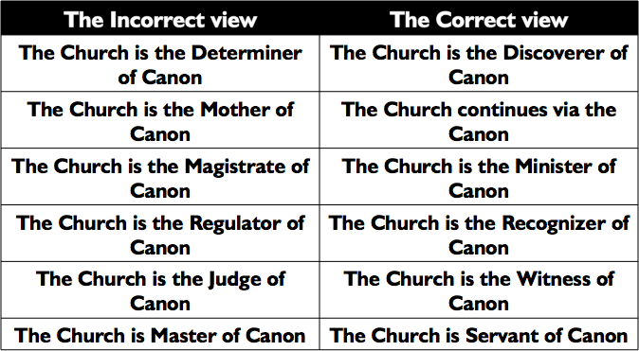
The Trustworthiness of The Scriptures
From God To Us -
How Did We Get The Bible As It Is Today?
Considered Canonical When Written

Slide 34
The Trustworthiness of The Scriptures
From God To Us -
How Did We Get The Bible As It Is Today?
Date | Event
c. 45-96 A.D. | Books of the New Testament written
2nd century | Codex (modern form factor) of books developed
c. 110 A.D. | Papias refers to the Gospels of Mark & Matthew
c. 125 A.D. | Earliest extant fragment of any part of the New Testament copied (John 18:38)
c. 140 A.D. | Gnostic Marcion attempts first canonical list
c. 150 A.D. | Justin Martyr refers to Christians gathering together and "the memoirs of the Apostles or the writings of the prophets are read, as time permits"
c. 160 A.D. | Tatian compiles a "harmony" of the four gospels, called the "Diatessaron"

Slide 35
The Trustworthiness of The Scriptures
From God To Us -
How Did We Get The Bible As It Is Today?
Date | Event
c. 180 A.D. | Christian prisoners in Scilla, Libya, refer to "the books, and letters of a just man, one Paul" as their defense
c. 180 A.D. | Ireneaus confirms four Gospels: Matthew, Mark, Luke, & John
c. 200 A.D. | Muratori Canon compiled
324 A.D. | Constantine becomes undisputed emperor of the Roman Empire
325 A.D. | Council of Nicea; Eusebius writes his Church History
332 A.D. | Bishop Eusebius of Caesarea is ordered by Constantine to create 50 volumes "on prepared parchment" of the Holy Scriptures
325 - 350 A.D. | Codex Vaticanus created; contains the complete New Testament as we have it today

Slide 36
The Trustworthiness of The Scriptures
From God To Us -
How Did We Get The Bible As It Is Today?
Date | Event
c. 350 A.D. | Codex Sinaiticus written; (now in the British Museum) contains most of modern day New Testament, plus the Shepherd of Hermas, and the Letter of Barnabas
367 A.D. | Athanasius, Bishop of Alexandria, writes his Paschal letter, listing the modern day New Testament canon
393 A.D. | Council of Hippo affirms modern day canon
397 A.D. | Council of Carthage affirms modern day canon
c. 400 A.D. | Jerome (A.D. 346-420) translates Bible into common Latin (the "Vulgate"), using the list of Athanasius

Slide 37
The Trustworthiness of The Scriptures
From God To Us -
How Did We Get The Bible As It Is Today?
How does the New Testament compare to other books of antiquity.
There are over 5,000 Greek manuscripts of the New Testament available to us today.
Over 2,200 Lectionaries (Books used in worship that cite the Bible).
Ancient Versions – 9,000 manuscripts
Church "Fathers" – ca. 36,000 citations – scholars say that all but four verses of the entire New Testament text could be reconstructed from the citations of the early Church Fathers alone!

Slide 38
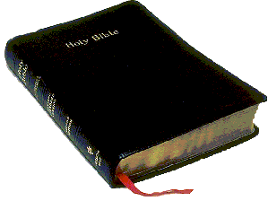
The Trustworthiness of The Scriptures
From God To Us -
How Did We Get The Bible As It Is Today?
How does the New Testament compare to other books of antiquity.
The New Testament is the best attested book of antiquity by far! - (Mt. 24:35)

Slide 40
The Trustworthiness of The Scriptures
From God To Us -
How Did We Get The Bible As It Is Today?
Charts by Don McClain
Prepared November 8-10, 2012
Preached November 11, 2012
West 65th Street church of Christ
P.O. Box 190062
Little Rock AR 72219
501-568-1062
Prepared using PPT 2010
Email – donmcclain@sbcglobal.net
More PPT & Audio Sermons:
http://w65stchurchofchrist.org/coc/sermons/
Note – Many of the transition effects used in this presentation may be lost using PPT 2007 Viewer
http://www.microsoft.com/downloads/details.aspx?FamilyID=cb9bf144-1076-4615-9951-294eeb832823&displaylang=en

