Slide 1
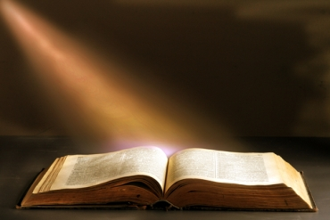
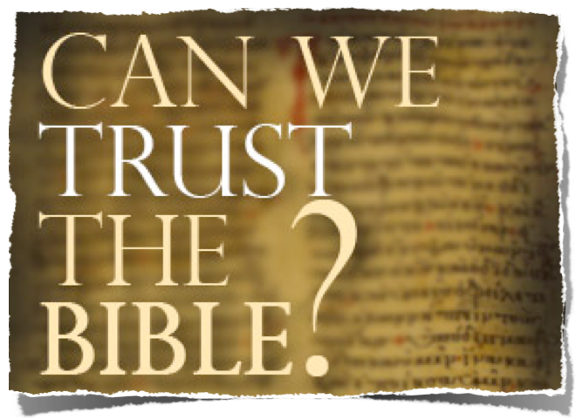
Prophecy Proves Scripture Is From God
How Did We Get The Bible As It Is Today?

Slide 2
The Trustworthiness of The Scriptures
Can We Trust The Bible?
Is It True? Is It Accurate? Is It From God?
Where did the Bible come from?
How do we know the right books are in the Bible?
Does the Bible contain errors?
What are the oldest copies we have of the Bible?
How do we know that the Bible hasn't been changed over the years?
Why are there so many translations of the Bible, and which one should I use?

Slide 3
The Trustworthiness of The Scriptures
Can We Trust The Bible?
Is It True? Is It Accurate? Is It From God?
God Is!
God Has Provided Divine Confirmation!
It Answers Every Human Need!
It Is One Harmonious Thought!
It claims to be the word of God!

Slide 4
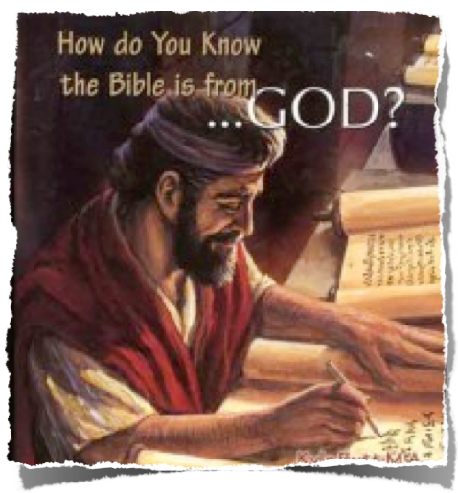
The Trustworthiness of The Scriptures
From God To Us -
How Did We Get The Bible As It Is Today?
Inspiration / Revelation
Words of God Written & Copied
Canonization -

Slide 5
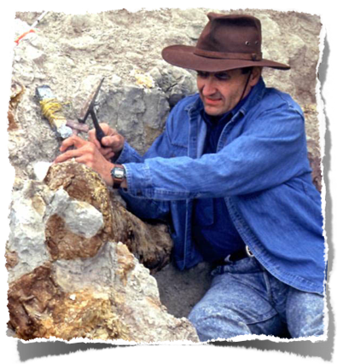
The Trustworthiness of The Scriptures
Can We Trust The Bible?
Is It True? Is It Accurate? Is It From God?
The Testimony of the Spade
Historical & Archaeological Evidence Supports The Trustworthiness of the Scriptures!

Slide 6
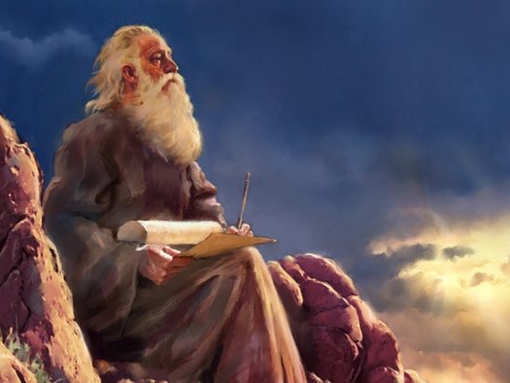
The Trustworthiness of The Scriptures
Can We Trust The Bible?
It IsTrue! It Is Accurate! It Is From God!
Does Bible Prophecy Support the Divine Origin of Scripture?

Slide 7
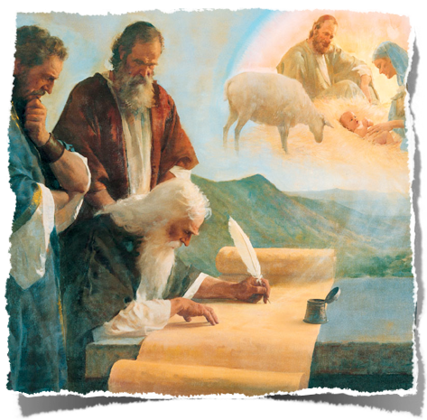
The Trustworthiness of The Scriptures
Can We Trust The Bible?
Is It True? Is It Accurate? Is It From God?
What Is Prophecy?
Vines - signifies "the speaking forth of the mind and counsel of God" (pro, "forth," phemi, "to speak:" see PROPHET); . . .

Slide 8
The Trustworthiness of The Scriptures
Can We Trust The Bible?
Is It True? Is It Accurate? Is It From God?
What Is Prophecy?
"Though much of OT prophecy was purely predictive, . . . prophecy is not necessarily, nor even primarily, fore-telling. It is the declaration of that which cannot be known by natural means, Mat 26:68, it is the forth-telling of the will of God, whether with reference to the past, the present, or the future

Slide 9
The Trustworthiness of The Scriptures
Can We Trust The Bible?
Is It True? Is It Accurate? Is It From God?
What Is Prophecy?
Real prophecy, (the forth-telling of the will of God), harmonizes with God’s revealed truth - Deut 13:1-18; Acts 17:11,12
False prophets were to be put to death - Deut 13:5
Prophets wrote about things that would come to pass so that everyone one know that God had spoken through them & that God is God - Ezek. 6,7

Slide 10
The Trustworthiness of The Scriptures
Can We Trust The Bible?
Is It True? Is It Accurate? Is It From God?
What Is Prophecy?
Biblical prophecies foretold events in detail that were beyond the scope of human speculation.
Not ambiguous generalizations – but specific, detailed language that has a clear, demonstrable, and identifiable fulfillment.
God’s standard for true prophecy is not about getting two out of three right, but 100% accuracy, 100% of the time.
(Deut 18:15-22)

Slide 11
The Trustworthiness of The Scriptures
Can We Trust The Bible?
Is It True? Is It Accurate? Is It From God?
What Is Prophecy?
Deuteronomy 18:22 (NKJV)
²² when a prophet speaks in the name of the LORD, if the thing does not happen or come to pass, that is the thing which the LORD has not spoken; the prophet has spoken it presumptuously; you shall not be afraid of him.

Slide 12
The Trustworthiness of The Scriptures
Can We Trust The Bible?
Is It True? Is It Accurate? Is It From God?
What Is Prophecy?
Jeremiah 28:9 (NKJV)
⁹ As for the prophet who prophesies of peace, when the word of the prophet comes to pass, the prophet will be known as one whom the LORD has truly sent."

Slide 13
The Trustworthiness of The Scriptures
Can We Trust The Bible?
Is It True? Is It Accurate? Is It From God?
What Is Prophecy?
Isaiah 42:9 (NKJV)
⁹ Behold, the former things have come to pass, And new things I declare; Before they spring forth I tell you of them."

Slide 14
The Trustworthiness of The Scriptures
Can We Trust The Bible?
Is It True? Is It Accurate? Is It From God?
What Is Prophecy?
Isaiah 48:3 (NKJV)
³ "I have declared the former things from the beginning; They went forth from My mouth, and I caused them to hear it. Suddenly I did them, and they came to pass.

Slide 15
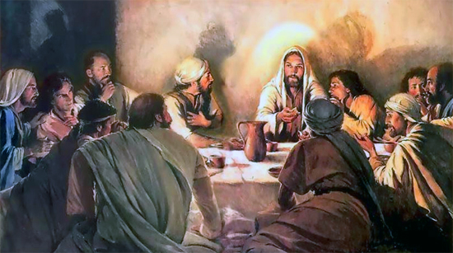
The Trustworthiness of The Scriptures
Can We Trust The Bible?
Is It True? Is It Accurate? Is It From God?
What Is Prophecy?
Jesus told of things before they occurred so that people would believe that He was the Messiah!
John 13:19 (NKJV)
Now I tell you before it comes, that when it does come to pass, you may believe that I am He.

Slide 16
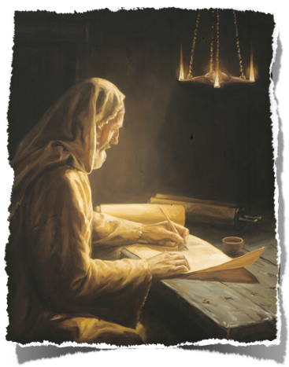
The Trustworthiness of The Scriptures
Can We Trust The Bible?
Is It True? Is It Accurate? Is It From God?
What Is Prophecy?
8,352 verses contain prophecy . . .
27% of the Bible is prophetic material . . .
NOT ONE prophecy has failed to come to pass . . .
The prophetic word has been confirmed – 2 Pet. 1:19
100% accuracy confirms Divine source!

Slide 17
The Trustworthiness of The Scriptures
Can We Trust The Bible?
Is It True? Is It Accurate? Is It From God?
Prophecies Regarding Nations
Israel:
Egyptian slavery and return to the land – Gen 15:13-16
Assyrian Captivity – Deut. 28:36,37; 2 Kings 17:4-6; 23,24
Babylonian captivity and return to the land – 2 Kings 24:12-15; 2 Chr. 36:5-7,22,23, (Cyrus); Jer. 25:9;

Slide 18
The Trustworthiness of The Scriptures
Can We Trust The Bible?
Is It True? Is It Accurate? Is It From God?
Prophecies Regarding Nations
End of other nations
The fall of Babylon, written two hundred years before it occurred - Isa 13:17-22
The fall of Egypt, that it would be destroyed more by civil war than by outside forces - Isa 19:1-4
The fall of Nineveh, with its utter desolation - Zeph 2:13-15

Slide 19
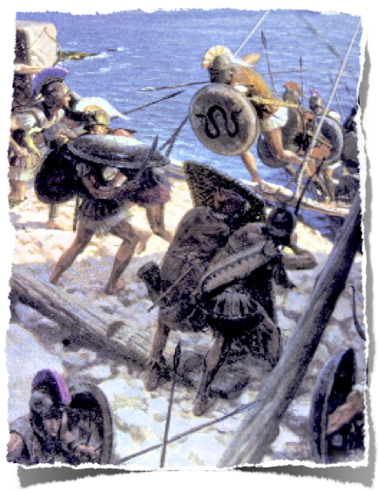
The Trustworthiness of The Scriptures
Prophecies Regarding Nations
Fall of Tyre
The walls would be broken down (Ezek. 26:4)
Left a bare rock (Ezek. 26:4)
A place for the spreading of nets (Ezek. 26:5)
Nebuchadnezzar would build a siege wall around it (Ezek. 26:8)
He would plunder it (Ezek. 26:9-12)
The stones, timber and soil would be cast into the sea (Ezek. 26:12)
The city would never be rebuilt (Ezek. 26:14)

Slide 20
The Trustworthiness of The Scriptures
Prophecies Regarding Nations
Fall of Tyre
The walls would be broken down (Ezek. 26:4)
Left a bare rock (Ezek. 26:4)
A place for the spreading of nets (Ezek. 26:5)
Nebuchadnezzar would build a siege wall around it (Ezek. 26:8)
He would plunder it (Ezek. 26:9-12)
The stones, timber and soil would be cast into the sea (Ezek. 26:12)
The city would never be rebuilt (Ezek. 26:14)
"Nebuchadnezzar took all Palestine and Syria and the cities on the seacoast, including Tyre, which fell after a siege of 13 years (573 B.C.)"
(E. A. Wallis Budge, Babylonian Life And History, p. 50).

Slide 21
The Trustworthiness of The Scriptures
Prophecies Regarding Nations
Fall of Tyre
The walls would be broken down (Ezek. 26:4)
Left a bare rock (Ezek. 26:4)
A place for the spreading of nets (Ezek. 26:5)
Nebuchadnezzar would build a siege wall around it (Ezek. 26:8)
He would plunder it (Ezek. 26:9-12)
The stones, timber and soil would be cast into the sea (Ezek. 26:12)
The city would never be rebuilt (Ezek. 26:14)
Alexander the Great (356-323 BC) sent messengers to Tyre, urging them to accept a peace treaty. . . . the Tyrians killed Alexander's ambassadors and threw their bodies from the top of the walls into the sea.
(Historian Phillip Myers).

Slide 22
The Trustworthiness of The Scriptures
Prophecies Regarding Nations
Alexander built a 200’ wide mole to get his troops from the mainland to the island. It was constructed from stones and timber from the old city of Tyre. (Ezek. 26:12).
A seven month siege ended July 332 B.C.
Fall of Tyre
The walls would be broken down (Ezek. 26:4)
Left a bare rock (Ezek. 26:4)
A place for the spreading of nets (Ezek. 26:5)
Nebuchadnezzar would build a siege wall around it (Ezek. 26:8)
He would plunder it (Ezek. 26:9-12)
The stones, timber and soil would be cast into the sea (Ezek. 26:12)
The city would never be rebuilt (Ezek. 26:14)
(Historian Phillip Myers).

Slide 23
The Trustworthiness of The Scriptures
Prophecies Regarding Nations
Alexander killed 8,000 and sold 30,000 into slavery.“The once great city is now as bare as the top of a rock - a place where fishermen dry their nets . . .”
Fall of Tyre
The walls would be broken down (Ezek. 26:4)
Left a bare rock (Ezek. 26:4)
A place for the spreading of nets (Ezek. 26:5)
Nebuchadnezzar would build a siege wall around it (Ezek. 26:8)
He would plunder it (Ezek. 26:9-12)
The stones, timber and soil would be cast into the sea (Ezek. 26:12)
The city would never be rebuilt (Ezek. 26:14)
(Historian Phillip Myers).

Slide 24
The Trustworthiness of The Scriptures
Prophecies Regarding Nations
"Alexander did far more against Tyre than Shalmaneser or Nebuchadnezzar had done. Not content with crushing her, he took care that she never should revive; for he founded Alexandria as her substitute, and changed forever the track of the commerce of the world."
Fall of Tyre
The walls would be broken down (Ezek. 26:4)
Left a bare rock (Ezek. 26:4)
A place for the spreading of nets (Ezek. 26:5)
Nebuchadnezzar would build a siege wall around it (Ezek. 26:8)
He would plunder it (Ezek. 26:9-12)
The stones, timber and soil would be cast into the sea (Ezek. 26:12)
The city would never be rebuilt (Ezek. 26:14)
(Edward Creasy, Fifteen Decisive Battles of the World, ch. 4)

Slide 25
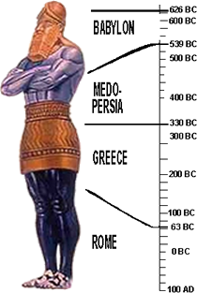
The Trustworthiness of The Scriptures
Prophecies Regarding Nations
Establishment of God’s Kingdom which would never be destroyed
Nebuchadnezzar’s dream - (Daniel 2:1-13)
Daniel receives from God the explanation of the dream - (Daniel 2:14-23)
Daniel explains the dream & its meaning - (Daniel 2:34-45)
“The dream is certain & its interpretation is sure” - (Daniel 2:45)
God’s kingdom established in AD 30

Slide 26
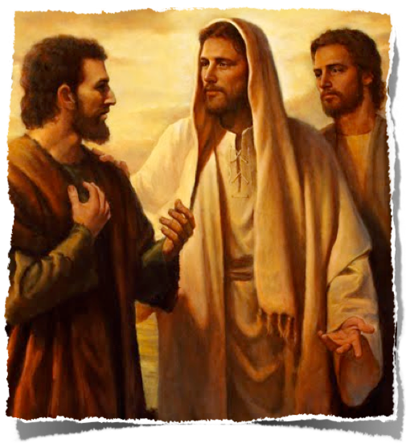
The Trustworthiness of The Scriptures
Prophecies Regarding Jesus
Luke 24:44 (NKJV)
⁴⁴ Then He said to them, "These are the words which I spoke to you while I was still with you, that all things must be fulfilled which were written in the Law of Moses and the Prophets and the Psalms concerning Me."

Slide 27
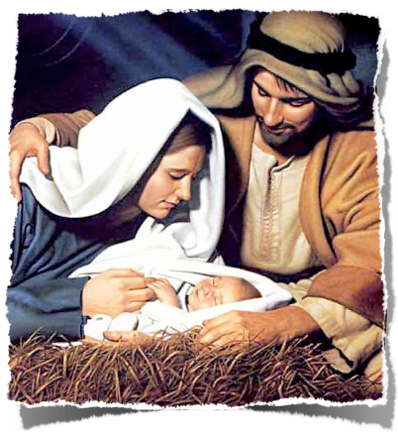
The Trustworthiness of The Scriptures
Prophecies Regarding Jesus
There are at least 324 prophecies fulfilled in Christ
The mathematical probability that all could be fulfilled in one person by chance alone has been calculated as one in 84 times ten to the 123rd power (84 followed by 123 zeroes) - [Introduction To Christian Evidences, Ferrell Jenkins, pp. 87-107]
The chance of fulfilling 8 prophecies is 1 out of 10¹⁷

Slide 28
The Trustworthiness of The Scriptures
Prophecies Regarding Jesus
Fulfilled Prophecy | Hebrew Scripture | New Testament Fulfillment
His pre-existence | Micah 5:2 | John 1:1, 14
Born of the seed of a woman | Genesis 3:15 | Matthew 1:18
Of the seed of Abraham | Genesis 12:3 | Matthew 1:1-16
All nations blessed by Abraham's seed | Genesis 12:3 | Matthew 8:5, 10
God would provide Himself a Lamb as an offering | Genesis 22:8 | John 1:29
From the tribe of Judah | Genesis 49:10 | Matthew 1:1-3
Heir to the throne of David | Isaiah 9:6-7 | Matthew 1:1
Called "The mighty God, The everlasting Father" | Isaiah 9:6 | Matthew 1:23

Slide 29
The Trustworthiness of The Scriptures
Prophecies Regarding Jesus
Fulfilled Prophecy | Hebrew Scripture | New Testament Fulfillment
Born in Bethlehem | Micah 5:2 | Matthew 2:1
Born of a virgin | Isaiah 7:14 | Matthew 1:18
Immanuel, "God with us" | Isaiah 7:14 | Matthew 1:23
Declared to be the Son of God | Psalm 2:7 | Matthew 3:17
His messenger before Him in spirit of Elijah | Malachi 4:5-6 | Luke 1:17
Preceded by a messenger to prepare His way | Malachi 3:1 | Matthew 11:7-11
Messenger crying "Prepare ye the way of the Lord" | Isaiah 40:3 | Matthew 3:3

Slide 30
The Trustworthiness of The Scriptures
Prophecies Regarding Jesus
Fulfilled Prophecy | Hebrew Scripture | New Testament Fulfillment
Called out of Egypt | Hosea 11:1 | Matthew 2:15
Slaughter of the children | Jeremiah 31:15 | Matthew2:18
Would be a Nazarene | Judges 13:5; Amos 2:11; Lam. 4:7 | Matthew 2:23
Brought light to Zabulon & Nephthalm, Galilee of the Gentiles | Isaiah 9:1-2 | Matthew 4:15
Presented with gifts | Psalm 72:10 | Matthew 2:1, 11
Rejected by His own | Isaiah 53:3 | Mat 21:42; Mk 8:31, 12:10; Lk 9:22, 17:25

Slide 31
The Trustworthiness of The Scriptures
Prophecies Regarding Jesus
Fulfilled Prophecy | Hebrew Scripture | New Testament Fulfillment
Stone builders rejected - became the headstone | Psalm 118:22-23; Isaiah 28:16 | Matthew 21:42; I Peter 2:7
A stone of stumbling to Israel | Isaiah 8:14-15 | I Peter 2:8
He entered Jerusalem as a king riding on an donkey | Zechariah 9:9 | Matthew 21:5
Betrayed by a friend | Psalms 41:9 | John 13:21
Sold for 30 pieces of silver | Zechariah 11:12 | Mat 26:15; Lk 22:5
The 30 pieces of silver given for the potter's field | Zechariah 11:12 | Matthew 27:9-10

Slide 32
The Trustworthiness of The Scriptures
Prophecies Regarding Jesus
Fulfilled Prophecy | Hebrew Scripture | New Testament Fulfillment
30 pcs silver thrown in temple | Zechariah 11:13 | Matthew 27:5
Forsaken by His disciples | Zechariah 13:7 | Matthew 26:56
Accused by false witnesses | Psalm 35:11 | Matthew 26:60
Silent to accusations | Isaiah 53:7 | Matthew 27:14
Heal blind/deaf/lame/dumb | Isaiah 35:5-6; 29:18 | Matthew 11:5
Preached to the poor/brokenhearted/captives | Isaiah 61:1 | Matthew 11:5
To bring a sword, not peace | Micah 7:6 | Matthew 10:34-35
He bore our sickness | Isaiah 53:4 | Matthew 8:16-17

Slide 33
The Trustworthiness of The Scriptures
Prophecies Regarding Jesus
Fulfilled Prophecy | Hebrew Scripture | New Testament Fulfillment
Spat upon, smitten and scourged | Isaiah 50:6, 53:5 | Matthew 27:26, 30
Smitten on the cheek | Micah 5:1 | Matthew 27:30
Hated without a cause | Psalm 35:19 | Matthew 27:23
The sacrificial lamb | Isaiah 53:5 | John 1:29
Given for a covenant | Isaiah 42:6; Jer 31:31-34 | Rom 11:27/Gal 3:17, 4:24/Heb 8:6, 8, 10; 10:16, 29; 12:24; 13:20
Would not strive or cry | Isaiah 42:2-3 | Mark 7:36

Slide 34
The Trustworthiness of The Scriptures
Prophecies Regarding Jesus
Fulfilled Prophecy | Hebrew Scripture | New Testament Fulfillment
People would hear not and see not | Isaiah 6:9-10 | Matthew 13:14-15
People trust in traditions of men | Isaiah 29:13 | Matthew 15:9
People give God lip service | Isaiah 29:13 | Matthew 15:8
God delights in Him | Isaiah 42:1 | Matthew 3:17, 17:5
Wounded for our sins | Isaiah 53:5 | John 6:51
He bore the sins of many | Isaiah 53:10-12 | Mark 10:45
Messiah not killed for Himself | Daniel 9:26 | Matthew 20:28

Slide 35
The Trustworthiness of The Scriptures
Prophecies Regarding Jesus
Fulfilled Prophecy | Hebrew Scripture | New Testament Fulfillment
Gentiles flock to Him | Is 55:5, 60:3, 65:1; Mal 1:11; 2 Sam 22:44-45; Ps 2:7-8 | Matthew 8:10
Crucified with criminals | Isaiah 53:12 | Matthew 27:35
His body was pierced | Zechariah 12:10; Ps. 22:16 | John 20:25, 27
Thirsty during execution | Psalm 22:16 | John 19:28
Given vinegar and gall for thirst | Psalm 69:21 | Matthew 27:34
Soldiers gambled for his garment | Psalm 22:18 | Matthew 27:35

Slide 36
The Trustworthiness of The Scriptures
Prophecies Regarding Jesus
Fulfilled Prophecy | Hebrew Scripture | New Testament Fulfillment
People mocked, "He trusted in God, let Him deliver him!" | Psalm 22:7-8 | Matthew 27:43
People gazing at Him | Psalm 22:17 | Matthew 27:36
Cried, "My God, my God why hast thou forsaken me?" | Psalm 22:1 | Matthew 27:46
Darkness over the land | Amos 8:9 | Matthew 27:45
No bones broken | Psalm 34:20, Numbers 9:12 | John 19:33-36
Side pierced | Zechariah 12:10 | John 19:34
Buried with the rich | Isaiah 53:9 | Matthew 27:57, 60

Slide 37
The Trustworthiness of The Scriptures
Prophecies Regarding Jesus
Fulfilled Prophecy | Hebrew Scripture | New Testament Fulfillment
Resurrected from the dead | Psalm 16:10-11; 49:15 | Mark 16:6
Priest after the order of Melchizedek | Psalm 110:4 | Hebrews 5:5-6; 6:20; 7:15-17
Ascended to right hand of God | Psalm 68:18 | Luke 24:51
LORD said unto Him, "Sit thou at my right hand, until I make thine enemies thy footstool | Psalm 110:1 | Matt 22:44; Mark 12:36;, 16:19; Luke 20:42-43; Acts 2:34-35; Heb 1:13
His coming glory | Malachi 3:2-3 | Luke 3:17

Slide 38
The Trustworthiness of The Scriptures
We Can Trust The Bible?
It IsTrue! It Is Accurate! It Is From God!
The Bible Has Fore-Told:
The rise and fall of nations . . .
Jesus the Christ . . .
The church - (Dan. 2:44; Joel 2:28-32; Acts 2)
The New Covenant – (Is. 2:2-4; Jer. 31:31-34)
Jesus’ Return!! (1 Th 4:16; 2 Pet 3:10-14)

Slide 39
The Trustworthiness of The Scriptures
We Can Trust The Bible?
It IsTrue! It Is Accurate! It Is From God!
Bible Prophecy Confirms the Divine Origin of Scripture!
Believe it - obey it & Trust it!

Slide 41
The Trustworthiness of The Scriptures
Can We Trust The Bible?
It IsTrue! It Is Accurate! It Is From God!
Charts by Don McClain
Prepared December 15, , 2012
Preached December 16, 2012
West 65th Street church of Christ
P.O. Box 190062
Little Rock AR 72219
501-568-1062
Prepared using PPT 2010
Email – donmcclain@sbcglobal.net
More PPT & Audio Sermons:
http://w65stchurchofchrist.org/coc/sermons/
Note – Many of the transition effects used in this presentation may be lost using PPT 2007 Viewer
http://www.microsoft.com/downloads/details.aspx?FamilyID=cb9bf144-1076-4615-9951-294eeb832823&displaylang=en

Slide 42
2 Peter 1:16-21 (NKJV)
¹⁶ For we did not follow cunningly devised fables when we made known to you the power and coming of our Lord Jesus Christ, but were eyewitnesses of His majesty. ¹⁷ For He received from God the Father honor and glory when such a voice came to Him from the Excellent Glory: "This is My beloved Son, in whom I am well pleased." ¹⁸ And we heard this voice which came from heaven when we were with Him on the holy mountain.

