Slide 1

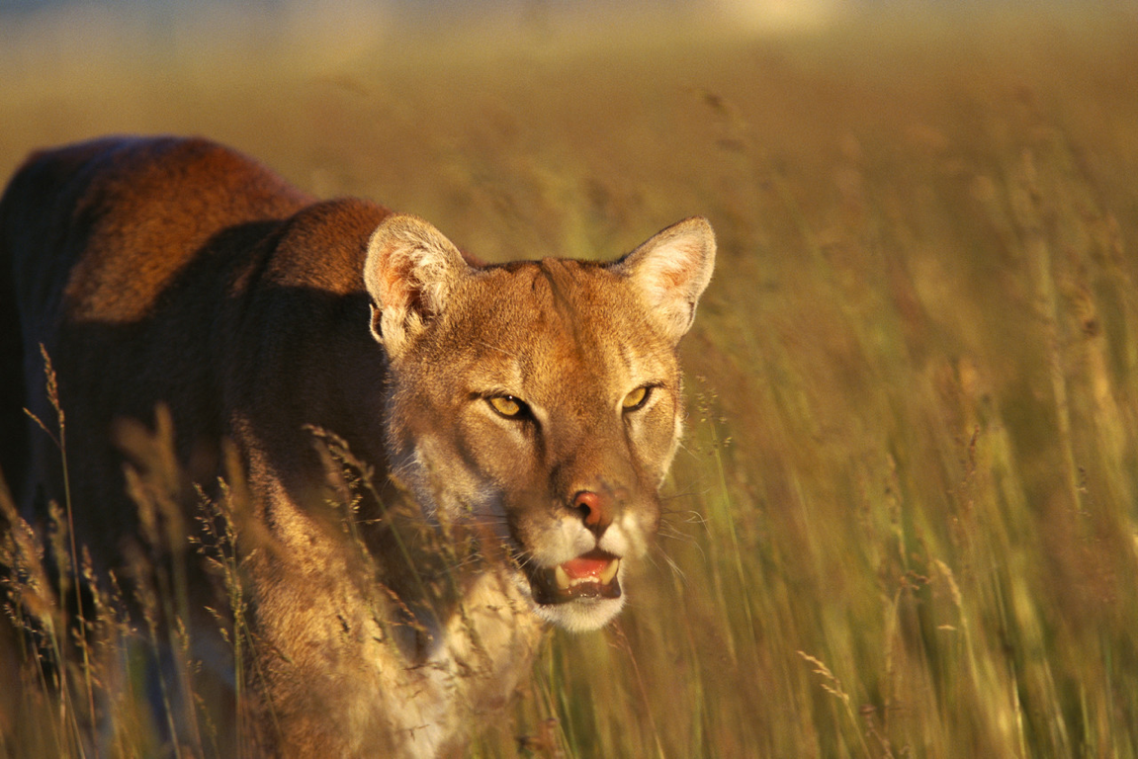

1 Peter 5:8 (NKJV)
Be sober, be vigilant; because your adversary the devil walks about like a roaring lion, seeking whom he may devour.

Slide 2

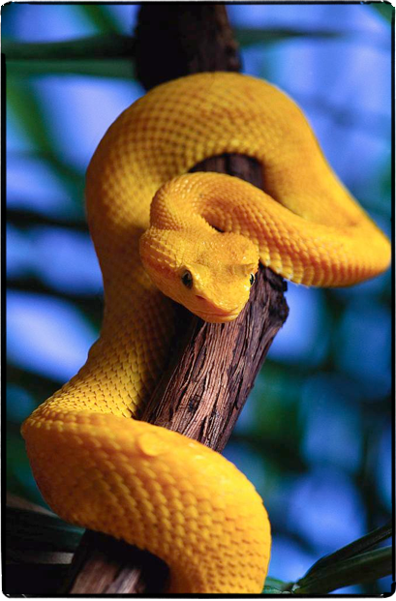
2 Cor. 2:11 (NKJV)
lest Satan should take advantage of us; for we are not ignorant of his devices.

Slide 3
2 Cor. 11:14 (NKJV) And no wonder! For Satan himself transforms himself into an angel of light.

Slide 4
John 8:44 (NKJV)
You are of your father the devil, and the desires of your father you want to do. He was a murderer from the beginning, and does not stand in the truth, because there is no truth in him. When he speaks a lie, he speaks from his own resources, for he is a liar and the father of it.

Slide 5
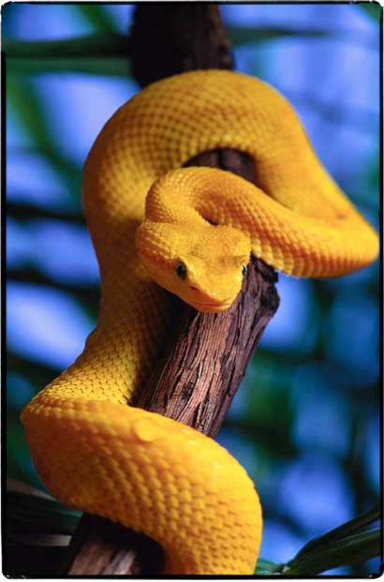
“sincerity of mind toward Christ, i.e. single-hearted faith in Christ, as opposed to false wisdom in matters pertaining to Christianity, 2 Corinthians 11:3 . . .”Thayer Greek-English Lexicon of the New Testament.
2 Cor. 11:3 (NKJV) But I fear, lest somehow, as the serpent deceived Eve by his craftiness, so your minds may be corrupted from the simplicity that is in Christ.

Slide 6
Genesis 3:1-7 (NKJV)
¹ Now the serpent was more cunning than any beast of the field which the LORD God had made. And he said to the woman, "Has God indeed said, 'You shall not eat of every tree of the garden'?"
² And the woman said to the serpent, "We may eat the fruit of the trees of the garden;

Slide 7
Genesis 3:1-7 (NKJV)
³ but of the fruit of the tree which is in the midst of the garden, God has said, 'You shall not eat it, nor shall you touch it, lest you die.' " ⁴ Then the serpent said to the woman, "You will not surely die. ⁵ For God knows that in the day you eat of it your eyes will be opened, and you will be like God, knowing good and evil."

Slide 8
Genesis 3:1-7 (NKJV)
⁶ So when the woman saw that the tree was good for food, that it was pleasant to the eyes, and a tree desirable to make one wise, she took of its fruit and ate. She also gave to her husband with her, and he ate.

Slide 9
Genesis 3:1-7 (NKJV)
⁷ Then the eyes of both of them were opened, and they knew that they were naked; and they sewed fig leaves together and made themselves coverings.

Slide 10

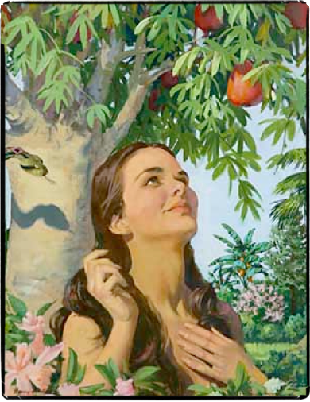
"Has God indeed said, 'You shall not eat of every tree of the garden'?" (3:1)
Did God really say that?
  Testing Eve’s knowledge of what God had said.
  Compare 3:1 with 2:16
  Satan wants us to be ignorant of God’s word - (Hos 4:6; Heb 5:12; 2 Cor. 11:3; Ephes. 6:12-17)

Slide 11
"Has God indeed said, 'You shall not eat of every tree of the garden'?" (3:1)
“Churches must recover the centrality and urgency of biblical teaching and preaching, and refuse to sideline the teaching ministry of the preacher.
Albert Mohler (The Scandal of Biblical Illiteracy: It's Our Problem)

Slide 12
"Has God indeed said, 'You shall not eat of every tree of the garden'?" (3:1)
“Pastors and churches too busy--or too distracted--to make biblical knowledge a central aim of ministry will produce believers who simply do not know enough to be faithful disciples."
Albert Mohler (The Scandal of Biblical Illiteracy: It's Our Problem)

Slide 13
"Has God indeed said, 'You shall not eat of every tree of the garden'?" (3:1)
"We will not believe more than we know, and we will not live higher than our beliefs.
Albert Mohler (The Scandal of Biblical Illiteracy: It's Our Problem)

Slide 14
"Has God indeed said, 'You shall not eat of every tree of the garden'?" (3:1)
Did God really say that?
  Planted the idea in Eve’s mind that “God is a depriver - not a blesser” - (2:9,15,16; James 1:17)
  Planted the idea that God withholds pleasure - a kill joy - (Ps 37:4; Ps 84:11; 1 Tim 6:17)

Slide 15
"Has God indeed said, 'You shall not eat of every tree of the garden'?" (3:1)
Did God really say that?
  Satan wants us to think of God as the cosmic kill-joy -
  To focus on what we can’t have or can’t do rather than what we can!
  Such robs us of joy!!!!!!

Slide 16
"Has God indeed said, 'You shall not eat of every tree of the garden'?" (3:1)
God’s law is to protect us. (A loving father makes rules to protect his children)
  For your good - Deut 6:24; 10:13; Ps 84:11; Is. 3:10; Mat 6:33; Rom 6:21-23
  The Lord wants to bless you - NOT destroy you! - Prov 22:4; 2 Pet 3:9

Slide 17
"Has God indeed said, 'You shall not eat of every tree of the garden'?" (3:1)
The Christian life is not one of negativity, but of joy, peace & glory - Phili. 4:4-13; 2 Thes 1:11
He loves you and wants what is best for you - John 3:16; Rom 5:8; 2 Cor 5:19-21; Titus 3:1-5; 1 John 4:9,10

Slide 18
"You will not surely die."
(3:4,5)
There is a battle going on today over the Word of God that began in the Garden of Eden –
Satan planted doubt in Eve’s mind: “God didn’t really mean what He said! You can’t really believe Him”

Slide 19
"You will not surely die."
(3:4,5)
Satan is busy today creating doubt in Scripture -
He wants you to doubt its reliability - its authority - its truthfulness!
Satan wants to offer you alternatives to the Bible.

Slide 20

Relativism - Truth changes
Subjectivism - What is truth for me may not be truth for you
Experimentalism - truth is only what we can test
Rationalism - must pass our logic test - it must make sense to us!
Pragmatism - does it work for us in gaining what we want?

Slide 21
"You will not surely die."
(3:4,5)
Satan wants us to believe there are no moral absolutes; no fixed standards of right and wrong.
Satan loves that sort of confusion.

Slide 22
"You will not surely die."
(3:4,5)
“Eve, there is no need to fear God’s judgment –
“He won’t punish you!”
“God is bluffing” -
“God loves you too much to fulfill His promise!”

Slide 23
"You will not surely die."
(3:4,5)
Satan wants you to believe you do not need to fear the judgment of God -Atheism -Humanism – Universalism
You can sin with impunity - God will not punish sin - (Law without penalty is only advice)

Slide 24
"You will not surely die."
(3:4,5)
Lie: “God is too good & too loving to punish sin”
  God is Holy - 1 Pet 1:15,16
  God is just - Ps 7:11
  God is faithful - 2 Tim 2:11-13
  God is Judge - Rom 2:16

Slide 25
"You will not surely die."
(3:4,5)
Lie: “God is too good & too loving to punish sin”
”Truth; “God is too good NOT to punish sin” - (1 John 1:5-10; Isaiah 59:1,2; Psalm 7:11; Rom 2:5-11)

Slide 26
"For God knows that in the day you eat of it your eyes will be opened,
and you will be like God, knowing good and evil." (3:5)
How do you know that the fruit is good or bad - you haven’t tasted it –
All you have is his word for it -God is holding out on you!
God doesn‘t want you to reach your potential!

Slide 27
"For God knows that in the day you eat of it your eyes will be opened,
and you will be like God, knowing good and evil." (3:5)
Eve, you need to be liberated - to be independent from God
You can be like God - knowing good and evil; (i.e., you have to try it - you have to experience it - think of the knowledge you can have . . . )

Slide 28
"For God knows that in the day you eat of it your eyes will be opened,
and you will be like God, knowing good and evil." (3:5)
Is God really trying to keep you from what is good & best for you? - Jer 6:16
Is God really a cruel task -master? - Deut 10:13
Are God’s rules oppressive & harmful? - 1 John 5:1-5

Slide 29
John 10:10 (NKJV)
The thief does not come except to steal, and to kill, and to destroy. I have come that they may have life, and that they may have it more abundantly.

Slide 30


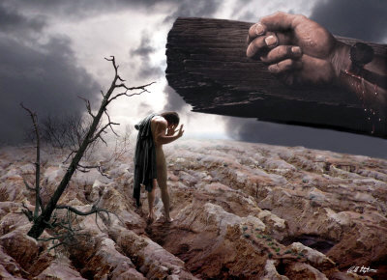
Satan Has Been Defeated - 9,10; James 4:7; 1 Cor 10:13
By God’s provision - (His strength, His kingdom, the authority of Christ) - John 3:16; Tit 3:1-5; Mat 16:18; 28:18-20; Acts 2:36-38
Revelation 12:10 (NKJV)
. . . "Now salvation, and strength, and the kingdom of our God, and the power of His Christ have come, for the accuser of our brethren, who accused them before our God day and night, has been cast down.

Slide 31
By Calvary's conquest - the blood of the Lamb - Mat 26:28
By confessing our faith in Christ - Rom 10:9,10
Complete commitment to the Lord - Luke 9:23-26
Revelation 12:11 (NKJV)
And they overcame him by the blood of the Lamb and by the word of their testimony, and they did not love their lives to the death.

Slide 33
Charts by Don McClain
Prepared October 25-28, 2012
Preached October 28, 2012
West 65th Street church of Christ
P.O. Box 190062
Little Rock AR 72219
501-568-1062
Prepared using PPT 2010
Email – donmcclain@sbcglobal.net
More PPT & Audio Sermons:
http://w65stchurchofchrist.org/donmaccla/2010SermonPage.html
Note – Many of the transition effects used in this presentation may be lost using PPT 2007 Viewer
http://www.microsoft.com/downloads/details.aspx?FamilyID=cb9bf144-1076-4615-9951-294eeb832823&displaylang=en

