Slide 1
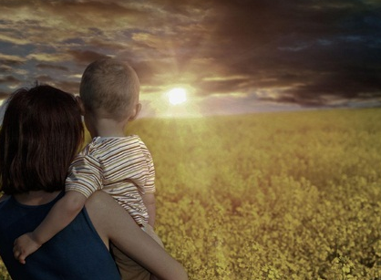
Is It Reasonable To Believe In God?
In This Scientific Age?

Slide 2
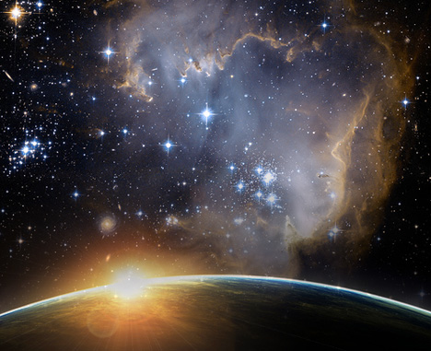
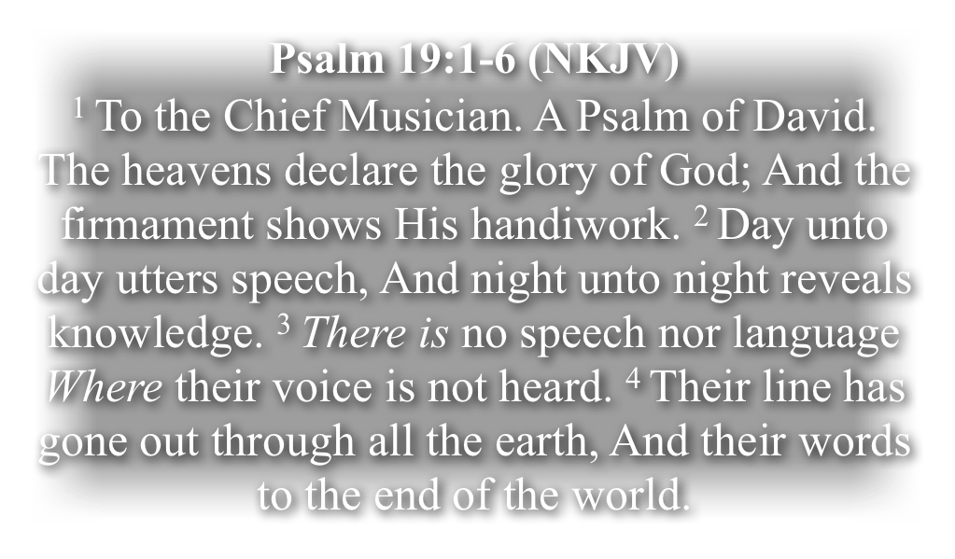
Is It Reasonable To Believe In God?

Slide 3
Is It Reasonable To Believe In God?

Slide 4
Is It Reasonable To Believe In God?
Acts 14:15-17 (NKJV)
¹⁵ . . .the living God, who made the heaven, the earth, the sea, and all things that are in them, ¹⁶ who in bygone generations allowed all nations to walk in their own ways. ¹⁷ Nevertheless He did not leave Himself without witness, in that He did good, gave us rain from heaven and fruitful seasons, filling our hearts with food and gladness."

Slide 5
Is It Reasonable To Believe In God?
Romans 1:19-20 (NKJV)
¹⁹ because what may be known of God is manifest in them, for God has shown it to them. ²⁰ For since the creation of the world His invisible attributes are clearly seen, being understood by the things that are made, even His eternal power and Godhead, so that they are without excuse,

Slide 6
Is It Reasonable To Believe In God?
The number of Americans who do not identify with any religion continues to grow at a rapid pace. One-fifth of the U.S. public – and a third of adults under 30 – are religiously unaffiliated today, the highest percentages ever in Pew Research Center polling.

Slide 7
Is It Reasonable To Believe In God?
In the last five years alone, the unaffiliated have increased from just over 15% to just under 20% of all U.S. adults. Their ranks now include more than 13 million self-described atheists and agnostics (nearly 6% of the U.S. public), as well as nearly 33 million people who say they have no particular religious affiliation (14%).

Slide 8
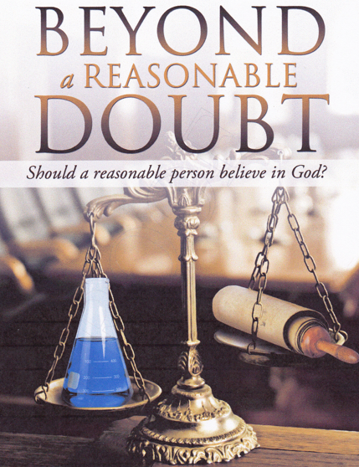
Is It Reasonable To Believe In God?
Are there better arguments for God’s existence than against it?
What is the best explanation for the existence and continuance of the universe?

Slide 9
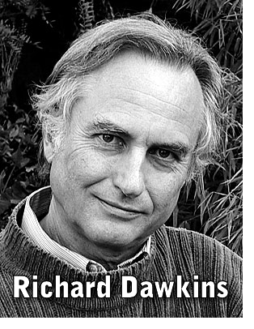
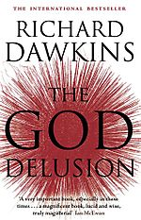
Is It Reasonable To Believe In God?
“A delusion is something that people believe in despite a total lack of evidence.”Richard Dawkins

Slide 10
Is It Reasonable To Believe In God?
Faith is the great cop-out, the great excuse to evade the need to think and evaluate evidence. Faith is belief in spite of, even perhaps because of, the lack of evidence.
Richard Dawkins

Slide 11
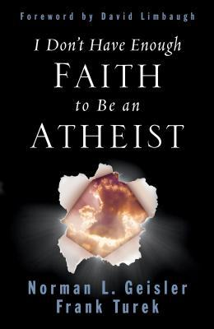
Is It Reasonable To Believe In God?
Faith is not some mystical, unexplainable conviction arrived at without evidence. (Isaiah 1:18)
Faith is a conviction arrived at by examining the evidence and accepting the most reasonable conclusion. (Heb 11:1; Rom 1:20; 10:17)

Slide 12
Is It Reasonable To Believe In God?
Hebrews 11:1-3 (NKJV)
¹ Now faith is the substance of things hoped for, the evidence of things not seen. ² For by it the elders obtained a good testimony. ³ By faith we understand that the worlds were framed by the word of God, so that the things which are seen were not made of things which are visible.

Slide 13
Is It Reasonable To Believe In God?
Today the theory of evolution is about as much open to doubt as the theory that the earth goes round the sun.
Richard Dawkins

Slide 14
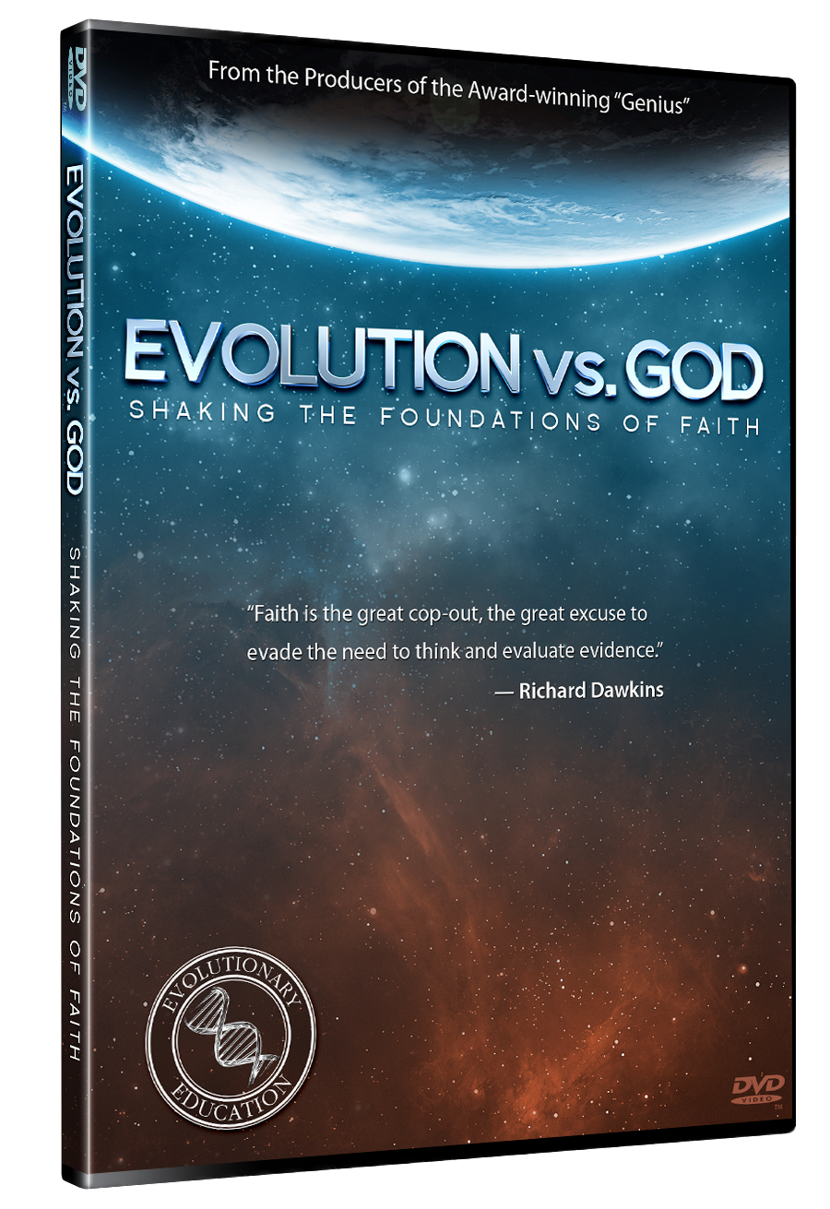
Is It Reasonable To Believe In God?
Questions were asked of students & professors who claimed to be atheists in an attempt to demonstrate that naturalistic evolution is not the result of scientific ‘proof’ but rather a theory requiring one to ‘believe’ in something that cannot be proven.

Slide 15
Is It Reasonable To Believe In God?
Atheist ‘CLAIM’ that science has ‘proven’ their position
Yet the question of HOW and WHEN the Universe began CANNOT be scientifically PROVEN -
An adequate explanation for the obvious design in our world CANNOT be answered by science -
The origin of life and its complexities CANNOT be scientifically explained!
Where is the science proving the change of one ‘KIND’ to another?

Slide 16
Is It Reasonable To Believe In God?
Cause And Effect — The Cosmological Argument The Most Reasonable Cause For The Material Universe?
Order of The Universe — The Teleological Argument - The Most Reasonable Cause For Organization?
The Irreducible Complexity of Living Things - The Most Reasonable Cause of Life & its complexities?
Mind, Ethics, & Reason – Anthropological Argument - The Most Reasonable Explanation For Consciousness?
Religion, – The Spiritual Argument - The Most Reasonable Explanation For Man’s desire to Worship, Seek God, & The Bible?

Slide 17
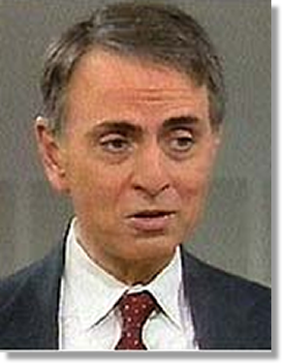
The Most Reasonable Cause For The Material Universe?
“The Cosmos is all that is or ever was or ever will be”
(Carl Sagan 1980, Cosmos, p. 4).
Did the universe always exist?
If the universe had a beginning, then it needs a first cause.

Slide 18
The Most Reasonable Cause For The Material Universe?
“The Cosmos is all that is or ever was or ever will be”
(Carl Sagan 1980, Cosmos, p. 4).
Did the universe self-cause itself?
In order to self-cause itself it would have to not exist (to cause existence) and exist (in order to be caused) at the same time.
Therefore, this option is ruled out because it violates the “Law of non-contradiction”.

Slide 19
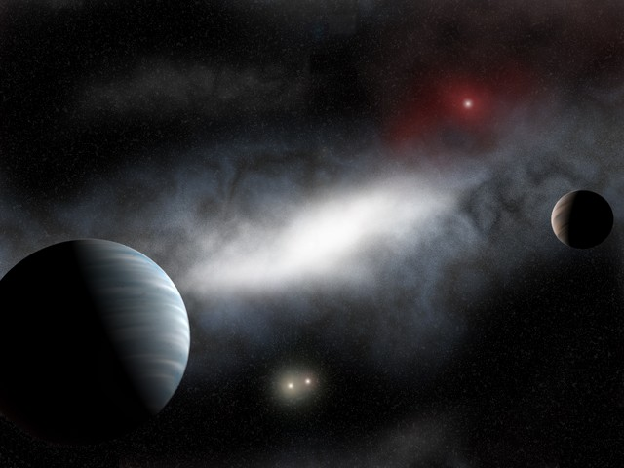
The Most Reasonable Cause For The Material Universe?
The 1st Law of Thermodynamics
1. Energy can be neither created nor destroyed (conservation of energy).
2. Thus power generation processes and energy sources actually involve conversion of energy from one form to another, rather than creation of energy from nothing. (Einstein's famous equation - E = MC2 - energy (E) is equal to matter (M) times the square of a constant (C).)

Slide 20
The Most Reasonable Cause For The Material Universe?
The 2nd Law of Thermodynamics
Heat can never pass spontaneously from a colder to a hotter body.
As a result of this fact, natural processes that involve energy transfer must have one direction, and all natural processes are irreversible.
Thus the entropy of an isolated system always increases with time. (Entropy is the measure of the disorder or randomness of energy and matter in a system. - Both energy and matter in the Universe are becoming less useful as time goes on).

Slide 21
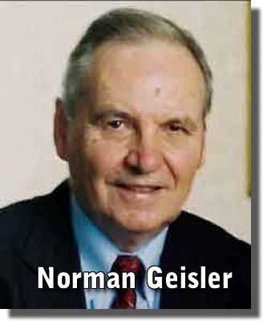
The Most Reasonable Cause For The Material Universe?
“The Second Law of thermodynamics is probably the most powerful piece of legislation in the physical world. It ultimately describes every process we have ever discovered: it is the final Court of Appeal in any dispute relating to action and procedures, whether they are naturally generated or man inspired.
It draws the conclusion that in our universe there is an overall reduction in order, a loss of available energy that is measured as an increase in entropy. . .”
[Geisler, Unshakable Foundations, Bethany House, 2001, pg. 74]

Slide 22
The Most Reasonable Cause For The Material Universe?
“. . . So the available stock of order is being exhausted. Akin to the dying battery of a flashlight, useful energy is being dissipated into entropy after which none remains for use… For us to live in a universe in which the Second Law of thermodynamics holds, then, it must be a universe that has a starting point, a creation.”
[Geisler, Unshakable Foundations, Bethany House, 2001, pg. 74]

Slide 23
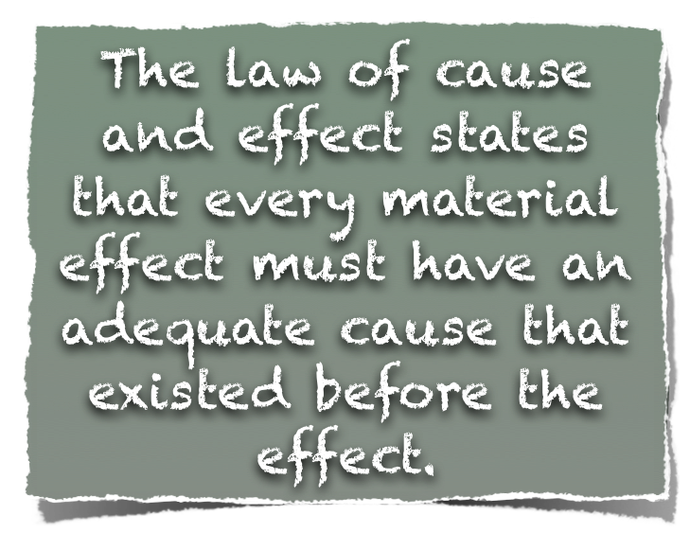
The Most Reasonable Cause For The Material Universe?

Slide 24
The Most Reasonable Cause For The Material Universe?
A healthy, rooted tree does not fall over because a fly flies into it.
An encyclopedia is not produced by spilling ink onto a stack of paper.
These are not adequate causes. For whatever effects we see, we must present adequate causes.

Slide 25
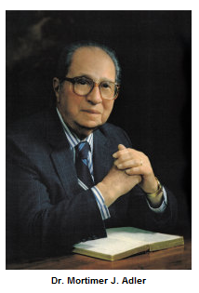
The Most Reasonable Cause For The Material Universe?
“If the existence of the cosmos as a whole needs to be explained, and if it cannot be explained by natural causes, Then we must look to the existence and action of a supernatural cause for its explanation”
[Mortimer J. Adler, How to Think about God New York: Macmillian, 1980) pg. 131]

Slide 26
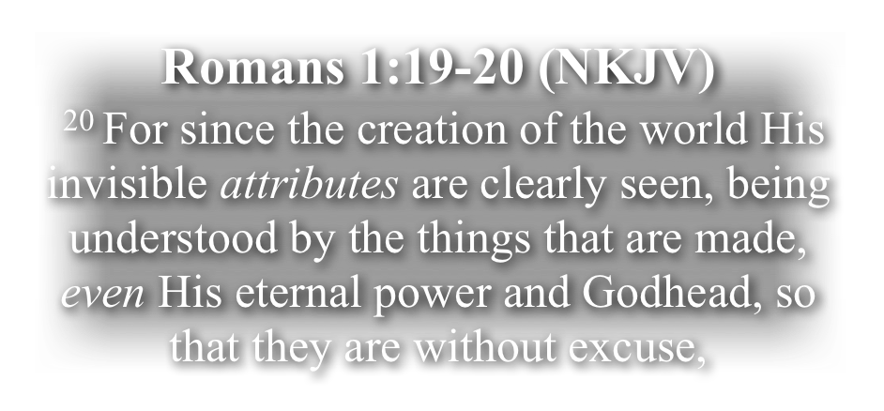
The Most Reasonable Cause For The Material Universe?

Slide 27
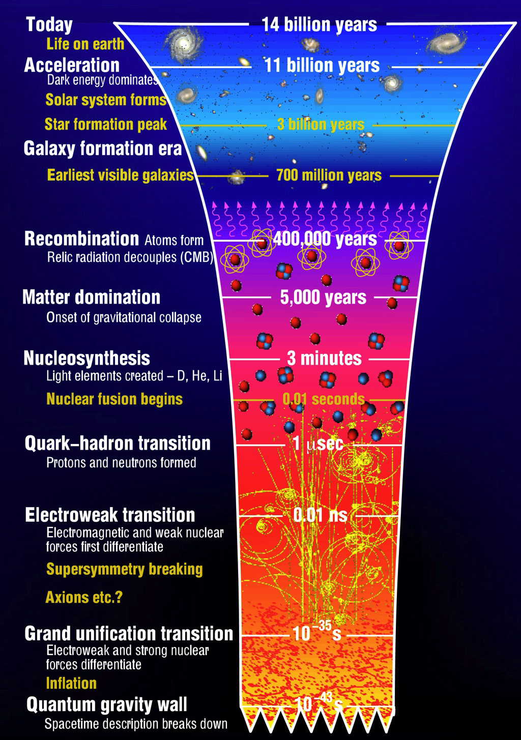
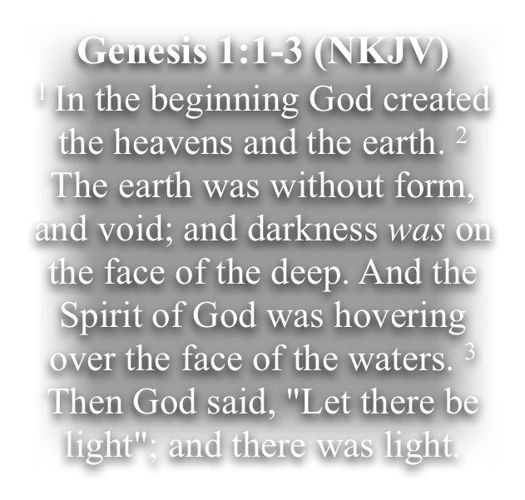
The Most Reasonable Cause For The Material Universe?

Slide 28
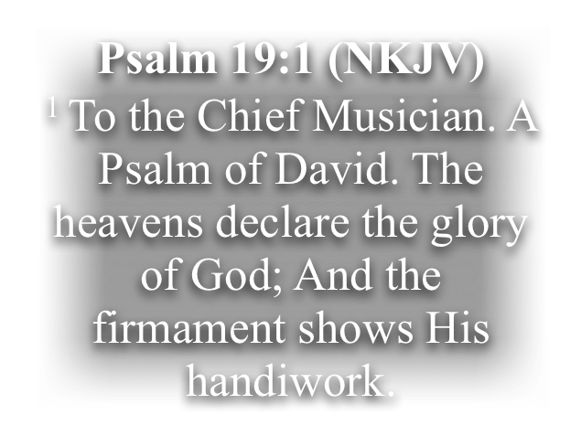
The Most Reasonable Cause For The Material Universe?

Slide 29
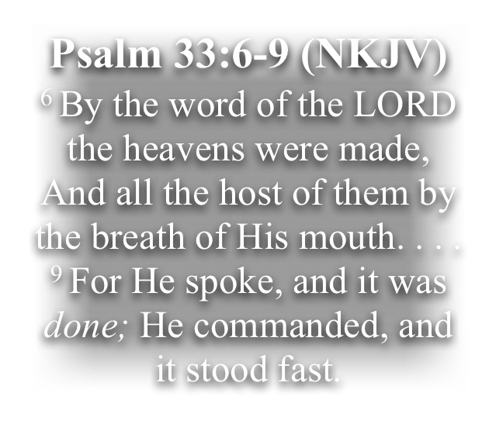
The Most Reasonable Cause For The Material Universe?

Slide 30
The Most Reasonable Cause For The Material Universe?

Slide 31
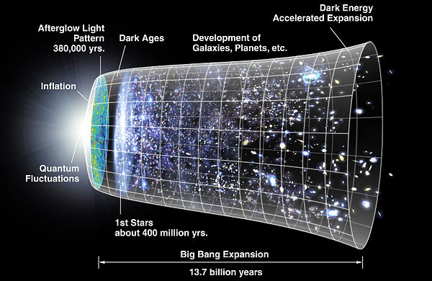

Slide 32
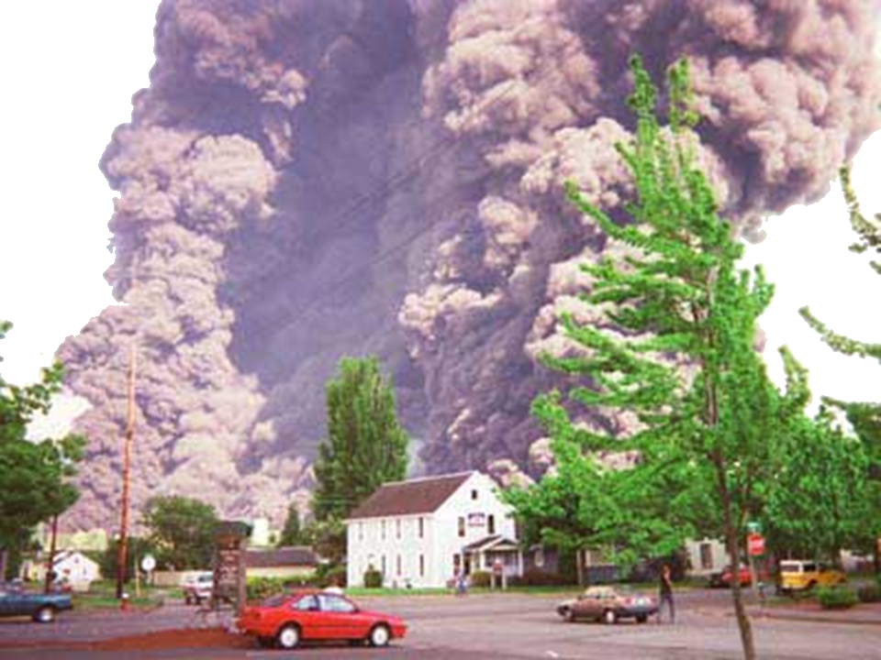
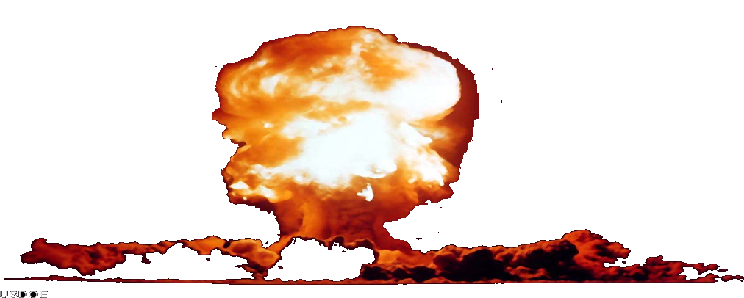
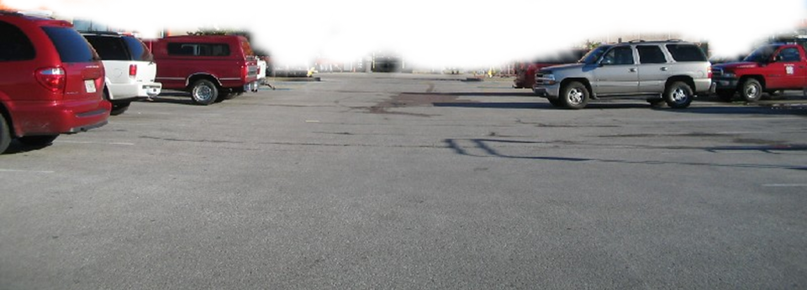
The Most Reasonable Cause For The Order of The Universe?

Slide 33
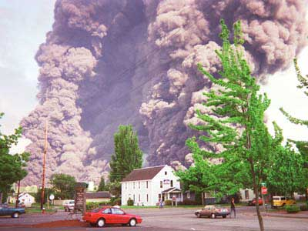
The Most Reasonable Cause For The Order of The Universe?

Slide 34
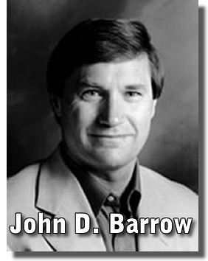
The Most Reasonable Cause For The Order of The Universe?
“At first, the absence of a beginning appears to be an advantage to the scientific approach. There are no awkward starting conditions to deduce or explain. But this is an illusion. We still have to explain why the Universe took on particular properties—its rate expansion, density, and so forth— at an infinite time in the past”
((2000), The Book of Nothing: Vacuums, Voids, and the Latest Ideas about the Origins of the Universe p. 296, (NewYork: Pantheon).

Slide 35
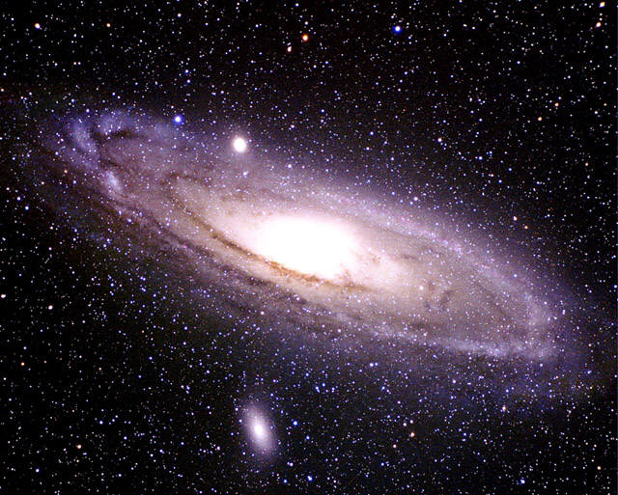
60x60=3600
3,600 x 24 = 86,400 – (seconds in a day)
86,400 x 365 = 31,536,000 (seconds in a year)
186,000 x 31,536,000= 58,656,960,000,000 (# miles light travels in 1 year) –
58,656,960,000,000 x 100,000 =
587 Quadrillion Miles
The Milky Way Galaxy: Vital Statistics
Diameter | 100,000 light years
Thickness (Nucleus) | 20,000 light years
Thickness (Disc) | 2,000 light years
Number of Stars | 100,000,000,000
Notes:
Zooming In On Earth - http://micro.magnet.fsu.edu/primer/java/scienceopticsu/powersof10/index.html
60x60=3600
3600x24=86,400 – (seconds in a day)
86,400x365=31536000 (seconds in a year)
186,000 (# of miles light travels in a second) x 31536000= 58,656,960,000,000 (# miles light travels in 1 year) – 58 trillion, 656, billion, 960, million miles = ONE LIGHT YEAR
58,656,960,000,000 x 100,000 =

Slide 36
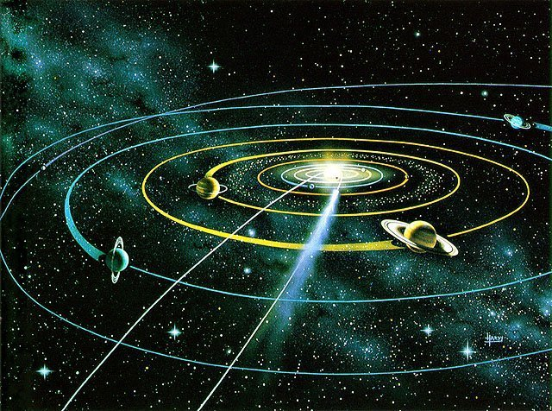
The Most Reasonable Cause For The Order of The Universe?

Slide 37
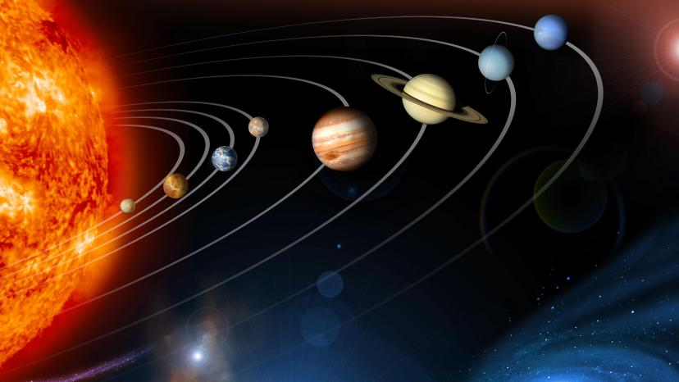
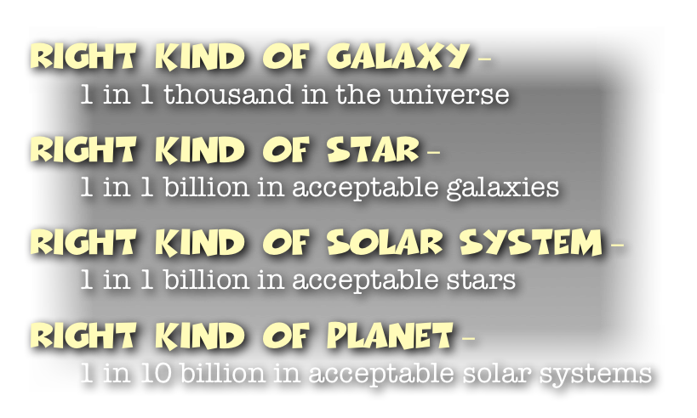
The Most Reasonable Cause For The Order of The Universe?

Slide 38
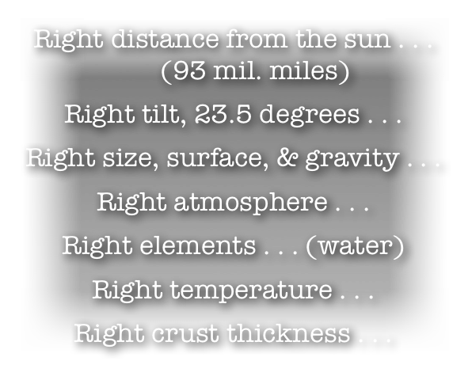
The Most Reasonable Cause For The Order of The Universe?

Slide 39
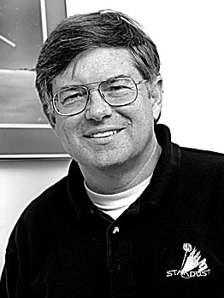
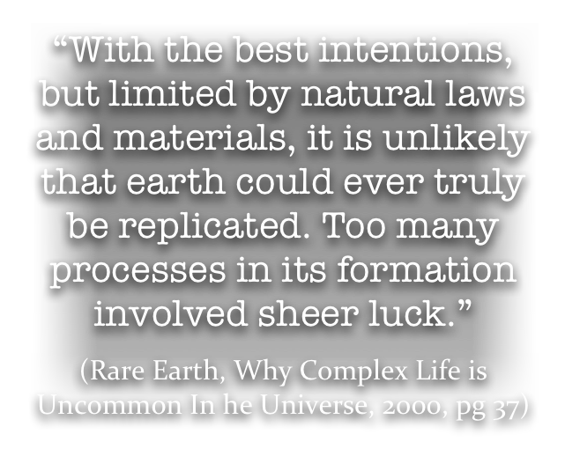
The Most Reasonable Cause For The Order of The Universe?

Slide 40
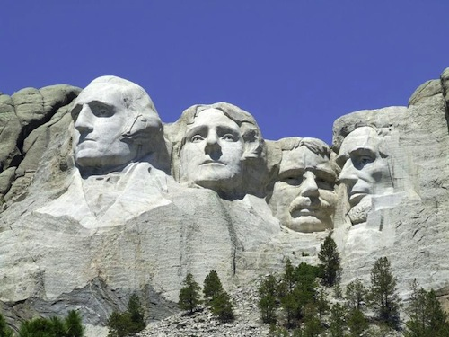
The Most Reasonable Cause For The Order of The Universe?

Slide 41
The Most Reasonable Cause For The Order of The Universe?
The Blind Watchmaker: Why the Evidence of Evolution Reveals a Universe Without Design (1996) by Richard Dawkins (Norton Publishing).

Slide 42
The Most Reasonable Cause For The Order of The Universe?
”Even the most ardent atheist concedes that design is all around us. To a Christian, the design we see all around us is totally consistent with the Bible’s explanation that God created all.
‘All appearance to the contrary, the only watchmaker in nature is the blind forces of physics, albeit deployed in a very special way. A true watchmaker has foresight: he designs his cogs and springs, and plans their interconnections, with future purpose in his mind’s eye.
The Blind Watchmaker: Why the Evidence of Evolution Reveals a Universe Without Design (1996) by Richard Dawkins (Norton Publishing).

Slide 43
The Most Reasonable Cause For The Order of The Universe?
Natural selection, the blind, unconscious, automatic process which Darwin discovered, and which we now know is the explanation for the existence and apparently purposeful form of all life, has no purpose in mind. . . . It has no mind . . . . It does not plan for the future . . . it is the blind watchmaker.’
The Blind Watchmaker: Why the Evidence of Evolution Reveals a Universe Without Design (1996) by Richard Dawkins (Norton Publishing).

Slide 44
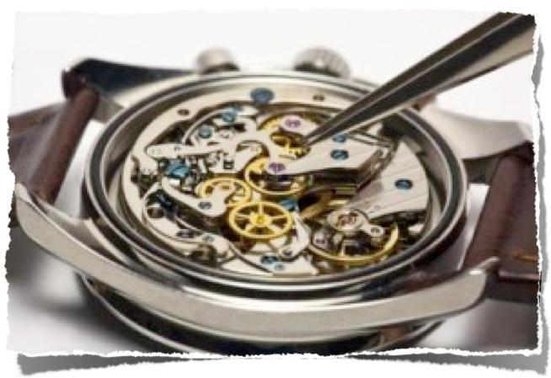
The Most Reasonable Cause For The Order of The Universe?

Slide 45
Is It Reasonable To Believe In God?
Hebrews 11:1-6 (NKJV)
¹ Now faith is the substance of things hoped for, the evidence of things not seen. ² For by it the elders obtained a good testimony. ³ By faith we understand that the worlds were framed by the word of God, so that the things which are seen were not made of things which are visible. . . . ⁶ But without faith it is impossible to please Him, for he who comes to God must believe that He is, and that He is a rewarder of those who diligently seek Him.

Slide 46
Is It Reasonable To Believe In God?
Not Only Is It Reasonable To Believe In God - It Is Unreasonable NOT TO!

Slide 47
Is It Reasonable To Believe In God?
Acts 17:30-31 (NKJV)
³⁰ Truly, these times of ignorance God overlooked, but now commands all men everywhere to repent, ³¹ because He has appointed a day on which He will judge the world in righteousness by the Man whom He has ordained. He has given assurance of this to all by raising Him from the dead."

Slide 48
48

Slide 49
Is It Reasonable To Believe In God?
Charts by Don McClain
Prepared October 10-12, 2013 - Preached October 13, 2013
West 65th Street church of Christ
P.O. Box 190062Little Rock AR 72219
501-568-1062
Prepared using Keynote
Email – donmcclain@sbcglobal.net
More Keynote, PPT & Audio Sermons:
http://w65stchurchofchrist.org/coc/sermons/
Note – Many of the transition effects used in this presentation will be lost using PPT 2007 Viewer
http://www.microsoft.com/downloads/details.aspx?FamilyID=cb9bf144-1076-4615-9951-294eeb832823&displaylang=en

Slide 50
Genesis 2:1-7 (NKJV)
¹ Thus the heavens and the earth, and all the host of them, were finished. ² And on the seventh day God ended His work which He had done, and He rested on the seventh day from all His work which He had done. ³ Then God blessed the seventh day and sanctified it, because in it He rested from all His work which God had created and made. ⁴ This is the history of the heavens and the earth when they were created, in the day that the LORD God made the earth and the heavens,

Slide 51
Genesis 2:1-7 (NKJV)
⁵ before any plant of the field was in the earth and before any herb of the field had grown. For the LORD God had not caused it to rain on the earth, and there was no man to till the ground; ⁶ but a mist went up from the earth and watered the whole face of the ground. ⁷ And the LORD God formed man of the dust of the ground, and breathed into his nostrils the breath of life; and man became a living being.

