Slide 1
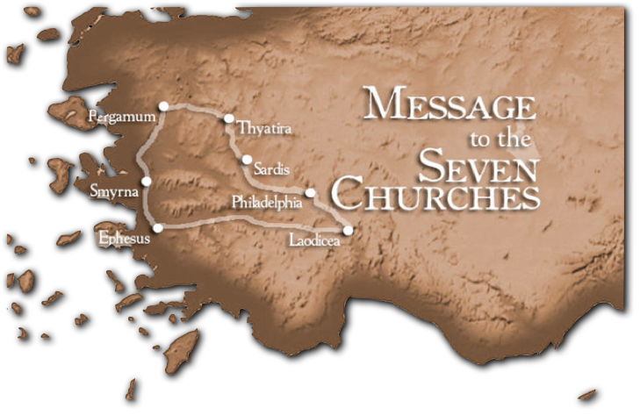
1
The One Who Speaks To The Churches
Patmos
“He who has an ear, let him hear what the Spirit says to the churches.”
Don McClain
W. 65th St church of Christ - 9/16/2007

Slide 2
A Revelation From Heaven
Time Frame (1:1,3; 22:6,10)
Figurative / Signs & Symbols
Revelation 1:1-2 (NKJV)
¹ The Revelation of Jesus Christ, which God gave Him to show His servants--things which must shortly take place. And He sent and signified it by His angel to His servant John, ² who bore witness to the word of God, and to the testimony of Jesus Christ, to all things that he saw.
things which must shortly take place
signified

Slide 3
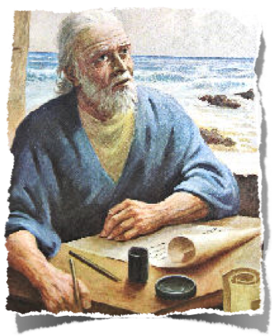
A Revelation From Heaven
A divine message - The Revelation of Jesus Christ, which God gave Him to show His servants
The Father - from Him who is and who was and who is to come - (1:4)
The Holy Spirit - from the seven Spirits who are before His throne - (1:4)
The Jesus Christ - and from Jesus Christ, the faithful witness, the firstborn from the dead, and the ruler over the kings of the earth - (1:5-7)

Slide 4
Blessed Is He . . .
Revelation 1:3 (NKJV)
³ Blessed is he who reads and those who hear the words of this prophecy, and keep those things which are written in it; for the time is near.

Slide 5
Blessed Is He . . .
“That read, hear the words of this prophecy, and keep those things which are written in it” - (1:3; 22:7)
“The dead who die in the Lord” - (14:13)
“Those that watch & keep His commandments” - (16:15; 22:14)
“That are called to the marriage supper of the Lamb” - (19:9)
“That has a part in the first resurrection” - (20:6)

Slide 6
To The Seven Churches Which Are In Asia
Revelation 1:4-6 (NKJV)
⁴ John, to the seven churches which are in Asia: Grace to you and peace from Him who is and who was and who is to come, and from the seven Spirits who are before His throne, . . .

Slide 7
To The Seven Churches Which Are In Asia
Revelation 1:11 (NKJV)
¹¹ saying, "I am the Alpha and the Omega, the First and the Last," and, "What you see, write in a book and send it to the seven churches which are in Asia: to Ephesus, to Smyrna, to Pergamos, to Thyatira, to Sardis, to Philadelphia, and to Laodicea."

Slide 8
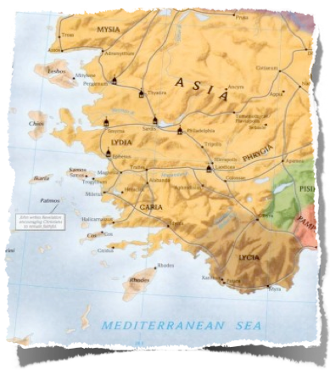
To The Seven Churches Which Are In Asia
Message to 7 actual churches
There were other churches
Number 7 is representative for wholeness, completeness
These 7 churches are representative of all
Ephesus - Left Their First LoveSmyrna - Poor-Rich ChurchPergamos - Where Satan DwellsThyatira - Compromising ChurchSardis - Dead ChurchPhiladelphia - An Open DoorLaodicea - Lukewarm / Self-Sufficient Church

Slide 9
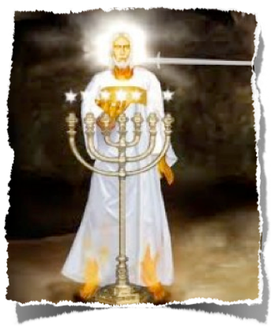
The Revelation of Jesus Christ
The One Speaking To The Churches
“The Faithful Witness” - (1:5; John 8:14; Heb 1:1-3; John 18:36-38)
“First Begotten From The Dead” - (1:5; Col. 1:18; 1 Cor. 15:20)
“Prince of the kings of the earth” - (1:5; 17:14; 19:16; Ep 1:20,21; 1 Tim 6:15)
“Who loved us & washed us from our sins in His own blood” - (1:5; Jn 13:34; Mat. 28:26; Heb 9:15,25-28)

Slide 10
The Revelation of Jesus Christ
The One Speaking To The Churches
“Made us kings & priest to God” - (1:6; 5:9,10; 1 Pet 2:9; Col. 1:13)
“To Him be glory and dominion forever and ever” - (1:6; 5:12-14; 17:14; Acts 2:36; 2 Pet 3:18; Jn 5:23)
“Coming in the clouds” - (1:7; Eph 1:20,21; Acts 1:9-11; 1 The 4:17)
“The Alpha & Omega, . . . Who is, Who was & Who is to come” - (1:8,11,17; 2:8; 21:6; 22:13)

Slide 11
The Revelation of Jesus Christ
The One Speaking To The Churches
“Like unto the Son of Man” - (Human form - 1:13; Dan 7:9-13; John 1:14; Heb 2:14-16; Phili 2:5-8)
“Clothed with garment down to His feet, girded around the chest with a golden band” - (Priestly attire with authority - 1:13; 15:6; Dan 10:5)
“Head & hair white as wool & snow” - (divine majesty, glory & purity - 1:14; Dan 7:9)

Slide 12
The Revelation of Jesus Christ
The One Speaking To The Churches
“Eyes as a flame of fire” - (penetrating, omniscient, divine knowledge / judgment - 1:14; Rev 2:18; 19:12; Dan 10:6)
“Feet like fine brass, refined in the fire” - (Strength, justice, authority & power to vanquish all enemies - 1:15; 2:18; Dan 10:6; Ezek. 1:7; 40:3)

Slide 13
The Revelation of Jesus Christ
The One Speaking To The Churches
“Voice as sound of many waters” - (overwhelming majesty, authority - demanding our attention - 1:15; 14:2; 19:6; Ps 93:4; Ez 43:2)
“Seven stars in His hand” - (Ownership & authority - all authority over the messengers to the churches / they & the churches belong to Him, to Whom they must give account - 1:16;20; 19:6; Ps 93:4; Ez 43:2; 2 Cor 5:10)

Slide 14
The Revelation of Jesus Christ
The One Speaking To The Churches
“Sharp two edged sword out of His mouth” - (word of truth / exposes & destroys / judges - 1:16; 2:12,16; 19:15,21; Is 11:4; Ep 6:17; Heb 4:12; Jn 12:48)
“Countenance as the unimpeded light of the sun” - (Heavenly divine glory & majesty - 1:16; Heb 1:3)
“Worthy of all reverence & worship” - (John “fell at His feet as dead” - 1:17; Ez 1:28; Dan 10:8,9; 17-19)

Slide 15
The Revelation of Jesus Christ
The One Speaking To The Churches
Revelation 1:17 (NKJV)
¹⁷ And when I saw Him, I fell at His feet as dead. But He laid His right hand on me, saying to me, "Do not be afraid; I am the First and the Last.

Slide 16
The Revelation of Jesus Christ
The One Speaking To The Churches
Revelation 1:18 (NKJV)
¹⁸ I am He who lives, and was dead, and behold, I am alive forevermore. Amen. And I have the keys of Hades and of Death.

Slide 17
The Revelation of Jesus Christ
The One Speaking To The Churches
Revelation 1:19 (NKJV)
¹⁹ Write the things which you have seen, and the things which are, and the things which will take place after this.

Slide 18
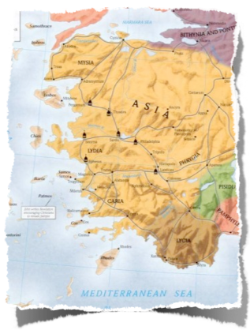
To The Seven Churches Which Are In Asia
The churches at that time needed hope, courage & comfort
Social disgrace; financial & material loss; physical persecution; loss of physical life - (Acts 14:22; 2 Tim 3:12)
Was / is being a Christian “worth it?” - Mat 10:28; 16:24-27; Rev 14:12,13
A message needed for all Christians of all ages

Slide 19
“He who has an ear, let him hear what the Spirit says to the churches.”
Faithfulness to the Lord is a worthwhile endeavor regardless what may happen to us in the flesh - (Rev 14:12,13)
We need to keep our focus on Jesus - (Rev. 1:5-19; Heb 12:1-3)
Jesus is still Lord of lords & King of kings! - (Rev 17:14)

Slide 20
“He who has an ear, let him hear what the Spirit says to the churches.”
Jesus knows our collective state - He knows our works - (How do we measure up as a church?)
Jesus knows our individual state - He knows our works - (How do we measure up as individuals?)

Slide 21
“He who has an ear, let him hear what the Spirit says to the churches.”
May we, as a church belonging to Christ, give Him the respect He deserves - surrendering to His authority in all things!
May we individually respect the Lord enough to surrender to His will - giving our best to Him who loved us and died for us!

Slide 22
“He who has an ear, let him hear what the Spirit says to the churches.”
Hear the gospel
Believe the gospel
Repent
Be baptized into Christ for the remission of your sins
Be faithful / submitting to, serving & trusting Jesus
Revelation 22:14 (NKJV)
¹⁴ Blessed are those who do His commandments, that they may have the right to the tree of life, and may enter through the gates into the city.

Slide 24
The Revelation of Jesus Christ
The One Speaking To The Churches
Charts by Don McClain
Prepared April 17-20, 2013; Preached April 21, 2013West 65th Street church of ChristP.O. Box 190062, Little Rock AR 72219501-568-1062Prepared using KeynoteEmail – donmcclain@sbcglobal.net More Keynote, PPT & Audio Sermons:http://w65stchurchofchrist.org/coc/sermons/

Slide 25
Colossians 1:13-23 (NKJV)
¹³ He has delivered us from the power of darkness and conveyed us into the kingdom of the Son of His love, ¹⁴ in whom we have redemption through His blood, the forgiveness of sins. ¹⁵ He is the image of the invisible God, the firstborn over all creation. ¹⁶ For by Him all things were created that are in heaven and that are on earth, visible and invisible, whether thrones or dominions or principalities or powers. All things were created through Him and for Him.

Slide 26
Colossians 1:13-23 (NKJV)
¹⁷ And He is before all things, and in Him all things consist. ¹⁸ And He is the head of the body, the church, who is the beginning, the firstborn from the dead, that in all things He may have the preeminence. ¹⁹ For it pleased the Father that in Him all the fullness should dwell, ²⁰ and by Him to reconcile all things to Himself, by Him, whether things on earth or things in heaven, having made peace through the blood of His cross.

Slide 27
Colossians 1:13-23 (NKJV)
²¹ And you, who once were alienated and enemies in your mind by wicked works, yet now He has reconciled ²² in the body of His flesh through death, to present you holy, and blameless, and above reproach in His sight-- ²³ if indeed you continue in the faith, grounded and steadfast, and are not moved away from the hope of the gospel which you heard, which was preached to every creature under heaven, of which I, Paul, became a minister.

