Slide 1
Guidance For Troubled Times - 1 Peter

Slide 2
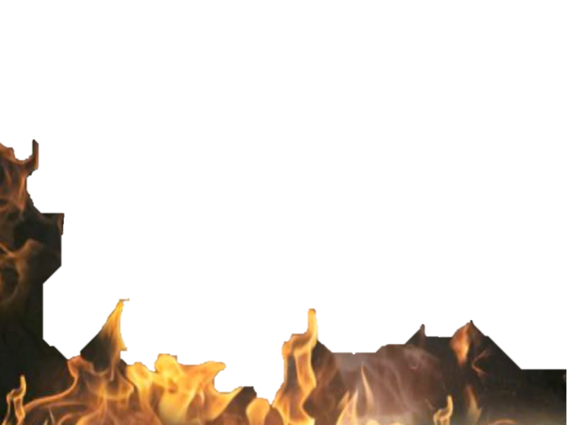
They were sojourners & pilgrims traveling through a wicked & hostile world. (as are we)
(1:1; 2:11,12)

Slide 3
They had been redeemed through the blood of Christ & sanctified to live faithful, obedient, holy lives for God.
(1:2,13-25; 2:11-3:7; 4:1-6,12-19; 5:10)

Slide 4
They were experiencing, or about to experience, persecution because of their faith -
(1:6,7; 2:12,19,20; 3:14,17; 4:12,13; 5:10)

Slide 7
Persecution will effect our faith, but that effect is determined by our attitude & response! (1 Pet 1:7-9; 3:14,15; 5:10)
How can we respond properly & in a beneficial way when we’re treated poorly because of our faith?

Slide 8
Realizing Our Standing Before God -
Chosen; royal priesthood, holy nation - (1:2; 2:9; Eph 1:4:5)
Set apart from the world for the service of God - (1:2,13-16; 4:1-3)
Redeemed with the precious blood of Jesus thus belonging to God - (1:18-23; 2:9,10; cf. 1 Cor. 6:19,20; 2 Cor 5:14-20)

Slide 9
Understanding God Will Judge Us
God will judge us without partiality and according to our works - (1:17; 4:17-18)
Committing our souls to God as to a faithful creator - (4:19)
Exalting God in our hearts - (3:15; 5:5-9)
Thus we humble ourselves before God & resist the devil - (5:6-9)

Slide 10
Trusting the promises of God
Begotten to a living hope through the resurrection of Christ - (1:3-9,13,21; 3:18-22; cf Rom 5:4,5; 8:24)
A crown of life that will not fade - (5:4)
God’s promise to “perfect, establish, strengthen & settle” you - (5:10; cf 1:Cor. 10:13; Eph 6:10-18; 2 Pet 1:5-11)

Slide 11
Submission To The Will of God
We purified our souls in obeying the truth - (1:22,23)
We are to continue in obedience - living holy lives - (1:2,13-17; 4:1-6)
Includes submission to those in authority over us - and treating others right - (2:11-3:7; 3:8-12; 4:7-11; 5:1-5)
Example of Jesus - (2:21-24; 3:18-4:2; Heb 12:1-2)

Slide 12
Spiritual Perspective / Godly Attitude
Our love and hope in the Lord will produce joy even in grievous trials - (1:6-9; 4:13; cf. Rom 5:2-5; James 1:2-6; John 16:33; 2 Cor. 4:16-18)
Reverence, sober minded, serious, watchful, prayerful - (1:13,17; 3:15; 4:7; 5:8; 3:7)

Slide 15
Charts by Don McClain
Prepared November 15,16, 2013
Preached November 17, 2013
West 65th Street church of Christ
P.O. Box 190062
Little Rock AR 72219
501-568-1062
Prepared using Keynote
Email – donmcclain@sbcglobal.net
More Keynote, PPT & Audio Sermons:
http://w65stchurchofchrist.org/coc/sermons/

Slide 16
James 1:1-8 (NKJV)
¹ James, a bondservant of God and of the Lord Jesus Christ, To the twelve tribes which are scattered abroad: Greetings. ² My brethren, count it all joy when you fall into various trials, ³ knowing that the testing of your faith produces patience. ⁴ But let patience have its perfect work, that you may be perfect and complete, lacking nothing.

Slide 17
James 1:1-8 (NKJV)
⁵ If any of you lacks wisdom, let him ask of God, who gives to all liberally and without reproach, and it will be given to him. ⁶ But let him ask in faith, with no doubting, for he who doubts is like a wave of the sea driven and tossed by the wind. ⁷ For let not that man suppose that he will receive anything from the Lord; ⁸ he is a double-minded man, unstable in all his ways.

