Slide 1
1
“The Flesh or the Spirit?” Galatians 5:16-21
Don McClain
W. 65th St church of Christ - 9/16/2007

Slide 2
“The Flesh or the Spirit?” 5:16-21
Paul Defends His Apostleship - (1:11-2:21)
Promise of Abraham Not Through The Law But Through Faith In Christ! - (3:1-29)
In Christ We Are Adopted As Sons & Heirs of God Through Christ! - (3:26-4:7)
Paul’s Concern For The Churches! - (4:8-20)
“Allegory of Hagar & Sarah”—(4:21-31)
“Stand Fast—Don’t Fall!” - 5:1-7
“Sin of Hindering Others” - 5:8-15

Slide 3
Galatians 5:16-21 (NKJV)
¹⁶ I say then: Walk in the Spirit, and you shall not fulfill the lust of the flesh. ¹⁷ For the flesh lusts against the Spirit, and the Spirit against the flesh; and these are contrary to one another, so that you do not do the things that you wish. ¹⁸ But if you are led by the Spirit, you are not under the law.

Slide 4
Galatians 5:16-21 (NKJV)
¹⁹ Now the works of the flesh are evident, which are: adultery, fornication, uncleanness, lewdness, ²⁰ idolatry, sorcery, hatred, contentions, jealousies, outbursts of wrath, selfish ambitions, dissensions, heresies, ²¹ envy, murders, drunkenness, revelries, and the like; of which I tell you beforehand, just as I also told you in time past, that those who practice such things will not inherit the kingdom of God.

Slide 5
“The Flesh or the Spirit?” 5:16-21
Context Very Important In Helping Us Understand This Section!
The contrast between the Law & the gospel - (The subject hasn’t changed!)
Turning To The Law of Moses Prevents One From Obeying The Truth - 5:7-10
Judaizers were causing trouble in the churches with their system of justification by works of the Law of Moses - 5:12-15

Slide 6
“The Flesh or the Spirit?” 5:16-21
Context Very Important In Helping Us Understand This Section!
The contrast in this section is between the “FRUIT” of their teaching and the “FRUIT” of the gospel - 5:16-26
Most expositors miss the point of this text completely and even use it to promote the opposite of what Paul is actually teaching.

Slide 7
“The Flesh or the Spirit?” 5:16-21
Many False Ideas & Applications
Error pertaining to the “indwelling” of the Holy Spirit.
Error pertaining to how the Holy Spirit guides the Christian’s walk.
Error pertaining to the nature of man.
Error pertaining to mans ability, (or inability).

Slide 8
“The Flesh or the Spirit?” 5:16-21
Many False Ideas & Applications
Galatians 5:16-18 (NIV) ¹⁶ So I say, live by the Spirit, and you will not gratify the desires of the sinful nature. ¹⁷ For the sinful nature desires what is contrary to the Spirit, and the Spirit what is contrary to the sinful nature. They are in conflict with each other, so that you do not do what you want. ¹⁸ But if you are led by the Spirit, you are not under law.

Slide 9
“The Flesh or the Spirit?” 5:16-21
Main Point of the Text
Galatians 5:16-21 teaches the same thing as Romans 7 -
Of course most expositors miss it on Romans 7 as well.

Slide 10
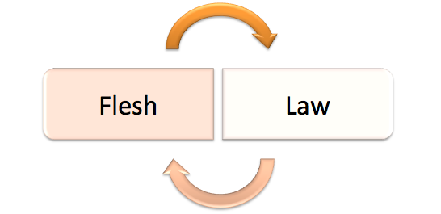
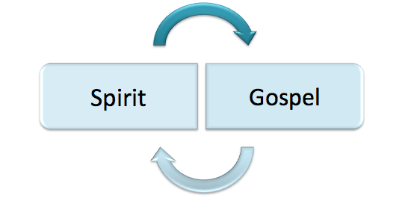
“The Flesh or the Spirit?” 5:16-21
Main Point of the Text
The Nature of The Fruit Produced Is Dependent Upon Which System One Follows!

Slide 11
“The Flesh or the Spirit?” 5:16-21
Main Point of the Text
The Nature of The Fruit Produced Is Dependent Upon Which System One Follows!
Works of the Flesh
Fruit of the Spirit

Slide 12
“The Flesh or the Spirit?” 5:16-21
Main Point of the Text
The Nature of The Fruit Produced Is Dependent Upon Which System One Follows!
Works of the Flesh
Fruit of the Spirit

Slide 13
“The Flesh or the Spirit?” 5:16-21
Walk In The Gospel / Spirit
To walk according to the Spirit is to walk according to the gospel -
The word “fulfill” here means to “bring to completion”
The one walking according to the gospel will NOT produce the same fruit as the one who seeks justification through the Law.

Slide 14
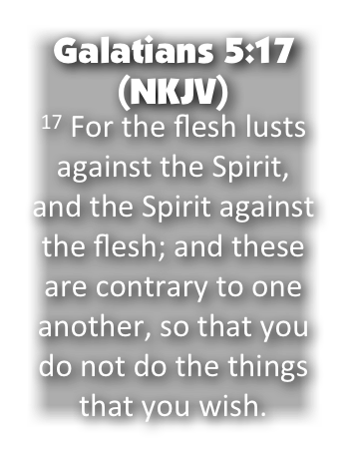
“The Flesh or the Spirit?” 5:16-21
Walk In The Gospel / Spirit
The two systems cannot coexist or be mingled together - this point has been made several times - (1:6-10; 3:3,4; 4:21-31; 5:1-15)
“So that you do not do the things you wish” -
Works both ways - Notice if you walk in the Spirit ⁽¹⁶⁾ - you will NOT produce the fruit of the flesh - the same is true in reverse. (1 Jn 3:9; cf. Rom 7:13-23)

Slide 15
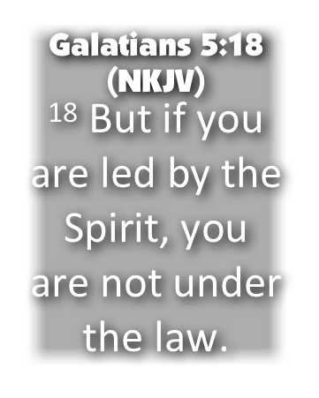
“The Flesh or the Spirit?” 5:16-21
Walk In The Gospel / Spirit
Those WALKING according to the Gospel are NOT under the condemnation of the Law - (2:19-21; 3:10-14)
No condemnation - Rom. 8:1,2
Provides what the Law could not - Rom 8:3-8
Life is found in the gospel - Rom 8:9-11
Deeds of the flesh put to death - Rom 8:12,13
Sons of God - Rom. 8:14-17

Slide 16
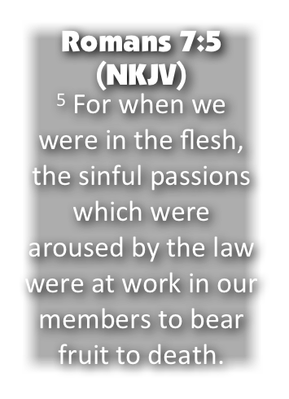
“The Flesh or the Spirit?” 5:16-21
State of Those Walking According To The Flesh, (LAW)
Galatians 5:19-21 (NKJV)
¹⁹ Now the works of the flesh are evident, which are: adultery, fornication, uncleanness, lewdness, ²⁰ idolatry, sorcery, hatred, contentions, jealousies, outbursts of wrath, selfish ambitions, dissensions, heresies, ²¹ envy, murders, drunkenness, revelries, and the like; of which I tell you beforehand, just as I also told you in time past, that those who practice such things will not inherit the kingdom of God.

Slide 17
Galatians 5:16 (NKJV)
I say then: Walk in the Spirit, and you shall not fulfill the lust of the flesh.
Galatians 3:26-29 (NKJV)
²⁶ For you are all sons of God through faith in Christ Jesus. ²⁷ For as many of you as were baptized into Christ have put on Christ. ²⁸ There is neither Jew nor Greek, there is neither slave nor free, there is neither male nor female; for you are all one in Christ Jesus. ²⁹ And if you are Christ's, then you are Abraham's seed, and heirs according to the promise.

Slide 19
“The Flesh or the Spirit?” 5:16-21
Charts by Don McClain
Prepared August 10,11, 2013Preached August 11, 2013West 65th Street church of ChristP.O. Box 190062Little Rock AR 72219501-568-1062Prepared using KeynoteEmail – donmcclain@sbcglobal.net More Keynote, PPT & Audio Sermons:http://w65stchurchofchrist.org/coc/sermons/
Note – Many of the transition effects used in this presentation will be lost using PPT 2007 Viewer
http://www.microsoft.com/downloads/details.aspx?FamilyID=cb9bf144-1076-4615-9951-294eeb832823&displaylang=en

