Slide 1
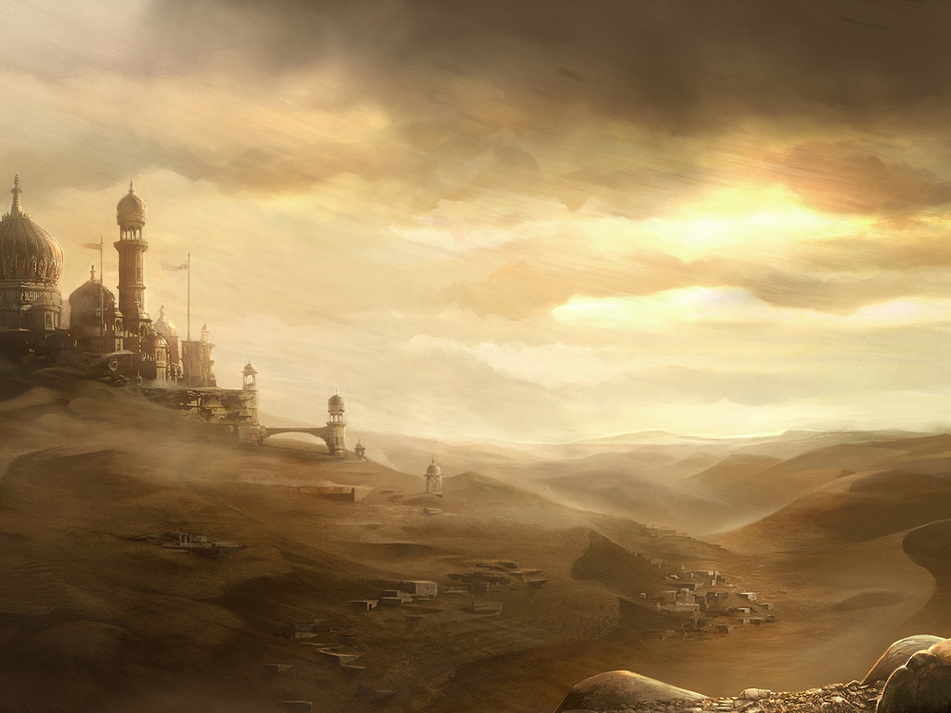
1
Lessons From The Book of Esther

Slide 2
Lessons From The Book of Esther
2
God’s Silence Does Not Mean He Is Absent
The events in the Book of Esther extend over a decade—from 483 b.c. (Xerxes’ 3rd year; Es. 1:3) to 473 (the end of Xerxes’ 12th year; 3:7).
The events in this book occurred between those recorded in Ezra 6 and 7.

Slide 3
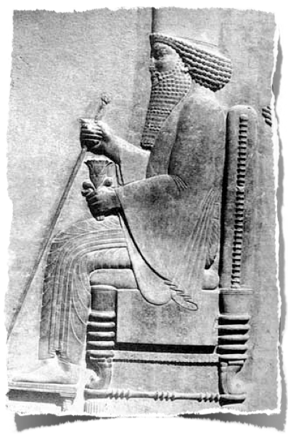
Lessons From The Book of Esther
3
God’s Silence Does Not Mean He Is Absent
Xerxes, called Ahasuerus throughout the Hebrew text of Esther (cf. niv marg.), ruled the Persian Empire for 21 years from 486 to 465 b.c. (1:1)

Slide 4
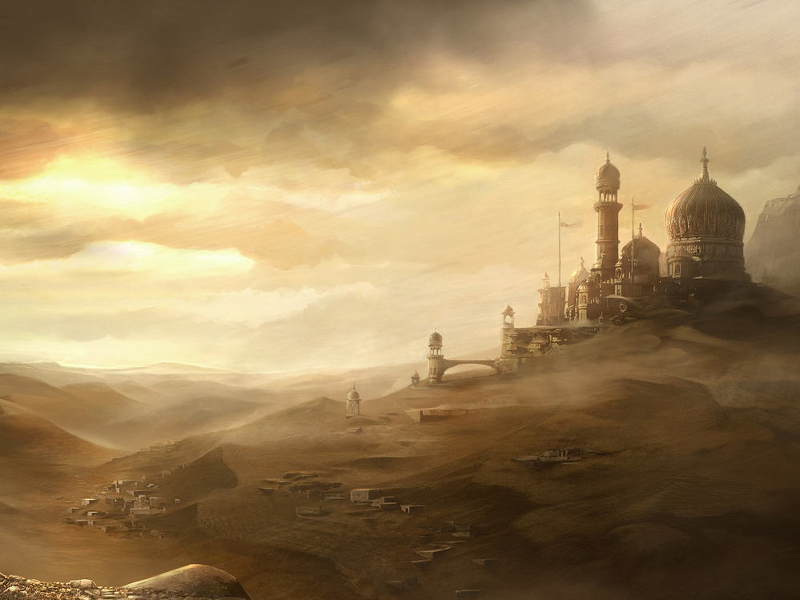
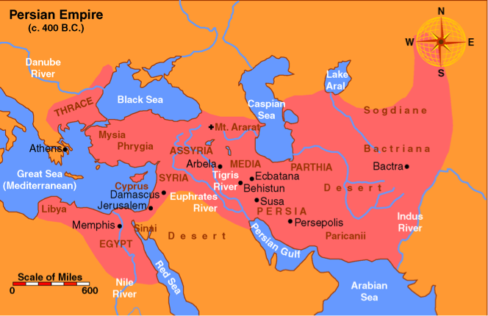
Xerxes ruled over 127 provinces... from India to Cush (1:1; cf. 8:9).
4

Slide 5
Lessons From The Book of Esther
5
God’s Silence Does Not Mean He Is Absent
Emperors of The Persian Empire
Cyrus (539-530 B.C.) Gave a decree allowing Jews too return to Jerusalem (Ezra 1)
Cambyses (530-522 B.C.)
Guamata or Pseudo-Smerdis (522 B.C.) a usurper
Darius I (522-486 B.C.) (Ezra 5-6)
Xerxes I, (Ahasuerus) (486-465 B.C.) (Ezra 4:6 / Esther)
Artaxerxes I (464-424 B.C.) Both Ezra & Nehemiah’s work belong to this period

Slide 6
Lessons From The Book of Esther
6
God’s Silence Does Not Mean He Is Absent
Esther Becomes Queen (chap. 1-2:18)
The king’s 180 day conference & 7 day banquet - (1:1-9)Vashti deposed (1:10-22)
The plan to replace Queen Vashti - (2:1-4)
Esther [star] (Hadassah [myrtle]) was raised & loved by her cousin, Mordecai - (2:5-7)
Esther taken to Kings palace for 12 months of preparation to meet the King - (2:8-15)
About 4 years passed before Esther was brought before the king [483-479 b.c.] - (16)

Slide 7
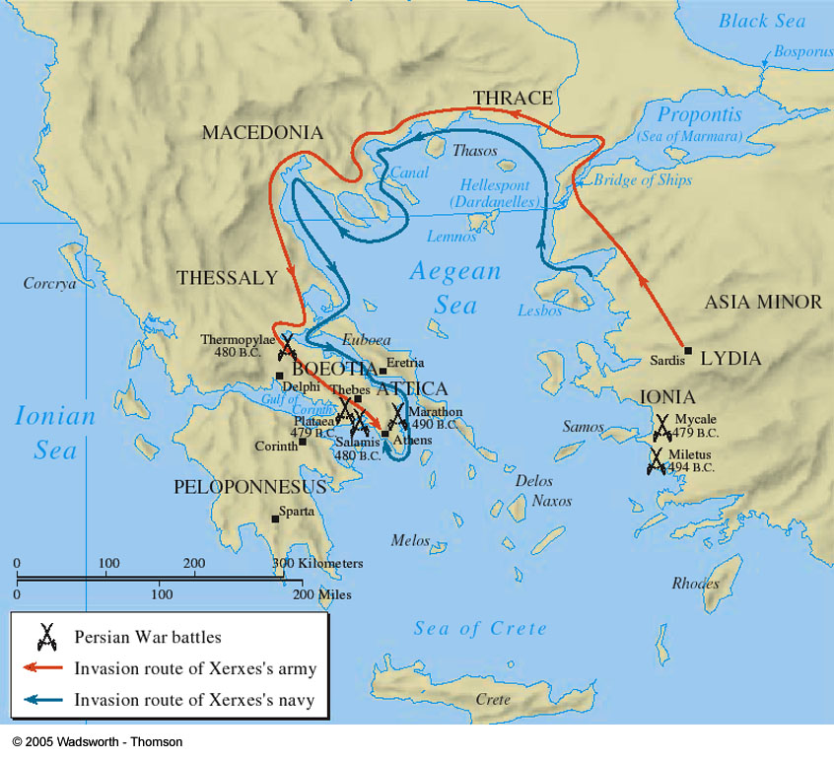
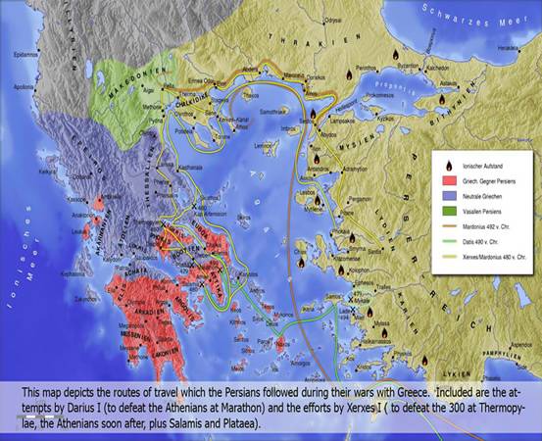
7
Esther 2:16 (NKJV) ¹⁶ So Esther was taken to King Ahasuerus, into his royal palace, in the tenth month, which is the month of Tebeth, in the seventh year of his reign.

Slide 8
Lessons From The Book of Esther
8
God’s Silence Does Not Mean He Is Absent
King Saved by Mordecai (2:21-23)
Mordecai sat inside the king’s gate learned of a plot by Bigthana and Teresh, royal guards, to assassinate the king -(2:19-21)
Mordecai told Queen Esther, who reported this to the king & gave credit to Mordecai for uncovering the scheme - (2:22)
The two men were hanged on a gallows (or “tree,” kjv, “/ post,” niv marg). (2:23)
A record of Mordecai discovering this assassination attempt was written in the official royal record (2:23; cf. Es. 6:1-2).

Slide 9
Lessons From The Book of Esther
9
God’s Silence Does Not Mean He Is Absent
Haman’s Plan To Eradicate The Jews - (2:21-3:15)
Ahasuerus made Haman second in command—all were to bow and pay him homage, but Mordecai refused. - (3:1,2)
Haman became so angry, he determined to destroy all the Jews in the king’s provinces - (every single Jew including in Jer.) - (3:6,7)
Haman told the king there was a small insignificant people who did not follow his laws. He offered 10,000 talents of silver to enrich the king’s treasury if he allowed them to be destroyed. - (3:8,9)

Slide 10
Lessons From The Book of Esther
10
God’s Silence Does Not Mean He Is Absent
Haman’s Plan To Eradicate The Jews - (2:21-3:15)
The king’s signet ring is given to Haman and he is given authority to do what “seems right” to him - (3:11)
Haman assembles the kings scribes and has a decree written in the name of the king on the “thirteenth day of the first month” commanding the eradication of ALL the Jews on the “thirteenth day of the twelfth month,” which is the month of Adar [March 473 B.C.] - (3:12,13)
It was sealed with the kings signet ring & sent throughout the empire - (3:14,15)

Slide 11
Lessons From The Book of Esther
11
God’s Silence Does Not Mean He Is Absent
Mordecai Petitions Esther To Help - (4:1-4:14)
When Mordecai heard about this genocidal decree, he tore his clothes, he dressed in rags, he put ashes on his head, he mourned openly - (4:1-3)
Esther hears of Mordecai’s actions, a copy of the edict was shown to her, & Mordecai asked Esther to go to the king and intercede for her people - (4:4-9)
At first, fearful of being put to death, she was reluctant - to go in to the king unannounced was against the law & could be a death sentence - (4:10-12)

Slide 12
Lessons From The Book of Esther
12
God’s Silence Does Not Mean He Is Absent
Mordecai Petitions Esther To Help - (4:1-4:14)
Esther 4:13-14 (NKJV)
¹³ And Mordecai told them to answer Esther: "Do not think in your heart that you will escape in the king's palace any more than all the other Jews.
¹⁴ For if you remain completely silent at this time, relief and deliverance will arise for the Jews from another place, but you and your father's house will perish. Yet who knows whether you have come to the kingdom for such a time as this?"
You are dead if you do & dead if you don’t
Key verse of the Book - (God’s will, will be accomplished)
God’s providence provides opportunities - we must choose!

Slide 13
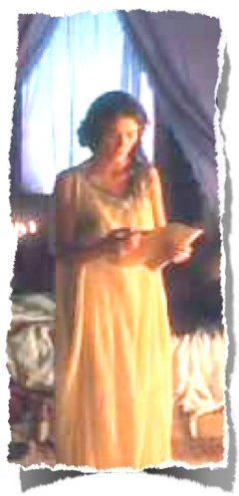
Lessons From The Book of Esther
13
God’s Silence Does Not Mean He Is Absent
Faith & Courage of Esther - (4:15-4:17)
Esther 4:16 (NKJV)
¹⁶ "Go, gather all the Jews who are present in Shushan, and fast for me; neither eat nor drink for three days, night or day. My maids and I will fast likewise. And so I will go to the king, which is against the law; and if I perish, I perish!"

Slide 14
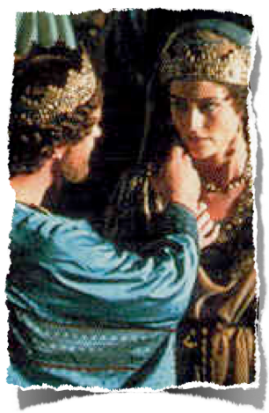
Lessons From The Book of Esther
14
God’s Silence Does Not Mean He Is Absent
Fall of Haman & His Evil Plot - (5:1-7:10)
Esther goes in before the king and is accepted - she is offered up to half the kingdom - (5:1-3)
Esther requests that the king & Haman attend a banquet with her that she has prepared - (5:4)
The king accepts, calls for Haman, they attend the banquet - again offers Esther up to half the kingdom - (5:5,6)
Esther requests that the king & Haman attend another banquet the next day - to which he again agrees - (5:7)

Slide 15
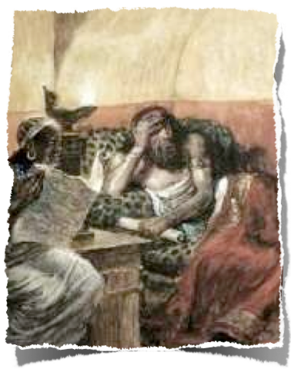
Lessons From The Book of Esther
15
God’s Silence Does Not Mean He Is Absent
Fall of Haman & His Evil Plot - (5:1-7:10)
Haman is ecstatic - “joyful with a glad heart” - but his joy is spoiled when he sees Mordecai not bowing before him - (5:9)
Haman confers with his family & decides to build a gallows 7 1/2 stories high to hang Mordecai on - (5:10-14)
A sleepless king is reminded of Mordecai’s role in exposing a plot to kill him - (6:1-3)

Slide 16
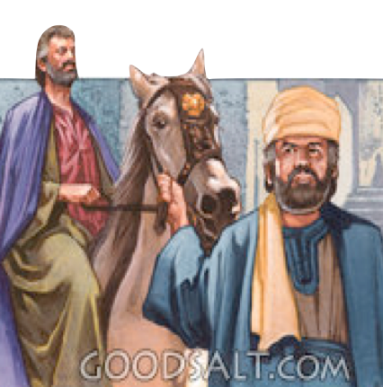
Lessons From The Book of Esther
16
God’s Silence Does Not Mean He Is Absent
Fall of Haman & His Evil Plot - (5:1-7:10)
Haman is humiliated by being forced to publicly honor Mordecai - (6:4-13)
As Haman bemoans these events with his family - the kings eunuchs arrive to take him to Esther’s second feast - (6:14)

Slide 17
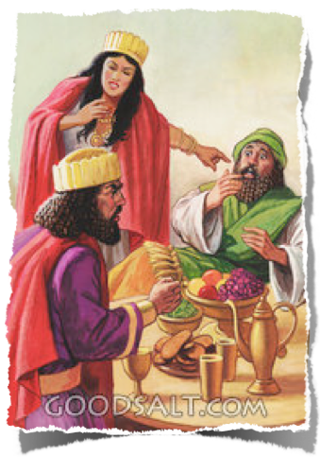
Lessons From The Book of Esther
17
God’s Silence Does Not Mean He Is Absent
Fall of Haman & His Evil Plot - (5:1-7:10)
Haman is exposed - (7:1-6)
King Ahasuerus is furious, walks out in a rage - comes back in finding Haman pleading with Esther for his life - (7:7-8)
Haman is hung on the gallows he had prepared for Mordecai - (7:9-10)

Slide 18
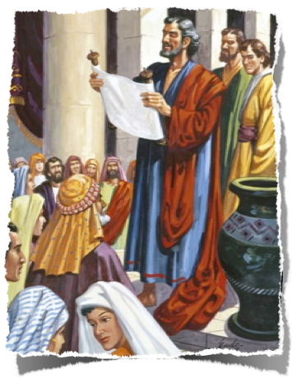
Lessons From The Book of Esther
18
God’s Silence Does Not Mean He Is Absent
Jews Saved & Rejoice - (8:1-10:3)
Mordecai receives royal position (8:1-2)
Second proclamation sent out (8:3-14)
Jews rejoice (8:15-17)
Jews took revenge (9:1-19)
Feast of Purim Established (9:20-32)
Greatness of Mordecai Described (chap. 10)

Slide 19
Lessons From The Book of Esther
19
God’s Silence Does Not Mean He Is Absent
Lessons We Need To Learn
Courage to say no - (Vashti)
Courage to not violate our conscience - (Mordecai)
Faith in God to keep His promises - (Mordecai, Esther)
Courage to do what is necessary for the wellbeing of others - (Esther)
The courage to take advantage of an open door - (Mordecai, Esther)

Slide 20
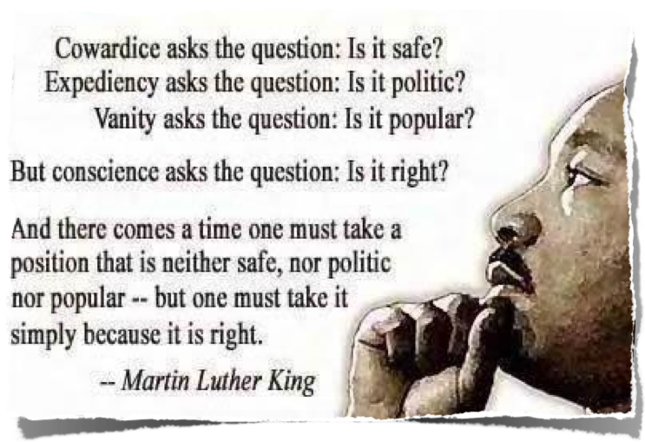
Lessons From The Book of Esther
20
God’s Silence Does Not Mean He Is Absent
Lessons We Need To Learn

Slide 21
Lessons From The Book of Esther
21
God’s Silence Does Not Mean He Is Absent
Lessons We Need To Learn
We do not know what is going on behind the scenes - we just need to trust God - (Mordecai, Esther; Rom 8:28; Titus 1:2)
Pride, resentment, anger & hatred negates joy & results in destruction - (Haman)
One’s “trouble shall return upon his own head” - (Haman; Gal. 6:7-9; Ps 7:14-16)

Slide 22
Lessons From The Book of Esther
22
God’s Silence Does Not Mean He Is Absent
Lessons We Need To Learn
Psalm 7:14-16 (NKJV)
¹⁴ Behold, the wicked brings forth iniquity; Yes, he conceives trouble and brings forth falsehood. ¹⁵ He made a pit and dug it out, And has fallen into the ditch which he made. ¹⁶ His trouble shall return upon his own head, And his violent dealing shall come down on his own crown.

Slide 23
Lessons From The Book of Esther
23
God’s Silence Does Not Mean He Is Absent
Lessons We Need To Learn
Danger of rash decisions - (Ahasuerus)
Willingness to correct wrongs in our life - (Ahasuerus)
Great reward is the result of faithfulness - (Mordecai)
God will take vengeance upon His enemies and the enemies of His people - (Heb 10:30; 2 Thes. 1:6-9)

Slide 24
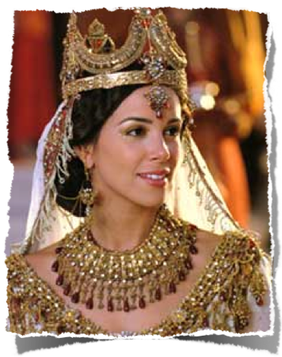
Lessons From The Book of Esther
24
God’s Silence Does Not Mean He Is Absent
Which Character Do We Most Resemble?
Ahasuerus - Irrational, unpredictable, unconcerned, hasty, ignorant, etc.?
Haman - Prejudiced, Proud & arrogant, deceitful, angry, hatred, vengeful, etc.?
Mordecai - honorable, faithful, conscientious, trusting, wise?
Esther - submissive, sacrificial, courageous, wise?

Slide 26
Lessons From The Book of Esther
26
God’s Silence Does Not Mean He Is Absent
Charts by Don McClain
Prepared March 29,30, 2013Preached March 31, 2013West 65th Street church of ChristP.O. Box 190062Little Rock AR 72219501-568-1062Prepared using KeynoteEmail – donmcclain@sbcglobal.net More Keynote, PPT & Audio Sermons:http://w65stchurchofchrist.org/coc/sermons/
Note – Many of the transition effects used in this presentation will be lost using PPT 2007 Viewer
http://www.microsoft.com/downloads/details.aspx?FamilyID=cb9bf144-1076-4615-9951-294eeb832823&displaylang=en

Slide 27
27
Genesis 50:15-21 (NKJV)
¹⁵ When Joseph's brothers saw that their father was dead, they said, "Perhaps Joseph will hate us, and may actually repay us for all the evil which we did to him." ¹⁶ So they sent messengers to Joseph, saying, "Before your father died he commanded, saying,

Slide 28
28
Genesis 50:15-21 (NKJV)
¹⁷ 'Thus you shall say to Joseph: "I beg you, please forgive the trespass of your brothers and their sin; for they did evil to you." ' Now, please, forgive the trespass of the servants of the God of your father." And Joseph wept when they spoke to him. ¹⁸ Then his brothers also went and fell down before his face, and they said, "Behold, we are your servants."

Slide 29
29
Genesis 50:15-21 (NKJV)
¹⁹ Joseph said to them, "Do not be afraid, for am I in the place of God? ²⁰ But as for you, you meant evil against me; but God meant it for good, in order to bring it about as it is this day, to save many people alive. ²¹ Now therefore, do not be afraid; I will provide for you and your little ones." And he comforted them and spoke kindly to them.

