Slide 1
Managing our time to the glory of God

Slide 2
Time is limited & precious

Slide 3
Time is limited & precious
Psalm 90:9-12 (NKJV)
⁹ For all our days have passed away in Your wrath; We finish our years like a sigh. ¹⁰ The days of our lives are seventy years; And if by reason of strength they are eighty years, Yet their boast is only labor and sorrow; For it is soon cut off, and we fly away. ¹¹ Who knows the power of Your anger? For as the fear of You, so is Your wrath. ¹² So teach us to number our days, That we may gain a heart of wisdom.

Slide 4
Time Moves Quickly
Job 16:22
"For when a few years are finished, I shall go the way of no return"
Job 9:25-26
"Now my days are swifter than a runner; They flee away, they see no good. They pass by like swift ships, Like an eagle swooping on its prey"

Slide 5
Idleness Is A Robber
Proverbs 6:6-11 (NKJV)
⁶ Go to the ant, you sluggard! Consider her ways and be wise, ⁷ Which, having no captain, Overseer or ruler, ⁸ Provides her supplies in the summer, And gathers her food in the harvest. ⁹ How long will you slumber, O sluggard? When will you rise from your sleep? ¹⁰ A little sleep, a little slumber, A little folding of the hands to sleep-- ¹¹ So shall your poverty come on you like a prowler, And your need like an armed man.

Slide 6
Idleness Is A Robber
Pro19:15 "Laziness casts one into a deep sleep, And an idle person will suffer hunger" | Pro 23:21 "For the drunkard and the glutton will come to poverty, And drowsiness will clothe a man with rags" | Pro 14:23 "In all labor there is profit, but idle chatter leads only to poverty"

Slide 7
Idleness Is A Robber
Romans 13:11 — And do this, knowing the time, that now it is high time to awake out of sleep; for now our salvation is nearer than when we first believed. 1 Thessalonians 5:6-8 — ⁶ Therefore let us not sleep, as others do, but let us watch and be sober. ⁷ For those who sleep, sleep at night, and those who get drunk are drunk at night. ⁸ But let us who are of the day be sober, putting on the breastplate of faith and love, and as a helmet the hope of salvation.

Slide 8
There’s a time for everything
Ecclesiastes 3:1-14 (NKJV)
¹ To everything there is a season, A time for every purpose under heaven:
² A time to be born, And a time to die; A time to plant, And a time to pluck what is planted; ³ A time to kill, And a time to heal; A time to break down, And a time to build up; ⁴ A time to weep, And a time to laugh; A time to mourn, And a time to dance; ⁵ A time to cast away stones, And a time to gather stones; A time to embrace, And a time to refrain from embracing; ⁶ A time to gain, And a time to lose; A time to keep, And a time to throw away; ⁷ A time to tear, And a time to sew; A time to keep silence, And a time to speak; ⁸ A time to love, And a time to hate; A time of war, And a time of peace.

Slide 9
There’s a time for everything
Ecclesiastes 3:1-14 (NKJV)
¹ To everything there is a season, A time for every purpose under heaven:
⁹ What profit has the worker from that in which he labors? ¹⁰ I have seen the God-given task with which the sons of men are to be occupied. ¹¹ He has made everything beautiful in its time. Also He has put eternity in their hearts, except that no one can find out the work that God does from beginning to end.

Slide 10
There’s a time for everything
Ecclesiastes 3:1-14 (NKJV)
¹ To everything there is a season, A time for every purpose under heaven:
¹² I know that nothing is better for them than to rejoice, and to do good in their lives, ¹³ and also that every man should eat and drink and enjoy the good of all his labor--it is the gift of God. ¹⁴ I know that whatever God does, It shall be forever. Nothing can be added to it, And nothing taken from it. God does it, that men should fear before Him.

Slide 11
There’s a time for everything
Ecclesiastes 3:1-14 (NKJV)
¹ To everything there is a season, A time for every purpose under heaven:
Earthly endeavors have their proper time and place (1-8) | Subject to things beyond our control (9-10)
God makes everything beautiful in its season (11) | God wants man to enjoy moderately His earthly gifts (12-13).
God is in control (14). | The usage of our time to be in harmony with our purpose - (14; 12:13,14)

Slide 12
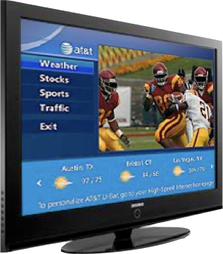
Many live over-committed, out of balance, & out of control lives!
Time is easily wasted.Many things compete for our time!

Slide 13
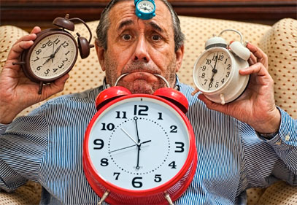
Many live over-committed, out of balance, & out of control lives!
Time is easily wasted.Many things compete for our time!
Effects our spiritual life
Effects others
We Are Responsible For How We Use The Time God Has Given Us! - Eph 5:15,15; Col. 4:5

Slide 14
Many live over-committed, out of balance, & out of control lives!
Our daily activities should not be “expenditures of time; they should be investments.”
(Kenneth J. Lodi, “Tapping Your Potential” pg. 28)

Slide 15
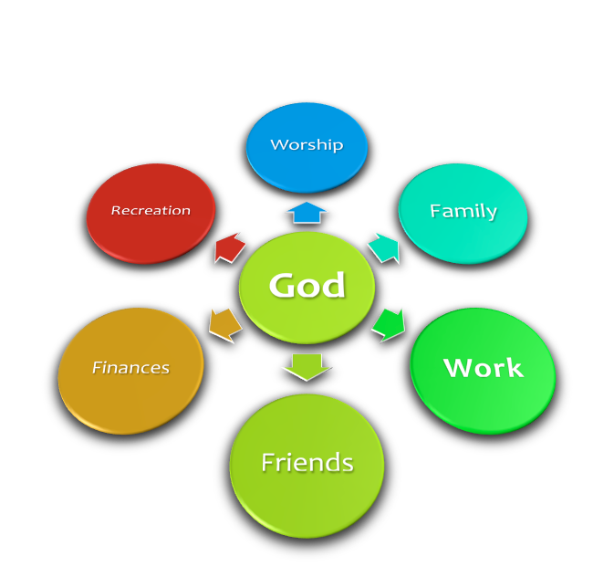
Many live over-committed, out of balance, & out of control lives!
If we honestly examine how we spend / use our time - we will see where our priorities really are! - (satisfying our pride & selfishness or in humble service to God! Lk 2:49; Jn. 4:34)

Slide 16
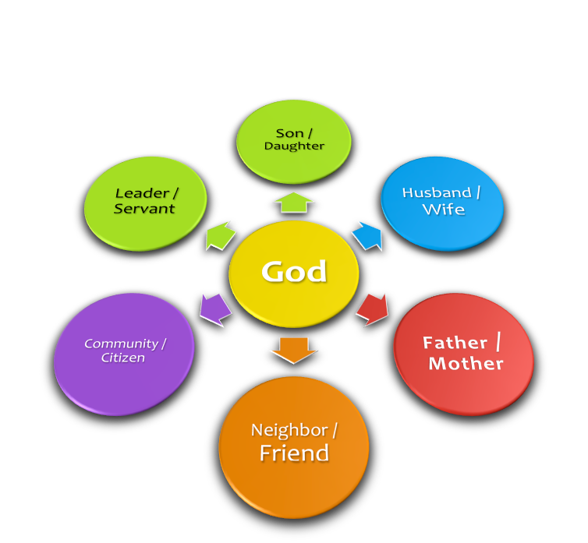
Many live over-committed, out of balance, & out of control lives!
Serving God is more than worship - (Assembling / praying / singing / teaching); more than evangelism . . .
Time must also be invested in being the _________ I should be

Slide 17
How To Make The Most of Our Time
Be Aware – Time is easily wasted –
Budget – Time is limited
Prioritize – Time is valuable!

Slide 18
How To Make The Most of Our Time
Be Aware – Time is easily wasted –
Budget – Time is limited
Prioritize – Time is valuable!
God FIRST - Worship - Spiritual Growth - Service - Influence . . .
Family – Parents need to parent – husbands need to be husbands – wives need to be wives!
Work –A means to an end –
Rest & Renewal – Not Laziness – Our Bodies MUST Rest

Slide 19
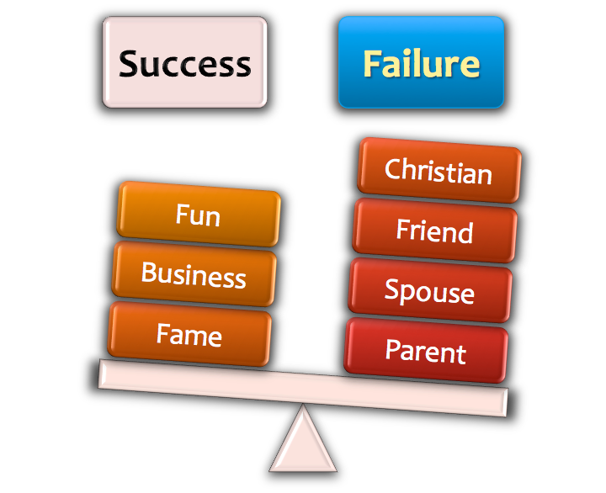
Self Evaluation
Matthew 16:26 (NKJV)
For what profit is it to a man if he gains the whole world, and loses his own soul? Or what will a man give in exchange for his soul?

Slide 20
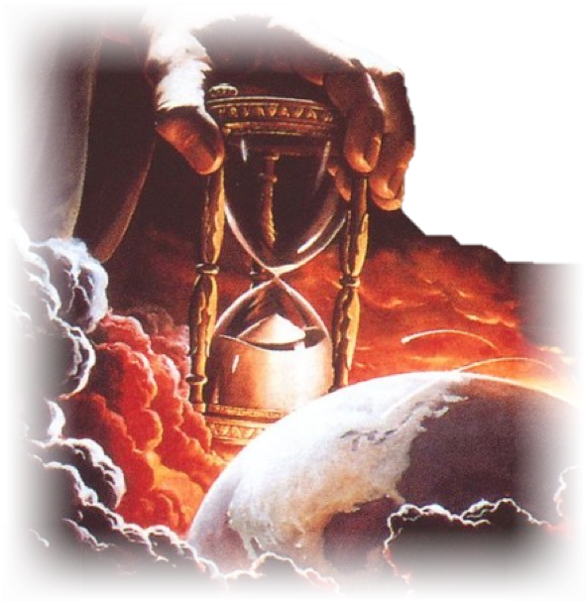
2 Peter 3:10-14 (NKJV)
¹² looking for and hastening the coming of the day of God, because of which the heavens will be dissolved, being on fire, and the elements will melt with fervent heat? ¹³ Nevertheless we, according to His promise, look for new heavens and a new earth in which righteousness dwells.

Slide 21
2 Peter 3:10-14 (NKJV)
¹⁴ Therefore, beloved, looking forward to these things, be diligent to be found by Him in peace, without spot and blameless;

Slide 22
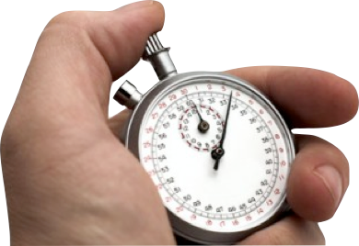
How much time do you have????
The day will come when "every one of us shall give account of himself to God"
(Romans 14:12).

Slide 23
Are You:
A child of God?
Using your time bringing glory & honor to God?
Acting Soberly?Loving Fervently? Serving Faithfully?

Slide 24
How will you live out the rest of your time? (1 Pet 4:2)
Have you obeyed the gospel? (Acts 22:16; 2 Cor 6:2)
What if time ran out today?

Slide 25
What Will Happen To You When Time Runs Out . . .
1 Peter 4:7 (NKJV)
But the end of all things is at hand; therefore be serious and watchful in your prayers.

Slide 27
Charts by Don McClain
Prepared August 28-31, 2013;
Preached September 1, 2013
West 65th Street church of Christ
P.O. Box 190062, Little Rock AR 72219
501-568-1062
Prepared using KeynoteEmail – donmcclain@sbcglobal.net More Keynote, PPT & Audio Sermons:http://w65stchurchofchrist.org/coc/sermons/

Slide 28
Ephesians 5:8-21 (NKJV)
⁸ For you were once darkness, but now you are light in the Lord. Walk as children of light ⁹ (for the fruit of the Spirit is in all goodness, righteousness, and truth), ¹⁰ finding out what is acceptable to the Lord. ¹¹ And have no fellowship with the unfruitful works of darkness, but rather expose them. ¹² For it is shameful even to speak of those things which are done by them in secret. ¹³ But all things that are exposed are made manifest by the light, for whatever makes manifest is light.

Slide 29
Ephesians 5:8-21 (NKJV)
¹⁴ Therefore He says: "Awake, you who sleep, Arise from the dead, And Christ will give you light." ¹⁵ See then that you walk circumspectly, not as fools but as wise, ¹⁶ redeeming the time, because the days are evil. ¹⁷ Therefore do not be unwise, but understand what the will of the Lord is.

Slide 30
Ephesians 5:8-21 (NKJV)
¹⁸ And do not be drunk with wine, in which is dissipation; but be filled with the Spirit, ¹⁹ speaking to one another in psalms and hymns and spiritual songs, singing and making melody in your heart to the Lord, ²⁰ giving thanks always for all things to God the Father in the name of our Lord Jesus Christ, ²¹ submitting to one another in the fear of God.

