Slide 1
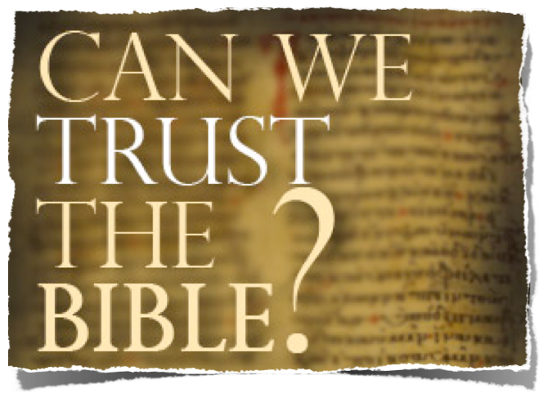
Has The Bible Been Corrupted?
What About The Alleged Contradictions?

Slide 2
The Trustworthiness of The Scriptures
Can We Trust The Bible?
Is It True? Is It Accurate? Is It From God?
God Is!
God Has Provided Divine Confirmation!
It Answers Every Human Need!
It Is One Harmonious Thought!
It claims to be the word of God!

Slide 3
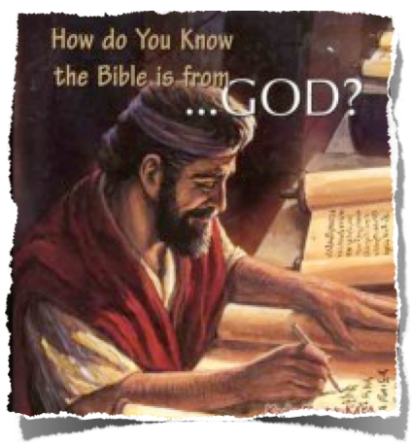
The Trustworthiness of The Scriptures
From God To Us -
How Did We Get The Bible As It Is Today?
Inspiration / Revelation
Words of God Written & Copied
Canonization -
Archaeological Evidence
Internal evidence

Slide 4
The Trustworthiness of The Scriptures
Can We Trust The Bible?
Is It True? Is It Accurate? Is It From God?
How do we know that the Bible hasn't been changed over the years?
Does the Bible contain errors & contradictions?

Slide 5
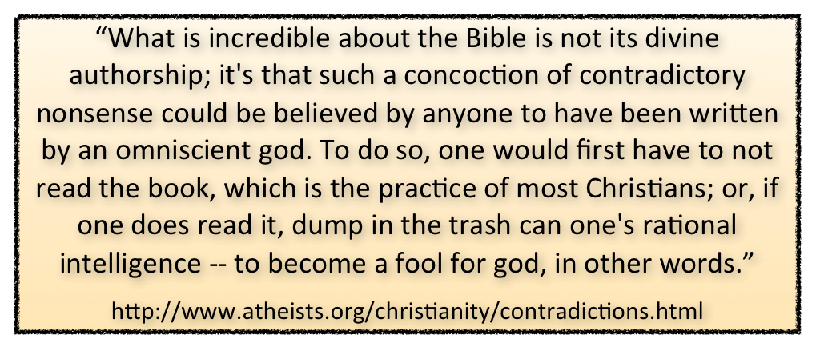
The Trustworthiness of The Scriptures
Can We Trust The Bible?
Is It True? Is It Accurate? Is It From God?
A Host of Bible enemies actively seek to dicsredit the trustworthiness of the scriptures!

Slide 6
The Trustworthiness of The Scriptures
Can We Trust The Bible?
Is It True? Is It Accurate? Is It From God?
What is a contradiction?
con·tra·dic·tion - Function: noun
1 : act or an instance of contradicting a : a proposition, statement, or phrase that asserts or implies both the truth and falsity of something b : a statement or phrase whose parts contradict each other <a round square is a contradiction in terms>
3 a : logical incongruity b : a situation in which inherent factors, actions, or propositions are inconsistent or contrary to one another

Slide 7
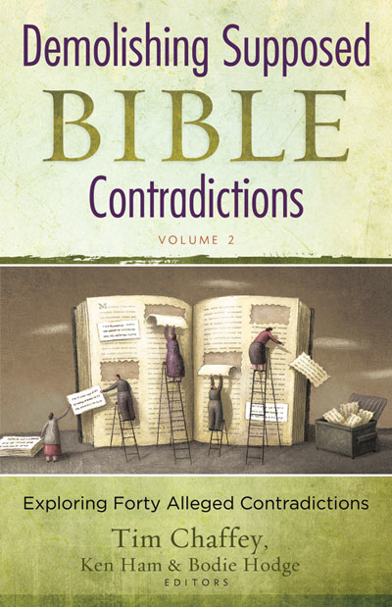
The Trustworthiness of The Scriptures
Can We Trust The Bible?
Is It True? Is It Accurate? Is It From God?
Does it matter if the Bible contradicts itself?
God is a being that contradicts Himself –
Or - the Bible is NOT the inspired word of God – 2 Tim. 3:16,17; 2 Peter 1:19-21

Slide 8
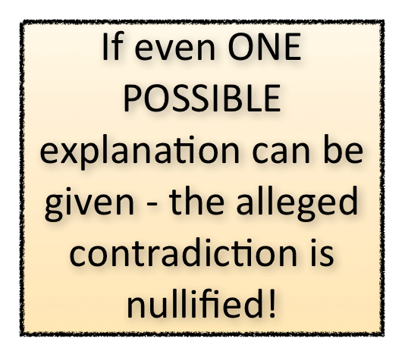
The Trustworthiness of The Scriptures
Can We Trust The Bible?
Is It True? Is It Accurate? Is It From God?
Does it matter if the Bible contradicts itself?

Slide 9
The Trustworthiness of The Scriptures
Can We Trust The Bible?
Is It True? Is It Accurate? Is It From God?
Different Types of Alleged Contradictions
Text verses Text –
Text verses Science –
Text Verses Logic –
Text Verses Copyist Errors -

Slide 10
The Trustworthiness of The Scriptures
Can We Trust The Bible?
Is It True? Is It Accurate? Is It From God?
Some Alleged Contradictions
http://skepticsannotatedbible.com/contra/by_name.html
How many of Zattu's offspring returned from Babylon?
Who was Zechariah's father?
Did Zedekiah see the king of Babylon?
Who was Zerubbabel's father?
Where does God dwell?
Did God call Abraham before or after he moved to Haran?

Slide 11
The Trustworthiness of The Scriptures
Can We Trust The Bible?
Some Alleged Contradictions
Text verses Text
Was Abraham justified by faith or works?
He was justified by faith. | He was justified by works.
Romans 4:2 For if Abraham were justified by works, he hath whereof to glory. | James 2:21 Was not Abraham our father justified by works, when he had offered Isaac his son upon the altar?

Slide 12
The Trustworthiness of The Scriptures
Can We Trust The Bible?
Some Alleged Contradictions
Text verses Text
How long was the ark of the covenant at Abinadab's house?
20 years | Over 40 years
1 Sam.7:1-2 says that the ark of the covenant was brought to Abinadab's house and that it stayed there for 20 years. This was before Saul was made king (1 Sam.10:24). | But according to 2 Sam.6:2-3, David removed the ark from Abinadab's house. And Acts 13:21 says that Saul (David's predecessor) was king for 40 years. So the ark must have been at Abinadab's house for more than 40 years.

Slide 13
The Trustworthiness of The Scriptures
Can We Trust The Bible?
Some Alleged Contradictions
Text verses Text
Should you answer a fool according to his folly?
Yes. | No.
Proverbs 26:5 Answer a fool according to his folly. | Proverbs 26:4 Answer not a fool according to his folly.

Slide 14
The Trustworthiness of The Scriptures
Can We Trust The Bible?
Some Alleged Contradictions
Text verses Text
How many sons did Abraham have?
Abraham had only one son. | Abraham had more than one son.
Hebrews 11:17 - By faith Abraham when he was tried, offered up Isaac, ... his only begotten son. Genesis 22:2 - Take now thy son, thine only son Isaac, ... and offer him there for a burnt offering. | Genesis 16:15 - And Hagar bare Abraham a son: . . . Ishmael. Genesis 21:2-3 -For Sarah conceived, and bare Abraham a son is his old age ... Isaac.

Slide 15
The Trustworthiness of The Scriptures
Can We Trust The Bible?
Some Alleged Contradictions
Text verses Text
How Long Was Israel In Egypt?
400 years | 430 years
Genesis 15:13 And he said unto Abram, Know of a surety that thy seed shall be a stranger in a land that is not theirs, and shall serve them, and they shall afflict them four hundred years. | Exodus 12:40 Now the sojourning of the children of Israel, who dwelt in Egypt, was four hundred and thirty years. Galatians 3:17 The law, which was four hundred and thirty years after.

Slide 16
The Trustworthiness of The Scriptures
Can We Trust The Bible?
Some Alleged Contradictions
Text verses Text
How Long Was Israel In Egypt?
“430 years from the promise to the Law (Genesis 15; Gal. 3:16-17)
The genealogical records of 1 Chro 6:1; 23:6-13, and Ex 6:16-20 allows a maximum of 352 (unless generations are absent from the records)
The Israelites returned to Palestine during the“fourth generation”— (Gen 15:16; cf. Ex 6:16-20, Num 3:17-19, 26:57-59, 1 Chro 6:1-3; 23:6,12-13) (Jacob-Levi-Kohath-Amram-Moses).
Archaeological research suggests that the Israelites was in Egypt for 215 years. 1662 B.C. - 1447 B.C. —a span of 215 years (David Rohl, 1995, pp. 329-332).
In Antiquities of the Jews, Josephus - the Israelites “left Egypt in the month of Xanthicus, on the fifteenth day of the lunar month; four hundred and thirty years after our forefather Abraham came into Canaan, but two hundred and fifteen years only after Jacob removed into Egypt” (II. 15.2).

Slide 17
The Trustworthiness of The Scriptures
Can We Trust The Bible?
Some Alleged Contradictions
Text verses Text
How Long Was Israel In Egypt?
75 – Abraham’s age when promise given (Gen 12:3-4)
25 - years later Isaac was born – (21:5)
60 - years later Jacob was born – (25:26)
130 - years later – Jacob went into Egypt – (47:9)
215 - years the people of Israel were in Egypt – (Gal. 3:17)
= 430 years -

Slide 18
The Trustworthiness of The Scriptures
Can We Trust The Bible?
Some Alleged Contradictions
Text verses Text
How Long Was Israel In Egypt?
Four hundred years—"Which began," says Mr. Ainsworth, "when Ishmael, son of Hagar, mocked and persecuted Isaac, Genesis 21:9; Galatians 4:29; which fell out thirty years after the promise, Genesis 12:3; which promise was four hundred and thirty years before the law, Galatians 3:17; and four hundred and thirty years after that promise came Israel out of Egypt, Exodus 12:41." - Adam Clarke - A Commentary and Critical Notes.
Exodus 12:40 and Galatians 3:17 state that the Egyptian bondage was 430 years (from 1876 to 1446). Apparently, then, Genesis 15:13 and Acts 7:6, with their references to 400 years, are using rounded figures (see comments on Acts 7:6 and comments on Gal. 3:17). - The Bible Knowledge Commentary: An Exposition of the Scriptures by Dallas Seminary Faculty.
The 400 years were, according to prophetic language, a round number for the 430 years that Israel spent in Egypt (Exo_12:40).- Kiel & Del.

Slide 19
The Trustworthiness of The Scriptures
Can We Trust The Bible?
Some Alleged Contradictions
How Long Was Israel In Egypt?
Text verses Science
Creation accounts - Gen 1,2
A bat is NOT a bird!! - Lev. 11:13-19; Deut. 14:11-18
Rabbits do not chew the cud – Lev. 11:6

Slide 20
The Trustworthiness of The Scriptures
Can We Trust The Bible?
Some Alleged Contradictions
How Long Was Israel In Egypt?
Text verses Science
Paleontology
Astronomy
Meteorology
Biology
Anthropology
Hydrology
Geology
Physics
The Bible is not a science book, yet it is scientifically accurate.
No accurate scientific evidence contradicts the Bible.

Slide 21
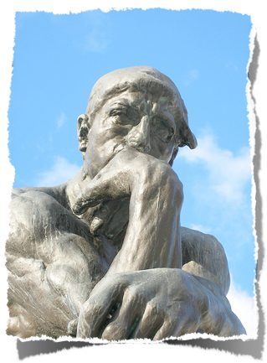
The Trustworthiness of The Scriptures
Can We Trust The Bible?
Some Alleged Contradictions
How Long Was Israel In Egypt?
Text verses Logic
Abraham is told to offer his son as a burnt offering – Gen 22:2 – Isn’t this contradictory to the stated nature of God? (cf. Lev. 18:21; 20:2-5; Deut. 12:31; 18:10; James 1:13).
Jephthah’s offering his daughter as a human sacrifice – Judges 11:34-40.
The sacrifice of Christ & resurrection - (1 Cor. 1:18-25; 3:19)

Slide 22
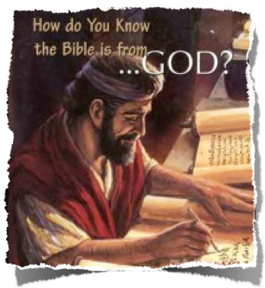
The Trustworthiness of The Scriptures
Can We Trust The Bible?
Some Alleged Contradictions
How many men did the chief of David's captains kill?
Text verses Copyist Errors
Was it 800 (2 Samuel 23:8) or 300 (1 Chronicles 11:11)? [#1 Skeptics Annotated Bible]
2 Sam. 23:8 - 800 - Following Masoretic Text and Targum; - 300 - Septuagint and Vulgate.
The difference may be due to a scribal error in copying Chronicles for the Hebrew numerical symbols 300 and 800 look much alike. [BKC]

Slide 23
The Trustworthiness of The Scriptures
Can We Trust The Bible?
Some Alleged Contradictions
Who prophesied about the potter's field?
Text verses Copyist Errors
Matthew 27:9-10 mentions Jeremiah as the prophet, however, no such prophecy is found in Jeremiah. The prophecy is found in Zechariah 11:12-13.
Jeremiah was the first of the prophets in the “Book of the Prophets,”
A transcribers' error? “this might be done by the change of only a single letter.” - (Jeremiah = Iriou - Zechariah = Zriou).

Slide 24
The Trustworthiness of The Scriptures
Can We Trust The Bible?
Is It True? Is It Accurate? Is It From God?
Does it matter if the Bible contradicts itself?

Slide 25
Can We Trust The Bible?
It Is True! It Is Accurate!
It Is From God!
Hear It
Believe It
Obey It
Follow It
Be Blessed Through It!

Slide 27
The Trustworthiness of The Scriptures
Can We Trust The Bible?
It IsTrue! It Is Accurate! It Is From God!
What About Alleged Contradictions?
Charts by Don McClain
Prepared January 20, , 2012
Preached January 20, 2012
West 65th Street church of Christ
P.O. Box 190062
Little Rock AR 72219
501-568-1062
Prepared using PPT 2010
Email – donmcclain@sbcglobal.net
More PPT & Audio Sermons:
http://w65stchurchofchrist.org/coc/sermons/
Note – Many of the transition effects used in this presentation may be lost using PPT 2007 Viewer
http://www.microsoft.com/downloads/details.aspx?FamilyID=cb9bf144-1076-4615-9951-294eeb832823&displaylang=en

