Slide 1
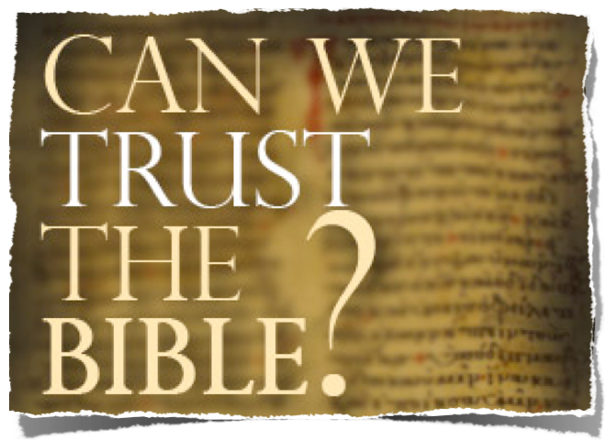
Can We Understand The Bible?
If “NO,” Why Not? If “YES,” How?

Slide 2
The Trustworthiness of The Scriptures
Can We Trust The Bible?
Is It True? Is It Accurate? Is It From God?
God Is!
God Has Provided Divine Confirmation!
It Answers Every Human Need!
It Is One Harmonious Thought!
It claims to be the word of God!

Slide 3
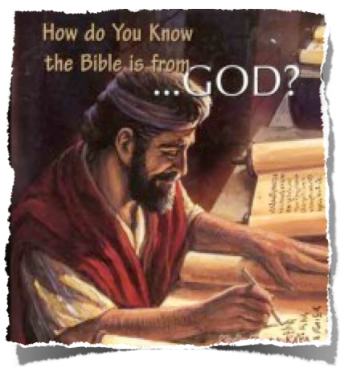
The Trustworthiness of The Scriptures
From God To Us -
How Did We Get The Bible As It Is Today?
Inspiration / Revelation
Words of God Written & Copied
Canonization -
Archaeological Evidence
Internal evidence

Slide 4
The Trustworthiness of The Scriptures
Can We Trust The Bible?
Is It True? Is It Accurate? Is It From God?
The Bible hasn't been changed over the years!
The Bible does not contradict itself

Slide 5
The Trustworthiness of The Scriptures
Can The Bible Be Understood?
Basic Principles
God gave us the Bible - did He do so knowing we couldn’t understand it?
If so - was it because He could but wouldn’t or because He would but couldn’t?

Slide 6
The Trustworthiness of The Scriptures
Can The Bible Be Understood?
Basic Principles
The word is truth - John 17:17
Truth does not contradict itself - therefore if we understand the truth we will understand it alike - 1 Cor. 1:10

Slide 7
The Trustworthiness of The Scriptures
Can The Bible Be Understood?
Basic Principles
Error is broad, you can be wrong any way you please, but truth is narrow - (Mat 7:13-14).
There is only one way that is right (John 14:6; Acts 4:12).
Just because someone sincerely believes he is right does not insure he is (Mat 7:22-23; 15:13-14).

Slide 8
The Trustworthiness of The Scriptures
Can The Bible Be Understood?
Basic Principles
If we accept conflicting answers, someone is wrong. (We may both be wrong, but only one can be right).
The inspired writers did not hesitate to claim that they taught the truth and that those who disagreed were wrong (e.g., 1 Timothy 6:3-5; 1 Peter 2:1-2; 1 John 4:5-6).

Slide 9
The Trustworthiness of The Scriptures
Can The Bible Be Understood?
Basic Principles
If one is teaching what the Bible teaches, then it’s not just a matter of opinion or interpretation. - (1 Peter 4:11).
If I can put my finger on the verse that teaches baptism as a requirement for salvation, then it's not my opinion, it's the truth - (Mark 16:16; Acts 2:38; 1 Pet 3:21).

Slide 10
The Trustworthiness of The Scriptures
Can The Bible Be Understood?
The Bible Was Written To Be Understood
God wants us to understand His will - (1 Tim 2:3-4).
God tells us to understand His will - (Eph 3:1-7).
Average people are capable of understanding it - (Jn 6:44-45; Eph 5:17).

Slide 11
The Trustworthiness of The Scriptures
Can The Bible Be Understood?
The Bible Was Written To Be Understood
God expected His people in the OT to understand His will
"Have you not read...?" - Mt 12:3,5; 19:4
Consider the Berean Jews and Timothy - Ac 17:11; 2 Ti 3:14-15
Yet, it contained a mystery that needed to be revealed - 1 Peter 1:10-12; Ep 3:3-5

Slide 12
The Trustworthiness of The Scriptures
Can The Bible Be Understood?
The Bible Was Written To Be Understood
Ephesians 3:3-5 (NKJV)
³ how that by revelation He made known to me the mystery (as I have briefly written already, ⁴ by which, when you read, you may understand my knowledge in the mystery of Christ), ⁵ which in other ages was not made known to the sons of men, as it has now been revealed by the Spirit to His holy apostles and prophets:

Slide 13
The Trustworthiness of The Scriptures
Can The Bible Be Understood?
The Bible Was Written To Be Understood
God expects His people today to understand His will
The O.T. mystery revealed-Romans 16:25,26
"The writers expected their readers to understand" – Luke 1:1-4; John 20:30-31; 2 Co 1:13; Ep 3:3-5
He Expects Us To Understand It Alike - John 17:20; 1 Co 1:10-13; Ph 2:2

Slide 14
The Trustworthiness of The Scriptures
Can The Bible Be Understood?
The Bible Was Written To Be Understood
Nothing has so radically changed since the Bible was completed that it is no longer understandable. - (1 Pt 1:22-25)
The Bible has not been lost or corrupted - (1 Peter 1:24-25)
Human nature remains the same - (Ecclesiastes 1:9-10).

Slide 15
The Trustworthiness of The Scriptures
Can The Bible Be Understood?
Why Do So Many Not Understand The Bible?
Some things are hard to understand?- 2 Peter 3:16-18; Revelation; Co 1:10
Many teach that we can’t understand the Bible alike!
Attempt to justify denominationalism -
Attempt to justify their own desires -
Attempt to justify those who disagree with them -

Slide 16
The Trustworthiness of The Scriptures
Can The Bible Be Understood?
Arguments Used To Deny Man’s Ability To Understand The Bible
“Only the Catholic Church can properly explain the Bible” -
"How can you get the true meaning of the Bible? You can get it only from God's official interpreter, the Catholic Church." - A Catechism for Adults on page 10

Slide 17
The Trustworthiness of The Scriptures
Can The Bible Be Understood?
Arguments Used To Deny Man’s Ability To Understand The Bible
“Only the Catholic Church can properly explain the Bible” -
Not What Paul said - Eph 5:3-5,17; 2 Tim 2:15; 3:14-17
Not what Bereans believed - Acts 17:11,12
Not what Peter said - 1 Peter 2:1,2; 2 Pet 3:14-18

Slide 18
The Trustworthiness of The Scriptures
Can The Bible Be Understood?
Arguments Used To Deny Man’s Ability To Understand The Bible
“Only 'Spirit-filled' people can understand it” - 1 Co 2:14
We don't need some special guidance of the Spirit to understand the Word; the Word of God itself is the Spirit's own revelation of God's will! Jn 6:63; 1 Cor. 2:1,4-14; Eph 3:2-5

Slide 19
The Trustworthiness of The Scriptures
Can The Bible Be Understood?
Arguments Used To Deny Man’s Ability To Understand The Bible
“Only 'Spirit-filled' people can understand it” - 1 Co 2:14
“Spirit filled preachers are necessary to explain the Bible” - (Acts 8:31; but - Eph 3:3-5)
“Because so many do not understand it alike . . .” - (1 Cor. 1:10,11; Mt. 13:10-16)

Slide 20
The Trustworthiness of The Scriptures
Can The Bible Be Understood?
The Real Reasons So Many Do Not Understand The Bible Alike . . .
Many study for the wrong reasons - 2 Tim 3:7
Many make little or no effort –
Many fail to follow the common laws of human communication!
Many do NOT have a love for the truth!! 2 Thes. 2:10-12

Slide 21
The Trustworthiness of The Scriptures
Can The Bible Be Understood?
The Real Reasons So Many Do Not Understand The Bible Alike . . .
The problem is not with God's Word; the problem is due to indifference, slothfulness, worldliness, deceit, & the sloppy handling of God's word - cf. 2 Ti 2:15
See Luke 8:11-15

Slide 22
The Trustworthiness of The Scriptures
Can The Bible Be Understood?
The Real Reasons So Many Do Not Understand The Bible Alike . . .
Honesty & Humility Are MORE important than intelligence!
Luke 8:15

Slide 23
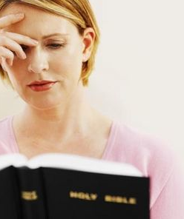
The Trustworthiness of The Scriptures
Can The Bible Be Understood?
You Can Understand The Bible
God has revealed His will to us through words.
Words are vehicles of thought and convey concepts.
We can understand God’s will through accepting the words of Scripture.

Slide 24
The Trustworthiness of The Scriptures
Can The Bible Be Understood?
You Can Understand The Bible
The basic principles of salvation - Acts 2; 8; 16 . . .
Continue to grow in the knowledge of the Lord - 1 Pet 2:2; 2 Pet 3:18
Become mature in understanding - Heb 5:12-14
Discerning error & sin -
Teach others -

Slide 25
The Trustworthiness of The Scriptures
Can The Bible Be Understood?
You Can Understand The Bible
Realize it matters what you believe - (John 8:32)
Humility - Study in order to learn and follow God’s will - (John 6:44,45)
Hunger - Develop a love for God & His word - (Mat 5:6)
Zeal - Be diligent in your search for truth - (2 Tim 2:15)

Slide 26
The Trustworthiness of The Scriptures
Can The Bible Be Understood?
You Can Understand The Bible
1 Peter 1:22-23 (NKJV)
Since you have purified your souls in obeying the truth through the Spirit in sincere love of the brethren, love one another fervently with a pure heart, [23] having been born again, not of corruptible seed but incorruptible, through the word of God which lives and abides forever,

Slide 27
Can We Trust The Bible?
It IsTrue! It Is Accurate! It Is From God!
Hear It
Believe It
Obey It
Follow It
Be Blessed Through It!

Slide 29
The Trustworthiness of The Scriptures
Can We Trust The Bible?
It IsTrue! It Is Accurate! It Is From God!
What About Alleged Contradictions?
Charts by Don McClain
Prepared February 10, , 2013
Preached February 10, 2013
West 65th Street church of Christ
P.O. Box 190062
Little Rock AR 72219
501-568-1062
Prepared using PPT 2010
Email – donmcclain@sbcglobal.net
More PPT & Audio Sermons:
http://w65stchurchofchrist.org/coc/sermons/
Note – Many of the transition effects used in this presentation may be lost using PPT 2007 Viewer
http://www.microsoft.com/downloads/details.aspx?FamilyID=cb9bf144-1076-4615-9951-294eeb832823&displaylang=en

