Slide 1
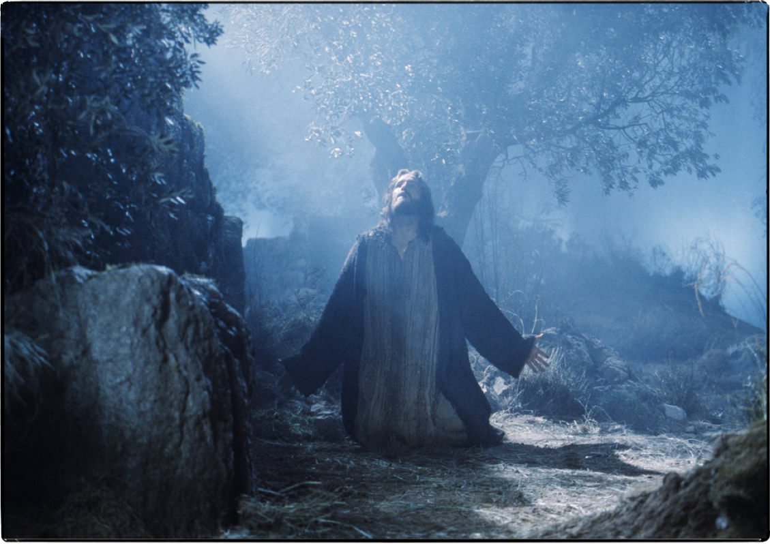
Matthew 26:39-42 (NKJV)
³⁹ . . . "O My Father, if it is possible, let this cup pass from Me; nevertheless, not as I will, but as You will." . . .
1
Don McClain
W. 65th St church of Christ - 9/16/2007

Slide 2
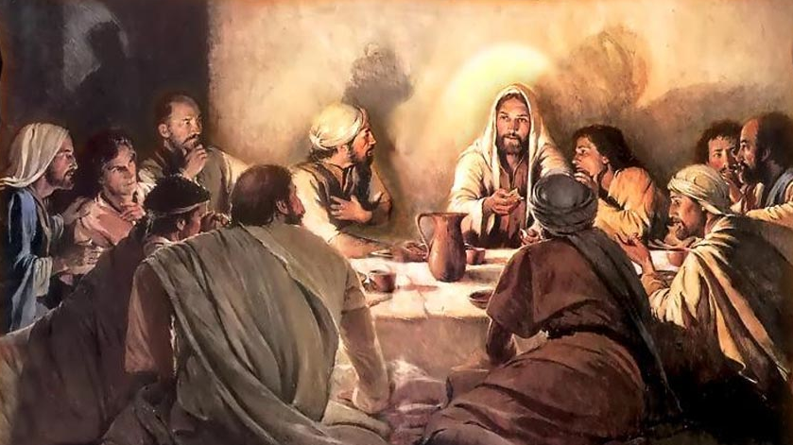
Event | Matthew | Mark | Luke | John
Jesus and disciples assemble for the Passover feast | 26:20 | 14:17 | 22:14-16 | 13:1
Jesus washes the disciples' feet | --- | --- | --- | 13:2-17
Jesus identifies His betrayer | 26:21-25 | 14:18-21 | 22:21-23 | 13:18-30
Jesus institutes the Lord's Supper | 26:26-29 | 14:22-25 | 22:15-20 | ---
The commandment of love | --- | --- | --- | 13:31-35
Jesus' discourse in upper room | --- | --- | --- | 14:1-30
2
Notes:
The traditional sites:
From its name "GETHSEM'ANE (geth-sem'a-ni; Gk. from Aram. ‘Oil press’), scholars conclude that the garden was situated in an olive grove that contained an olive press. Attempts to locate the exact site of the garden have been unsuccessful.
There are two traditional places called Gethsemane. One is the possession of the Latin church, and it consists of a triangular spot, some seventy paces in circumference. It is enclosed by a fence and contains some large and old olive trees, in addition to a flower garden. Adjacent to it stands the Church of All Nations, which encloses a "rock of agony."
The Greeks have set up another traditional Gethsemane, located farther up Mount Olivet. Thomson (Land and Book, 2:483) says that he inclines to think both are wrong, and he would place the garden in a secluded spot several hundred yards NE of the other traditional sites." (UBD)
The gospel accounts do not provide enough details to show the exact site of the garden." (NIBD) . . . The olive grove at the foot of the Mount of Olives, to which Jesus was accustomed to retire (Luke 22:39) with His disciples and which was the scene of His agony (Mark 14:32; Luke 22:39-40; John 18:1).
Why Did Jesus Go to Gethsemane? (The course of events that night:)
Completed the Passover in the upper room, sung a hymn, and went out to the Mt of Olives - (Mark 14:26).
Went out to pray (Matthew 26:36).
It was the Lord’s custom to go there for prayer (Luke 21:37; 22:39).
On this night Jesus followed His usual habit (John 18:1).
Judas knowing this made his plans for betrayal accordingly (18:2).
Jesus betrayed in Gethsemane (Matthew 26:36-39).
Consider what happened in "a place called Gethsemane":

Slide 3
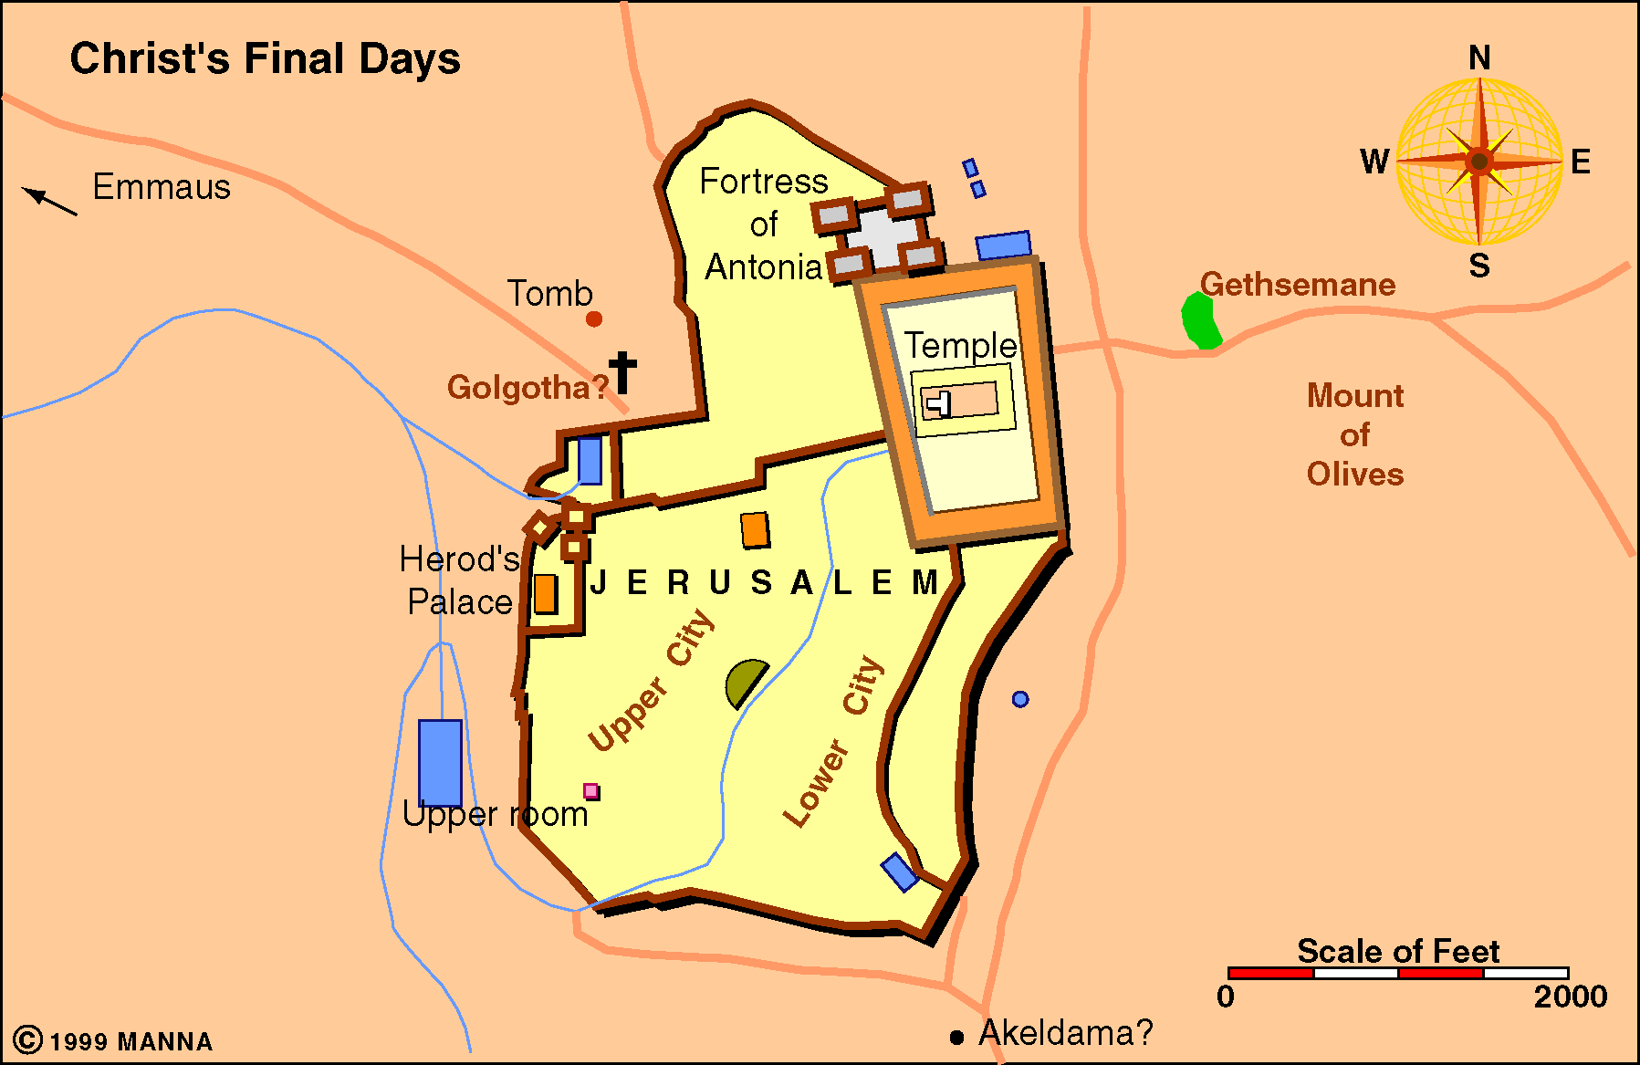
Matthew 26:30-56 Mark 14:26-50 Luke 22:33-46
John 14:31
³¹ But that the world may know that I love the Father, and as the Father gave Me commandment, so I do. Arise, let us go from here.
Mat 26:30; Mark 14:26
When they had sung a hymn they went out to the Mt of Olives
3
Notes:
The traditional sites:
From its name "GETHSEM'ANE (geth-sem'a-ni; Gk. from Aram. ‘Oil press’), scholars conclude that the garden was situated in an olive grove that contained an olive press. Attempts to locate the exact site of the garden have been unsuccessful.
There are two traditional places called Gethsemane. One is the possession of the Latin church, and it consists of a triangular spot, some seventy paces in circumference. It is enclosed by a fence and contains some large and old olive trees, in addition to a flower garden. Adjacent to it stands the Church of All Nations, which encloses a "rock of agony."
The Greeks have set up another traditional Gethsemane, located farther up Mount Olivet. Thomson (Land and Book, 2:483) says that he inclines to think both are wrong, and he would place the garden in a secluded spot several hundred yards NE of the other traditional sites." (UBD)
The gospel accounts do not provide enough details to show the exact site of the garden." (NIBD) . . . The olive grove at the foot of the Mount of Olives, to which Jesus was accustomed to retire (Luke 22:39) with His disciples and which was the scene of His agony (Mark 14:32; Luke 22:39-40; John 18:1).
Why Did Jesus Go to Gethsemane? (The course of events that night:)
Completed the Passover in the upper room, sung a hymn, and went out to the Mt of Olives - (Mark 14:26).
Went out to pray (Matthew 26:36).
It was the Lord’s custom to go there for prayer (Luke 21:37; 22:39).
On this night Jesus followed His usual habit (John 18:1).
Judas knowing this made his plans for betrayal accordingly (18:2).
Jesus betrayed in Gethsemane (Matthew 26:36-39).
Consider what happened in "a place called Gethsemane":

Slide 4
Matthew 26:30-56 Mark 14:26-50 Luke 22:33-46
Luke 22:24-30
Now there was also a dispute among them, as to which of them should be considered the greatest.
4
Notes:
The traditional sites:
From its name "GETHSEM'ANE (geth-sem'a-ni; Gk. from Aram. ‘Oil press’), scholars conclude that the garden was situated in an olive grove that contained an olive press. Attempts to locate the exact site of the garden have been unsuccessful.
There are two traditional places called Gethsemane. One is the possession of the Latin church, and it consists of a triangular spot, some seventy paces in circumference. It is enclosed by a fence and contains some large and old olive trees, in addition to a flower garden. Adjacent to it stands the Church of All Nations, which encloses a "rock of agony."
The Greeks have set up another traditional Gethsemane, located farther up Mount Olivet. Thomson (Land and Book, 2:483) says that he inclines to think both are wrong, and he would place the garden in a secluded spot several hundred yards NE of the other traditional sites." (UBD)
The gospel accounts do not provide enough details to show the exact site of the garden." (NIBD) . . . The olive grove at the foot of the Mount of Olives, to which Jesus was accustomed to retire (Luke 22:39) with His disciples and which was the scene of His agony (Mark 14:32; Luke 22:39-40; John 18:1).
Why Did Jesus Go to Gethsemane? (The course of events that night:)
Completed the Passover in the upper room, sung a hymn, and went out to the Mt of Olives - (Mark 14:26).
Went out to pray (Matthew 26:36).
It was the Lord’s custom to go there for prayer (Luke 21:37; 22:39).
On this night Jesus followed His usual habit (John 18:1).
Judas knowing this made his plans for betrayal accordingly (18:2).
Jesus betrayed in Gethsemane (Matthew 26:36-39).
Consider what happened in "a place called Gethsemane":

Slide 5
Matthew 26:30-56 Mark 14:26-50 Luke 22:33-46
Mat 26:31; Mark 14:27
Then Jesus said to them, "All of you will be made to stumble because of Me this night, for it is written: 'I will strike the Shepherd, And the sheep of the flock will be scattered.'
5
Notes:
The traditional sites:
From its name "GETHSEM'ANE (geth-sem'a-ni; Gk. from Aram. ‘Oil press’), scholars conclude that the garden was situated in an olive grove that contained an olive press. Attempts to locate the exact site of the garden have been unsuccessful.
There are two traditional places called Gethsemane. One is the possession of the Latin church, and it consists of a triangular spot, some seventy paces in circumference. It is enclosed by a fence and contains some large and old olive trees, in addition to a flower garden. Adjacent to it stands the Church of All Nations, which encloses a "rock of agony."
The Greeks have set up another traditional Gethsemane, located farther up Mount Olivet. Thomson (Land and Book, 2:483) says that he inclines to think both are wrong, and he would place the garden in a secluded spot several hundred yards NE of the other traditional sites." (UBD)
The gospel accounts do not provide enough details to show the exact site of the garden." (NIBD) . . . The olive grove at the foot of the Mount of Olives, to which Jesus was accustomed to retire (Luke 22:39) with His disciples and which was the scene of His agony (Mark 14:32; Luke 22:39-40; John 18:1).
Why Did Jesus Go to Gethsemane? (The course of events that night:)
Completed the Passover in the upper room, sung a hymn, and went out to the Mt of Olives - (Mark 14:26).
Went out to pray (Matthew 26:36).
It was the Lord’s custom to go there for prayer (Luke 21:37; 22:39).
On this night Jesus followed His usual habit (John 18:1).
Judas knowing this made his plans for betrayal accordingly (18:2).
Jesus betrayed in Gethsemane (Matthew 26:36-39).
Consider what happened in "a place called Gethsemane":

Slide 6
Matthew 26:30-56 Mark 14:26-50 Luke 22:33-46
Mat 26:31-35;
Mark 14:27-31;
Luke 22:33-38
Jesus speaks of His death & resurrection - Mat 26:31,32; Mark 14:27,28
Peter affirms his loyalty, even to death - Mat 26:33; Mark 14:29; Luke 22:33
Jesus foretells Peter’s denial and Peter & the other apostles reaffirmation - Mat 26:34,35; Mark 14:30:31; Luke 22:31-34; John 13:38
Needed supplies - Luke 22:35-38
6
Notes:
The traditional sites:
From its name "GETHSEM'ANE (geth-sem'a-ni; Gk. from Aram. ‘Oil press’), scholars conclude that the garden was situated in an olive grove that contained an olive press. Attempts to locate the exact site of the garden have been unsuccessful.
There are two traditional places called Gethsemane. One is the possession of the Latin church, and it consists of a triangular spot, some seventy paces in circumference. It is enclosed by a fence and contains some large and old olive trees, in addition to a flower garden. Adjacent to it stands the Church of All Nations, which encloses a "rock of agony."
The Greeks have set up another traditional Gethsemane, located farther up Mount Olivet. Thomson (Land and Book, 2:483) says that he inclines to think both are wrong, and he would place the garden in a secluded spot several hundred yards NE of the other traditional sites." (UBD)
The gospel accounts do not provide enough details to show the exact site of the garden." (NIBD) . . . The olive grove at the foot of the Mount of Olives, to which Jesus was accustomed to retire (Luke 22:39) with His disciples and which was the scene of His agony (Mark 14:32; Luke 22:39-40; John 18:1).
Why Did Jesus Go to Gethsemane? (The course of events that night:)
Completed the Passover in the upper room, sung a hymn, and went out to the Mt of Olives - (Mark 14:26).
Went out to pray (Matthew 26:36).
It was the Lord’s custom to go there for prayer (Luke 21:37; 22:39).
On this night Jesus followed His usual habit (John 18:1).
Judas knowing this made his plans for betrayal accordingly (18:2).
Jesus betrayed in Gethsemane (Matthew 26:36-39).
Consider what happened in "a place called Gethsemane":

Slide 7
Matthew 26:30-56 Mark 14:26-50 Luke 22:33-46
Luke 22:39-46
Coming out, He went to the Mount of Olives, as He was accustomed, and His disciples also followed Him.
JOHN 18:1,2
When Jesus had spoken these words, He went out with His disciples over the Brook Kidron, where there was a garden, which He and His disciples entered. ² And Judas, who betrayed Him, also knew the place; for Jesus often met there with His disciples.
7
Notes:
The traditional sites:
From its name "GETHSEM'ANE (geth-sem'a-ni; Gk. from Aram. ‘Oil press’), scholars conclude that the garden was situated in an olive grove that contained an olive press. Attempts to locate the exact site of the garden have been unsuccessful.
There are two traditional places called Gethsemane. One is the possession of the Latin church, and it consists of a triangular spot, some seventy paces in circumference. It is enclosed by a fence and contains some large and old olive trees, in addition to a flower garden. Adjacent to it stands the Church of All Nations, which encloses a "rock of agony."
The Greeks have set up another traditional Gethsemane, located farther up Mount Olivet. Thomson (Land and Book, 2:483) says that he inclines to think both are wrong, and he would place the garden in a secluded spot several hundred yards NE of the other traditional sites." (UBD)
The gospel accounts do not provide enough details to show the exact site of the garden." (NIBD) . . . The olive grove at the foot of the Mount of Olives, to which Jesus was accustomed to retire (Luke 22:39) with His disciples and which was the scene of His agony (Mark 14:32; Luke 22:39-40; John 18:1).
Why Did Jesus Go to Gethsemane? (The course of events that night:)
Completed the Passover in the upper room, sung a hymn, and went out to the Mt of Olives - (Mark 14:26).
Went out to pray (Matthew 26:36).
It was the Lord’s custom to go there for prayer (Luke 21:37; 22:39).
On this night Jesus followed His usual habit (John 18:1).
Judas knowing this made his plans for betrayal accordingly (18:2).
Jesus betrayed in Gethsemane (Matthew 26:36-39).
Consider what happened in "a place called Gethsemane":

Slide 8
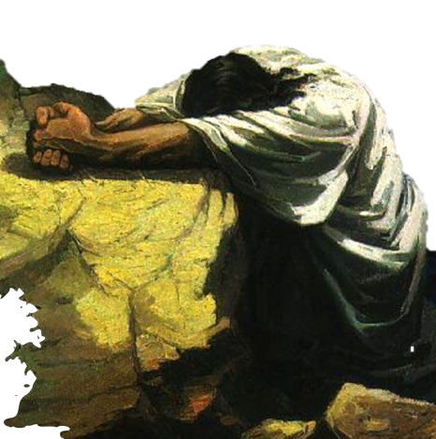
8
One of the most moving experiences recorded concerning the life of Christ took place in the garden of Gethsemane.
Here we see the humanity of Jesus clearly presented -
"Took part of the same" - “in all things” - “tempted in all points as we are, yet without sin” - (Heb. 2:10-18; 4:14-16)
Don McClain
W. 65th St church of Christ - 9/16/2007

Slide 9
9
Matthew 26:30-56 (NKJV)
³⁶ Then Jesus came with them to a place called Gethsemane, and said to the disciples, "Sit here while I go and pray over there."
Meaning oil-press. Beyond the brook Kedron, and distant about three-quarters of a mile from the walls of Jerusalem.
Don McClain
W. 65th St church of Christ - 9/16/2007

Slide 10
10
Matthew 26:30-56 (NKJV)
³⁶ Then Jesus came with them to a place called Gethsemane, and said to the disciples, "Sit here while I go and pray over there." ³⁷ And He took with Him Peter and the two sons of Zebedee, and He began to be sorrowful and deeply distressed. ³⁸ Then He said to them, "My soul is exceedingly sorrowful, even to death. Stay here and watch with Me."
(Thayer)
lupeo, - to distress; reflexive or passive to be sad :- cause grief, grieve, be in heaviness, (be) sorrow (-ful), be (make) sorry.
(Louw, J. P., & Nida)
Greek-English lexicon of the NT
5.275 λυπέωb: (derivative of λύπηb ‘state of sadness,’ 25.273) to cause someone to be sad, sorrowful, or distressed—‘to make sad, to sadden.
Don McClain
W. 65th St church of Christ - 9/16/2007

Slide 11
11
Matthew 26:30-56 (NKJV)
³⁶ Then Jesus came with them to a place called Gethsemane, and said to the disciples, "Sit here while I go and pray over there." ³⁷ And He took with Him Peter and the two sons of Zebedee, and He began to be sorrowful and deeply distressed. ³⁸ Then He said to them, "My soul is exceedingly sorrowful, even to death. Stay here and watch with Me."
(Thayer)
ademoneo, - to be in distress (of mind) :- be full of heaviness, be very heavy. (KJ, "to be very heavy," RV, "to be sore troubled.“)
(Louw, J. P., & Nida)
Greek-English lexicon of the NT
25.247 ἀδημονέω: to be distressed and troubled, with the probable implication of anguish—‘to be troubled, to be upset, to be distressed.’
Don McClain
W. 65th St church of Christ - 9/16/2007

Slide 12
12
Matthew 26:30-56 (NKJV)
³⁶ Then Jesus came with them to a place called Gethsemane, and said to the disciples, "Sit here while I go and pray over there." ³⁷ And He took with Him Peter and the two sons of Zebedee, and He began to be sorrowful and deeply distressed. ³⁸ Then He said to them, "My soul is exceedingly sorrowful, even to death. Stay here and watch with Me."
(Thayer)
"perilupos” grieved all around, i.e. intensely sad :- exceeding (very) sorrowful), used in (Mt 26:38) and (Mk 14:34)
(Louw, J. P., & Nida)
Greek-English lexicon of the NT
25.277 περίλυπος, ον: pertaining to being very sad or deeply distressed—‘very sad, sorrowful.’ ‘I am so sorrowful as to almost die’ Mt 26:38.
Don McClain
W. 65th St church of Christ - 9/16/2007

Slide 13
13
(Thayer)
"ekthambeo” - to astonish utterly - affright, greatly (sore) amaze. Found in the book of Mark only; (9:15; 14:33; 16:5)
(Louw, J. P., & Nida)
Greek-English lexicon of the NT
25.210 ἐκθαμβέομαι: to be greatly astounded, . . . ‘to be amazed, . . . to be alarmed.’ . . .In the meaning of ‘alarmed,’ ἐκθαμβέομαι may often be rendered simply as ‘to be afraid.’
Mark 14:32-34 (NKJV)
³² Then they came to a place which was named Gethsemane; and He said to His disciples, "Sit here while I pray." ³³ And He took Peter, James, and John with Him, and He began to be troubled and deeply distressed. ³⁴ Then He said to them, "My soul is exceedingly sorrowful, even to death. Stay here and watch."
Don McClain
W. 65th St church of Christ - 9/16/2007

Slide 14
14
(Word Pictures in the New Testament.)
“. . . Jesus himself feels amazement as he directly faces the struggle in the Garden of Gethsemane. . . . "Long as He had foreseen the Passion, when it came clearly into view its terror exceeded His anticipations" (Swete). "He learned from what he suffered," (Hebrews 5:8) and this new experience enriched the human soul of Jesus.”
Mark 14:32-34 (NKJV)
³² Then they came to a place which was named Gethsemane; and He said to His disciples, "Sit here while I pray." ³³ And He took Peter, James, and John with Him, and He began to be troubled and deeply distressed. ³⁴ Then He said to them, "My soul is exceedingly sorrowful, even to death. Stay here and watch."
Don McClain
W. 65th St church of Christ - 9/16/2007

Slide 15
15
(Thayer)
“agonia” - a struggle - i.e. (figurative) anguish, agony . . . to denote severe emotional strain and anguish. So in (Luke 22:44),
(Louw, J. P., & Nida)
Greek-English lexicon of the NT
25.283 ἀγωνία, ας f: a state of great mental and emotional grief and anxiety—‘anguish, intense sorrow.’ . . .‘in anguish he prayed even more fervently’ Lk 22:44.0
Luke 22:43-44 (NKJV)
⁴³ Then an angel appeared to Him from heaven, strengthening Him. ⁴⁴ And being in agony, He prayed more earnestly. Then His sweat became like great drops of blood falling down to the ground.
Don McClain
W. 65th St church of Christ - 9/16/2007

Slide 16
16
(Wiersbe, W. W. (1996). The Bible exposition commentary)
“There is a rare physical phenomenon known as hematidrosis, in which, under great emotional stress, the tiny blood vessels rupture in the sweat glands and produce a mixture of blood and sweat.”
Luke 22:43-44 (NKJV)
⁴³ Then an angel appeared to Him from heaven, strengthening Him. ⁴⁴ And being in agony, He prayed more earnestly. Then His sweat became like great drops of blood falling down to the ground.
Don McClain
W. 65th St church of Christ - 9/16/2007

Slide 17
17
HEMATIDROSIS
Dave Miller Apologetics Press
“. . . During the waning years of the twentieth century, 76 cases of hematidrosis were studied and classified into categories according to causative factors (Holoubek and Holoubek, 1996). Acute fear and intense mental contemplation were found to be the most frequent inciting causes. . . .”
http://www.apologeticspress.org/APContent.aspx?category=13&article=2323
Luke 22:43-44 (NKJV)
⁴³ Then an angel appeared to Him from heaven, strengthening Him. ⁴⁴ And being in agony, He prayed more earnestly. Then His sweat became like great drops of blood falling down to the ground.
Don McClain
W. 65th St church of Christ - 9/16/2007
Notes:
HEMATIDROSIS
by
Dave Miller, Ph.D.
Luke, the author of the New Testament books of Luke and Acts, by profession, was a physician. His writings manifest an intimate acquaintance with the technical language of the Greek medical schools of Asia Minor. For example, of the four gospel writers, only Dr. Luke referred to Jesus’ ordeal as “agony” (agonia). It is because of this agony over things to come that we learn during His prayer “his sweat was as it were great drops of blood falling down to the ground” (Luke 22:44). Only Luke referred to Jesus’ sweat (idros), a much used term in medical language, and only Luke referred to Jesus’ sweat as consisting of great drops of blood (thromboi haimatos)—a medical condition alluded to by both Aristotle and Theophrastus (Hobart, 1882, pp. 80-84). The Greek term thromboi (from which we get thrombus, thrombin, et al.) refers to clots of blood (Nicoll, n.d., 1:631; Vincent, 1887, 1:425). Bible scholar Richard Lenski commented on the use of this term: “‘As clots,’ thromboi, means that the blood mingled with the sweat and thickened the globules so that they fell to the ground in little clots and did not merely stain the skin” (1961, p. 1077).
The Greek word hosei (“as it were”) refers to condition, not comparison, as Greek scholar Henry Alford observed:
The intention of the Evangelist seems clearly to be, to convey the idea that the sweat was (not fell like, but was like drops of blood;—i.e., coloured with blood,—for so I understand the hosei, as just distinguishing the drops highly coloured with blood, from pure blood.... To suppose that it only fell like drops of blood (why not drops of any thing else? And drops of blood from what, and where?) is to nullify the force of the sentence, and make the insertion of haimatos not only superfluous but absurd (1874, 1:648, italics in orig.; cf. Robertson, 1934, p. 1140).
We conclude that the terminology used by the gospel writer to refer to the severe mental distress experienced by Jesus was intended to be taken literally, i.e., that the sweat of Jesus became bloody (cf. Robertson, 1930, 2:272).
A thorough search of the medical literature demonstrates that such a condition, while admittedly rare, can and has occurred. Commonly referred to as hematidrosis or hemohidrosis (“Hematidrosis,” 2002; Allen, 1967, pp. 745-747), this condition results in the excretion of blood or blood pigment in the sweat. Under conditions of great emotional stress, tiny capillaries in the sweat glands can rupture (Lumpkin, 1978), thus mixing blood with perspiration. This condition has been reported in extreme instances of stress (see Sutton, 1956, pp. 1393-1394). During the waning years of the twentieth century, 76 cases of hematidrosis were studied and classified into categories according to causative factors (Holoubek and Holoubek, 1996). Acute fear and intense mental contemplation were found to be the most frequent inciting causes. While the extent of blood loss generally is minimal, hematidrosis also results in the skin becoming extremely tender and fragile (Barbet, 1953, pp. 74-75; Lumpkin, 1978), which would have made Christ’s pending physical insults even more painful.
From these factors, it is evident that even before Jesus endured the torture of the cross, He suffered far beyond what most of us will ever suffer. His penetrating awareness of the heinous nature of sin, its destructive and deadly effects, the sorrow and heartache that it inflicts, and the extreme measure necessary to deal with it, make the passion of Christ beyond comprehension.
REFERENCES
Alford, Henry (1874), Alford’s Greek Testament (Grand Rapids, MI: Baker, 1980 reprint).
Allen, A.C. (1967), The Skin: A Clinicopathological Treatise (New York: Grune and Stratton), second edition.
Barbet, P. (1953), A Doctor at Calvary: The Passion of Our Lord Jesus Christ as Described by a Surgeon (Garden City, NY: Doubleday Image Books).
“Hematidrosis,” (2002), Dorland’s Illustrated Medical Dictionary, [On-line], URL: http://www.mercksource.com/pp/us/cns/cns_hl_dorlands. jspzQzpgzEzzSzppdocszSzuszSzcommonzSzdorlandszSzdorlandzSzdmd _h_05zPzhtm.
Hobart, William K. (1882), The Medical Language of St. Luke (Grand Rapids, MI: Baker, 1954 reprint).
Holoubek, J.E. and A.B. Holoubek (1996), “Blood, Sweat, and Fear. ‘A Classification of Hematidrosis,’ ” Journal of Medicine, 27[3-4]:115-33.
Lenski, R.C.H. (1961), The Interpretation of St. Luke’s Gospel (Minneapolis, MN: Augsburg).
Lumpkin, R. (1978), “The Physical Suffering of Christ,” Journal of Medical Association of Alabama, 47:8-10.
Nicoll, W. Robertson, ed. (no date), The Expositor’s Greek Testament (Grand Rapids, MI: Eerdmans).
Robertson, A.T. (1930), Word Pictures in the New Testament (Grand Rapids, MI: Baker).
Robertson, A.T. (1934), A Grammar of the Greek New Testament in the Light of Historical Research (Nashville, TN: Broadman Press).
Sutton, R.L. Jr. (1956), Diseases of the Skin (St. Louis, MO: Mosby College Publishing), eleventh edition.
Vincent, M.R. (1887), Word Studies in the New Testament (Grand Rapids, MI: Eerdmans, 1946 reprint).

Slide 18
18
(Thayer)
“STRONG (ischuros) Crying - (krauge),- boisterous, mighty, powerful, valiant - an outcry . . .
(Louw, J. P., & Nida)
Vehement - 78.16 ἰσχυρόςc - a high point on a scale of extent . . . ‘great, greatly, intense, severe.’
Cries - 25.138 κραυγήb, - to weep or wail, with emphasis upon the noise accompanying the weeping—‘to weep, to wail, to lament, weeping, crying.
Hebrews 5:7-8 (NKJV)
⁷ who, in the days of His flesh, when He had offered up prayers and supplications, with vehement cries and tears to Him who was able to save Him from death, and was heard because of His godly fear, ⁸ though He was a Son, yet He learned obedience by the things which He suffered.
Don McClain
W. 65th St church of Christ - 9/16/2007

Slide 19
19
“He was experiencing sorrow (lypeisthai, “to be grieved or sad to the point of distress”; cf. 14:9; 17:23; 18:31; 19:22) and trouble such as He had never known in His earthly life. He asked the three disciples to stay and keep watch with Him (26:38). In this hour of His greatest need the Lord wanted those with a sympathetic understanding to be praying with Him.” (BKC)
Don McClain
W. 65th St church of Christ - 9/16/2007

Slide 20
20
He asked the three disciples to stay and keep watch with Him (Mt 26:38).
How many times have you heard someone say, “If it were not for ____________ I don’t know what I would have done.” -
In times of hardship & suffering we long to have the support and encouragement of others - Prov 17:17, Eccl 4:10-12
Don McClain
W. 65th St church of Christ - 9/16/2007

Slide 21
21
He was concerned for His disciples as He urged them to “watch and pray” lest they fall (Mt. 26:41).
When we fail to look beyond ourselves, we tend to magnify our problems.
To make your load of life lighter, you need to take on the load of another (Gal. 6:2)
Don McClain
W. 65th St church of Christ - 9/16/2007

Slide 22
22
Matthew 26:39-42 (NKJV)
³⁹ . . . "O My Father, if it is possible, let this cup pass from Me; nevertheless, not as I will, but as You will." . . . ⁴² Again, a second time, He went away and prayed, saying, "O My Father, if this cup cannot pass away from Me unless I drink it, Your will be done."
Don McClain
W. 65th St church of Christ - 9/16/2007

Slide 23
23
Mark 14:36 (NKJV)
And He said, "Abba, Father, all things are possible for You. Take this cup away from Me; nevertheless, not what I will, but what You will."
Luke 22:42 (NKJV)
saying, "Father, if it is Your will, take this cup away from Me; nevertheless not My will, but Yours, be done."
Jesus is searching for possibilities within, not contrary to, the Father’s will.
Don McClain
W. 65th St church of Christ - 9/16/2007

Slide 24
24
Jesus knew “all things that would come upon Him” -(John 18:4; cf. 12:27; 13:1; Mark 9:31; 10:33; Mat 26:2)
He prayed to His Father demonstrating complete trust, devotion & loyalty - (Heb 2:9-18; 4:15,16; 5:7-9)
His hour had come -
Don McClain
W. 65th St church of Christ - 9/16/2007

Slide 25
25
Jesus did not insist that God change His will, but rather, He asked for strength to bear His will.
His willingness & desire to obey His Father, coupled with His love for us, took Him “as a lamb to the slaughter” to the cross.
Don McClain
W. 65th St church of Christ - 9/16/2007

Slide 26
26
If Jesus, as strong as He was, needed to pray for strength, then surely we need to pray as well.
Prayer is to be practiced so that we do not faint - (Luke 18:1).
James said that if we suffer, we should pray (Ja 5:13-16).
Don McClain
W. 65th St church of Christ - 9/16/2007

Slide 27
27
Matthew 26:45-46 (NKJV)
⁴⁵ Then He came to His disciples and said to them, "Are you still sleeping and resting? Behold, the hour is at hand, and the Son of Man is being betrayed into the hands of sinners. ⁴⁶ Rise, let us be going. See, My betrayer is at hand."
Don McClain
W. 65th St church of Christ - 9/16/2007

Slide 28
28
Matthew 26:51-54 (NKJV)
⁵¹ And suddenly, one of those who were with Jesus stretched out his hand and drew his sword, struck the servant of the high priest, and cut off his ear. ⁵² But Jesus said to him, "Put your sword in its place, for all who take the sword will perish by the sword. ⁵³ Or do you think that I cannot now pray to My Father, and He will provide Me with more than twelve legions of angels? ⁵⁴ How then could the Scriptures be fulfilled, that it must happen thus?"
Don McClain
W. 65th St church of Christ - 9/16/2007

Slide 29
29
John 18:11 (NKJV)
¹¹ So Jesus said to Peter, "Put your sword into the sheath. Shall I not drink the cup which My Father has given Me?"
Don McClain
W. 65th St church of Christ - 9/16/2007

Slide 30
30
Jesus resigned Himself to His Father’s will (Luke 22:42)
.He did not please Himself (Romans 15:3).
The Father answered His prayer - He was heard because of His godly fear - (Luke 22:43, Heb 5:7)
He learned obedience through suffering - (Heb 5:8; Phili 2:8)
Don McClain
W. 65th St church of Christ - 9/16/2007

Slide 31
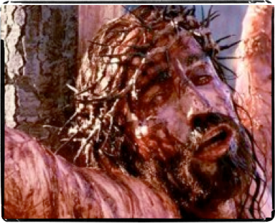
31
Surrendered, arrested and led to the high priest –
Struck, mocked, spit upon -
Led to Pilate, then to Herod & back to Pilate -
Mocked, scourged, crown of thorns . . .
Fell under the weight of His cross -
Crucified -
Isaiah 52:14 (NKJV) ¹⁴ Just as many were astonished at you, So His visage was marred more than any man, And His form more than the sons of men;
Don McClain
W. 65th St church of Christ - 9/16/2007

Slide 32
32
Jesus Warns Us – Are We Sleeping? - Matt. 26:41
Doing Right Doesn’t Always Feel Good At The Moment - Matt. 26:39
When Temptation Comes, The Time To Prepare Is Past - Matt. 26:56
Don McClain
W. 65th St church of Christ - 9/16/2007

Slide 33
33
Jesus Went To His Death Willingly And Proved His Love Forever - Matt. 26:46; John 18:1-8
When We Trust God and His way, Suffering In Doing Right Leads To Glory - Lk. 24:13-32; 2 Cor. 4:7-18
Don McClain
W. 65th St church of Christ - 9/16/2007

Slide 34
34
No one who is serious about being a Christian can remain unmoved as they think of Jesus’ agony in the Garden.
But why did he “drink the bitter cup”? Because he loved us so. It was our sin, indeed it was my sin (!) that took him there.
Don McClain
W. 65th St church of Christ - 9/16/2007

Slide 35
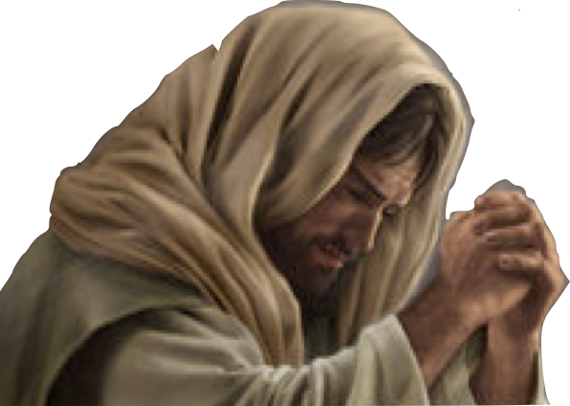
35
Let us think deeply of his distress, His grief and sorrow, and fashion our lives accordingly.
Pray & Obey!
Don McClain
W. 65th St church of Christ - 9/16/2007

Slide 37
37
Charts by Don McClain
Prepared March 7-9, 2013 - Preached March 10, 2013West 65th Street church of Christ, P.O. Box 190062, Little Rock AR 72219501-568-1062Prepared using KeynoteEmail – donmcclain@sbcglobal.net More Keynote, PPT & Audio Sermons:http://w65stchurchofchrist.org/coc/sermons/
Note – Many of the transition effects used in this presentation will be lost using PPT 2007 Viewer
http://www.microsoft.com/downloads/details.aspx?FamilyID=cb9bf144-1076-4615-9951-294eeb832823&displaylang=en
Don McClain
W. 65th St church of Christ - 9/16/2007

Slide 38
Isaiah 53:1-12 (NKJV)
¹ Who has believed our report? And to whom has the arm of the LORD been revealed? ² For He shall grow up before Him as a tender plant, And as a root out of dry ground. He has no form or comeliness; And when we see Him, There is no beauty that we should desire Him. ³ He is despised and rejected by men, A Man of sorrows and acquainted with grief. And we hid, as it were, our faces from Him; He was despised, and we did not esteem Him. ⁴ Surely He has borne our griefs And carried our sorrows; Yet we esteemed Him stricken, Smitten by God, and afflicted.
38
Don McClain
W. 65th St church of Christ - 9/16/2007

Slide 39
Isaiah 53:1-12 (NKJV)
⁵ But He was wounded for our transgressions, He was bruised for our iniquities; The chastisement for our peace was upon Him, And by His stripes we are healed. ⁶ All we like sheep have gone astray; We have turned, every one, to his own way; And the LORD has laid on Him the iniquity of us all. ⁷ He was oppressed and He was afflicted, Yet He opened not His mouth; He was led as a lamb to the slaughter, And as a sheep before its shearers is silent, So He opened not His mouth.
39
Don McClain
W. 65th St church of Christ - 9/16/2007

Slide 40
Isaiah 53:1-12 (NKJV)
⁸ He was taken from prison and from judgment, And who will declare His generation? For He was cut off from the land of the living; For the transgressions of My people He was stricken. ⁹ And they made His grave with the wicked-- But with the rich at His death, Because He had done no violence, Nor was any deceit in His mouth. ¹⁰ Yet it pleased the LORD to bruise Him; He has put Him to grief. When You make His soul an offering for sin, He shall see His seed, He shall prolong His days, And the pleasure of the LORD shall prosper in His hand.
40
Don McClain
W. 65th St church of Christ - 9/16/2007

Slide 41
Isaiah 53:1-12 (NKJV)
¹¹ He shall see the labor of His soul, and be satisfied. By His knowledge My righteous Servant shall justify many, For He shall bear their iniquities. ¹² Therefore I will divide Him a portion with the great, And He shall divide the spoil with the strong, Because He poured out His soul unto death, And He was numbered with the transgressors, And He bore the sin of many, And made intercession for the transgressors.
41
Don McClain
W. 65th St church of Christ - 9/16/2007

